Slide 1
62 yo with ho UPS resected 11/4/2020

Slide 2
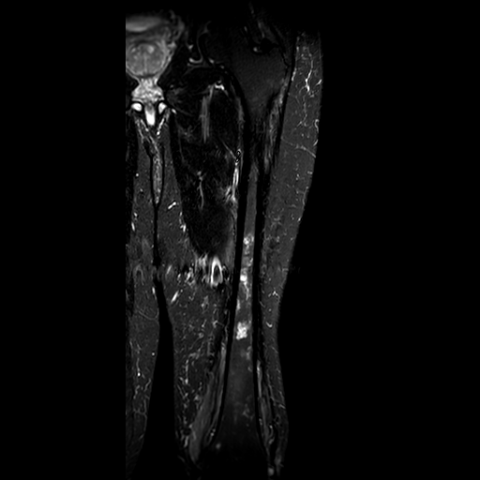
4/11/22

Slide 3
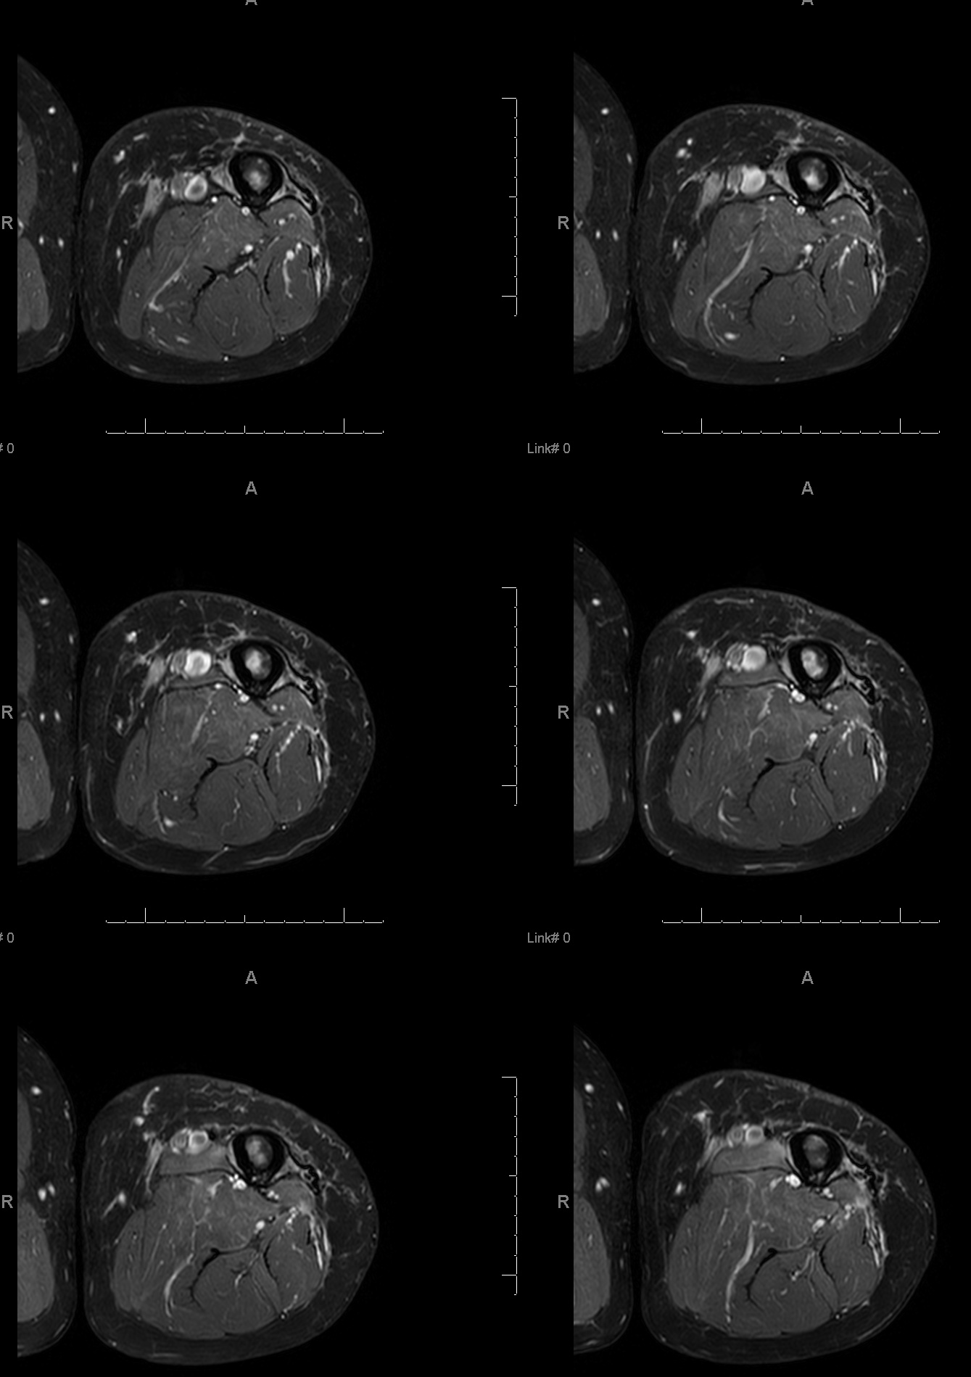
4/11/22

Slide 4
4/11/22

Slide 5
4/11/22

Slide 6
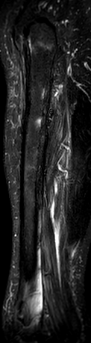
11/4/20 4/11/22

Slide 7
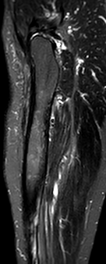
06/1/21 4/11/22

Slide 8
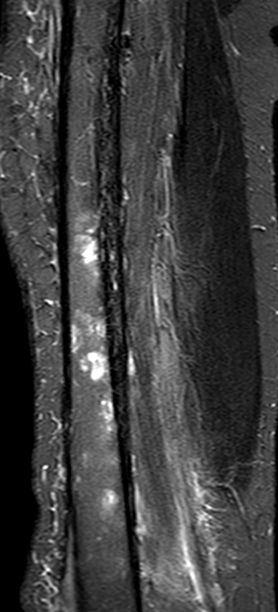
12/06/21 4/11/22

Slide 9
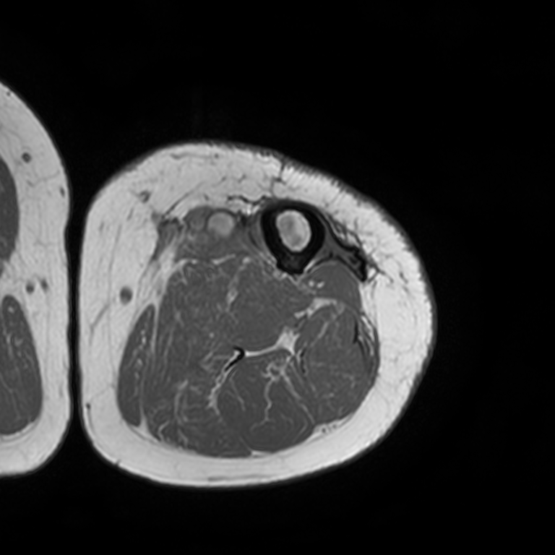
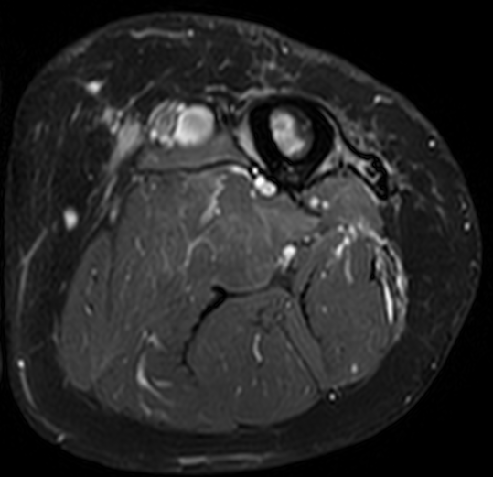
T1 T2fs

Slide 10
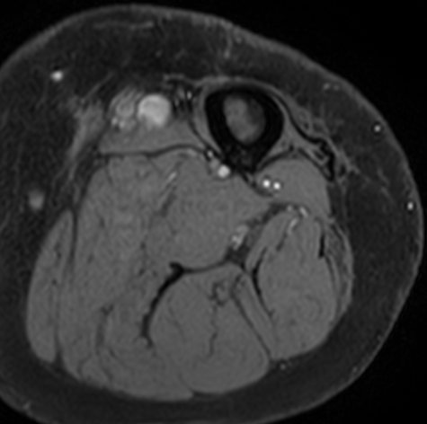
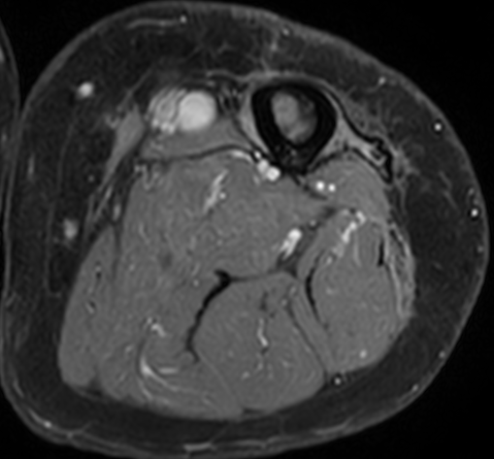
T1fspre T1fspost

Slide 11
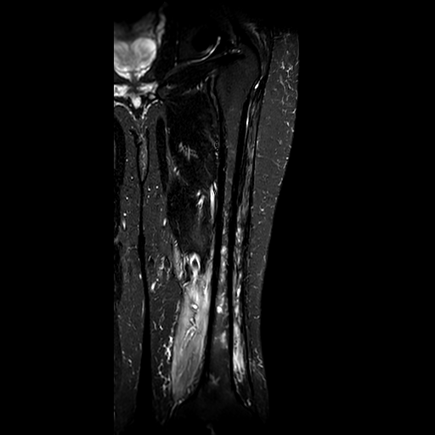
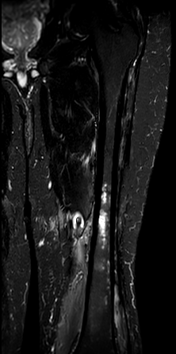
Sequential Coronal STIR (TE 80)

