Slide 1
49F with progressive neuropathic symptoms, particularly in L hand
Smoker, othwewise, healthy.
No prior radiation. Normal renal function.

Slide 2
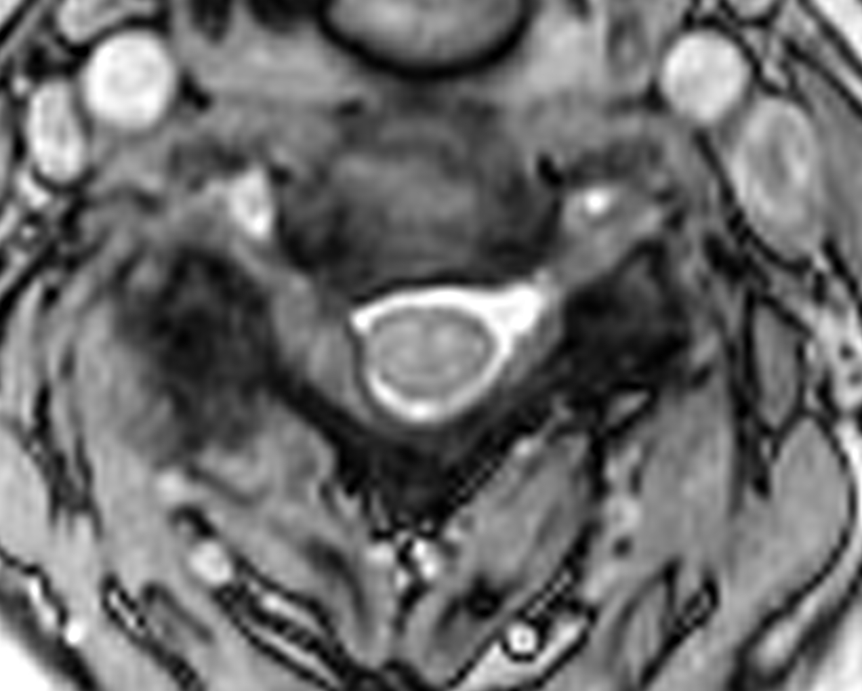
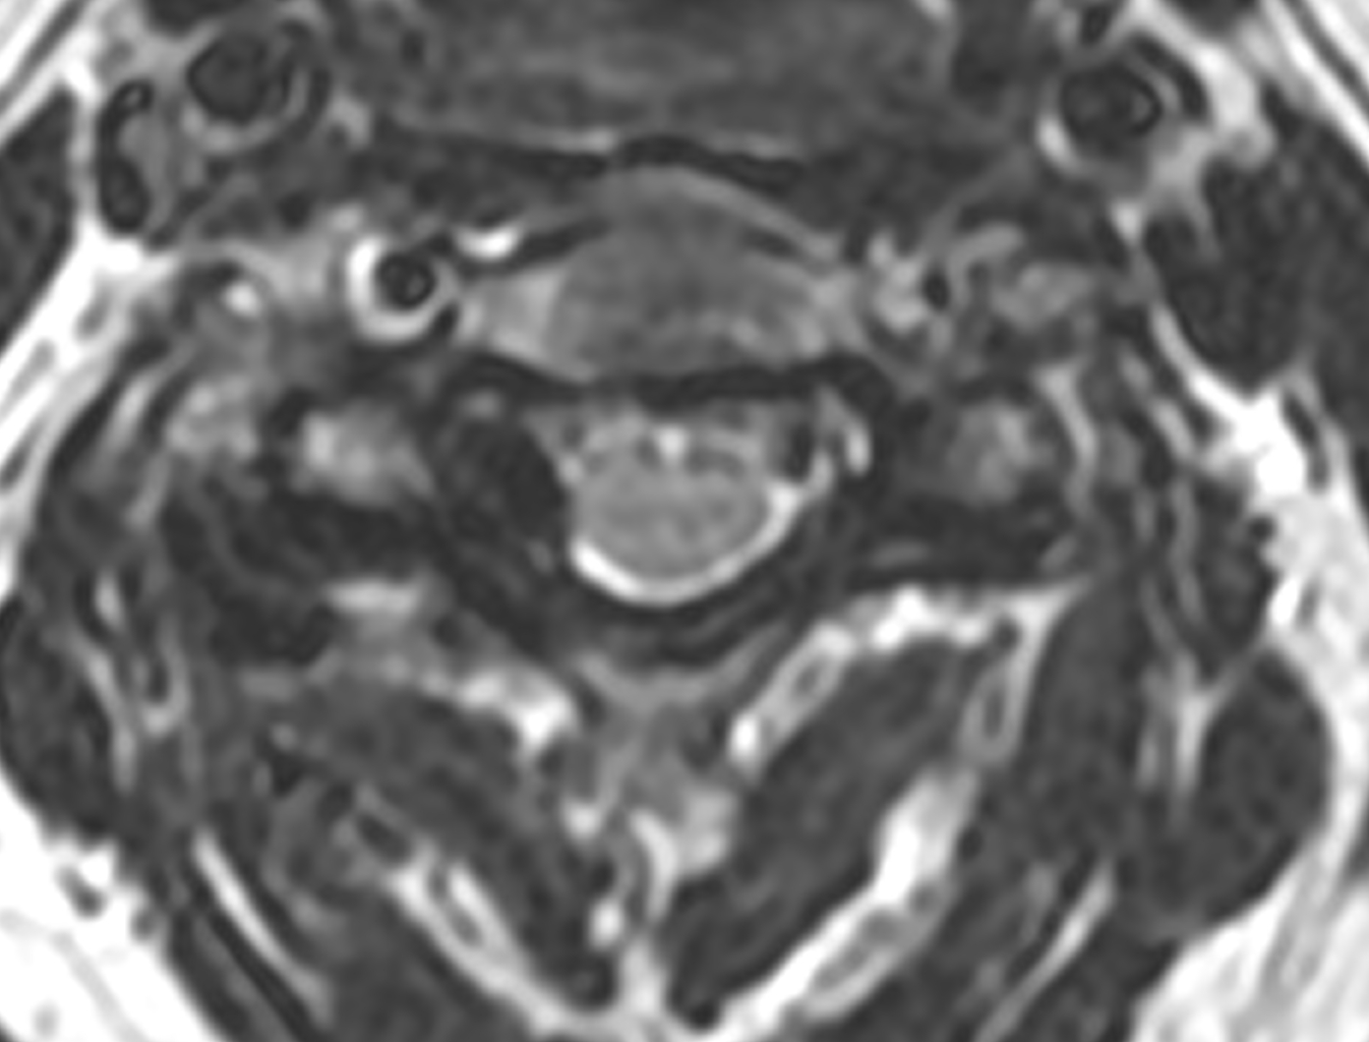
C3-4
C7-T1

Slide 3
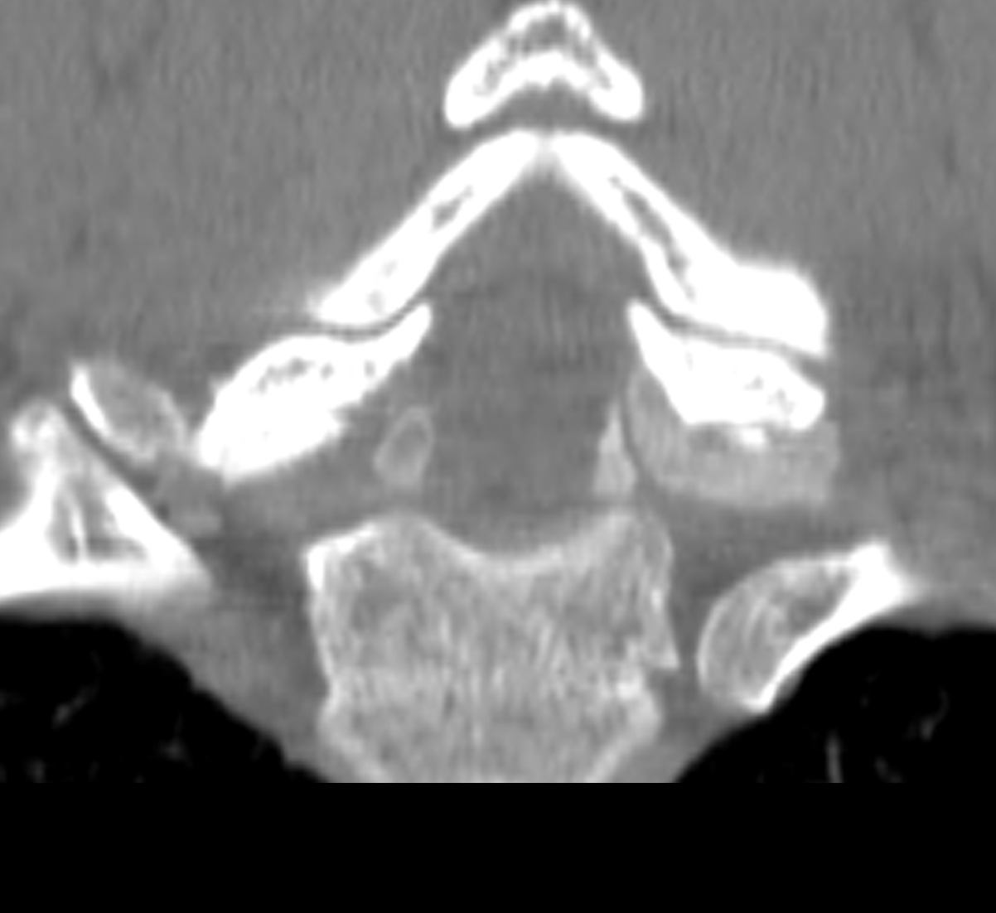
C3-4
C7-T1

Slide 4
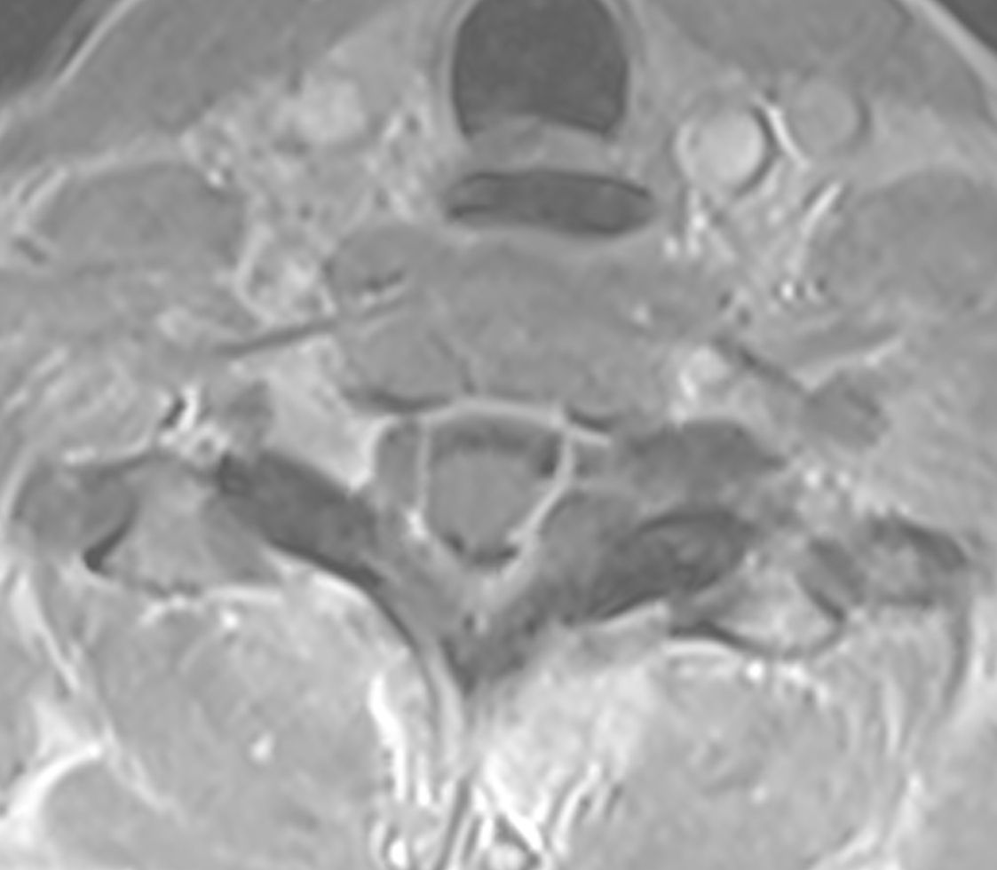
T1 Post-Gad

