Slide 1
Press F5 or “start slide show”icon to scroll images
41 yr Female
5 months history of right upper lip and cheek swelling
No skin discolouration and non painful
Past history of previous “capillary lesion” on lower lip treated
with “sclerotherapy”. No additional or specific details otherwise available.
MRI shows non specific mild skin thickening with predominantly superficial
subcutaneous fat edema and slight fatty hypertrophy involving the
right upper lip and extending into the cheek
No obvious flow voids or calcified phleboliths seen and no discreet
masses seen
I would have thought of cellulitis but referring clinician says there is no redness
or pain and has been stable for at least 5 months
Any suggestions?

Slide 2
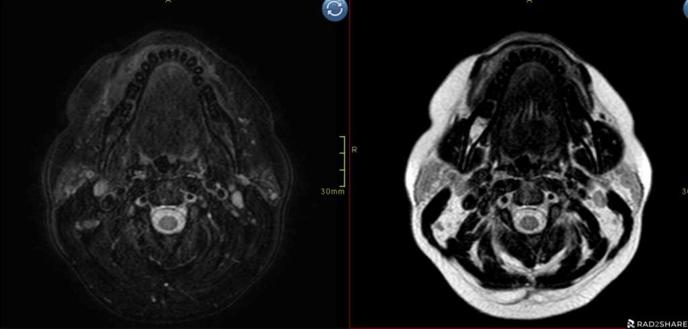
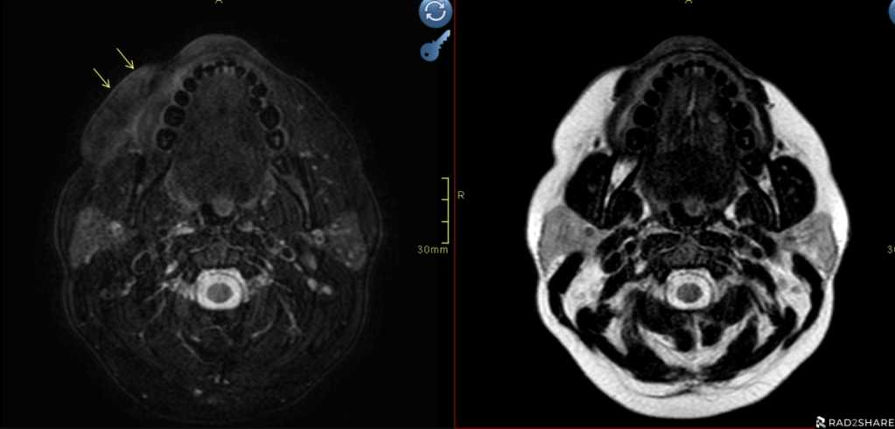
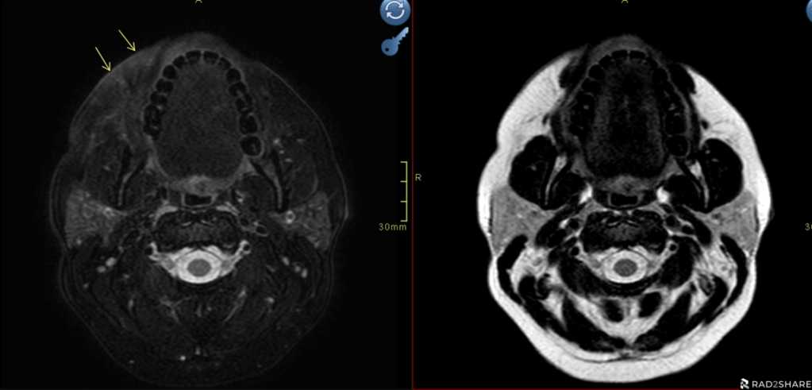
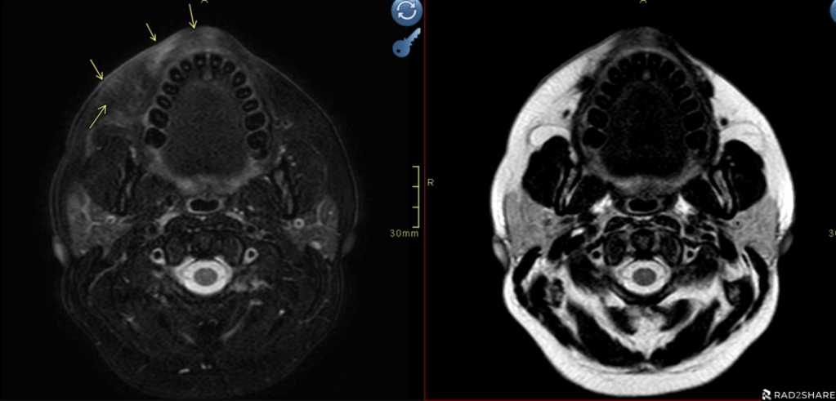
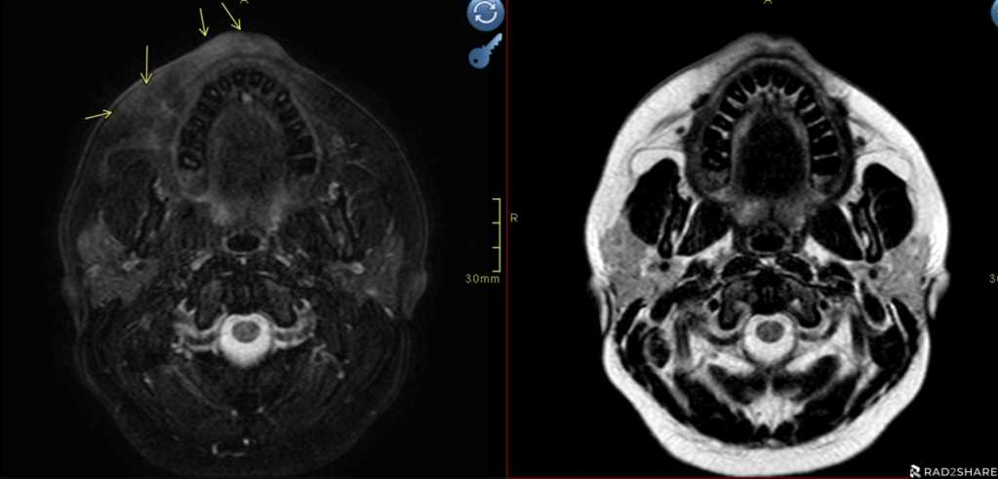
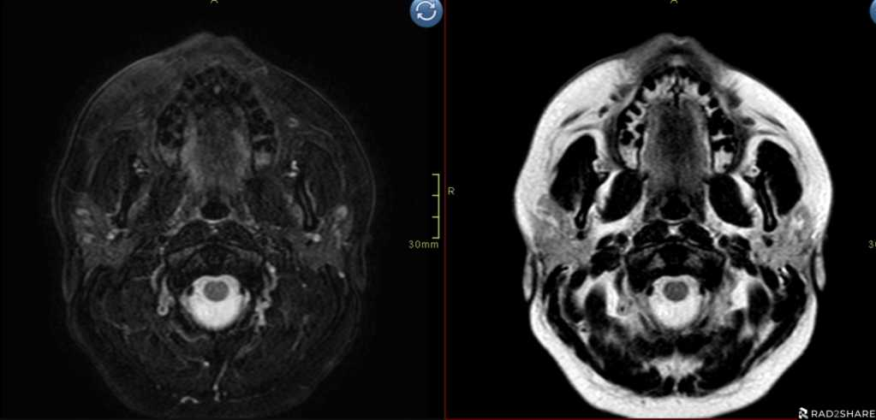
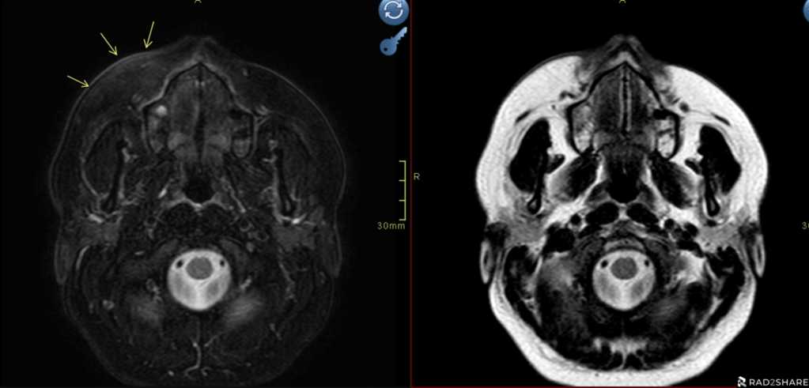
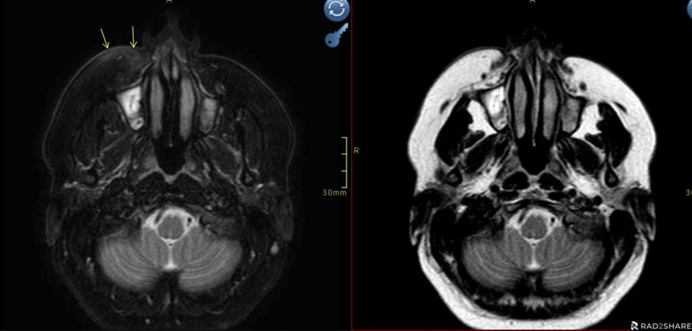
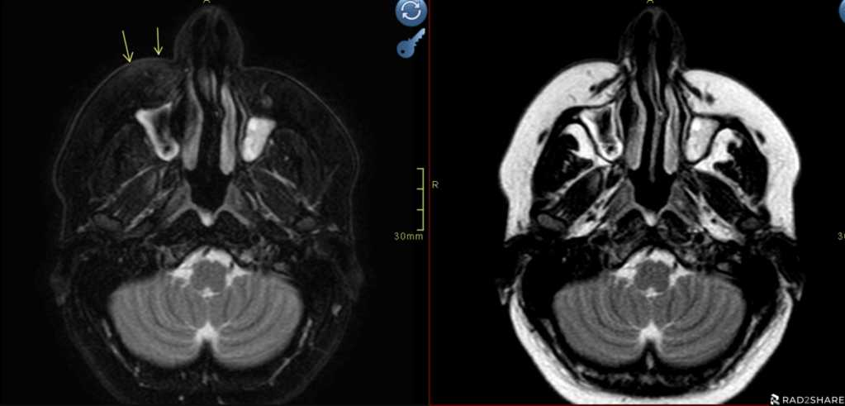
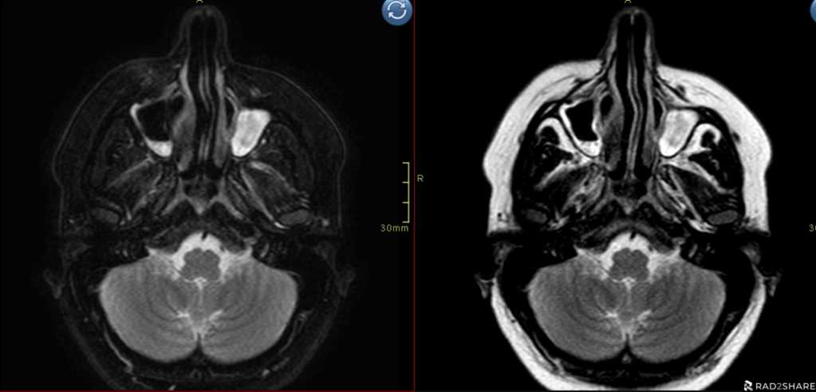
T2 Fat sat
T2
1/10
2/10
3/10
4/10
5/10
6/10
7/10
8/10
9/10
10/10

Slide 3
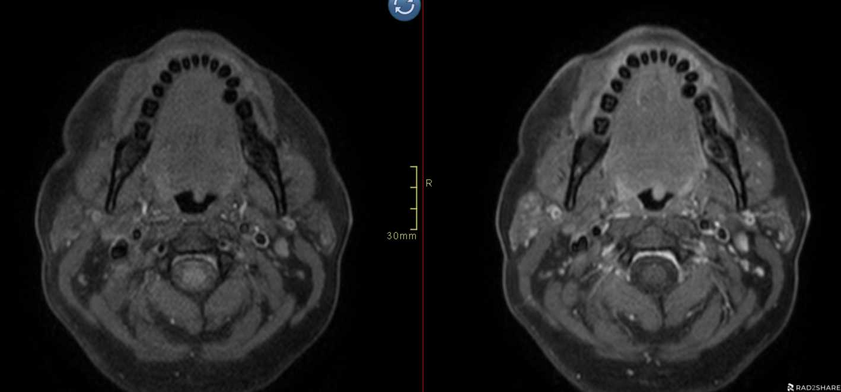
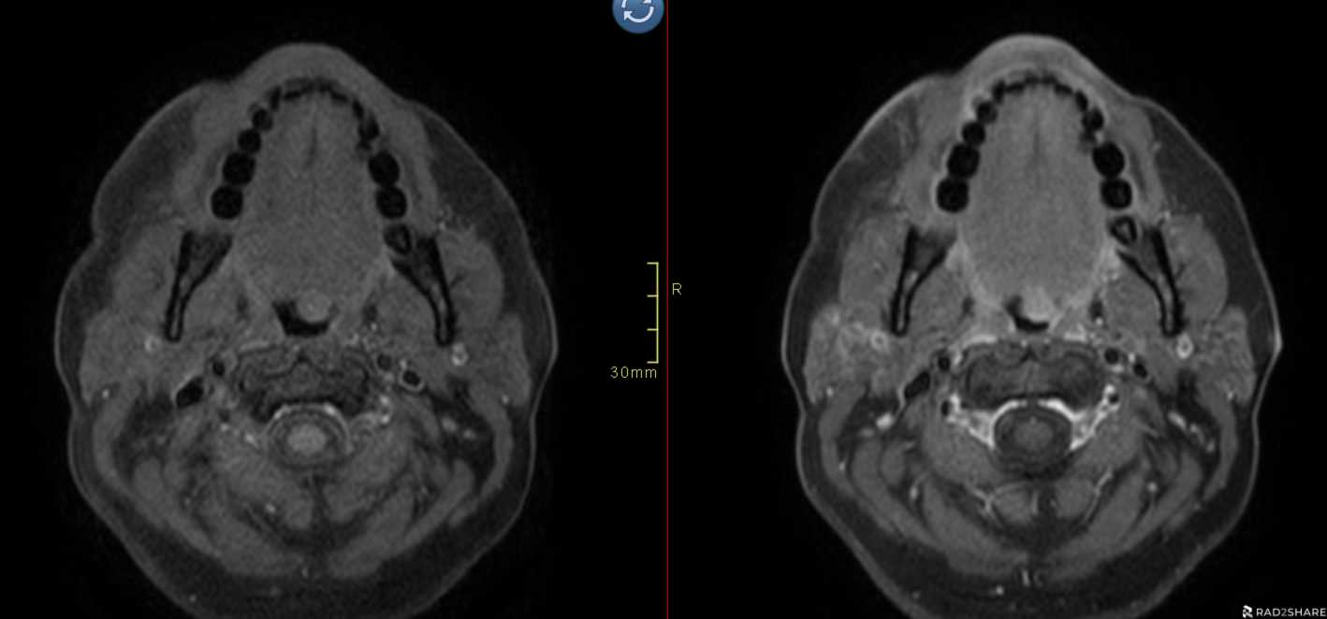
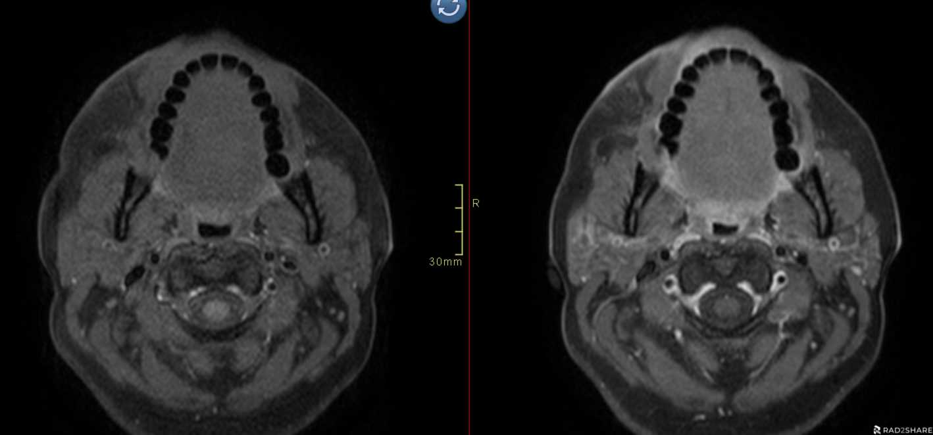
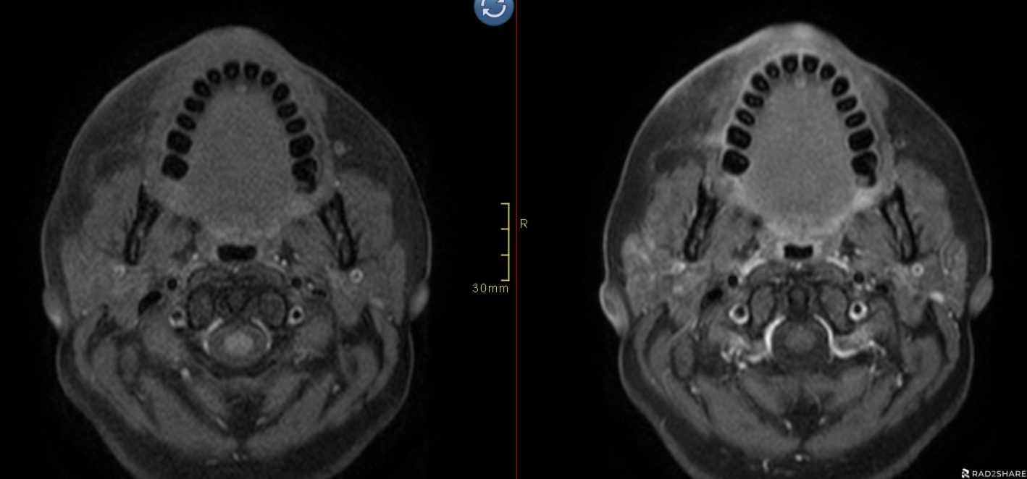
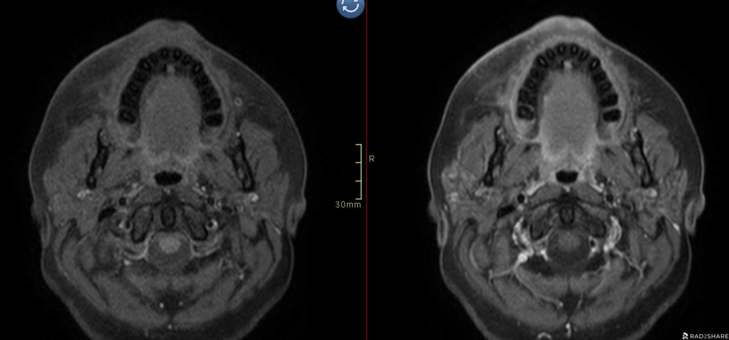
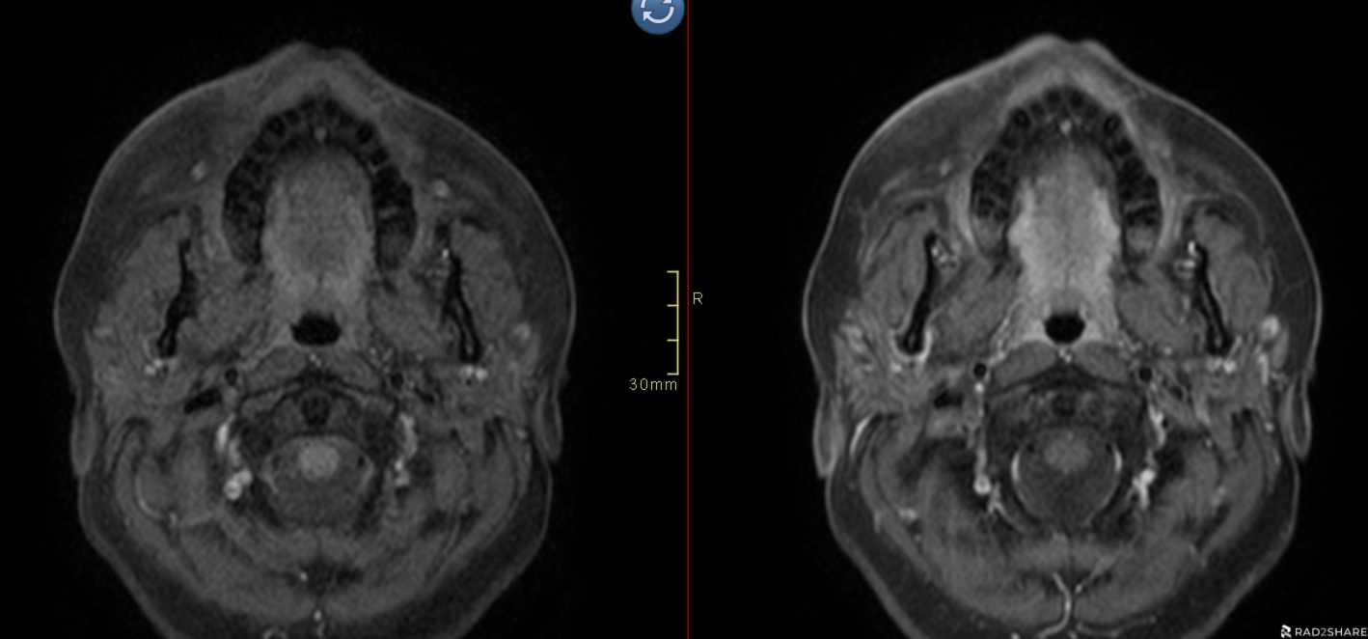
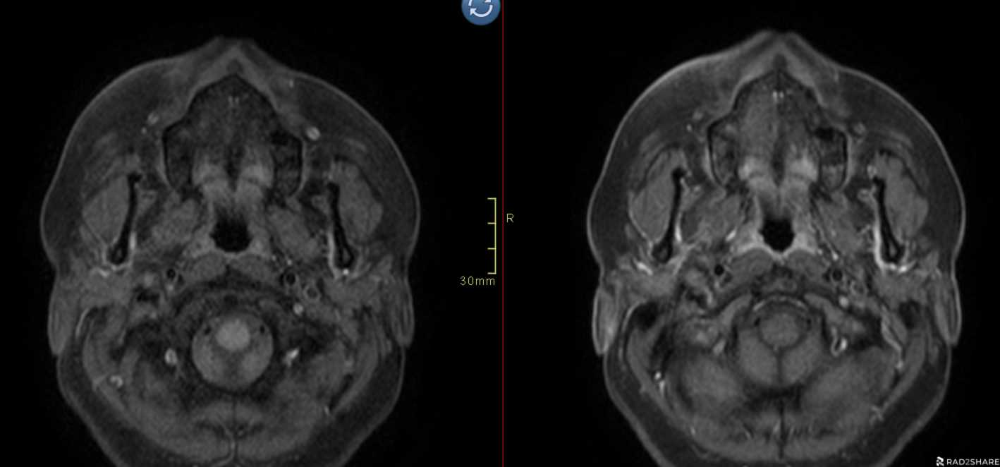
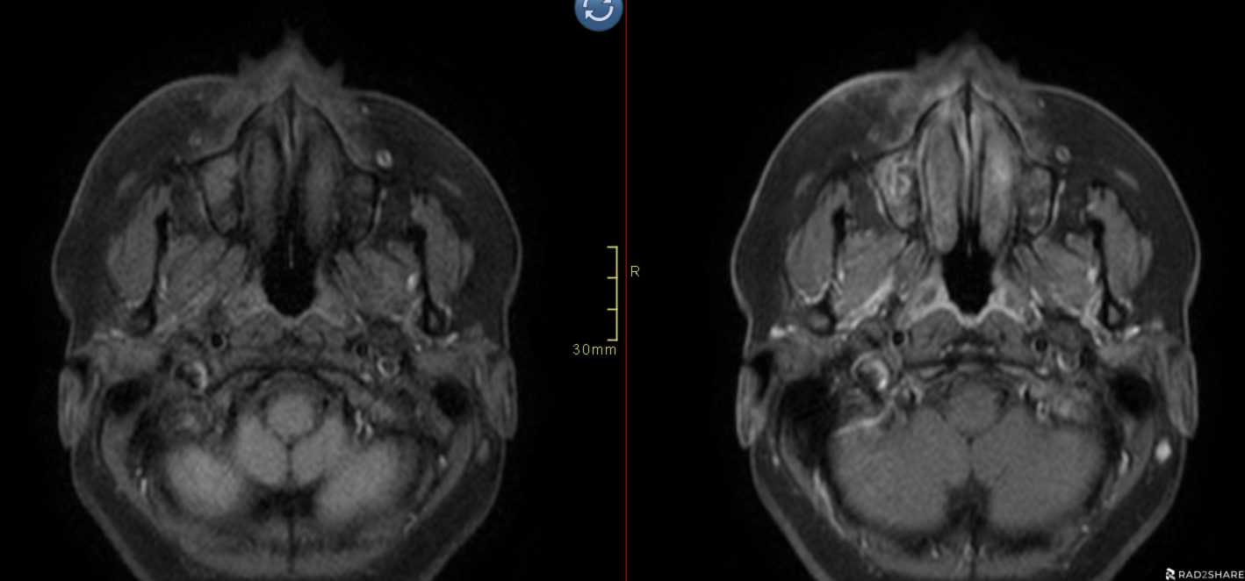
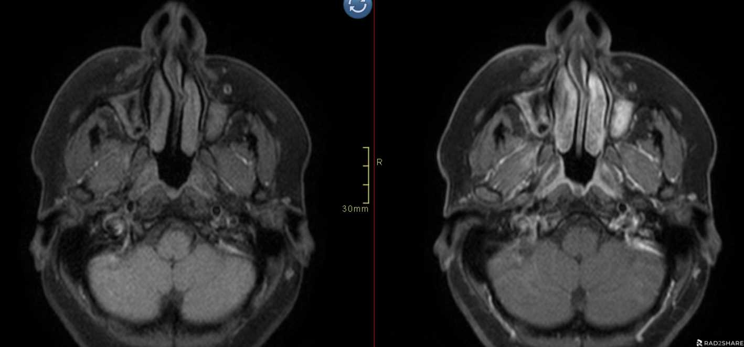
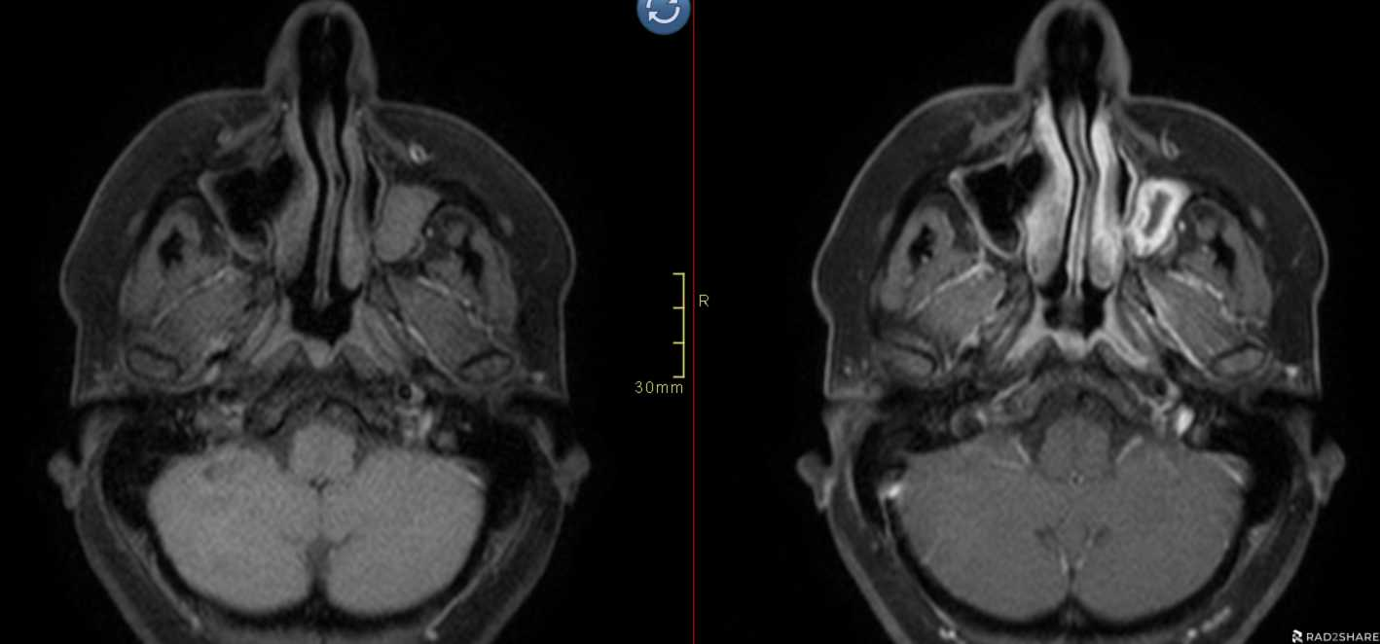
T1 Fat sat
T1 Fat sat post Gad
1/10
2/10
3/10
4/10
5/10
6/10
7/10
8/10
9/10
10/10

Slide 4
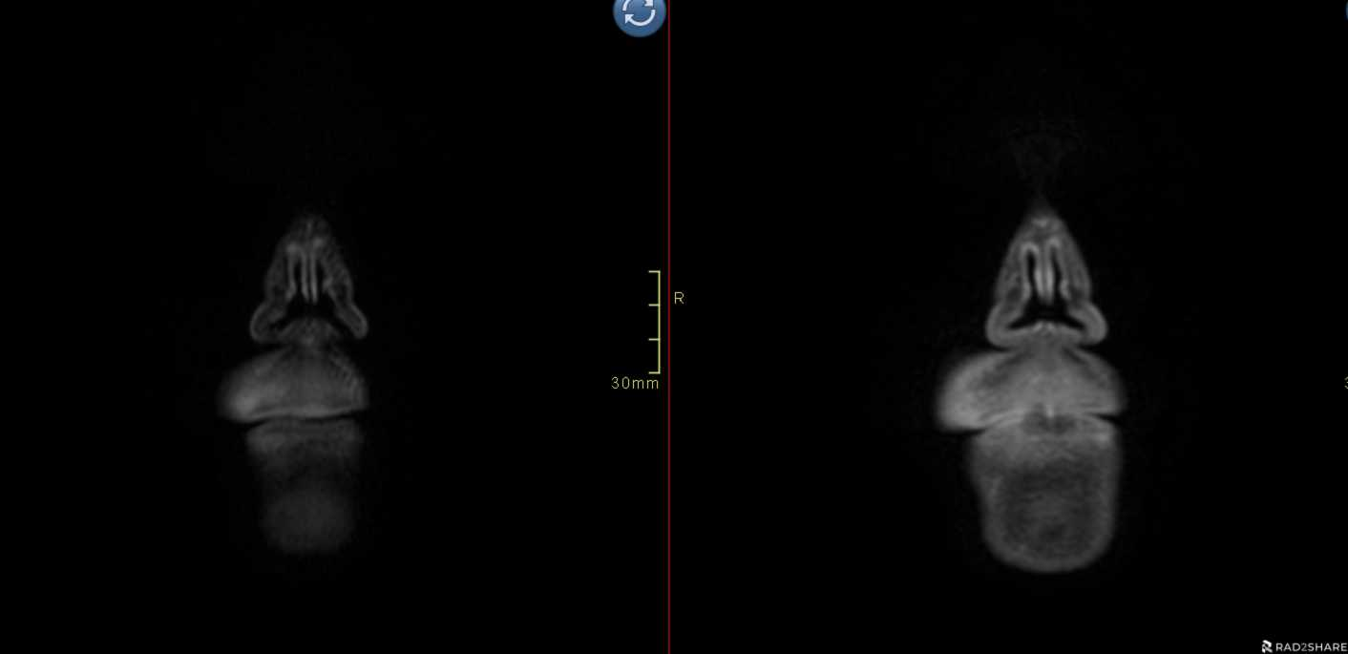
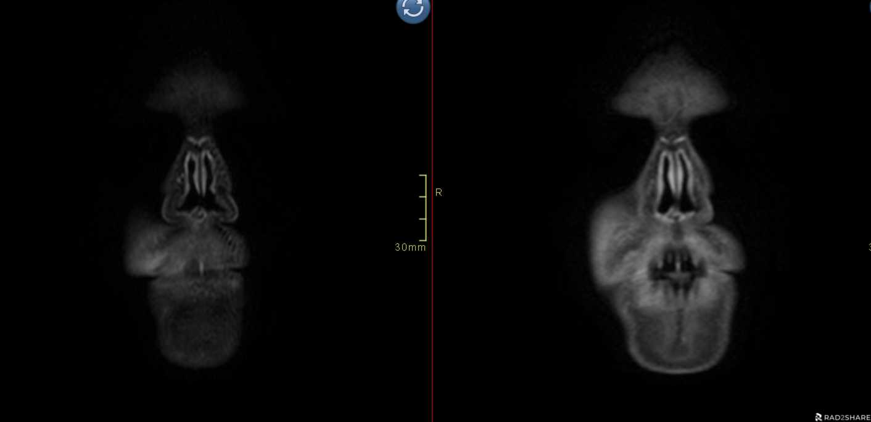
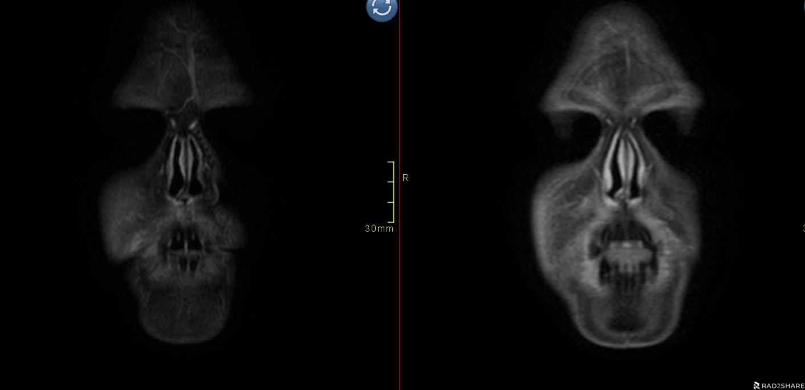
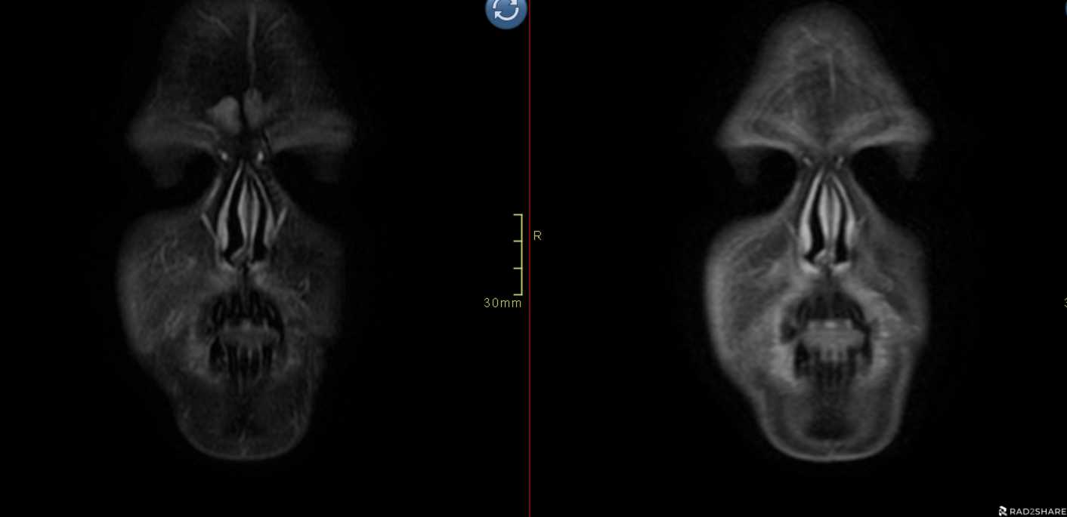
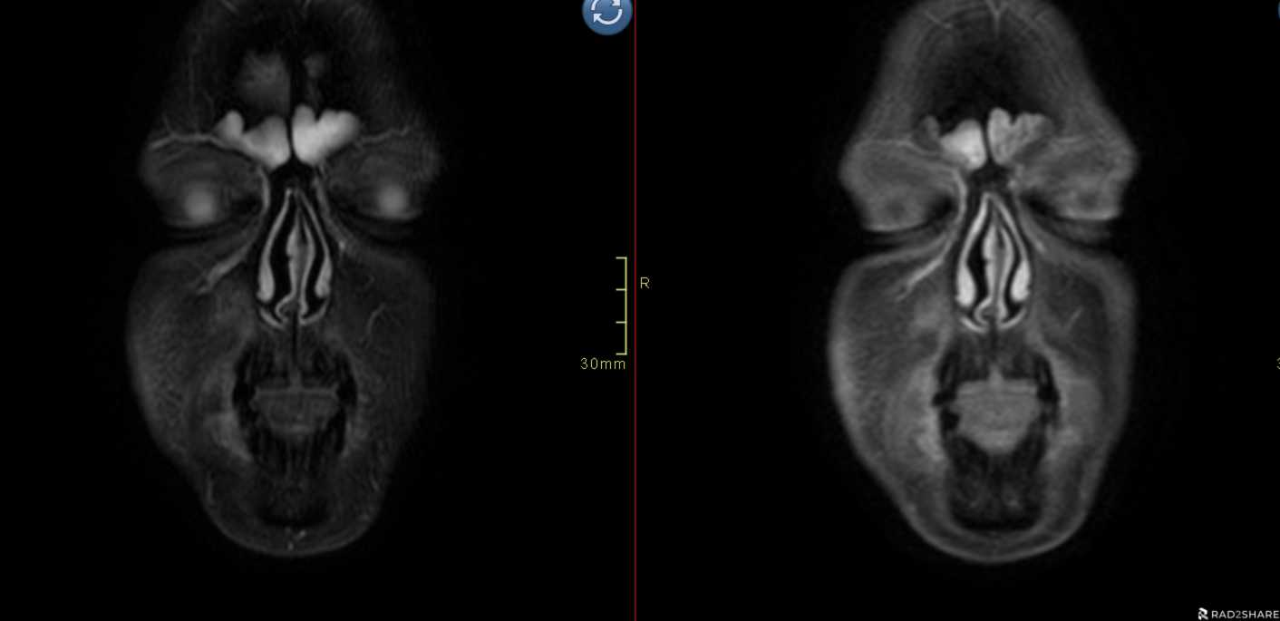
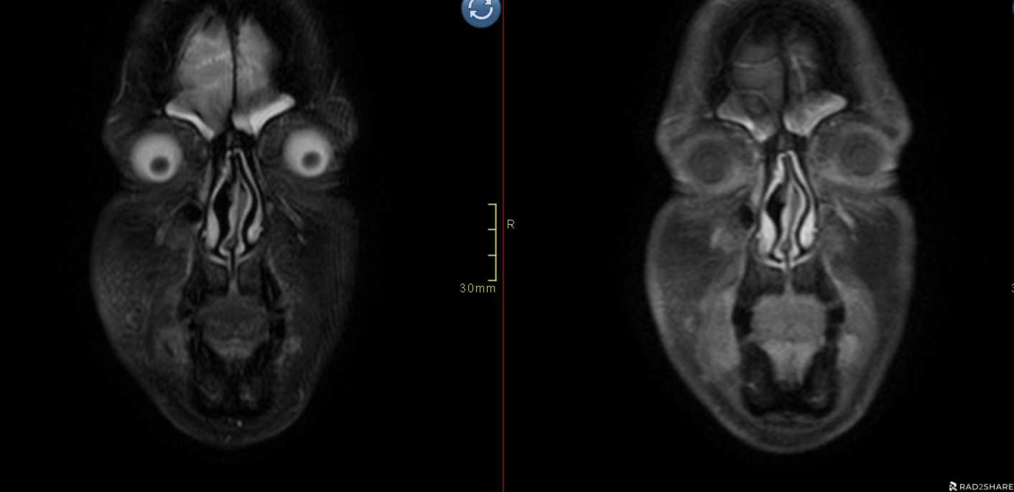
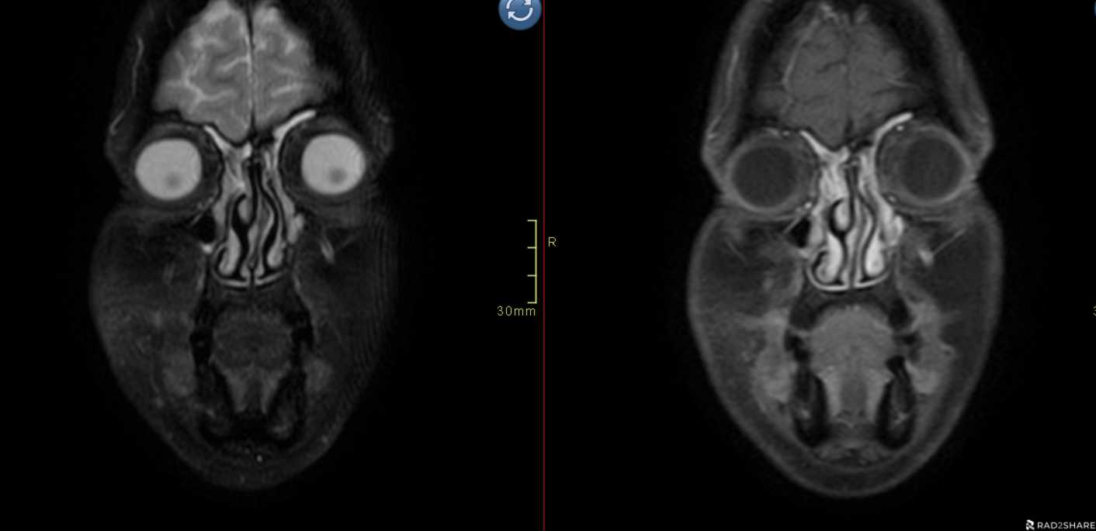
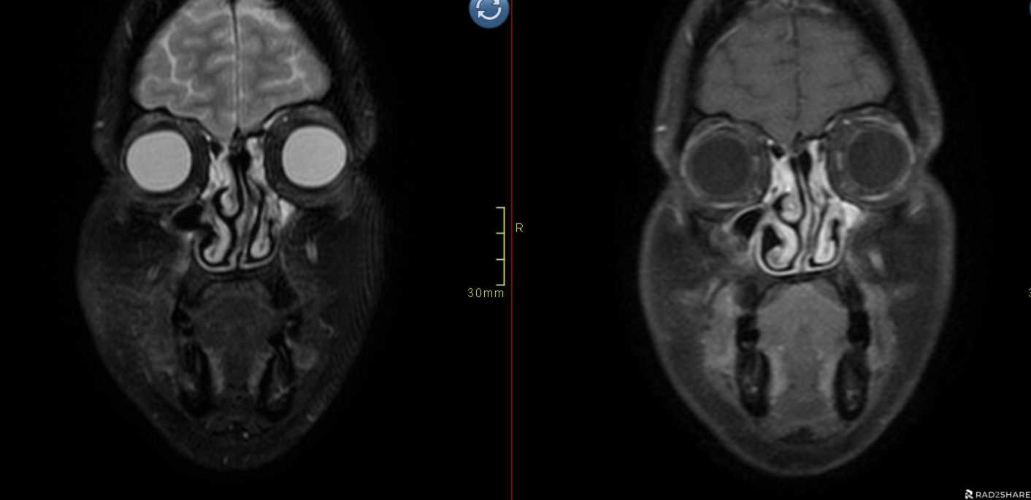
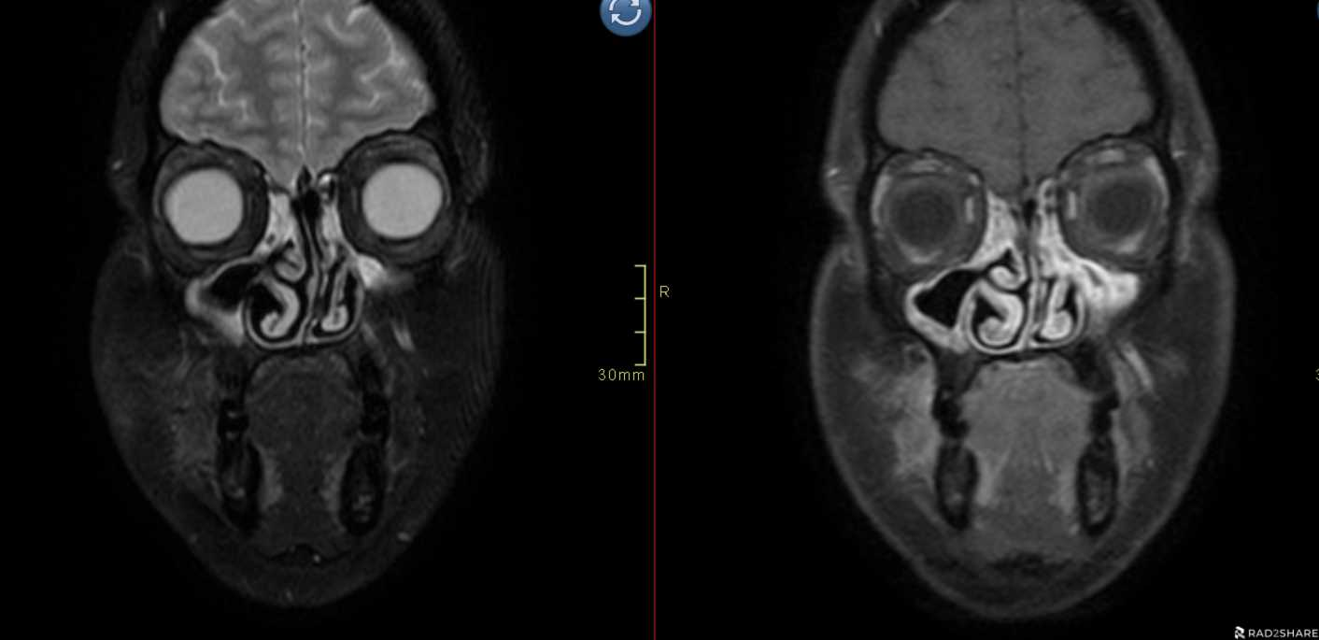
T2 Fat sat
T1 fat sat post Gad
1/9
2/9
3/9
4/9
5/9
6/9
7/9
8/9
9/9

Slide 5
