Slide 1
After coming in for arthrogram during tornado watch and undergoing the arthrogram
Pt had change of heart and did not want to complete the MR examination. Examination time was shortened from 20-14 min using Thrive (Philips 3T MR) rather than the routine T1fs

Slide 2
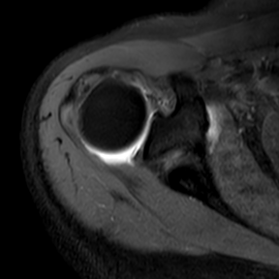
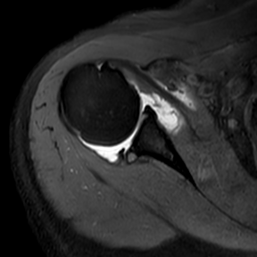
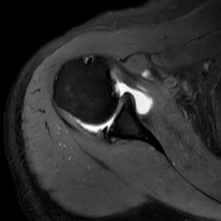
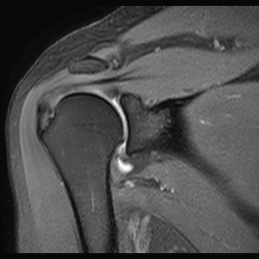
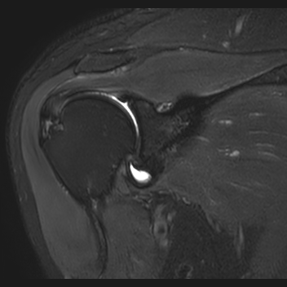
T1W-SPIR Thrive
T1W-SPIR Thrive
T2 fs Tr 4344 Te 60

