Slide 1
20 yo female, injury 2 weeks ago during baseball
Ulnar and dorsal wrist pain, full ROM

Slide 2
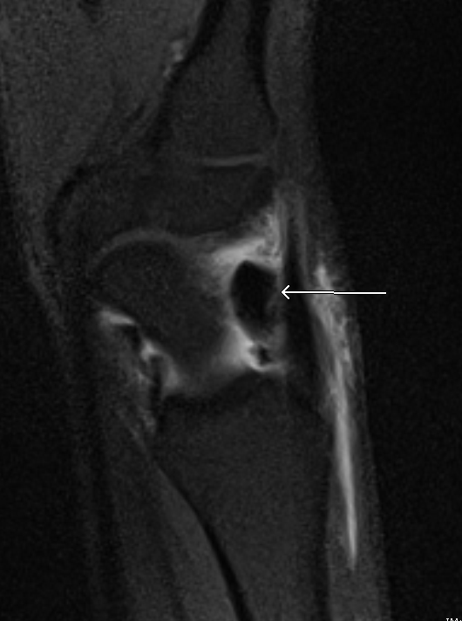
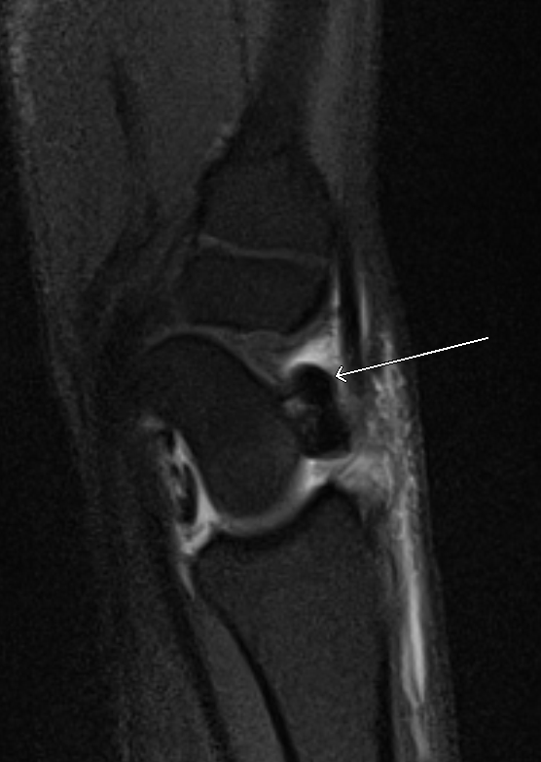
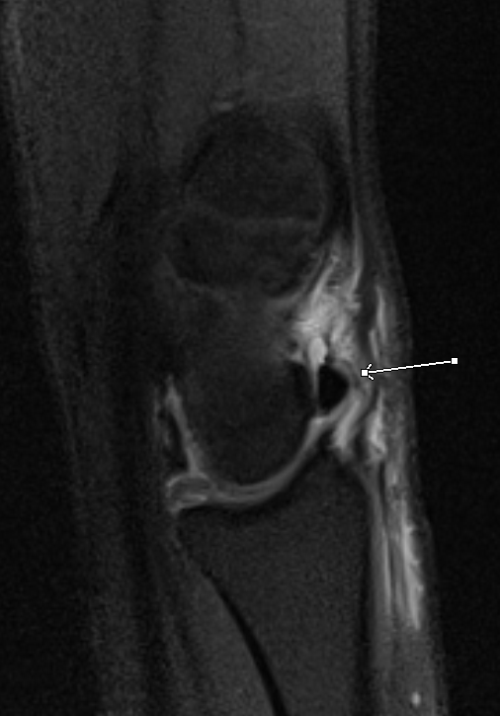
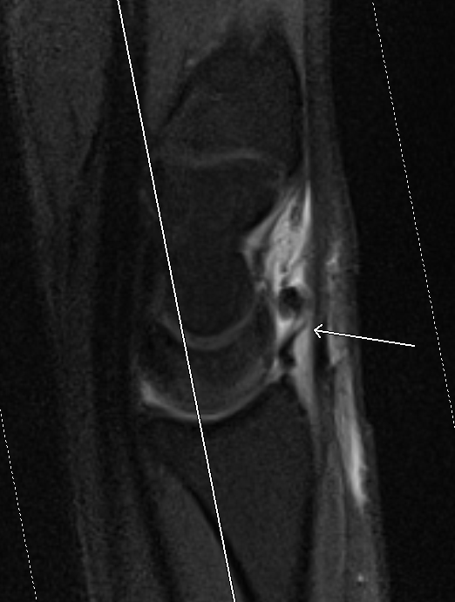
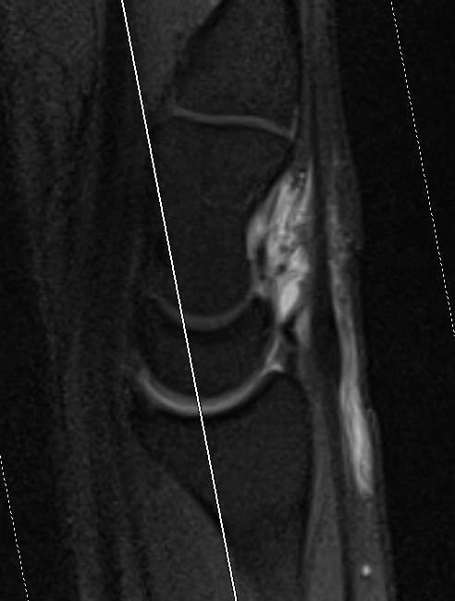
Wrist arthrogram sag T1 fat sat

Slide 3
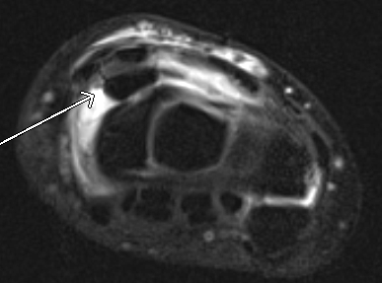
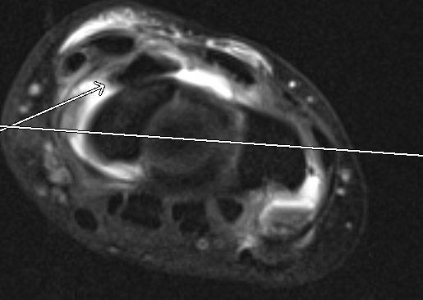
Wrist arthrogram axial T1 fat sat

Slide 4
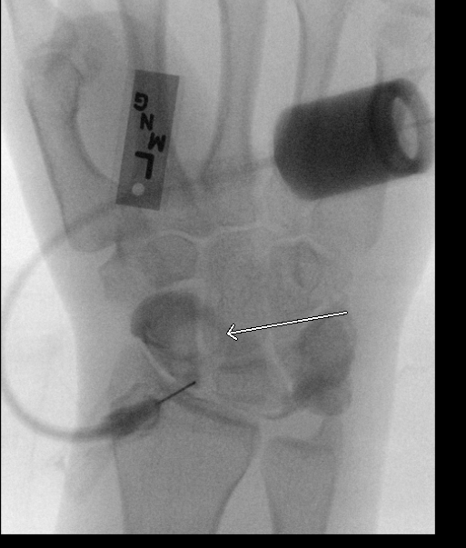

Slide 5
What is this dark blob at the dorsal wrist? A torn ligament that is bunched up?
Thank you for your help!!!

