Slide 1
39 yo F
Chronic knee pain, predominantly medial, recently worsened. No trauma. R/o medial meniscal tear

Slide 2
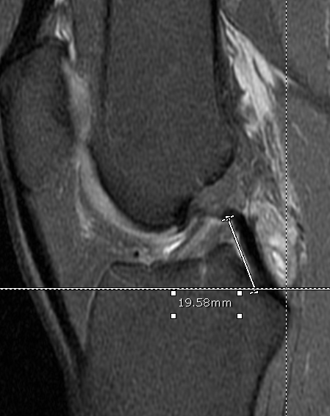
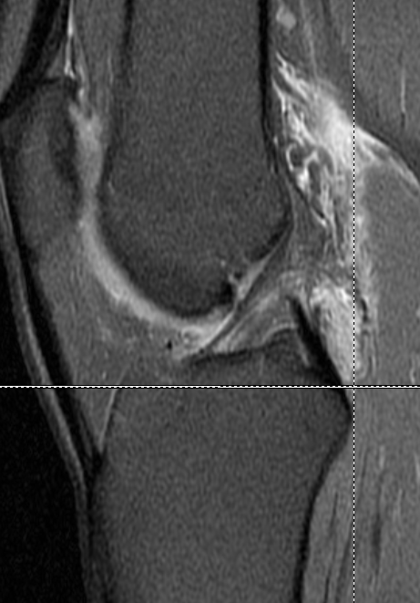

Slide 3
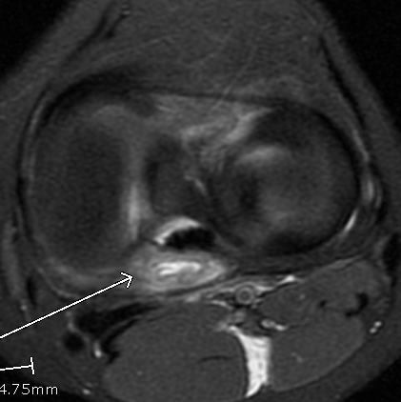

Slide 4
I think that this is a cyst or bursa that has ruptured and is leaking into the posterior knee soft tissues. It looks to be inside the joint capsule. Is there a bursa there?? Doesn’t seem to be in quite the right place. Or would this have to be some sort of ganglion? Does anyone have any other idea or ddx?
Thanks!

