Slide 1
Young person with right parotid mass
Surgeon ordered MRN as outside rad couldn’t tell if facial nerve was involved

Slide 3
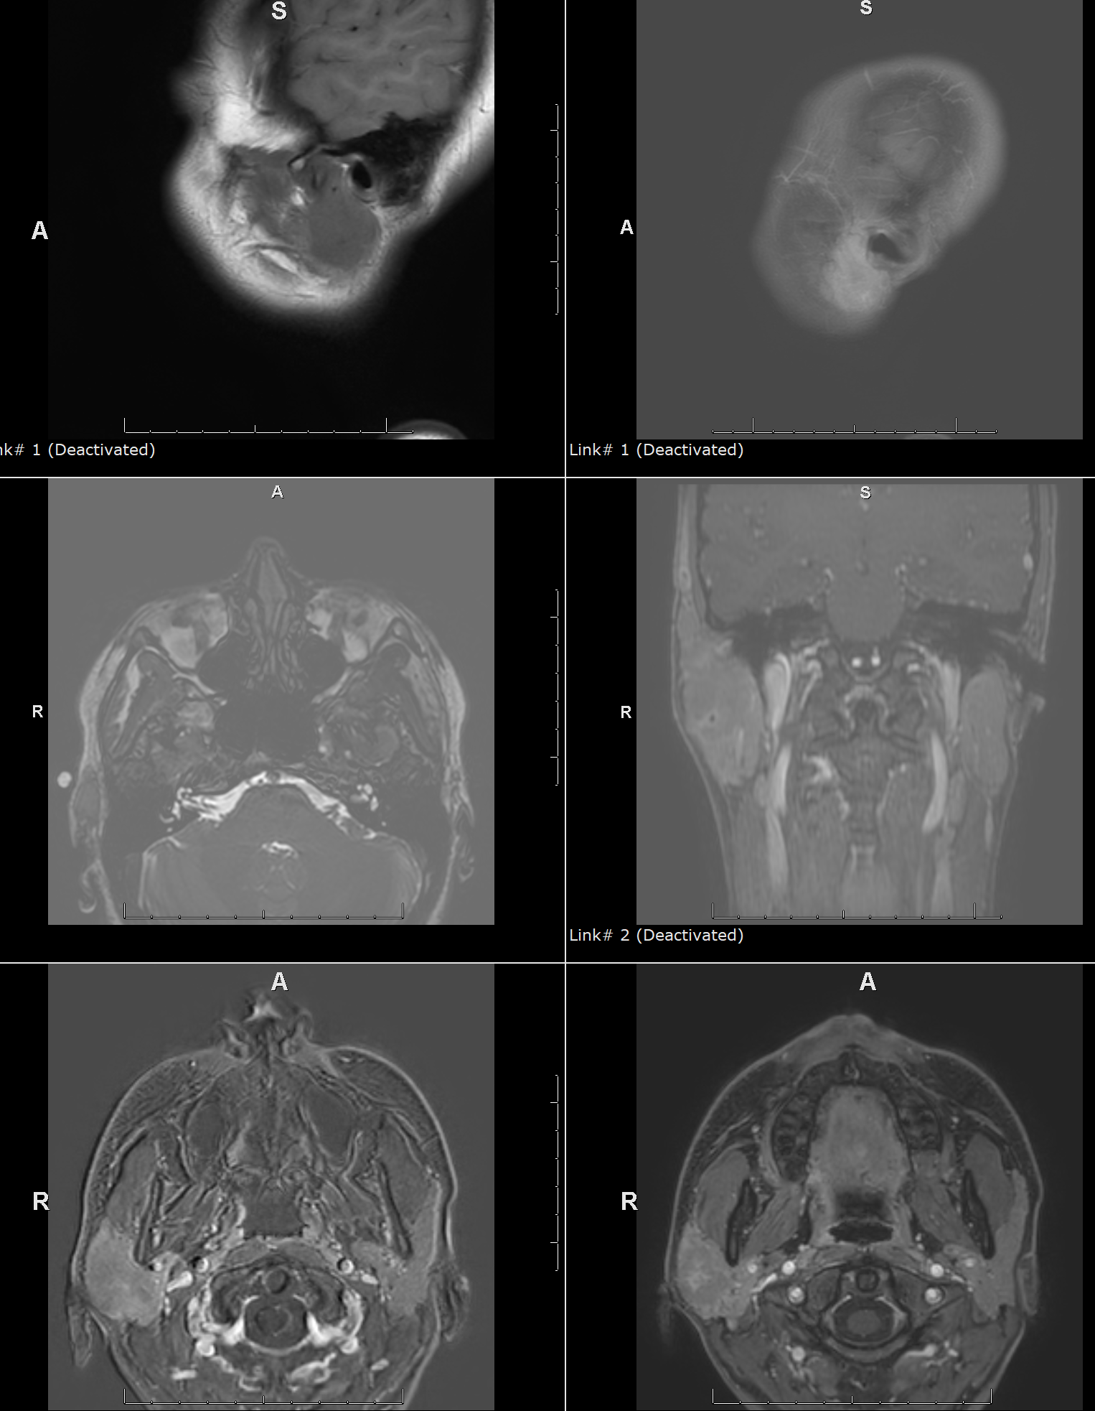

Slide 4
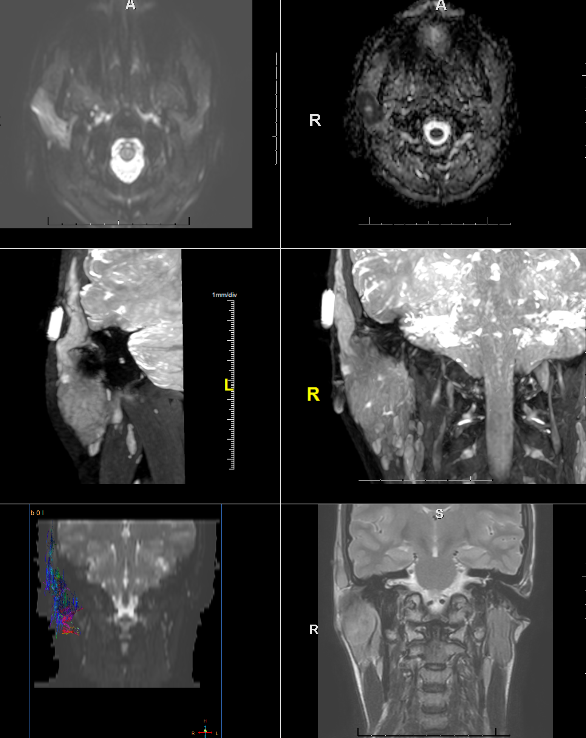
MR neurography shows extension into distal facial segment in stylomastoid canal and temporal branch

