Slide 1
Normal Menisci- axial anatomy
Chhabra A et al. The International Society of Arthroscopy, Knee Surgery and Orthopaedic Sports Medicine classification of knee meniscus tears: three-dimensional MRI and arthroscopy correlation. Eur Radiol. 2019;29(11):6372‐6384. doi:10.1007/s00330-019-06220-w

Slide 2
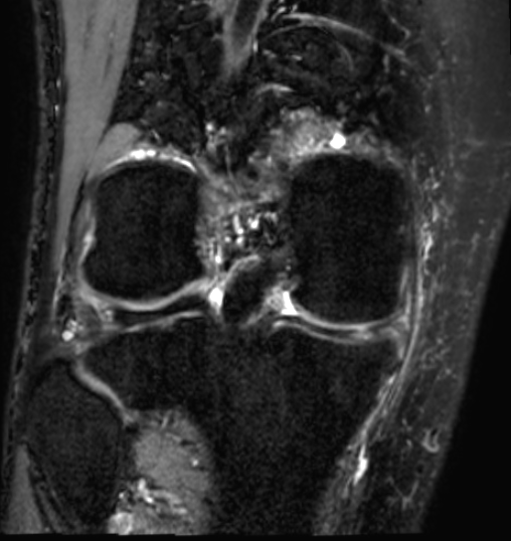
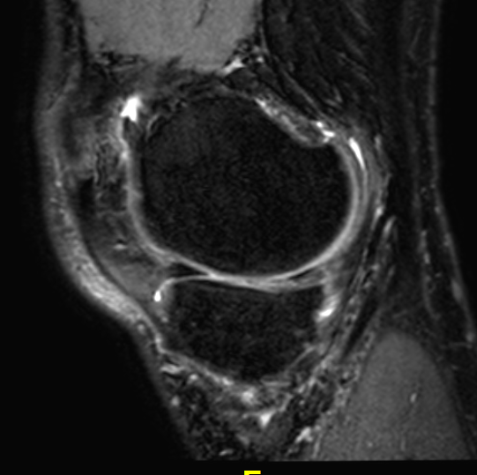
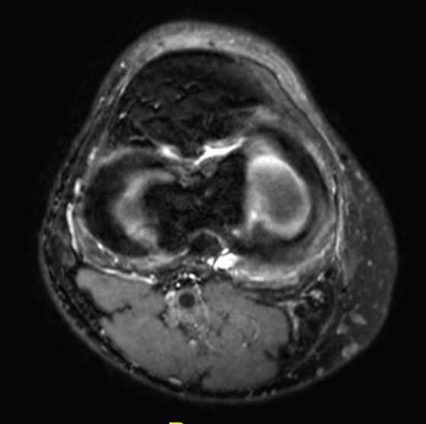
Tear- complex flap- warped Goggle on axials

Slide 3
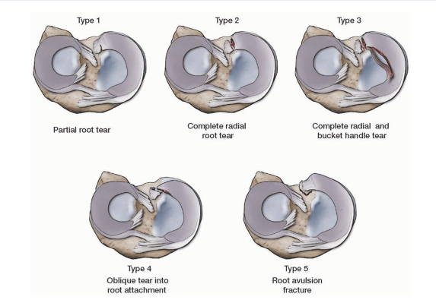
Laprade Classification
https://musculoskeletalkey.com/arthroscopic-meniscal-root-repair/

Slide 4
Laprade IV (partially broken)- LM

Slide 5
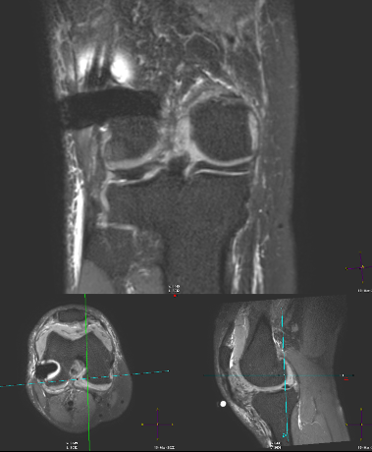
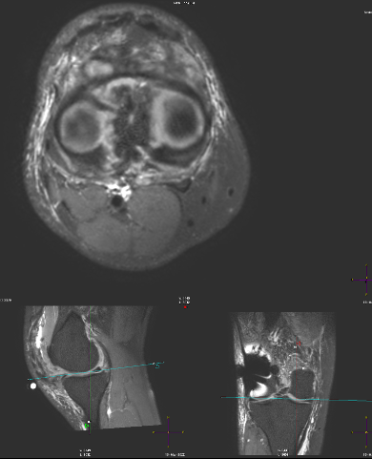
Laprade II (completely Broken) Goggle- lateral slip of posterior root

Slide 6
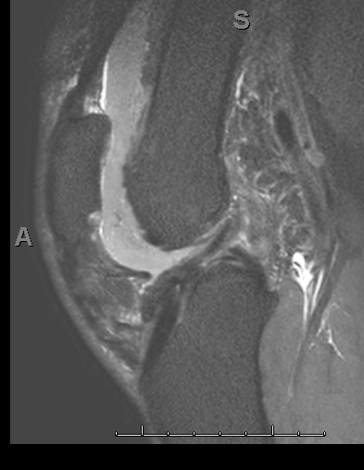
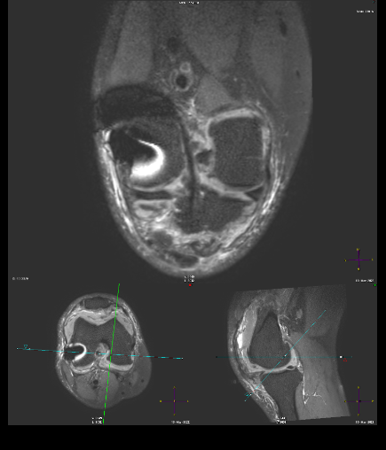
ACL- intact- diffusely attenuated but too vertical- should be below 75 deg angulation

Slide 7
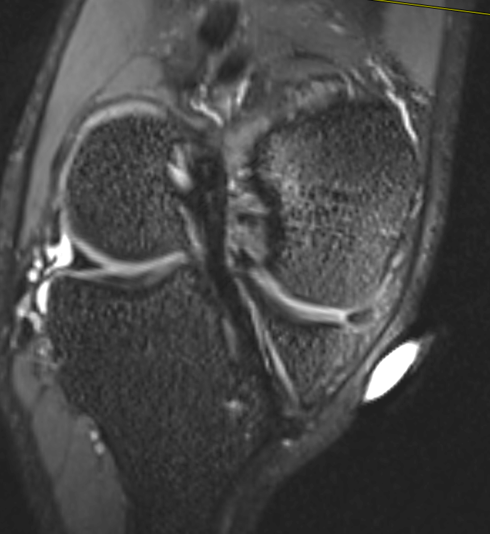
Another one- too vertical- leads to rotational instability

