Slide 1
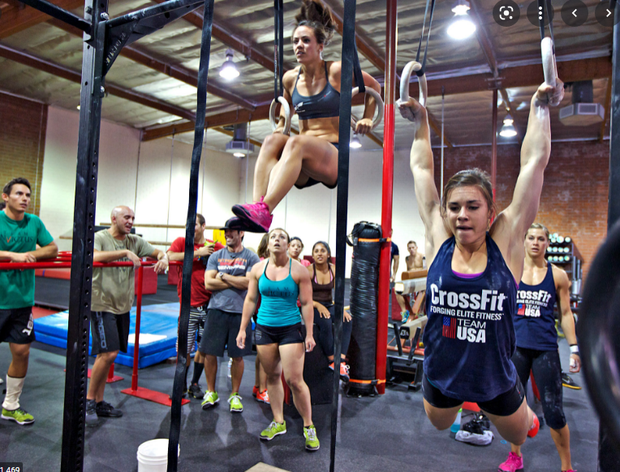
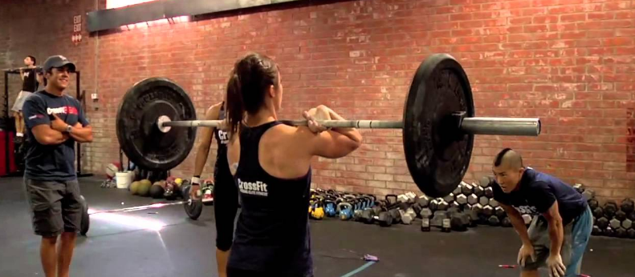
OCAD CASE
Female, 30 years old, thigh pain in the last 30 days
difficulty for walking, practices crossfit,
no history of significative trauma;
no previous history of diseases;
On physical examination: hardened mass on the anterior aspect of the thigh
Carlos Henrique Alencar, MD
Cláudio Régis Silveira, MD
São Carlos Hospital, Fortaleza, CE, Brazil

Slide 2
04/Mar/2022

Slide 3
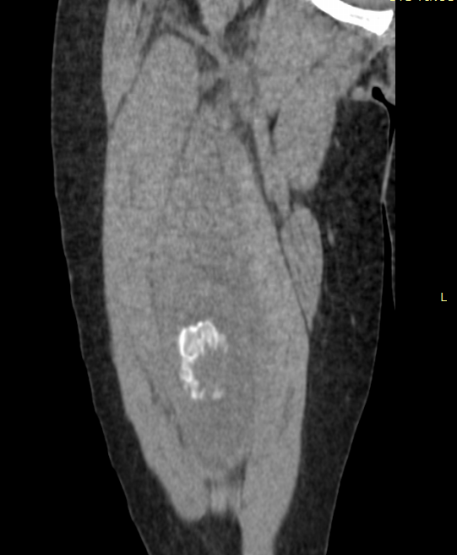
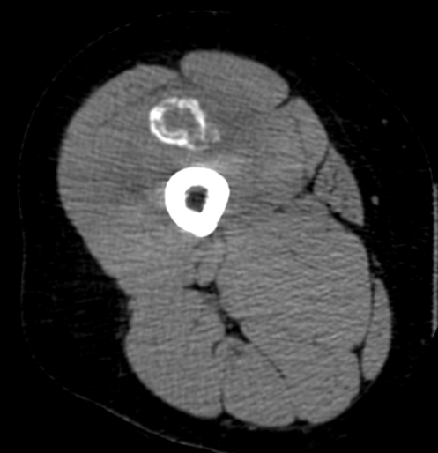
04/Mar/2022

Slide 4
04/Mar/2022

Slide 5
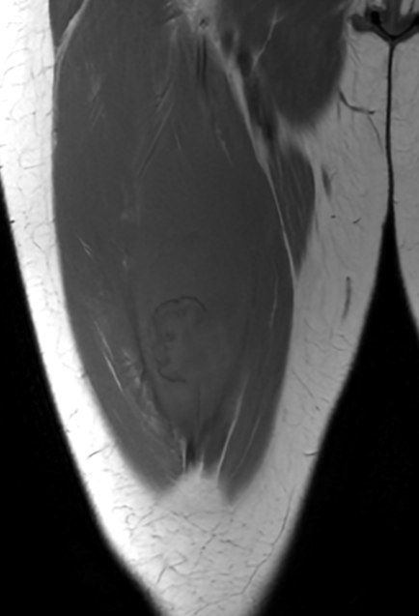
04/Mar/2022
Stir
Stir
T1

Slide 6
04/Mar/2022
Stir Sag
Stir Sag
Stir Sag

Slide 7
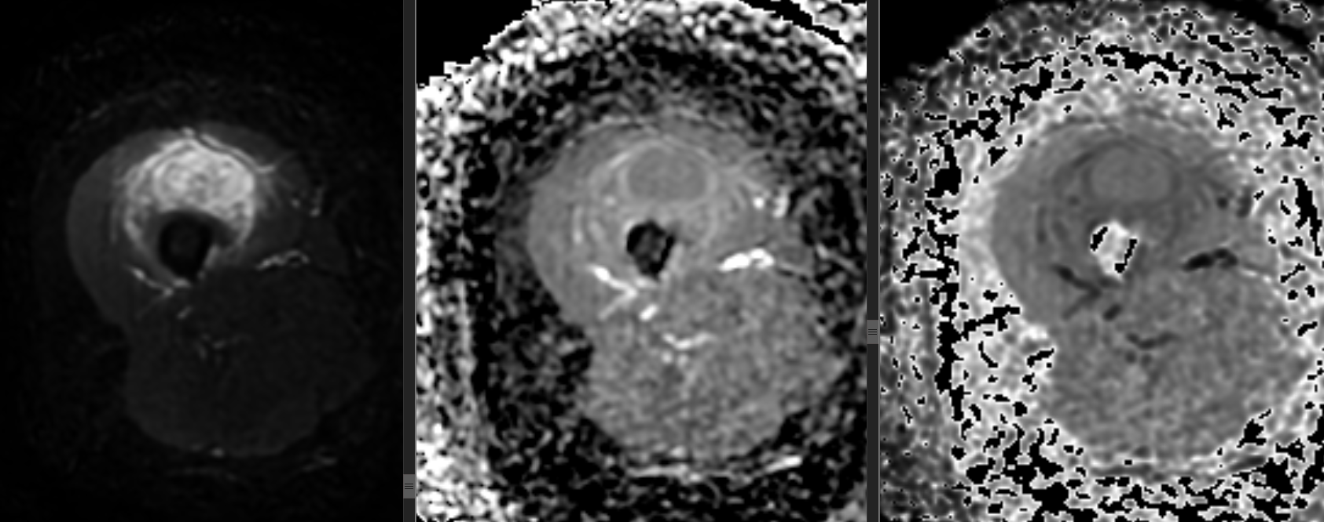
04/Mar/2022
DWI
ADC
eADC

Slide 8
04/Mar/2022
ADC Value between 1.7 - 1.9 x 10-³ mm/2)

Slide 9
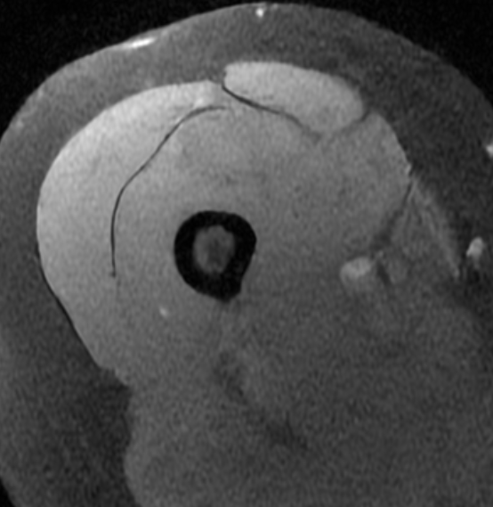
04/Mar/2022
T1 Fat Sat Cor
T1 Flex Pre
T1 Fat Sat Ax

Slide 10
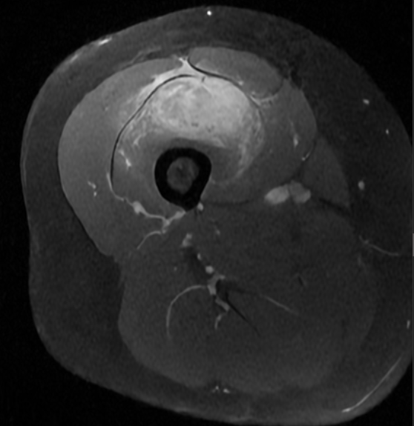
04/Mar/2022
T1 Fat Sat Post Cor
T1 Flex Post
T1 Fat Sat Post enhancement Ax

Slide 11
04/Mar/2022
T1 Fat Sat Post Sag

Slide 12
What are your hypothesis for the lesion?
Myositis ossificans?
Soft Tissue Sarcoma?
Extraosseous osteosarcoma (EOO) / Extraskeletal osteosarcoma (ESOS) ?
More suggestions?
What to do? Biopsy, control or resection?

