Slide 1
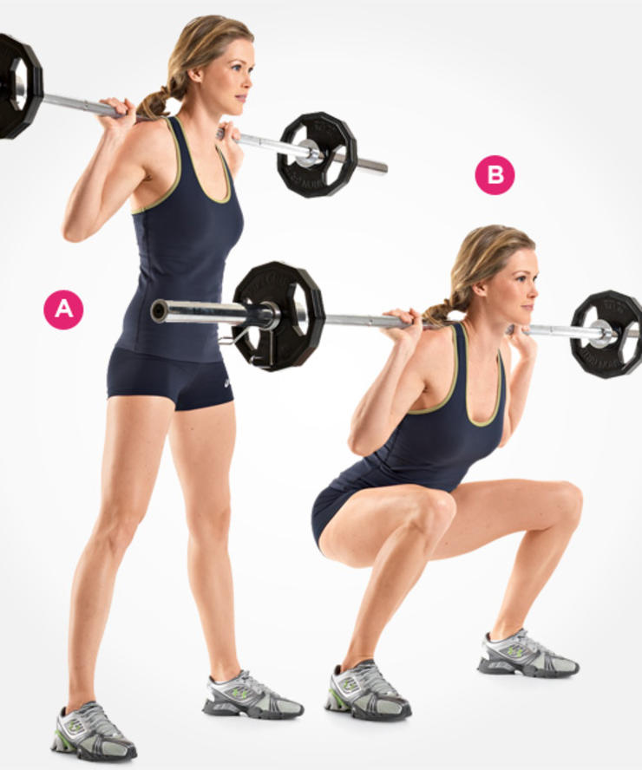
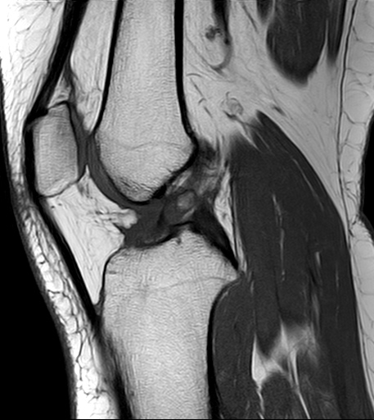
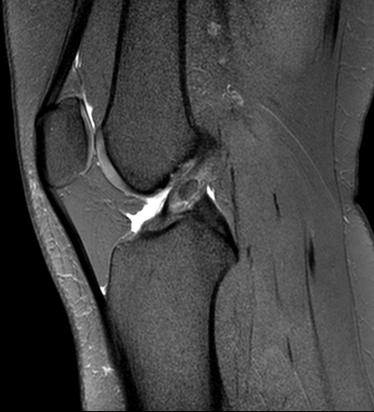
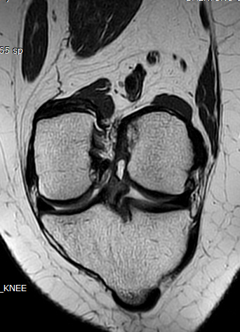
24/F
Pain after work outs (quat) for 6 months
Courtesy of Sung Moon Lee
T2
PDFS
T1
ACL ossicle ? vs. Heterotopic ossification?

Slide 2
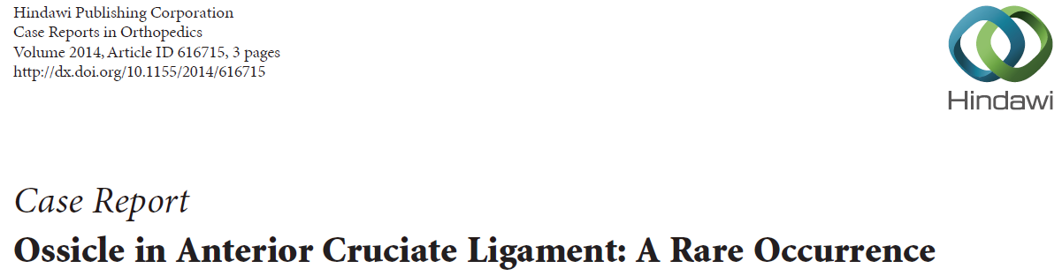
Ossicle
maybe defined as a mature lamellar and cancellous bone with a covering of hyaline cartilage and fatty marrow within
Conclusion
The occurrence of intra-articular ossicles in the knee though have been reported, we did not come across any mention of an intrasubstance ossicle in the ACL. We thus report a case of an ossicle in the substance of the anteromedial bundle of the ACL, in a patient with mild pain and discomfort, who got completely relieved of his symptoms after its excision.
After one year of postoperative follow-up, the patient is asymptomatic and back to his sporting activity without any constrains.

Slide 3
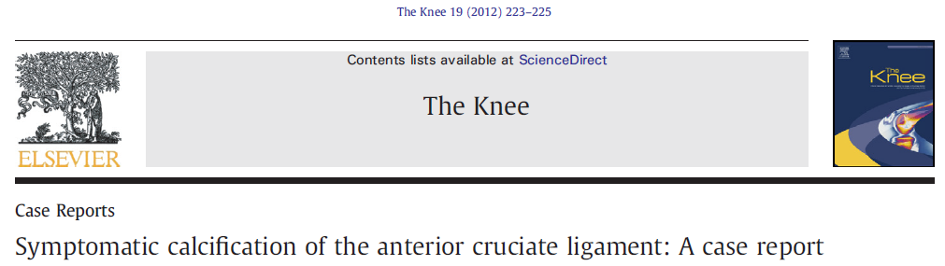
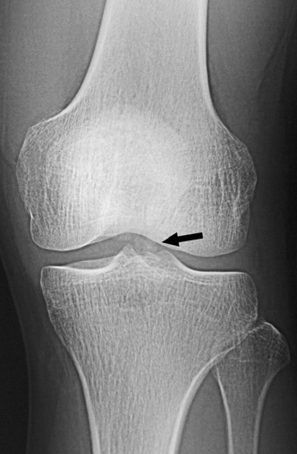
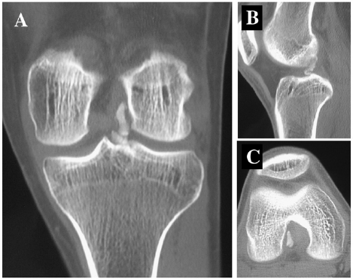
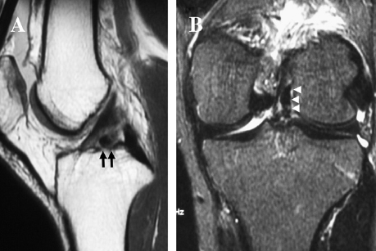

Slide 4
