Slide 1
Focal ossification (?) of femoral cartilage

Slide 2
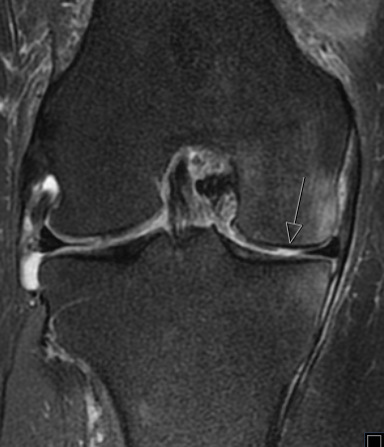
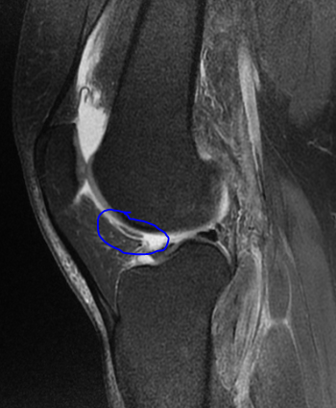
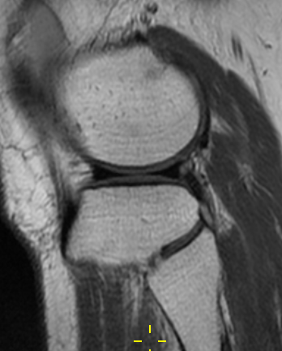
MRI 2019; chondral defect medially, free chondral body, was later removed arthroscopically. Nothing special in lateral compartment.

Slide 3
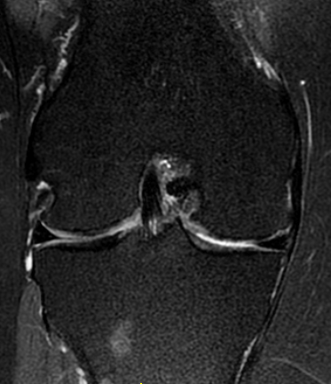
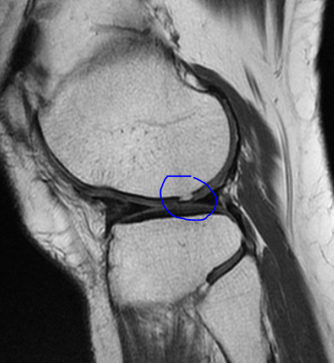
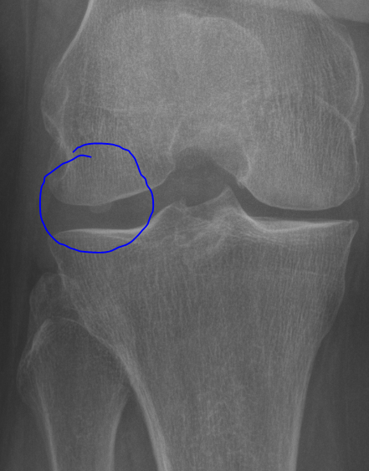
2022: small bony protuberance into the cartilage in lateral compartment. (yes.. could look like a fabella in x ray, but it is the same entity as in the MRI..)

