Slide 1
78F with 4 mo hx of painful growing lump in calf.
No antecedent trauma or prior surgery.
Patient “refuses” to have MRI….

Slide 3
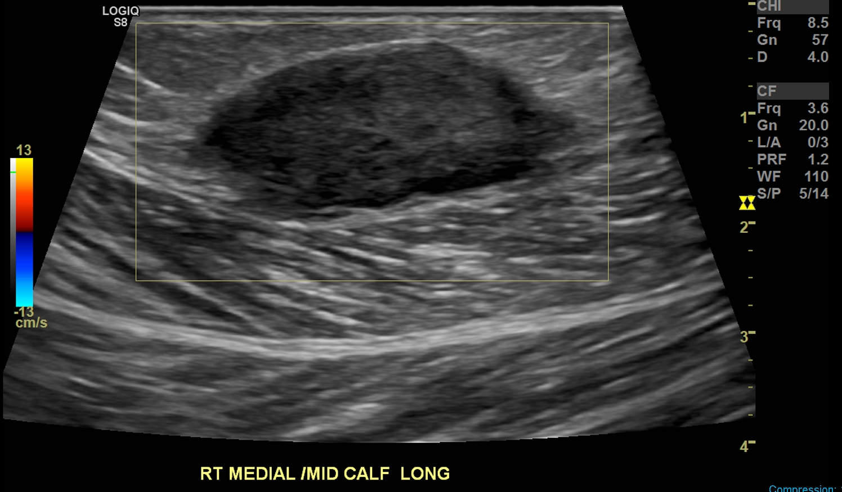
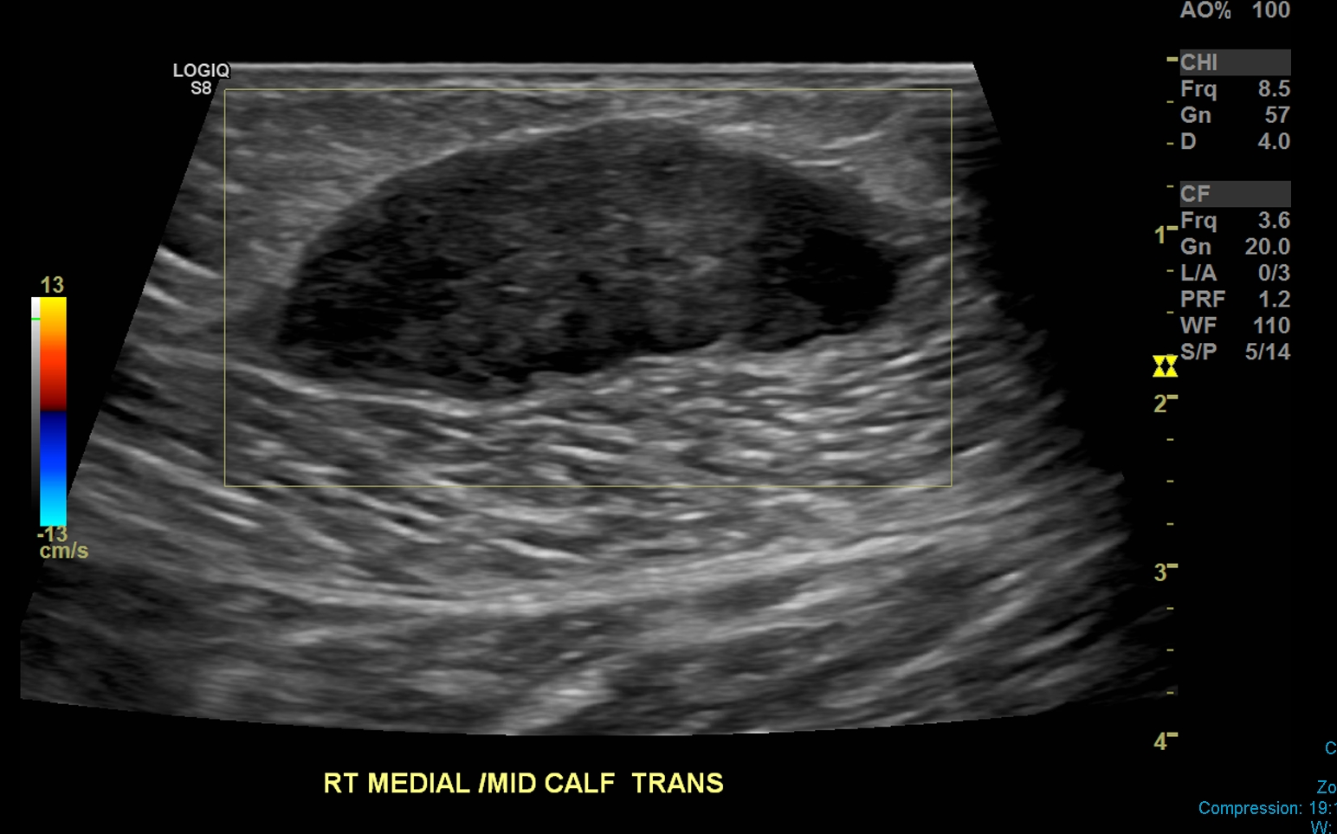

Slide 4
I thought “this looks pretty nonthreatening. Avascular on US, lenticular, maybe based in fascia. Could be hematoma, could be fibroma, less likely PNST. But I wonder why no MRI?”

Slide 5
So I called tumor surgeon who ordered CT to ask why he didn’t get MR. He said, “Because she REFUSES to have an MRI. And because I already needled it, and the path came back……

Slide 6
High-grade pleomorphic sarcoma. I’m resecting it next week.”

Slide 7
YIKES.

