Slide 1
67 yo female with endstage renal disease
Femoral lesion seen incidentally. No prior radiographs or CT at this institution

Slide 2
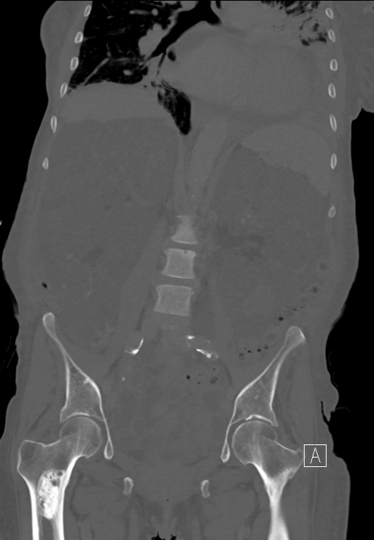
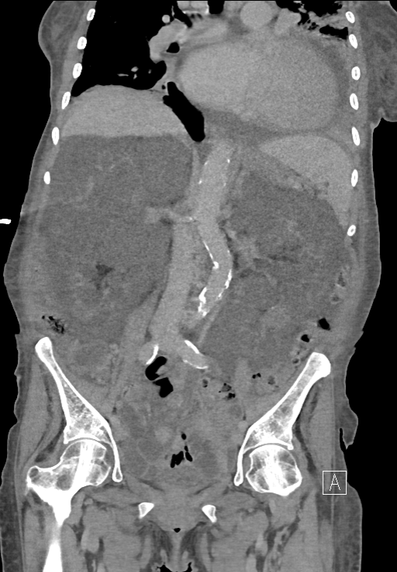

Slide 4
