Slide 1
35Y, Male, Investigating for head ache.
MRI revealed a small mass lesion in left cingulate gyrus posteriorly.
Cortical based, well marginated ovoid cystic lesion with ring enhancing solid area within which shows susceptibility signal loss on SWI.
Minimal perilesional oedema.
No restricted diffusion.
Possibilities - Incidentally noted DNET,
small ganglioglioma, low grade glioma,
Value your expert opinion.

Slide 2
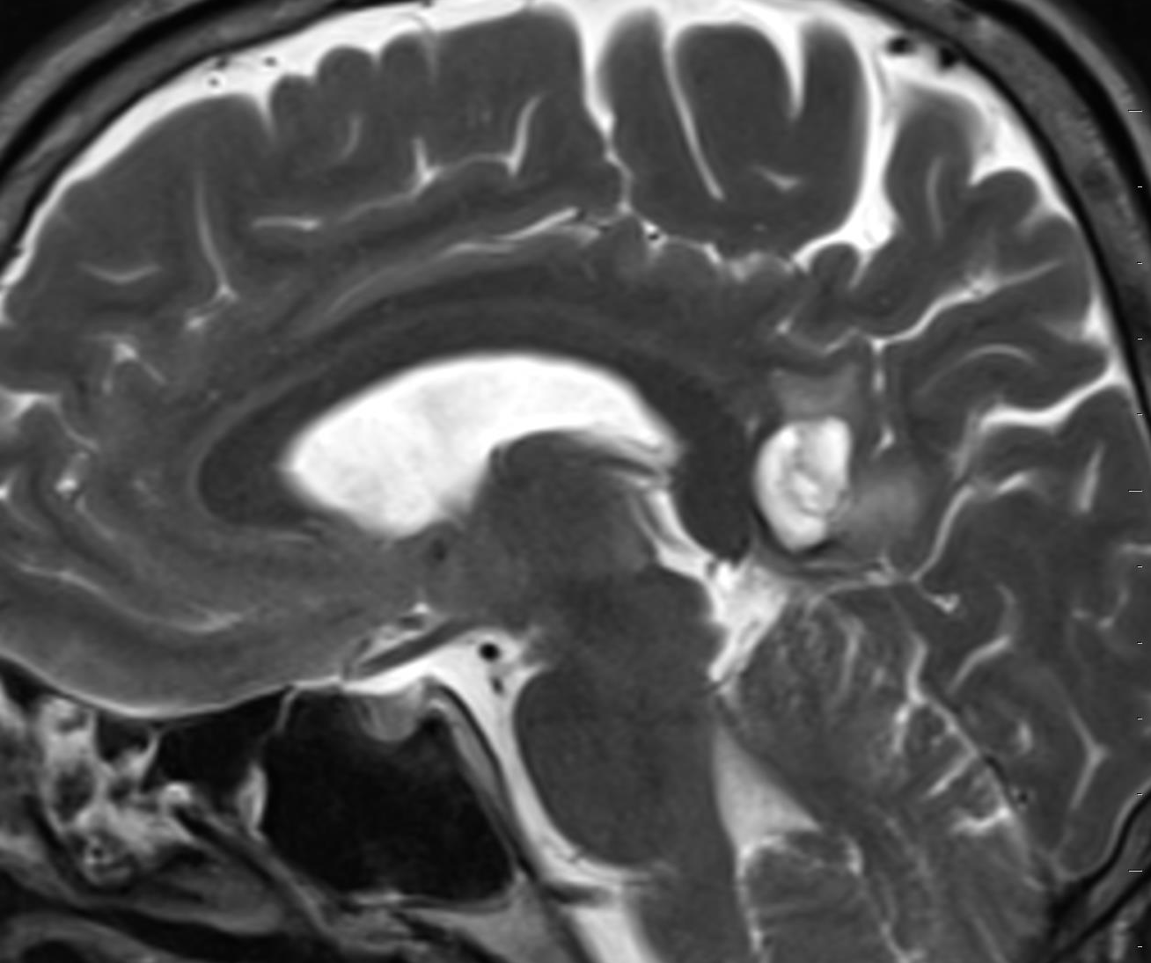
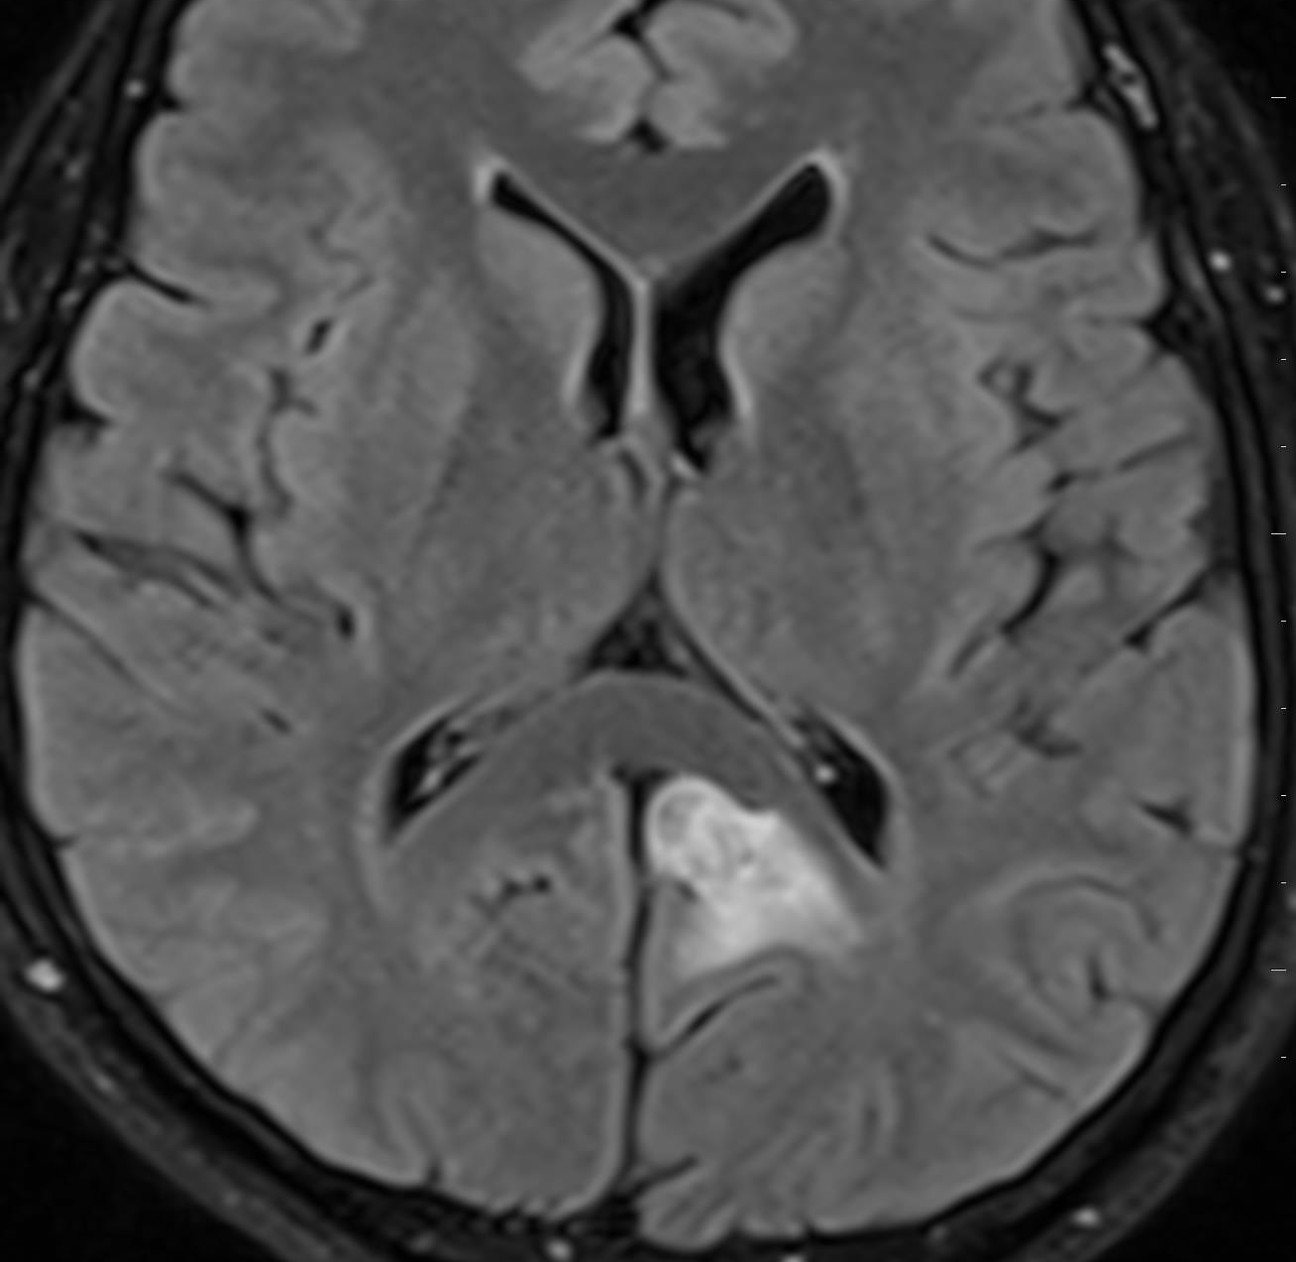
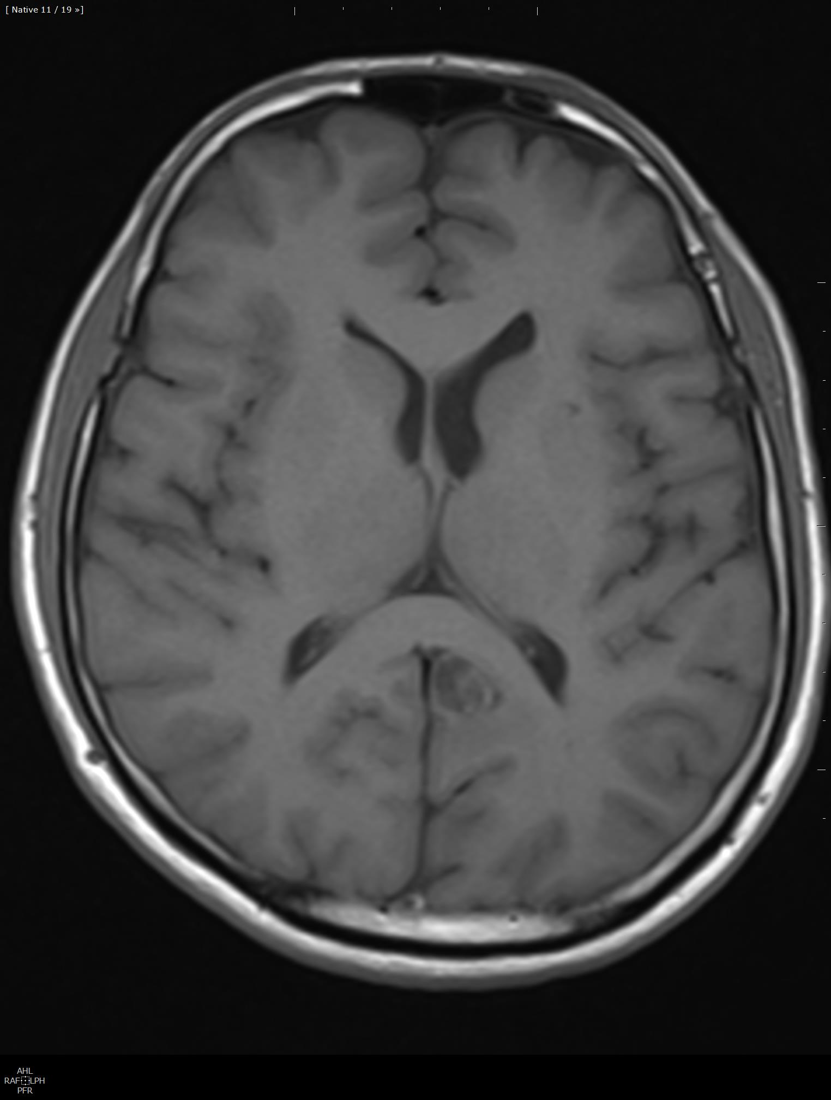
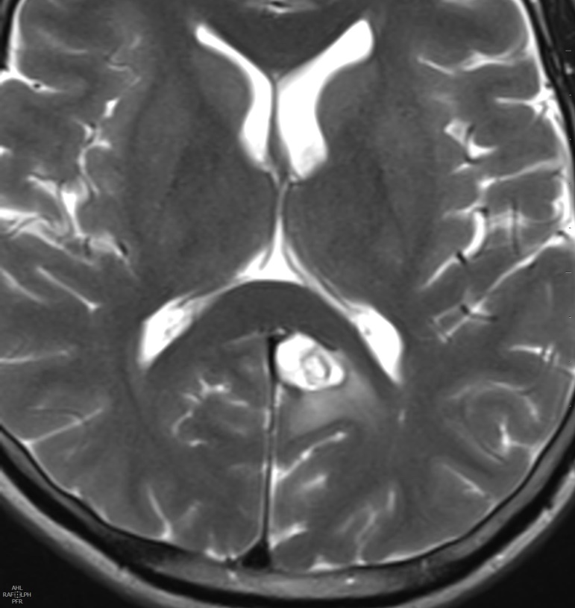

Slide 3
