Slide 1
OCAD CASE
Male, 15 years old, down syndrome
knee pain and swelling, no history of trauma;
osteoporosis treated with alendronate
Cláudio Régis Silveira, MD
Carlos Henrique Alencar, MD
São Carlos Hospital, Fortaleza, CE, Brazil

Slide 2
28/Jan/2022

Slide 3
01/Feb/2022 - Knee mri

Slide 4
01/Feb/2022

Slide 5
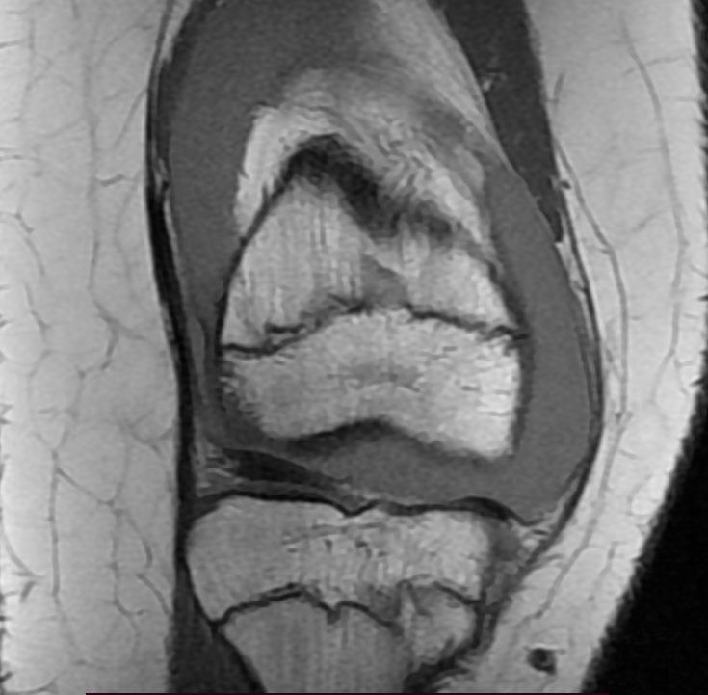
01/Feb/2022
Puncture confirmed hemarthrosis

Slide 6
01/Feb/2022

Slide 7
01/Feb/2022

Slide 8
01/Feb/2022

Slide 9
Patient refused the use of the endovenous contrast media.
Xray and Mri finding:
Zebra Sign
Reduced bone texture, suggesting osthoporosis
Irregular bone cortex of the distal femur, perhaps a previous fracture
Hemarthrosis
Strain of the cruciate anterior ligament
Signs of a previous lateral patellar dislocation

Slide 10
What are your hypothesis for the femoral physeal lesion?
Small low grade chondral lesion?
More suggestions?

