Slide 1
13 year male with shoulder pain for 2 months

Slide 2
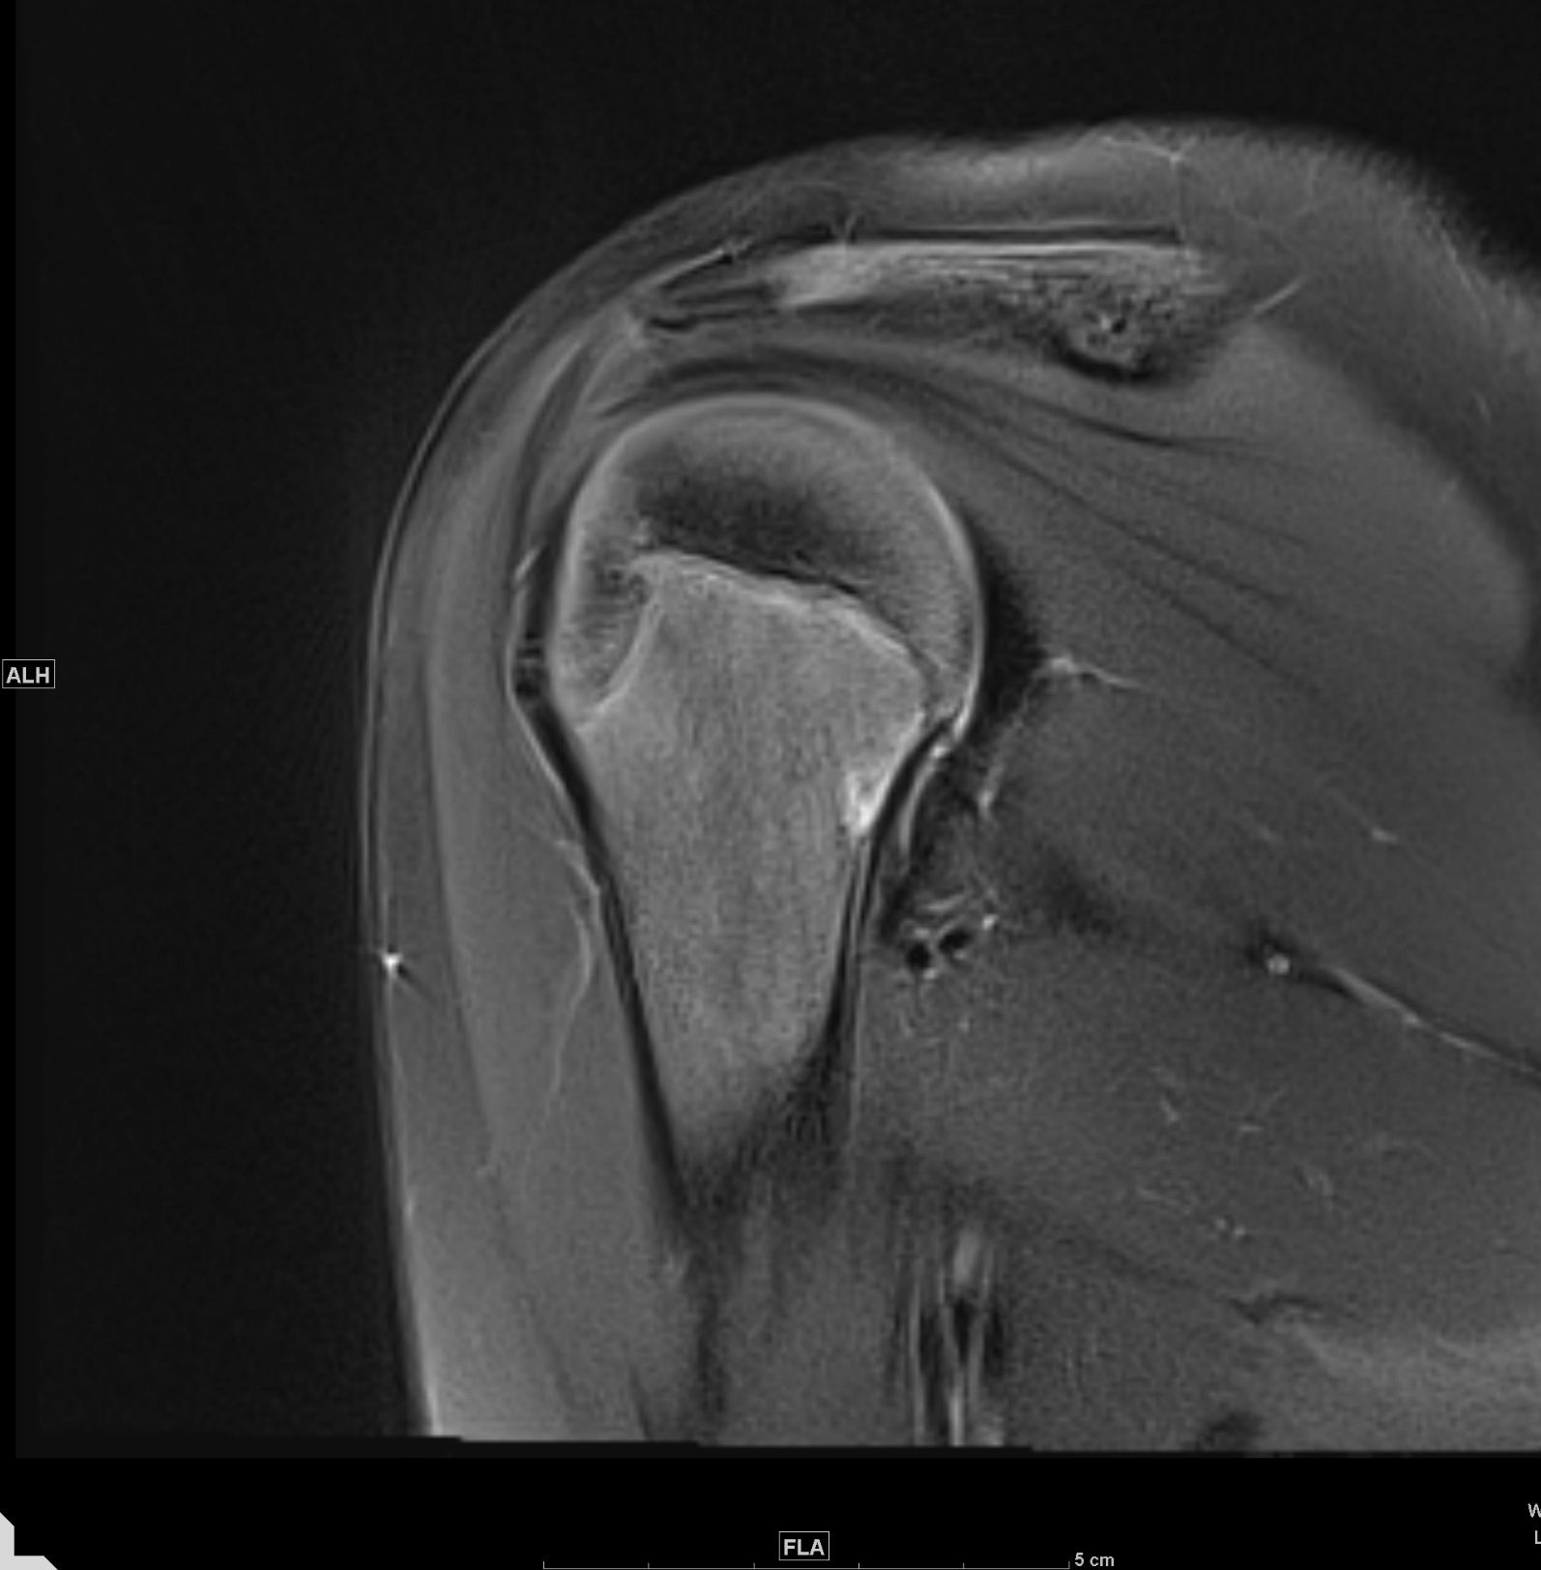
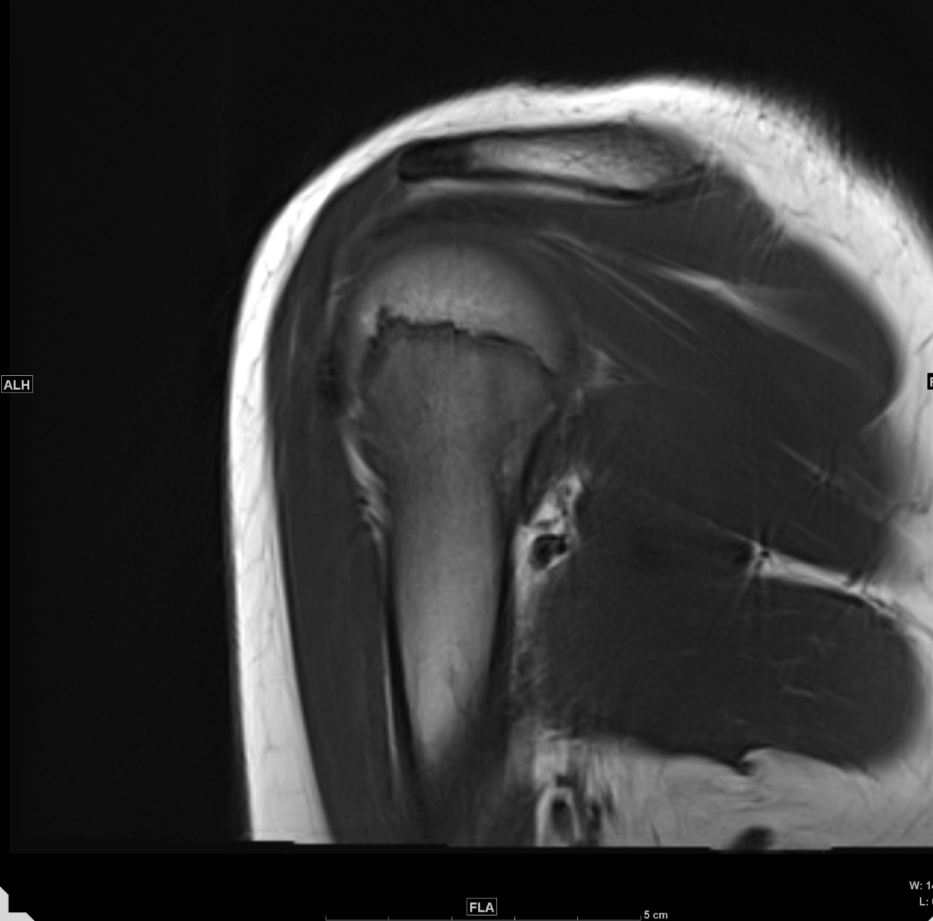

Slide 4
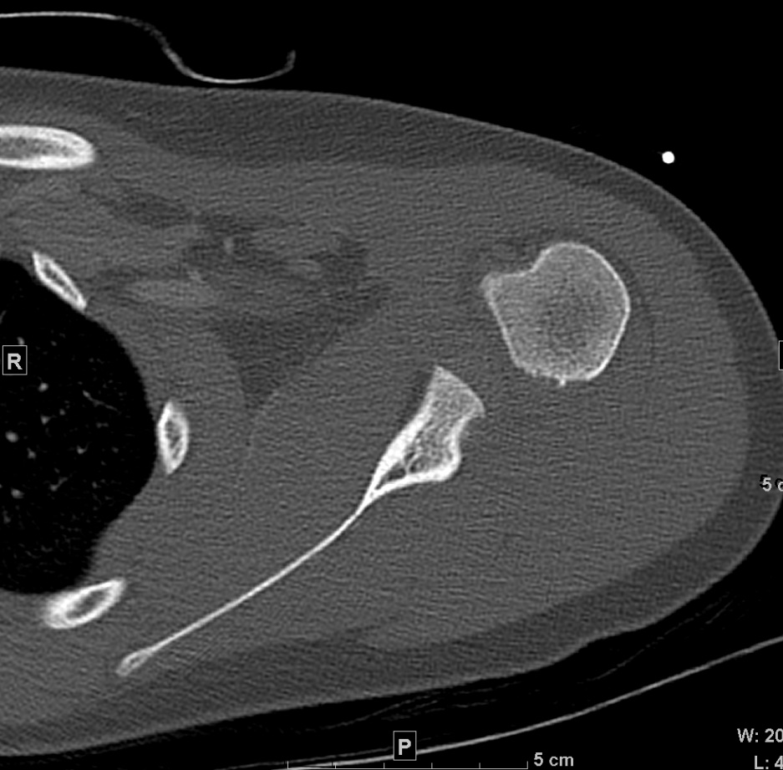

Slide 6
Benign fibro-osseous lesion?
Could this be juxtacortical chondroma?
Should I recommend follow-up or anything further
Thank you very much for help

