Slide 1
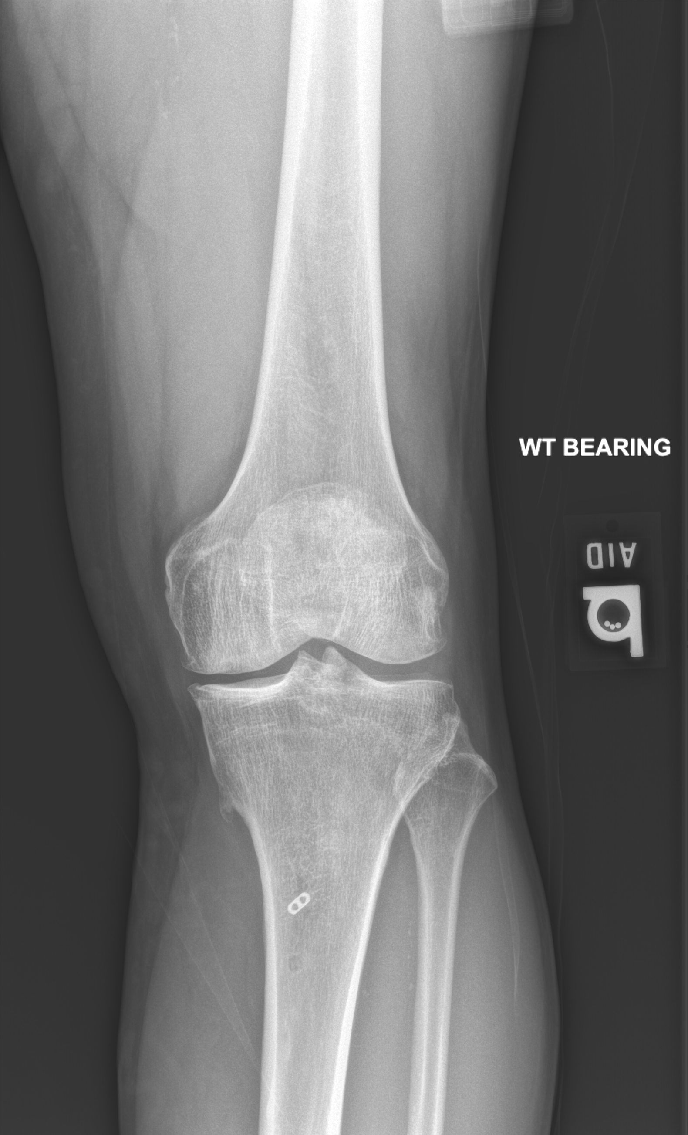
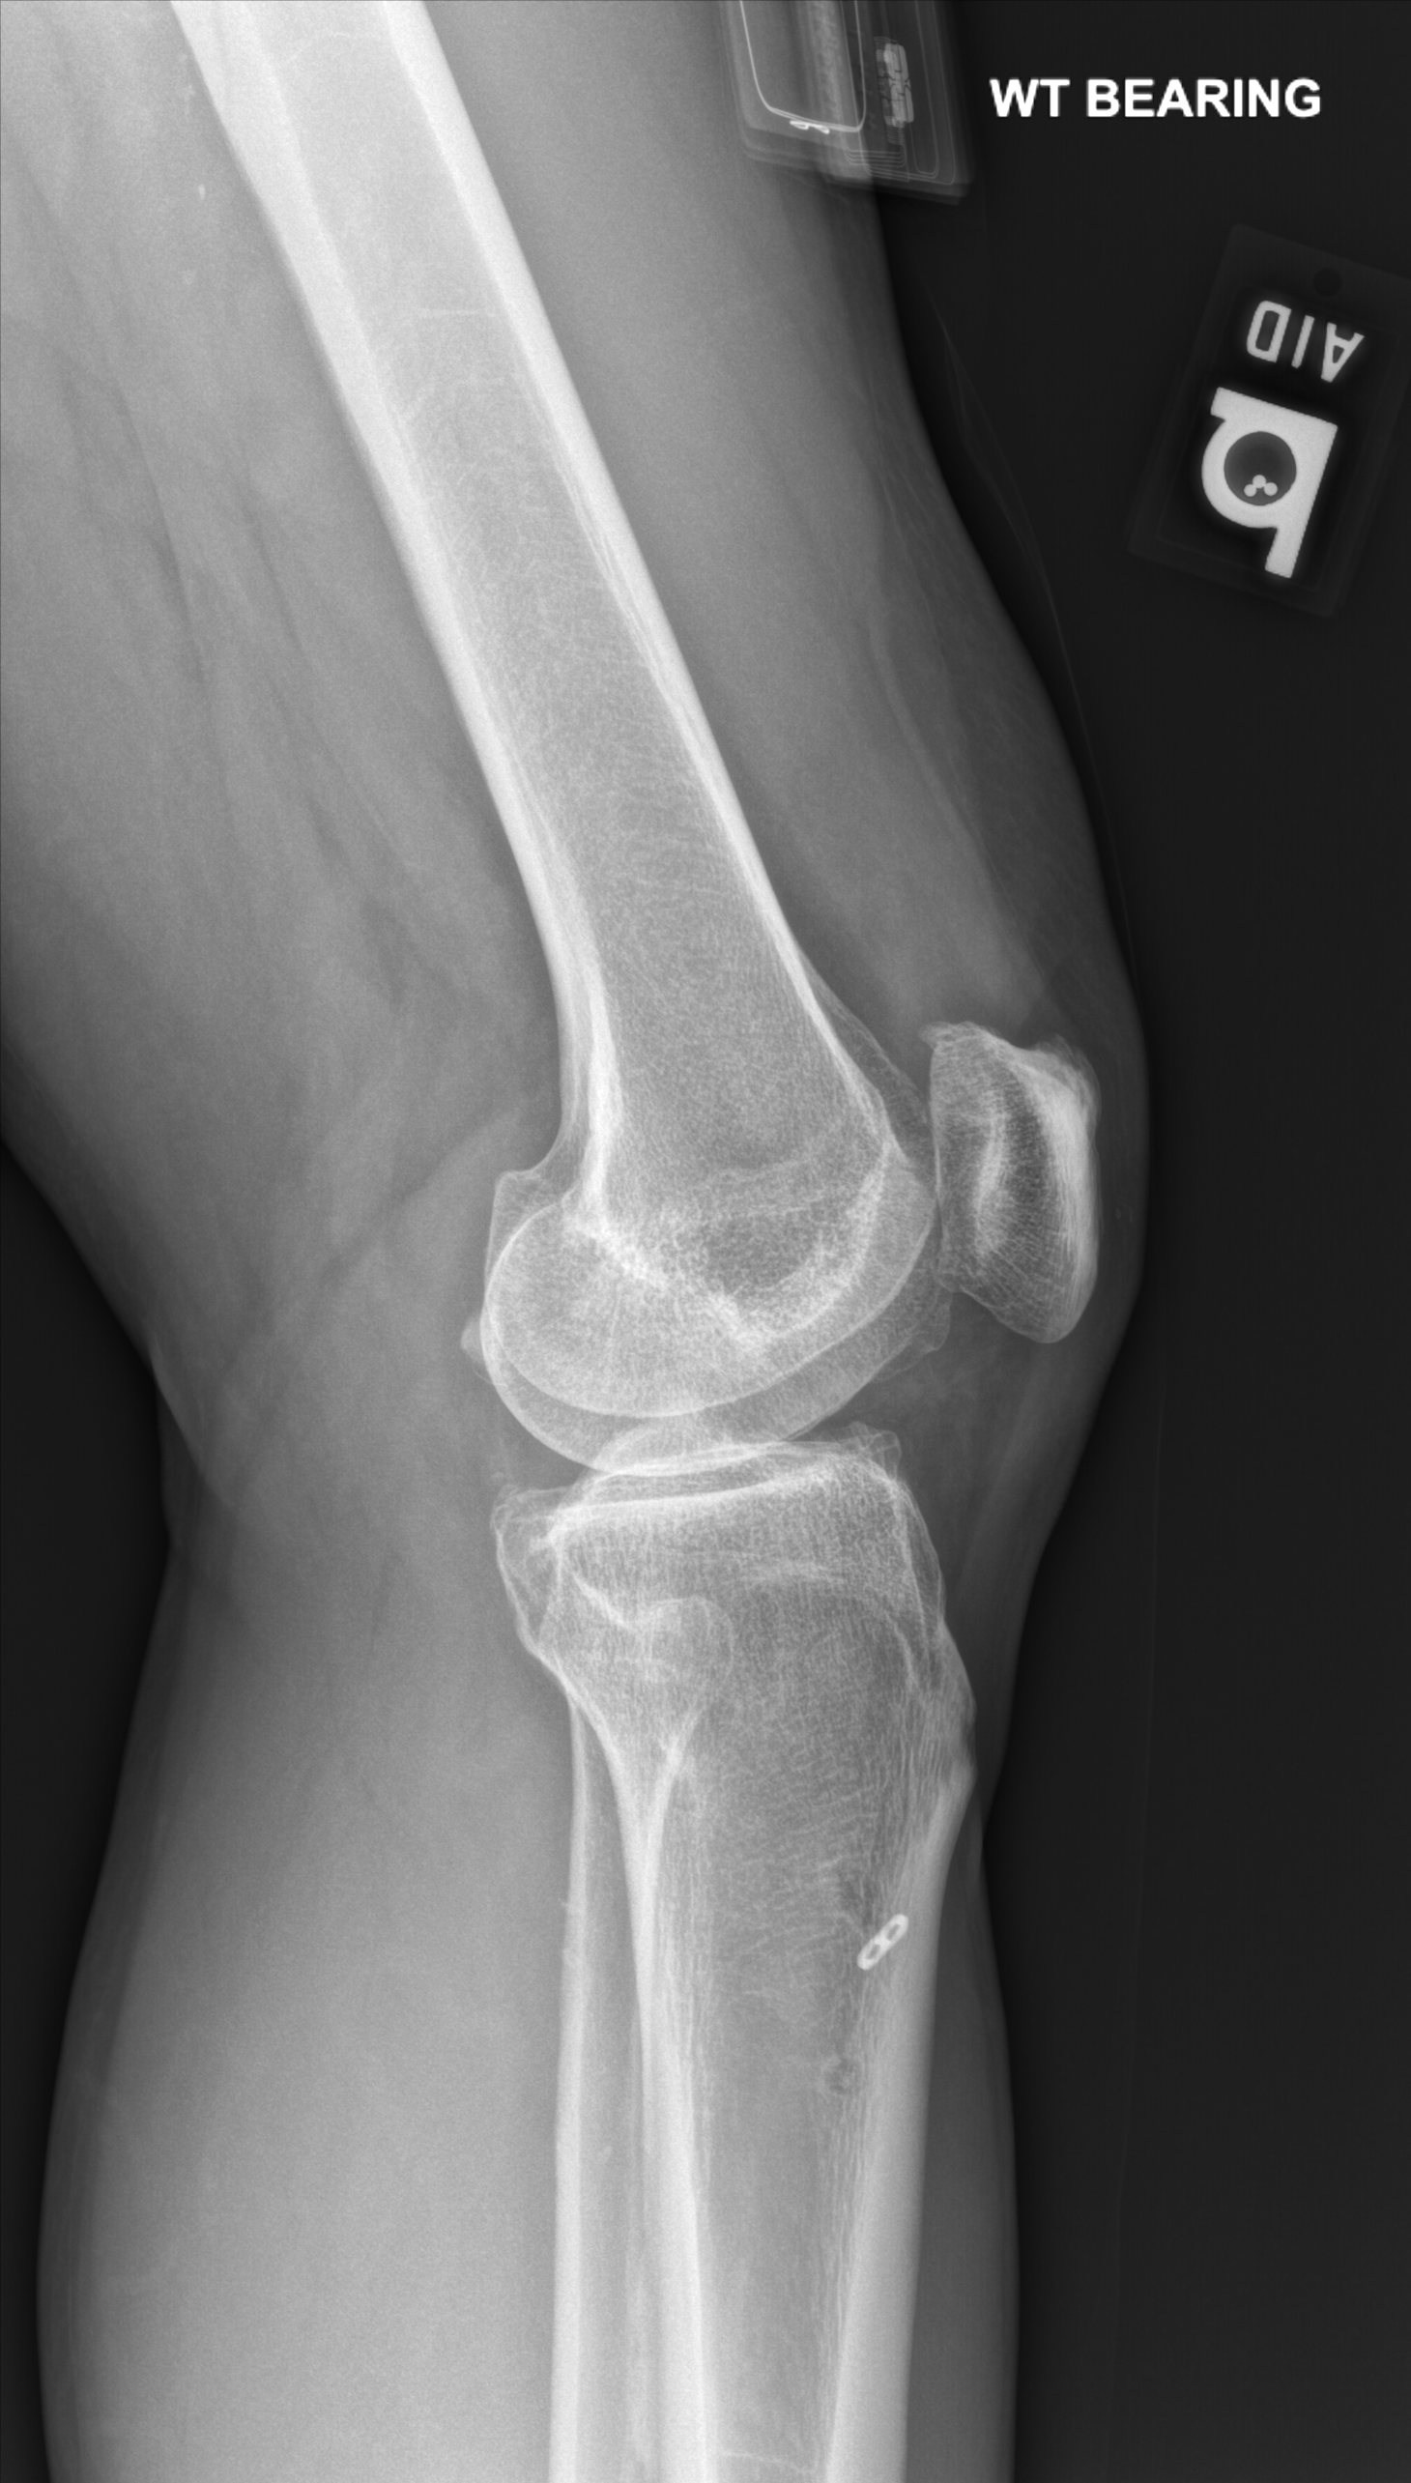

Slide 2
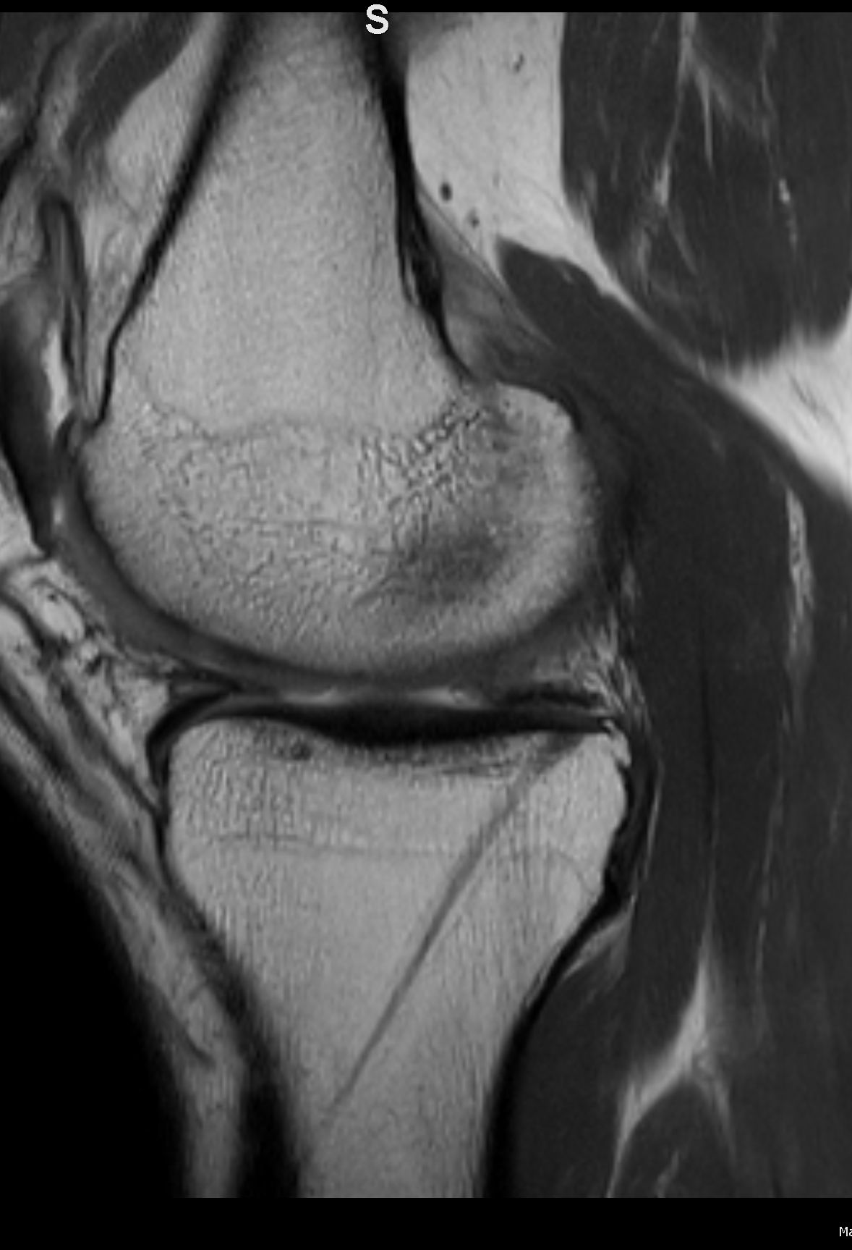
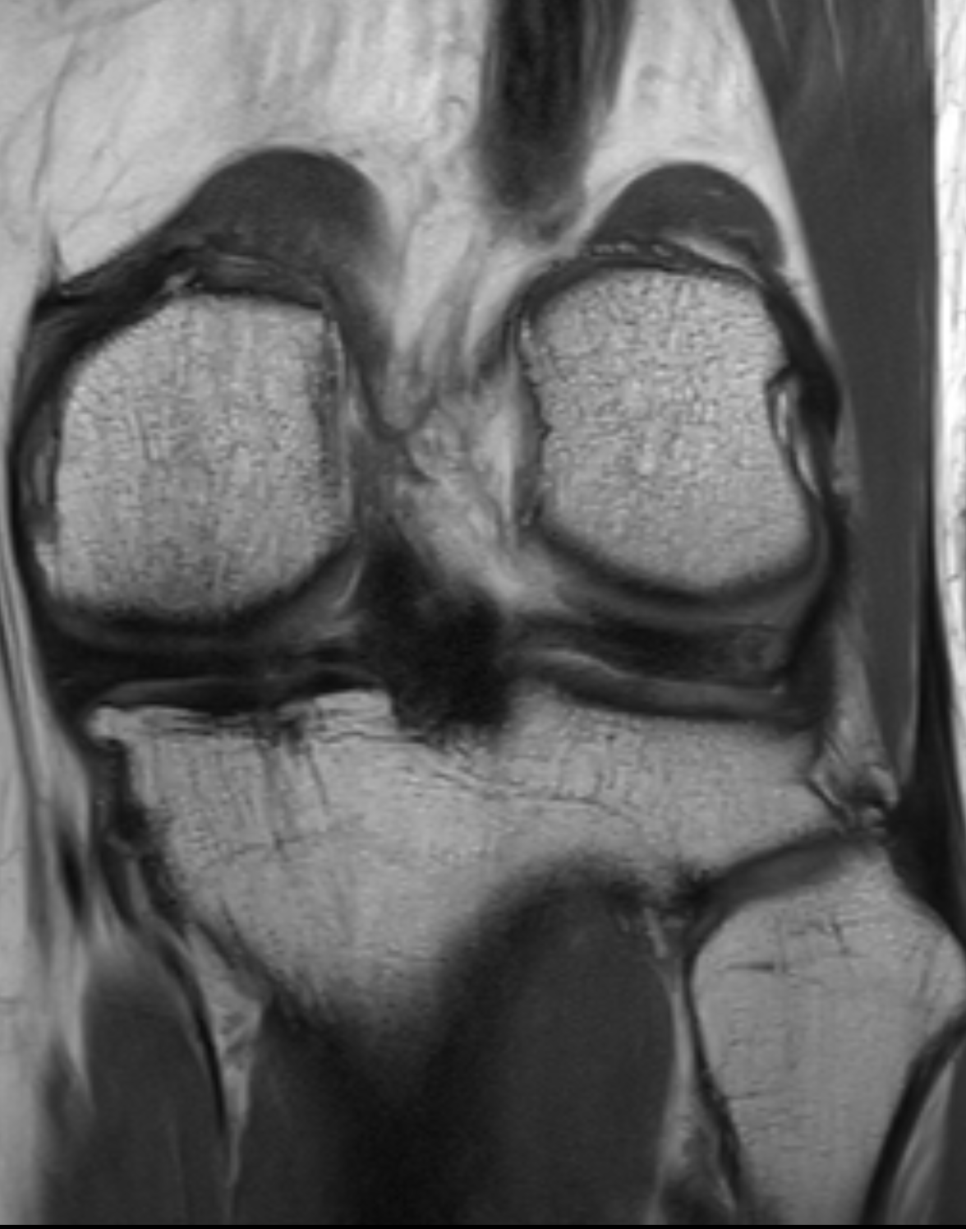

Slide 3
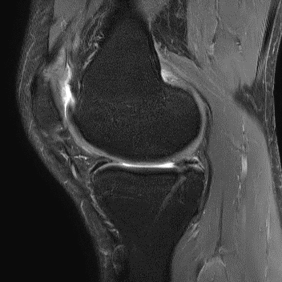
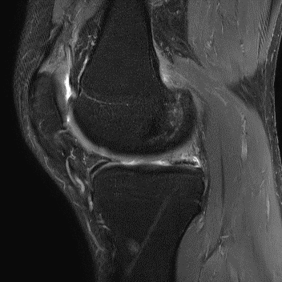

Slide 4
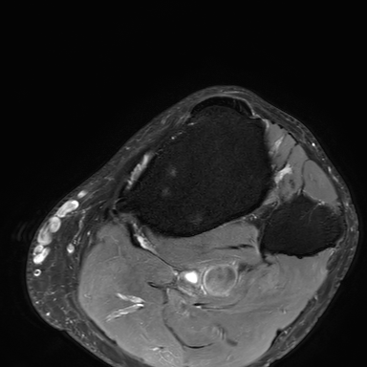
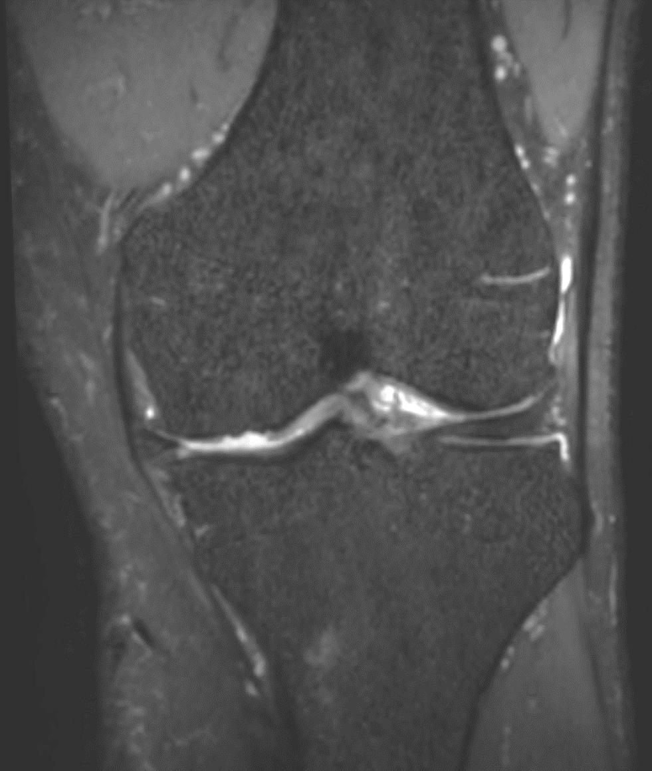

Slide 5
Findings
Medial meniscal root repair via transtibial tunnel with anchor in proximal tibial diaphysis
Tug deformity of proximal tibial metaphysis at pes anserinus with bursitis
Grade 4 osteochondral injury of medial tibial plateau

