Slide 1
36/M
r/o CRPS after distal humerus medial epicondyle osteotomy for ulnar nerve release (POD 2weeks)

Slide 2
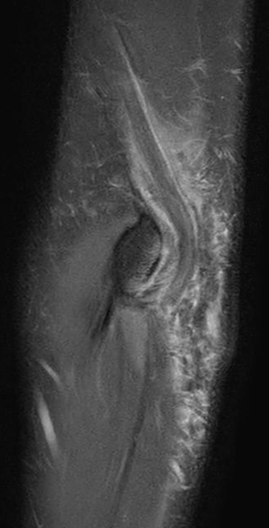
*
*
*
Notes:
*

Slide 3
T2 FS
T1
T2
T2 FS
T1
T2

Slide 4
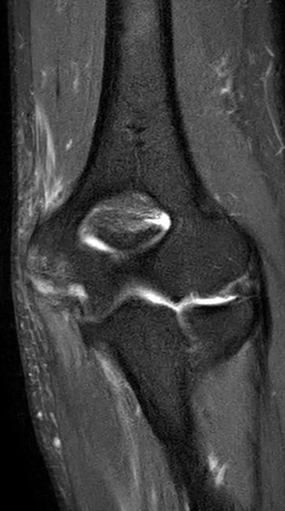
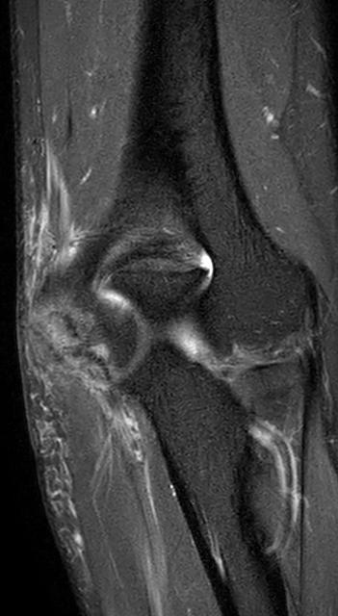
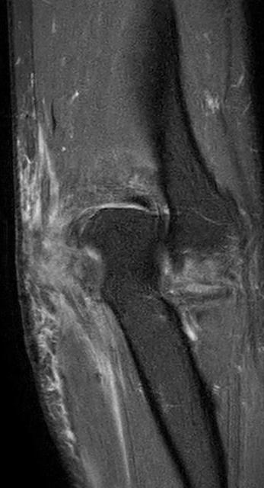
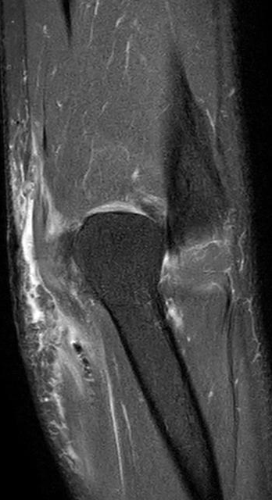
T2 FS

Slide 5
T2
T1
Notes:
T1

