Slide 1
70 yrs F, slowly increasing left thigh swelling, one month

Slide 2
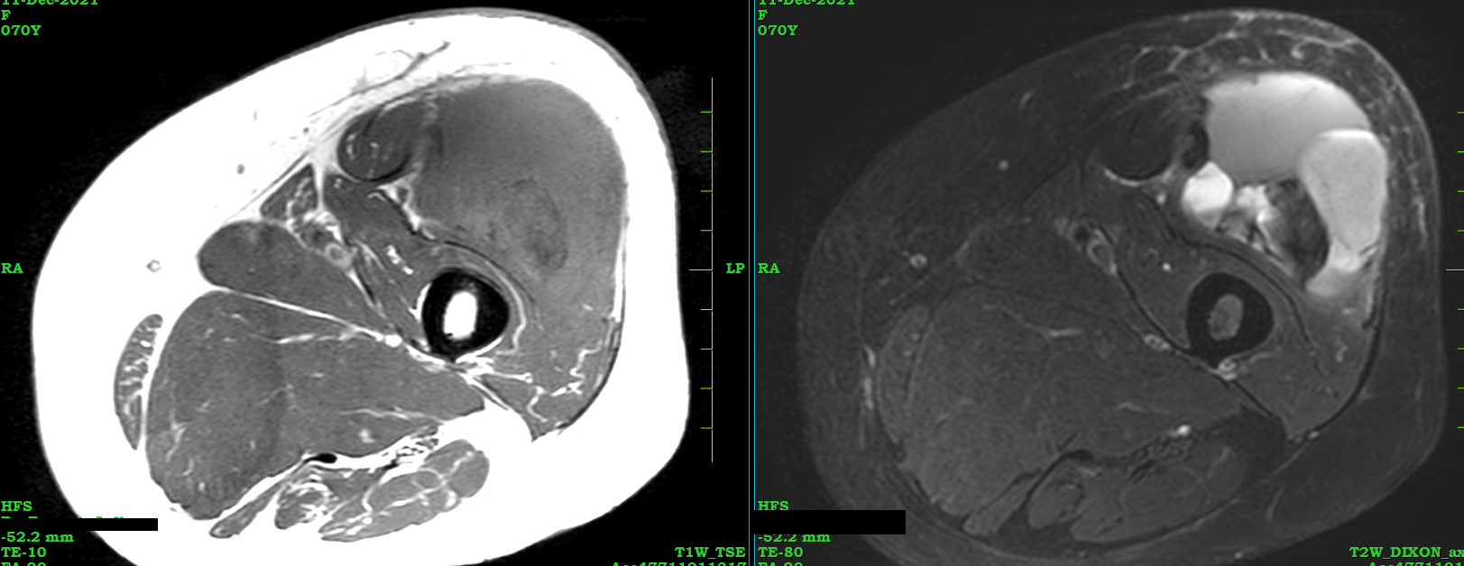

Slide 3
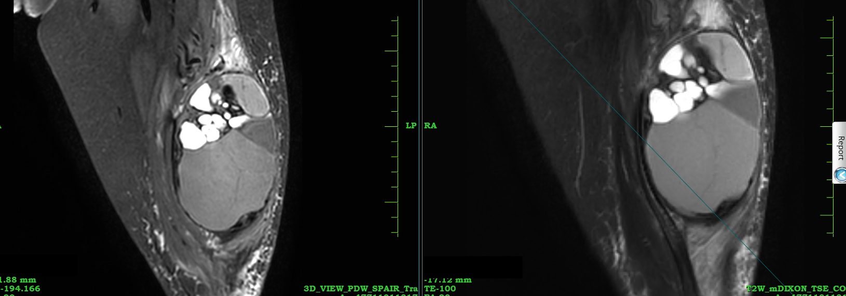

Slide 4
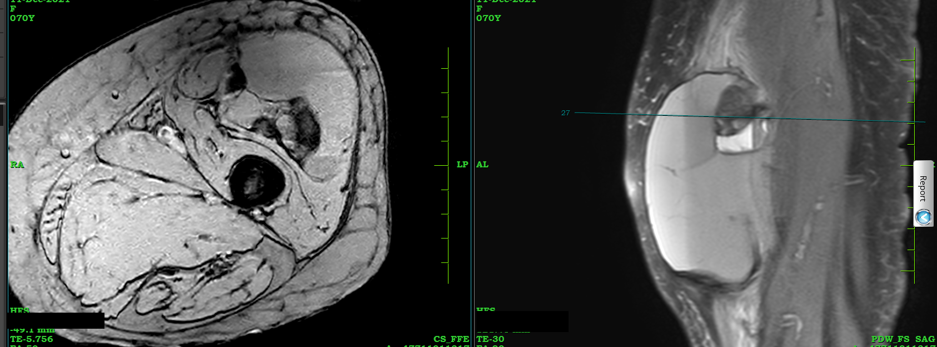

Slide 5
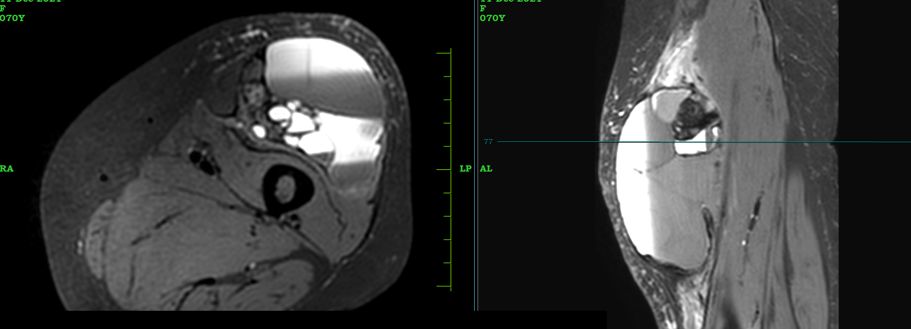

Slide 6
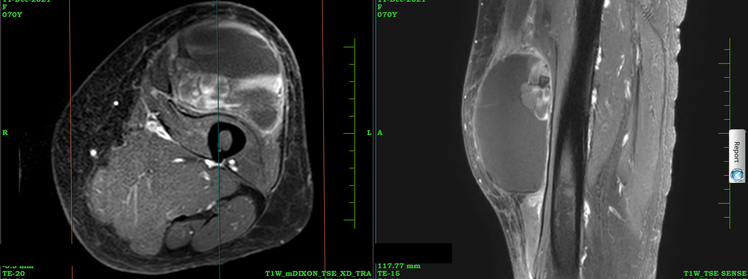
Contrast

Slide 7
Your opinions please

