Slide 1
15 yo boy. Minor trauma 6 months ago (someone jumped at his back). Since then localized pain midline spine. He actually states that the pain right after this trauma was localized lower in the spine, but present pain corresponds exactly to finding in Th1 spinous process. No rheuma history or articular pain, no other known past diseases.
He has been training in a fitness centre for past 2 years.
He came initially for MRI. We ended up doing all 4 modalities :) Findings in spinous process Th1. With MRI looked like fracture sequelae? (clay shoveler), but in X-ray/ CT looks like erosions. Any suggestions ? Enthesitis with erosions? No accentuated Doppler in area. Is this an auntminnie type of case that we are not aware of ?
(could this be some kind of analogue to distal osteolysis of clavicle/ weightlifters’ shoulder, cfr. training in fitness centre..?)

Slide 2
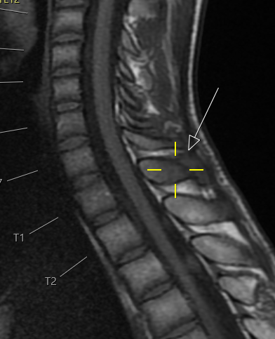
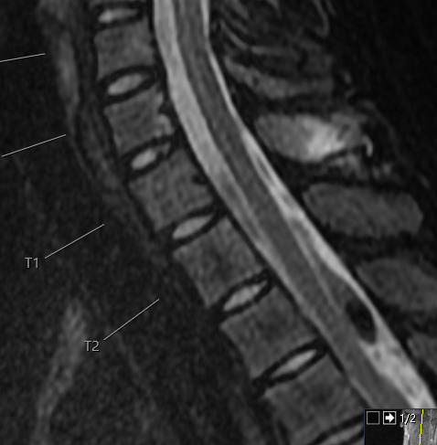
Sag T1
Sag STIR

Slide 3
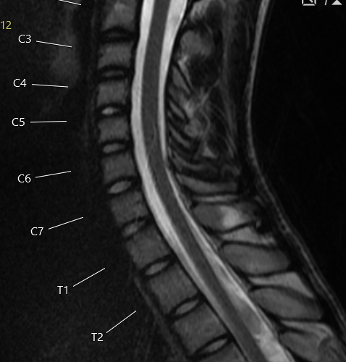
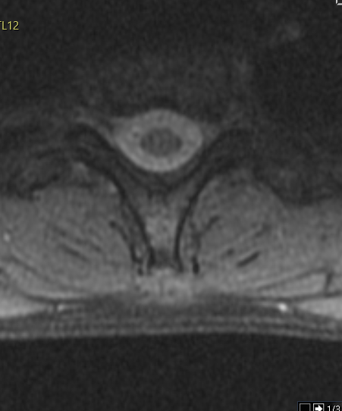
Sag T2
Trv T2

Slide 4
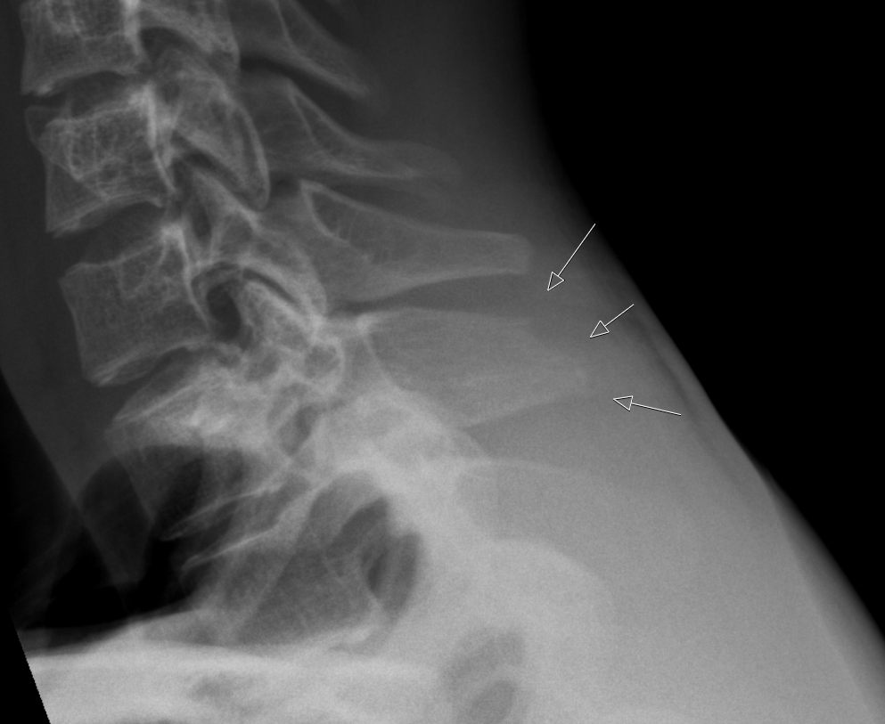

Slide 5
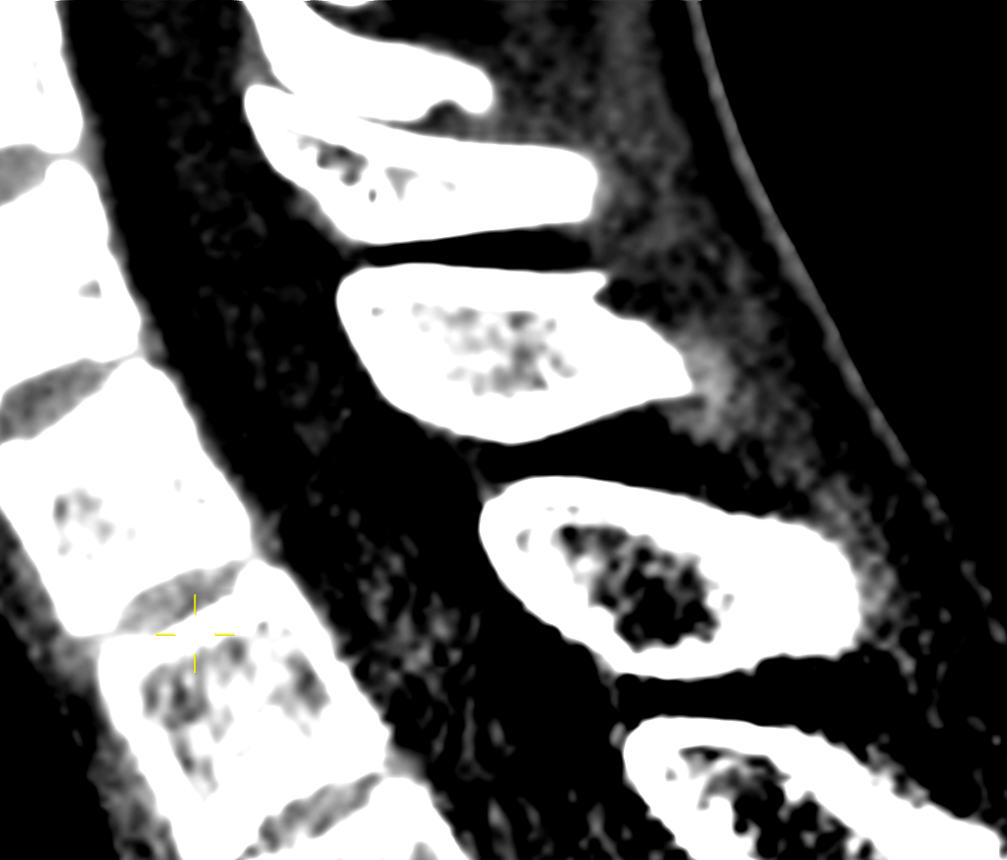

Slide 6
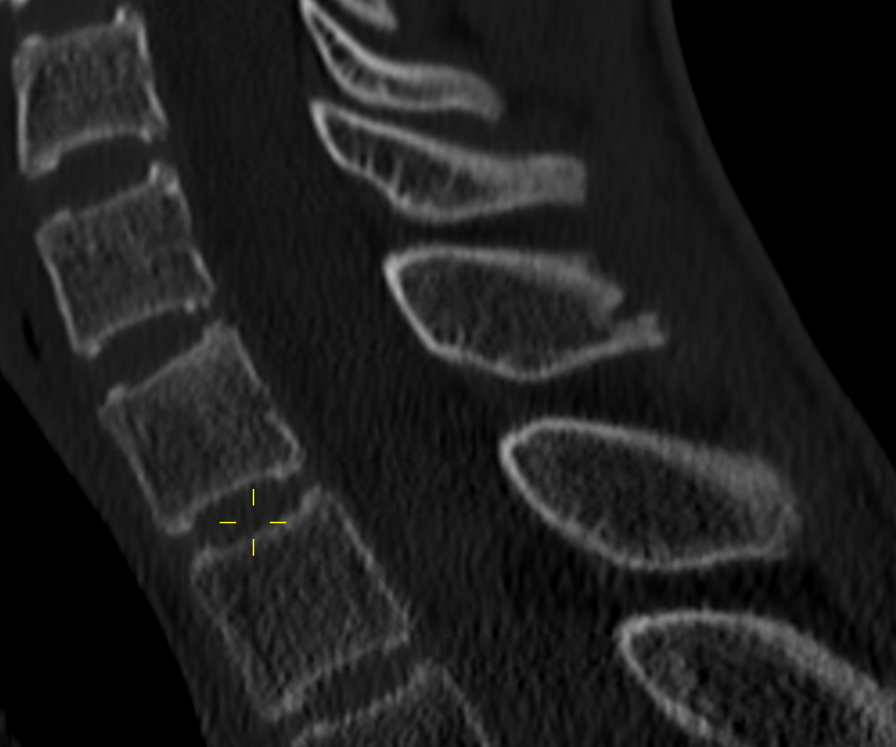
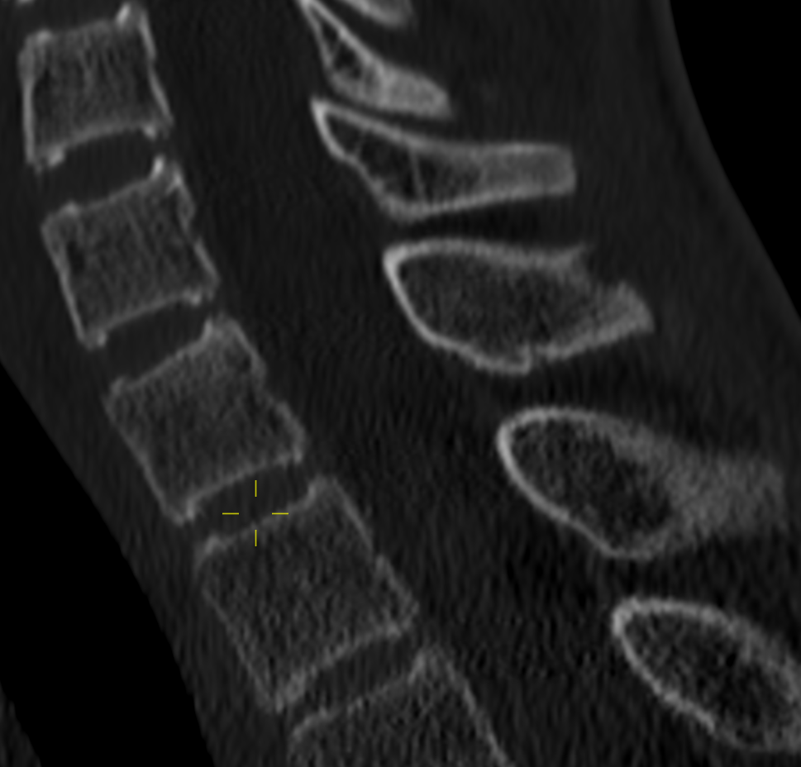

Slide 7
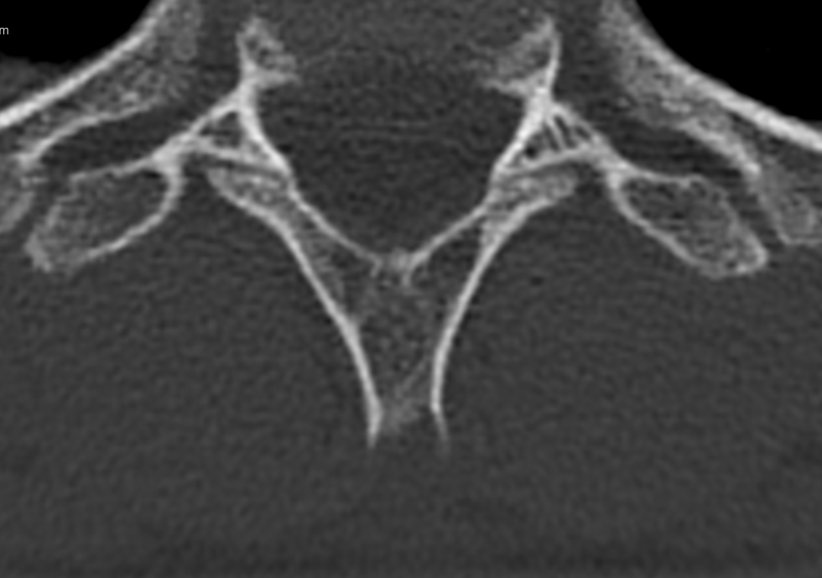
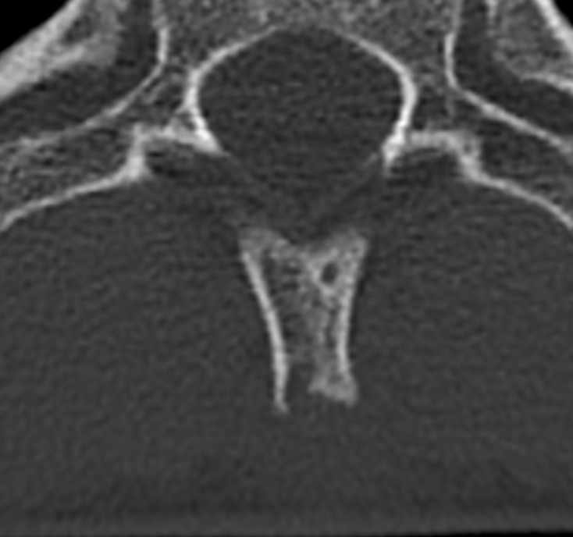

Slide 8
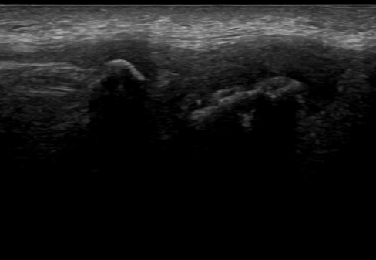
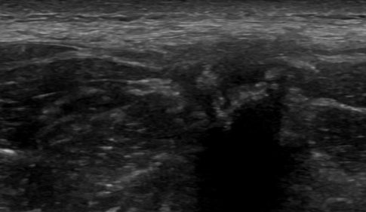
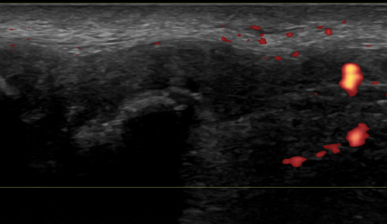
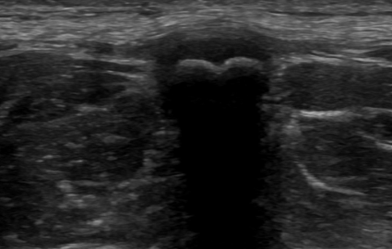
TRV US
Sag US
Normal TRV US C7 spinous
Sag US w/ doppler, no doppler

