Slide 1
?Artefact or myositis/rhabdomyolysis
17yr female for bilateral groin pain
Odd geographic muscle signal on 3T

Slide 2
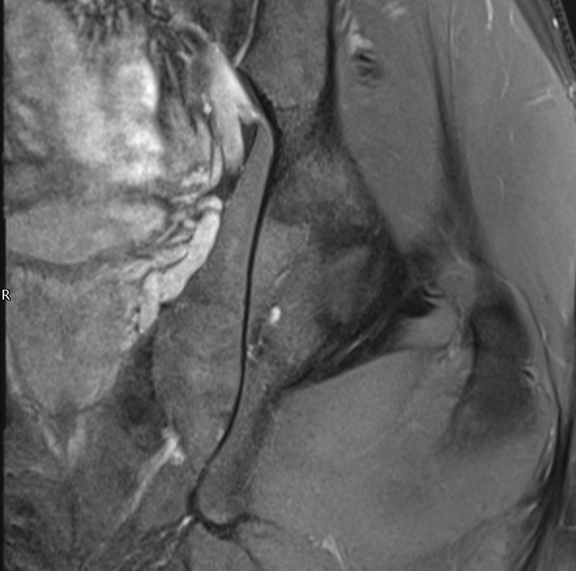
Less obvious PDFS
PDFS DIXON WATER
Obt Int

Slide 3
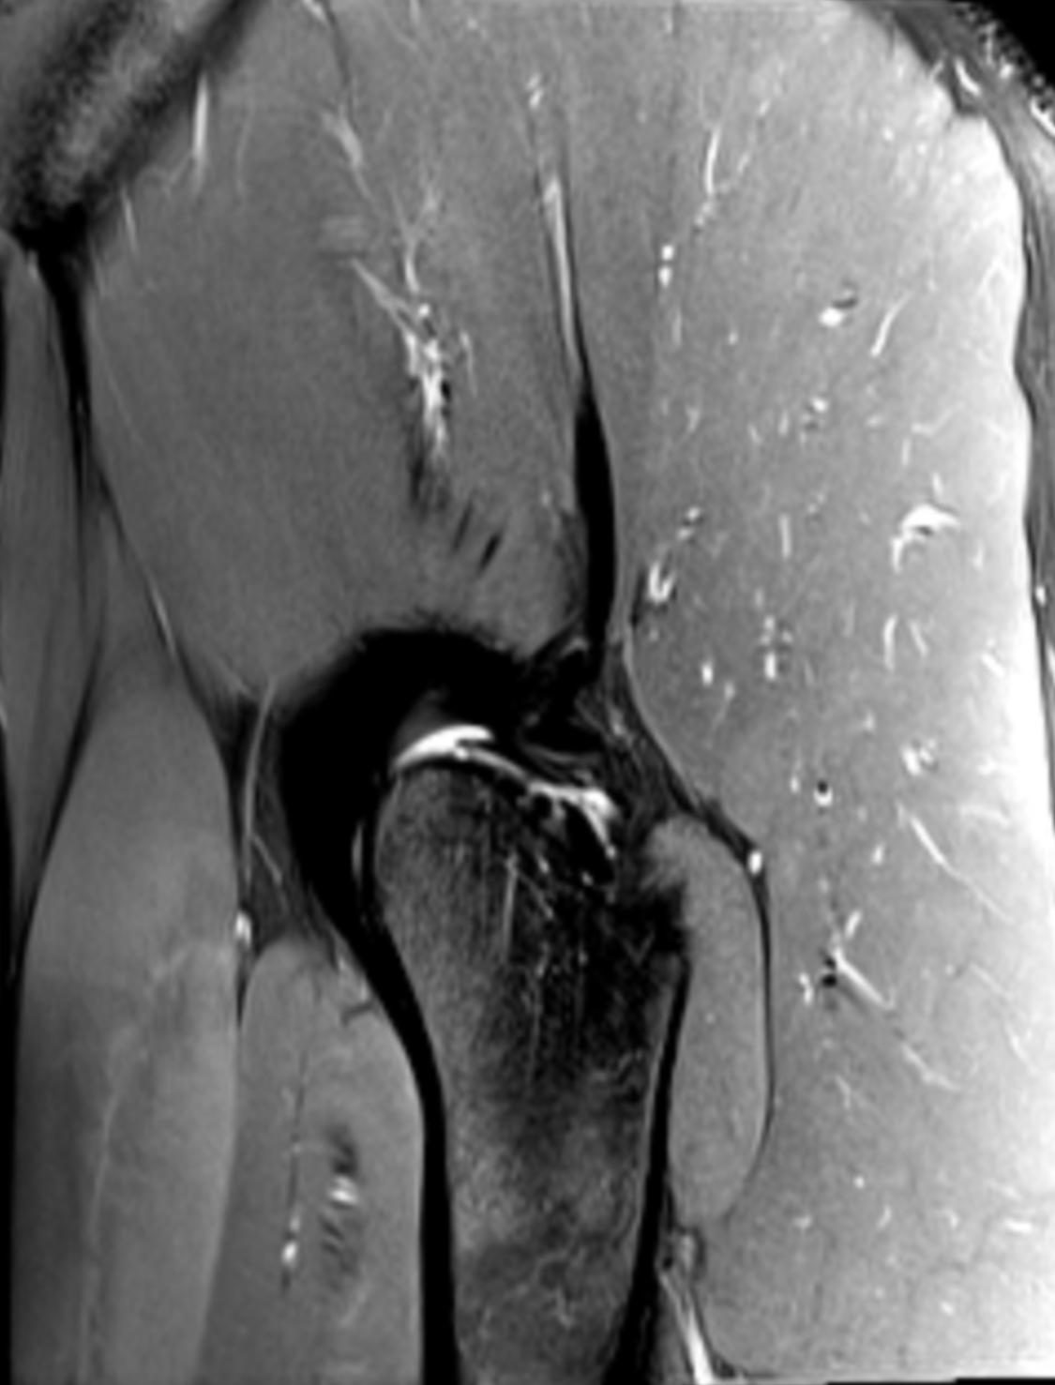
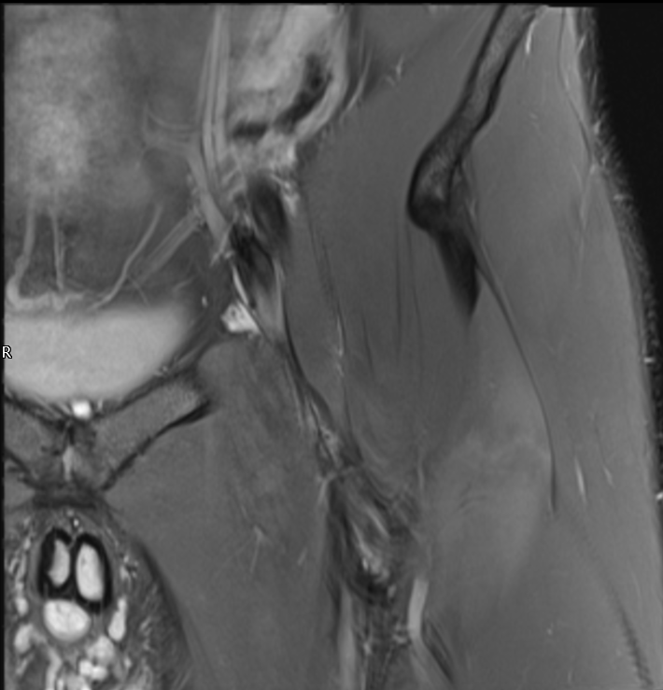
PDFS
Rec fem (PDFS)

