Slide 1
MRI pelvis of 28 year old male with right gluteal swelling, progressive since 6 months.
History of heavy workouts at the gym.

Slide 2
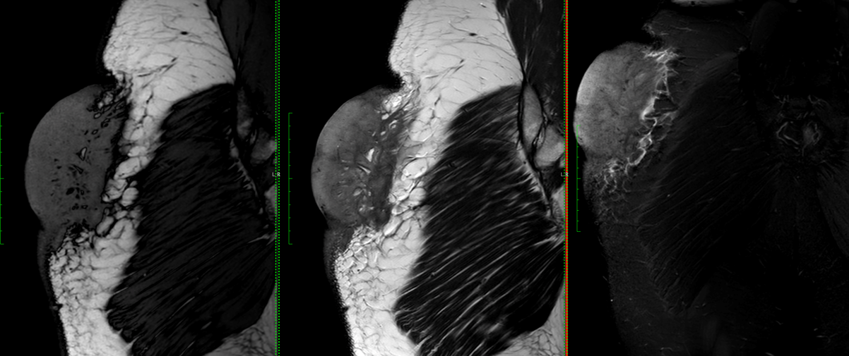
T1
T2
STIR

Slide 3
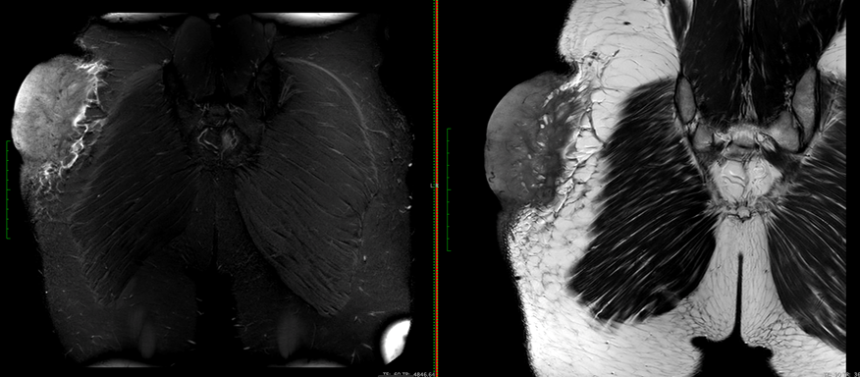
T2
STIR

Slide 4
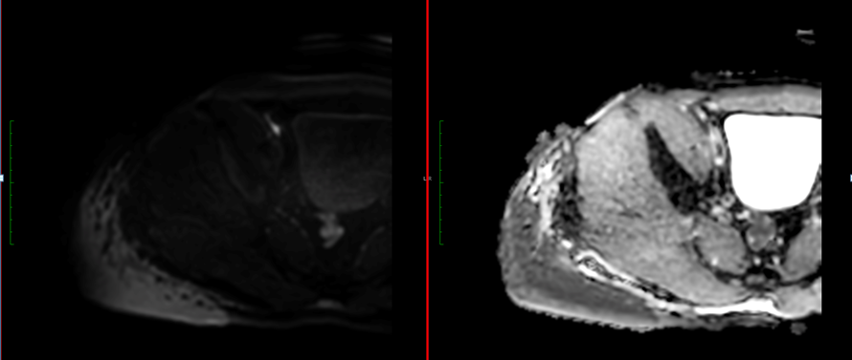
adc
DWI

Slide 5
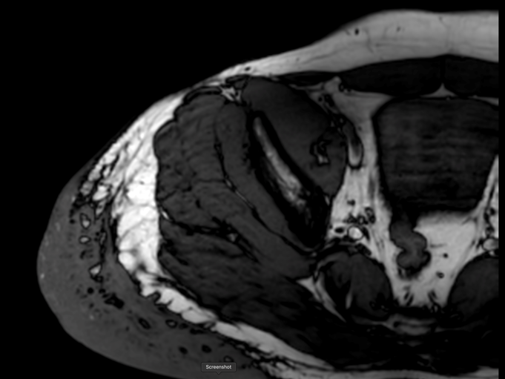
T1

Slide 6
Contrast study(Not included) showed moderate homogeneous enhancement
What is your opinion?

