Slide 1
52 M with hip pain
Daniel Amirhamzeh, MD
Radnet/Envision
MSK Radiologist

Slide 2
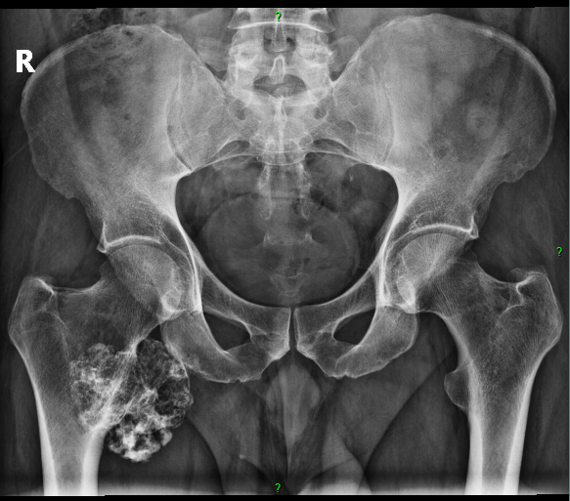

Slide 3
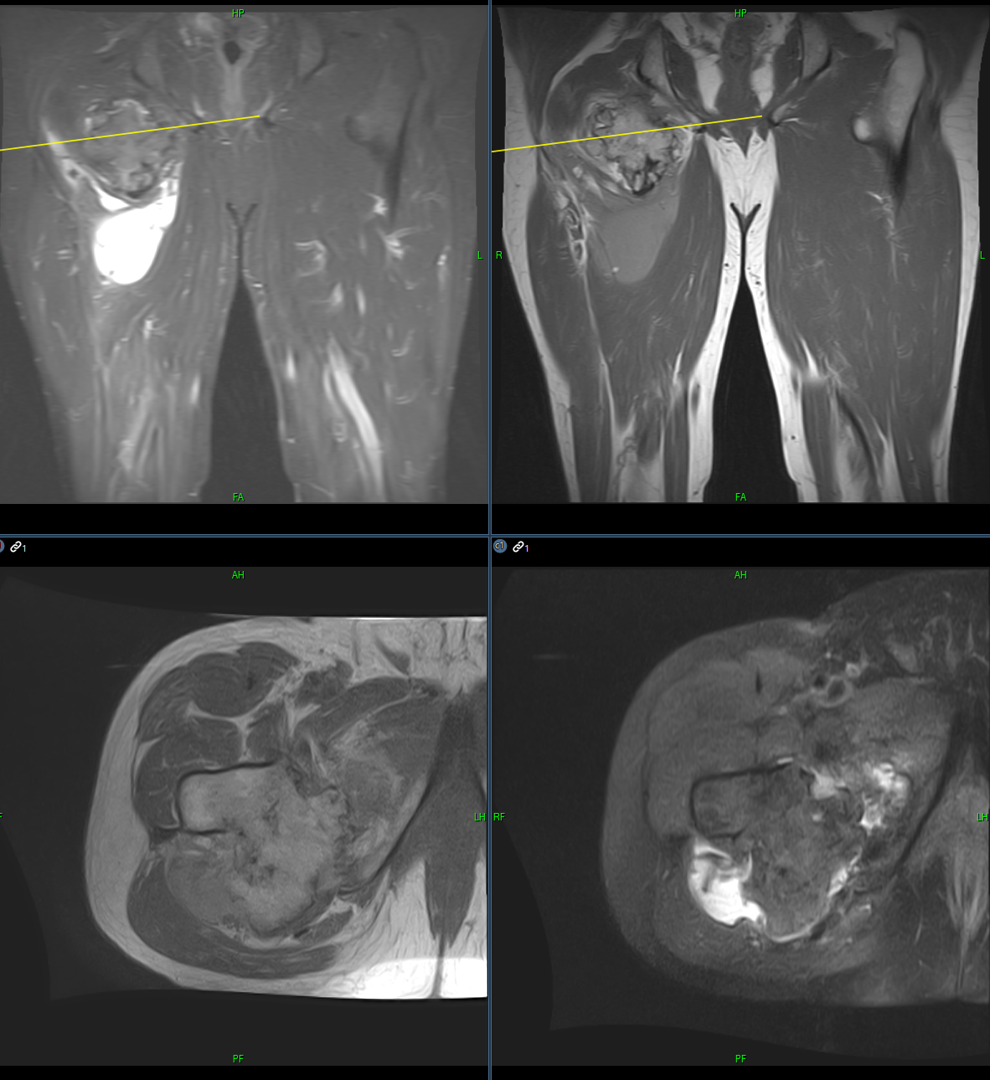

Slide 4
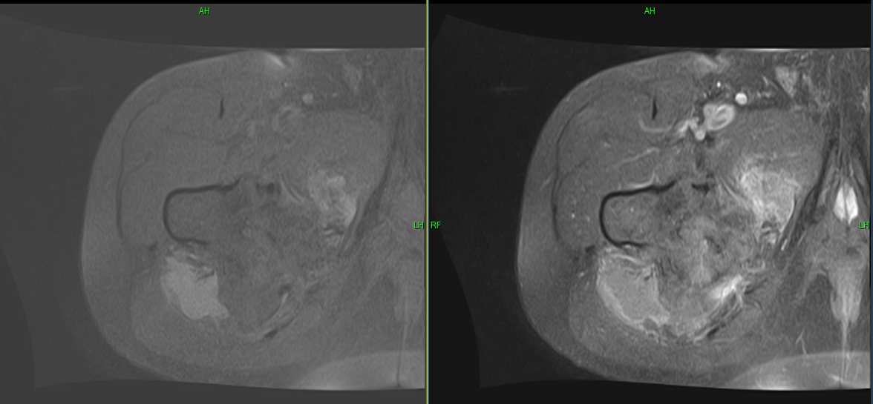

Slide 5
DDx:
Chondrosarcoma
Any other thoughts?

