Slide 1
20 year old diabetic had CT neck for submandibular swelling
Previously undiagnosed sclerosis and enlargement of the skull base, upper cervical spine, mandible, clavicle and scapula

Slide 2
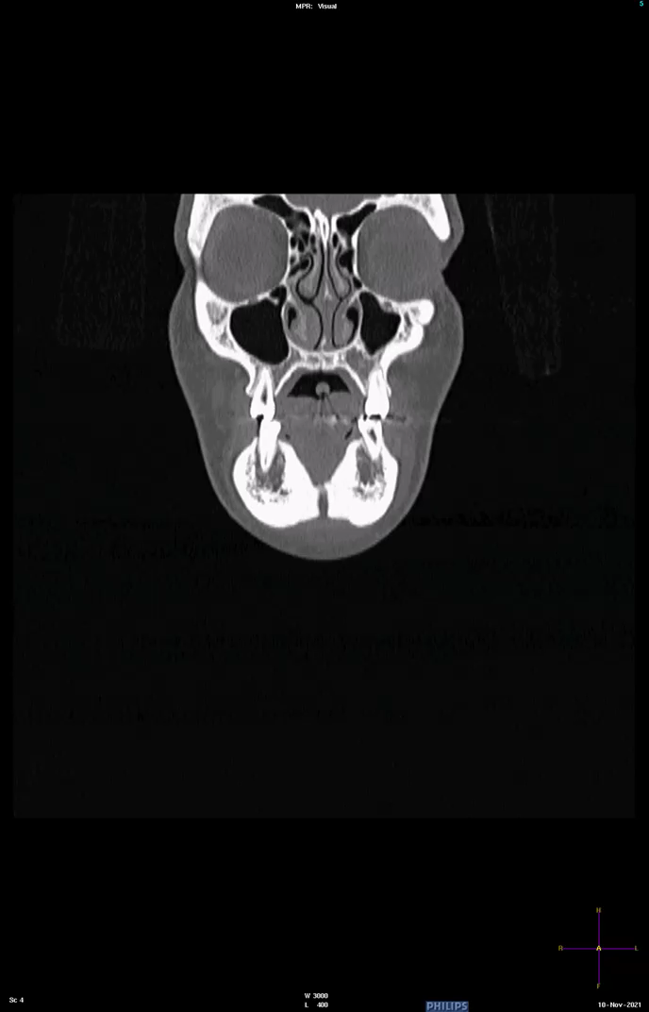

Slide 3
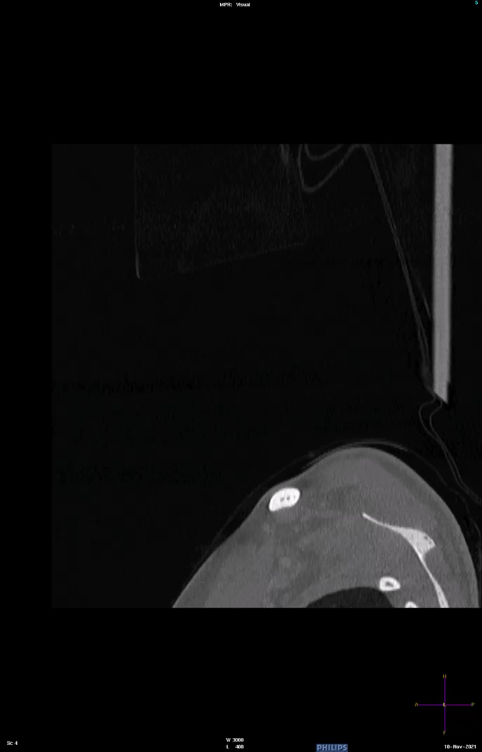

Slide 4
