Slide 1
64 yo F, remote history of cervical cancer, presents for further evaluation of an incidental pelvic lesion
…of course, that’s not the whole story

Slide 2
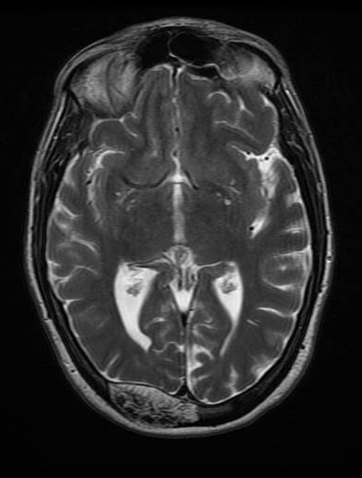
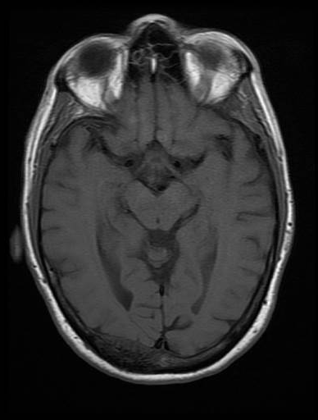
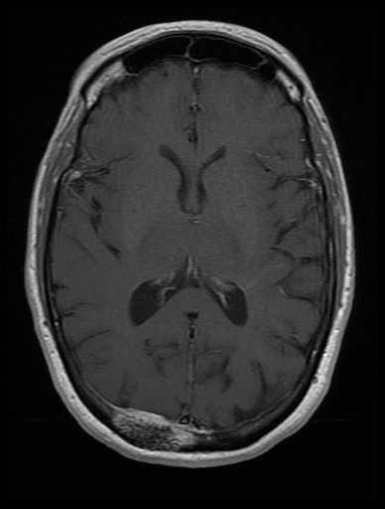
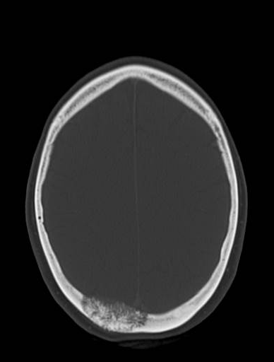
Back in 2015, incidentally found skull lesion on brain MRI
T2, T1 pre, T1 post, and CT

Slide 3
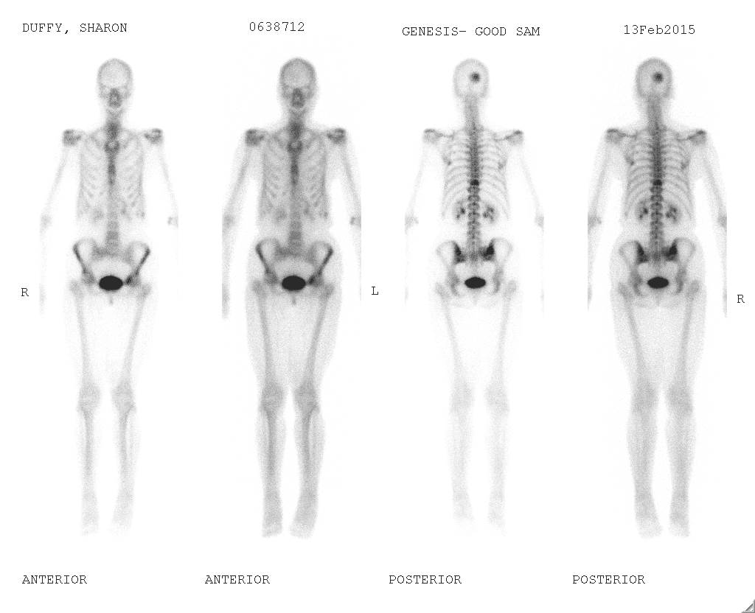
Bone scan done: skull lesion is hot. Also found increased uptake in T8.

Slide 4
CT/MRI of T spine revealed hemangioma
T2, T1, CT

Slide 5
They did PET-CT: no bone lesions were avid, but additional lesions were found in the right pelvis, left acetabulum (not shown) and left femur:

Slide 7
Now in 06/2021, CT abd/pelvis for something unrelated:
New lytic lesion in Left iliac bone, Right iliac and sacral lesions look larger, left acetabular lesion similar to 2015 (not shown), and unchanged peripherally sclerotic lesion Left intertrochanteric femur (not shown)

Slide 8
Current MRI pelvis: T1, T1 post, and STIR

Slide 10
Current MRI pelvis
T1, T1 post

Slide 11
STIR

Slide 12
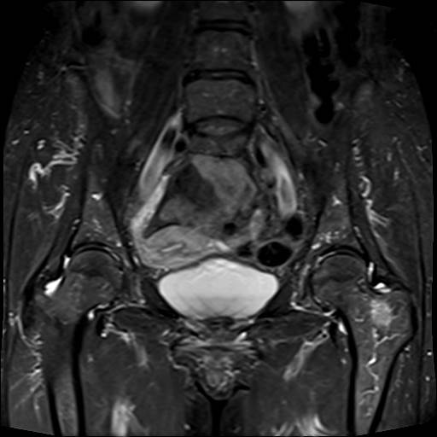
…and surprise, another lesion in the left femoral neck that wasn’t seen on prior CT! T1/T1 post, and coronal STIR

Slide 13
To summarize:
Probable hemangiomas in the calvarium and T8 from 2015. No follow up imaging available.
Heterogeneous, enhancing lesions with coarsened trabeculae in the right ilium and sacrum, increased in size from 2015.
Heterogeneous, enhancing lesion with coarsened trabeculae in the left acetabulum, unchanged in size, similar in appearance to right pelvic lesions.
New lytic lesion with enhancement in the left iliac bone.
New enhancing lesion in the left femoral neck, not seen on CT.
Unchanged peripherally sclerotic lesion left intertrochanteric femur.

Slide 14
Are these all just hemangiomas???
Does the left iliac bone lesion or left femoral neck lesion look suspicious to you that it could be something else? Mets/myeloma?
I will recommend follow-up, but should any of these be biopsied (And if so, which one/s)?

Slide 15
Thank you!

