Slide 1
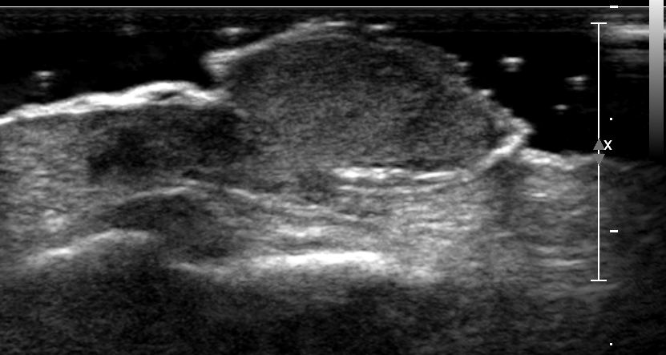
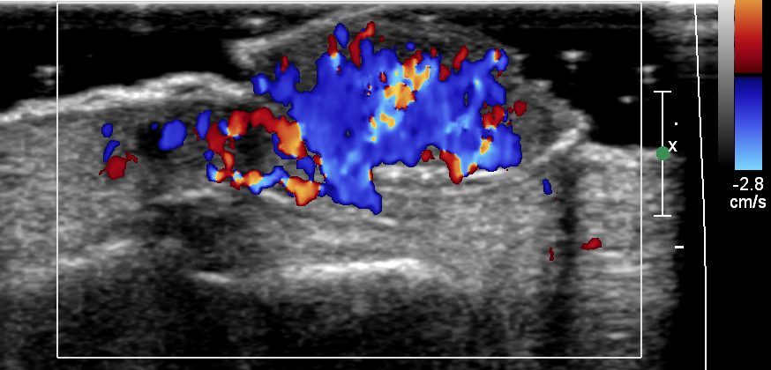
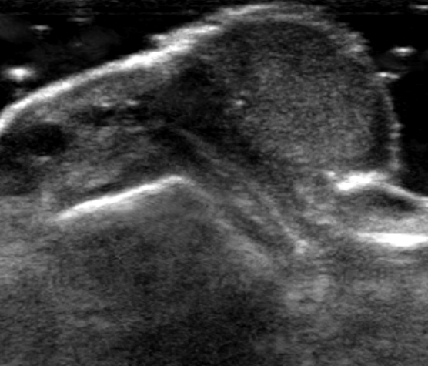
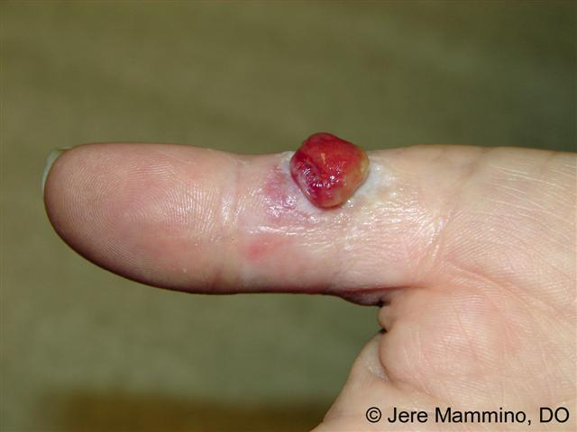
Pyogenic Granuloma
27/M Growing mass on 2nd finger
Courtesy of
Tae Eun Kim
nirvana1979@daum.net
Courtesy of

Slide 2
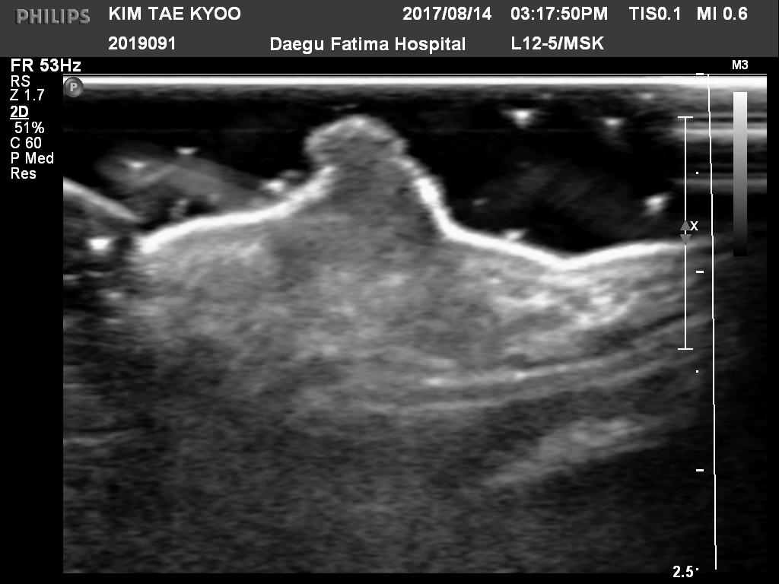
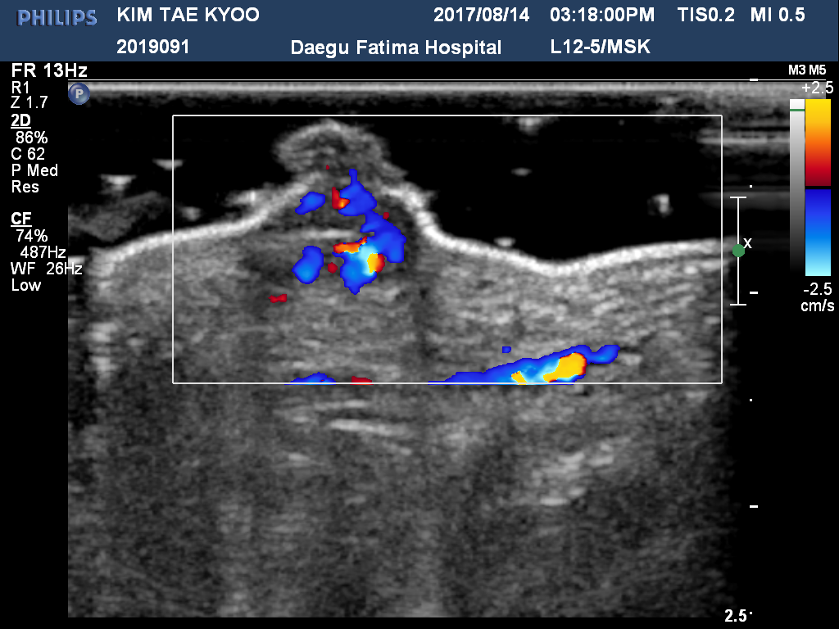
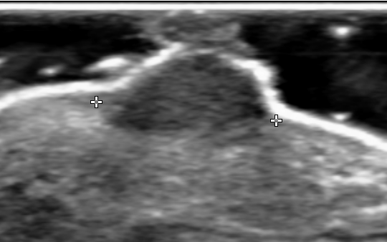
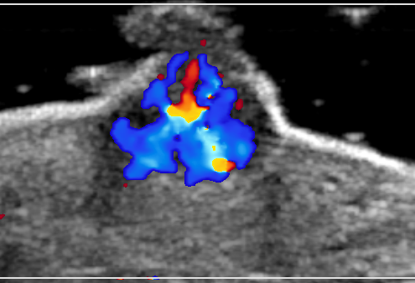
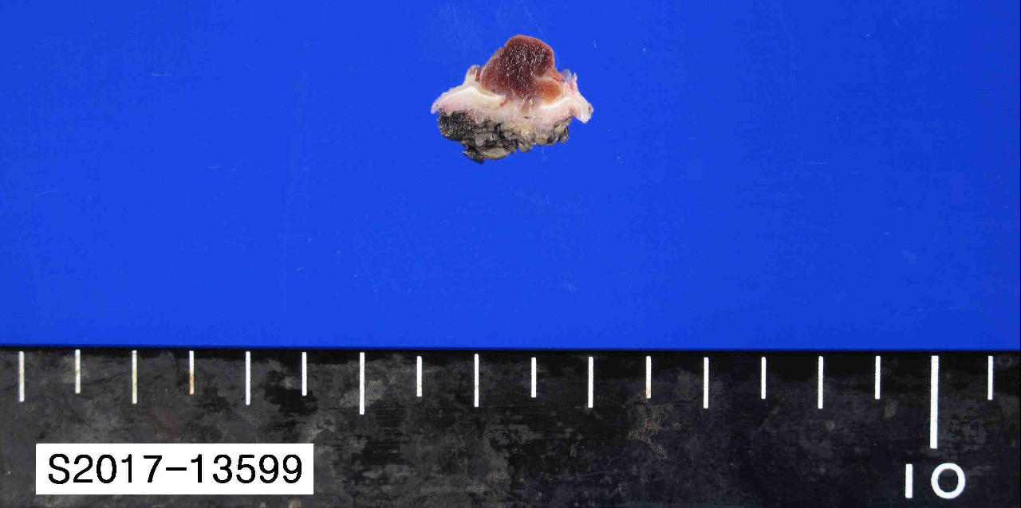
Pyogenic Granuloma
34/F Soft tissue mass, palm

Slide 3
Pyogenic Granuloma
A pyogenic granuloma is not a true granuloma, nor is it pyogenic
Reactive vascular lesion
Not usually evaluated radiologically
Granulation tissue-type hemangioma, lobular capillary hamangioma
  Polypoid form of capillary hemangioma in the skin and mucous membrane (60%)
  Trauma related (30%)
  Gingiva, finger, lips, face and tongue
  Related to pregnancy (granuloma gravidarum)
Limited descriptions of the imaging findings
  US : homogeneous hypoechoic ill-defined oval subQ mass with prominent vascularity
Imaging of soft tissue tumors, 3rd ed.

Slide 4
