Slide 1
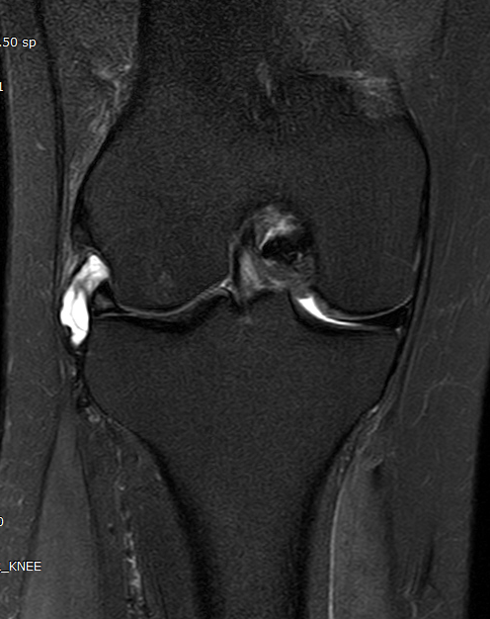
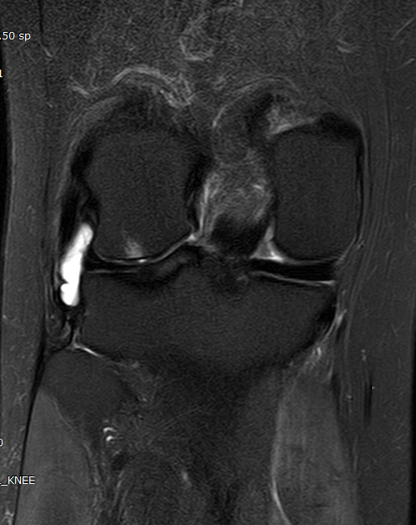
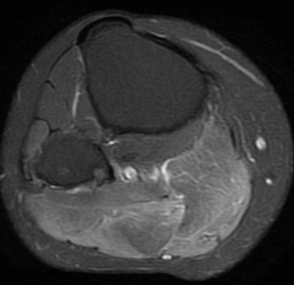
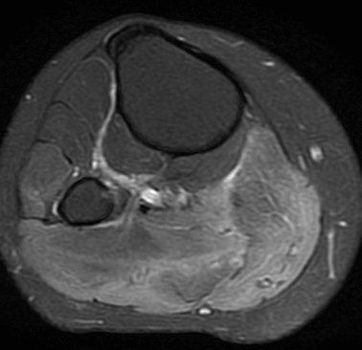
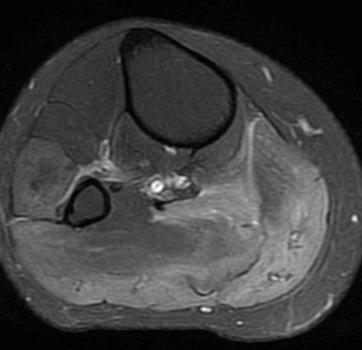
43/F Right Knee and calf pain, sprain a week before
T2FS
R/O Meniscal cyst
R/O Myositis, inflammatory.
: cause???
Courtesy of
SungMoon Lee
laurence2@naver.com
Rt.

Slide 2
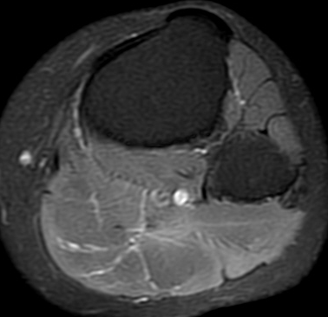
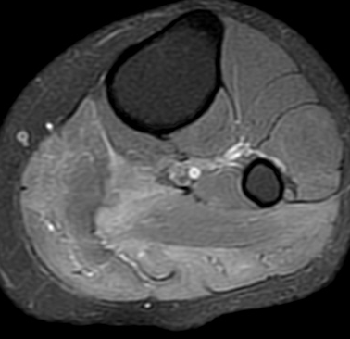
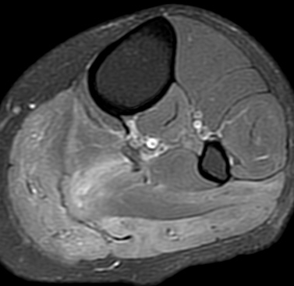
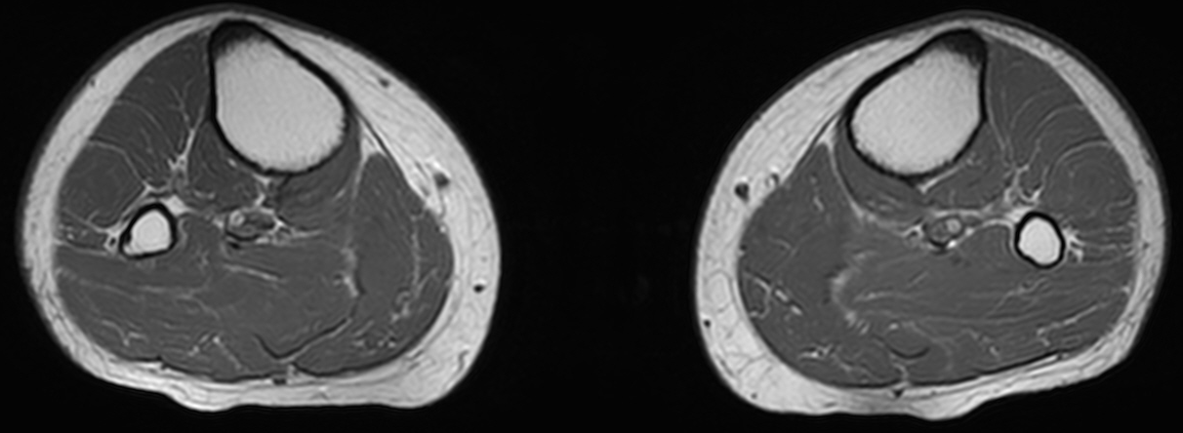
Lt.
T1.
History of botox injection,
both calf
(within 1 month)

Slide 3
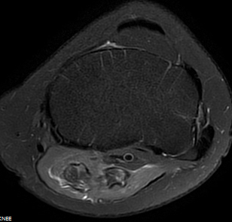
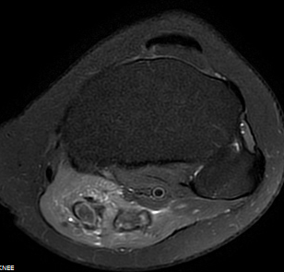
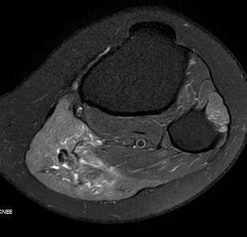
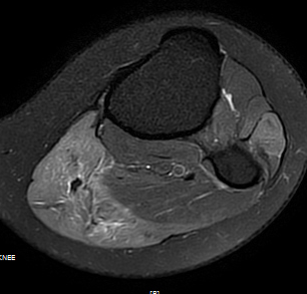
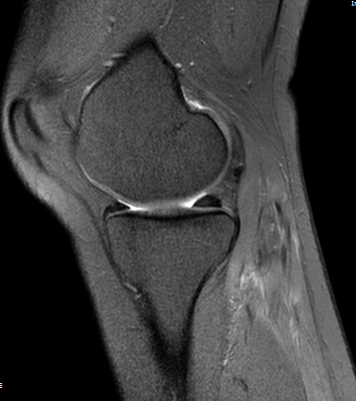
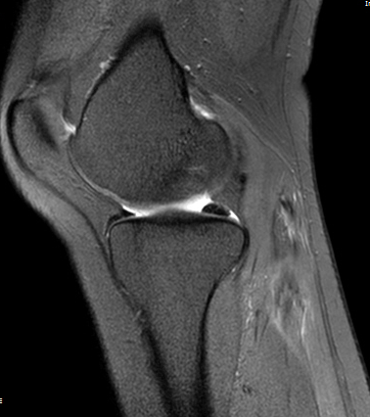
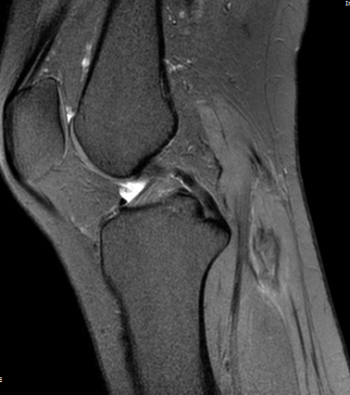
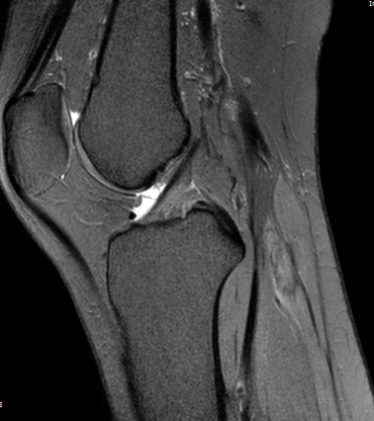
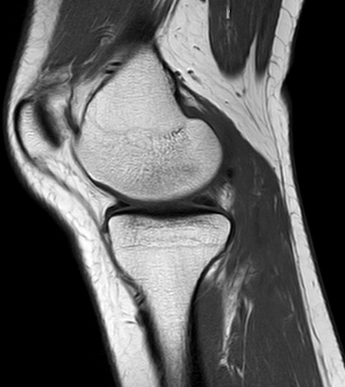
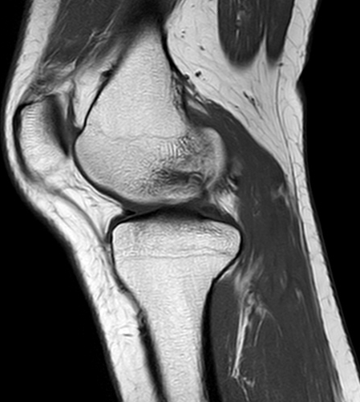
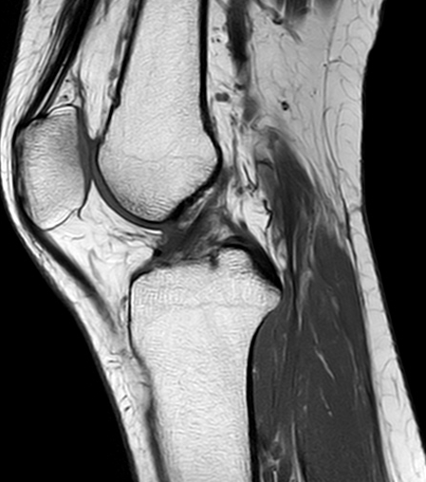
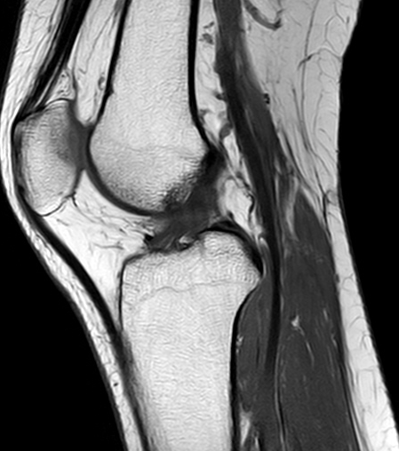
30/F Left Knee pain and feeling of instability for several years.
T2FS
T1

Slide 4
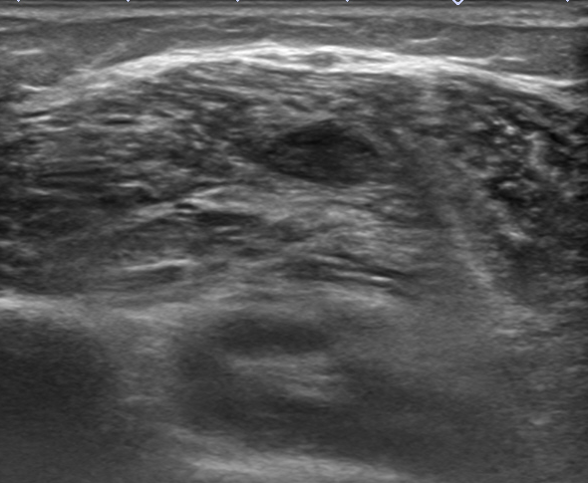
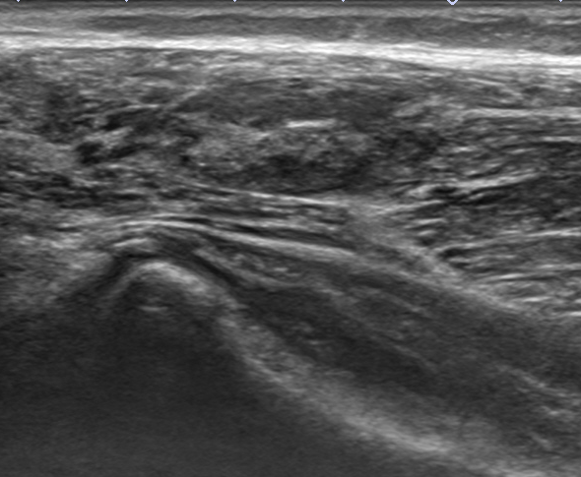
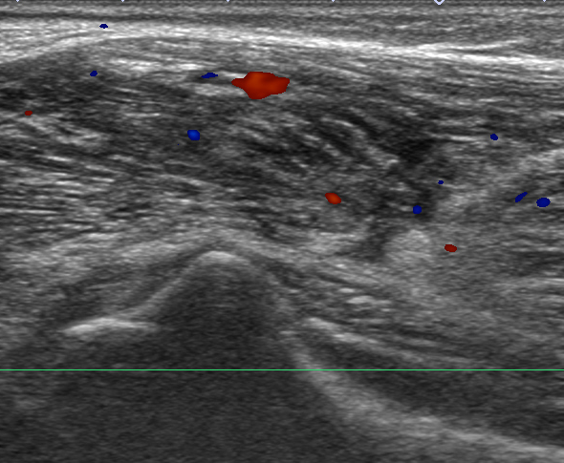
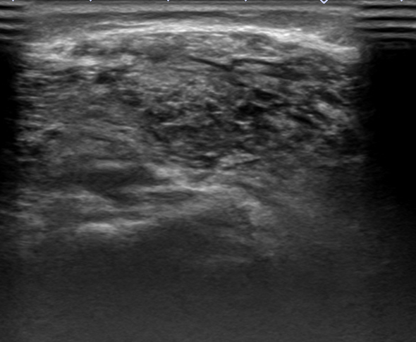
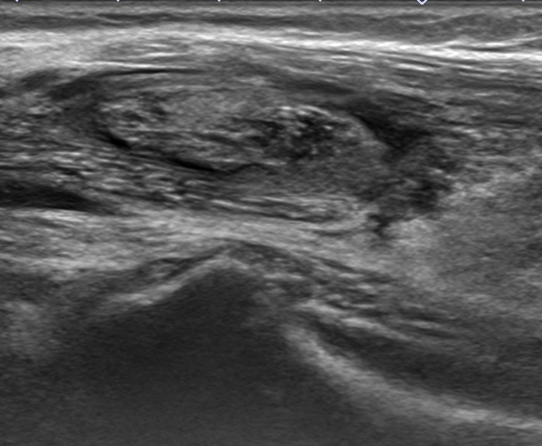
Lt. GL
Lt. GM
History of nerve block and botox injection 2 months ago,
both calf

Slide 5
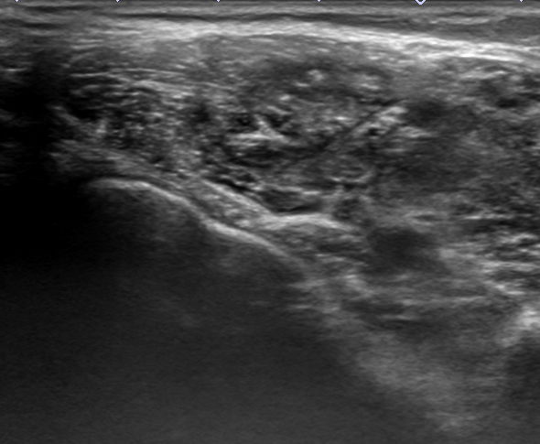
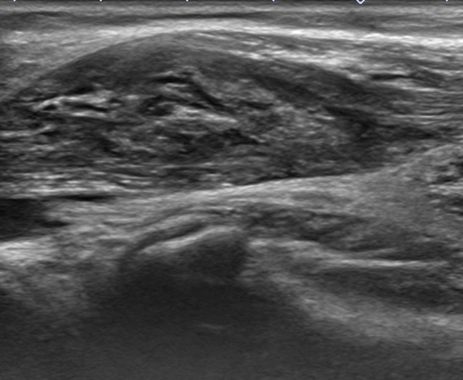
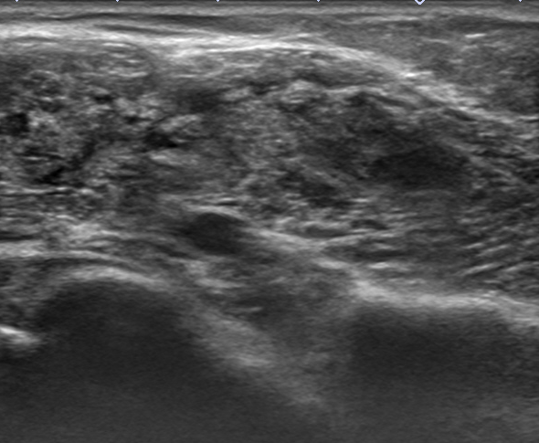
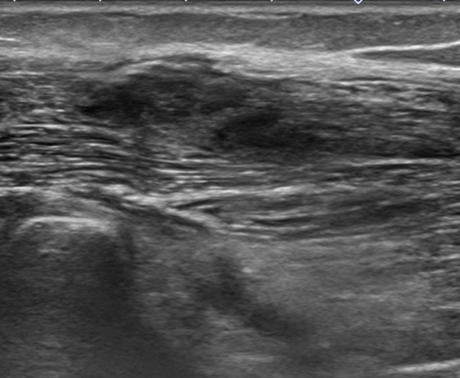
Rt. GL
Rt. GM
Focal muscle
denervation with
fibrosis?
Botox-induced
myositis?

Slide 6
Botox and Myositis
Botox and Myositis - from FDA reports
On May, 11, 2017
26,593 people reported to have side effects when taking Botox.
Among them, 23 people (0.09%) have Myositis.
1 month < 100%, Female 96.65%
20-29: 7.69 %
30-39: 0.0 %
40-49: 69.23 %
50-59: 15.38 %
60+: 7.69 %
Top other side effects for these people
Muscle Aches (16 people, 69.57%)
Weakness (14 people, 60.87%)
Myasthenia Gravis (14 people, 60.87%)
Diplopia (14 people, 60.87%)
Breathing Difficulty (13 people, 56.52%)

Slide 7
