Slide 1
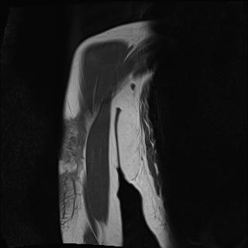
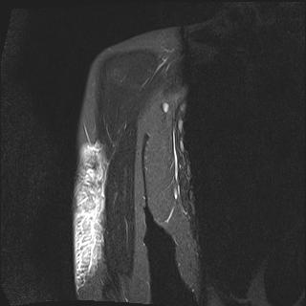
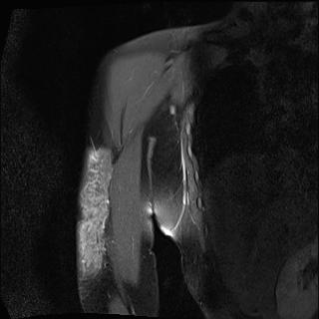
Localized Morphea
44F
CC; Right upper arm mass for 1 year
PE; Subcutaneous nodules and plaque on both lateral arms
Imp.; Localized morphea (scleroderma) or sarcoidosis
Lab.; Hb(L), Hct(L)
Ex.Bx; Chronic panniculitis / fat necrosis
Dx.; Localized morphea
Tx.; mtx trial 7.5 mg/w
Courtesy of TaeYong Moon
tymn@pusan.ac.kr

Slide 2
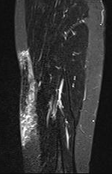
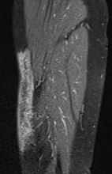
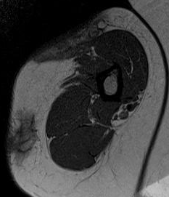
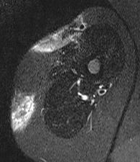
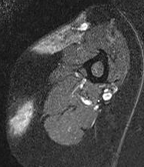
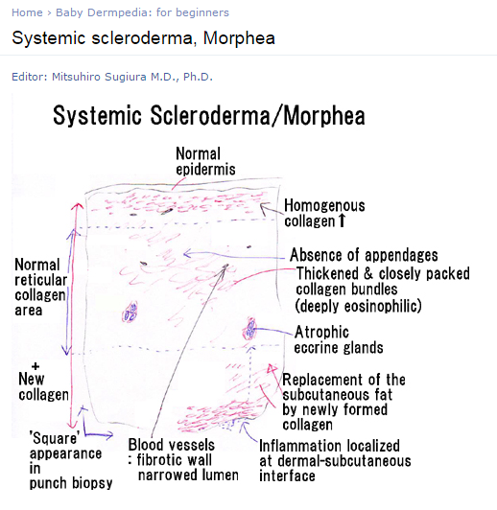
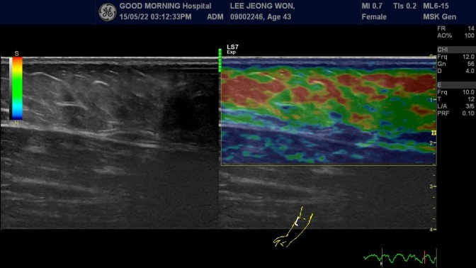
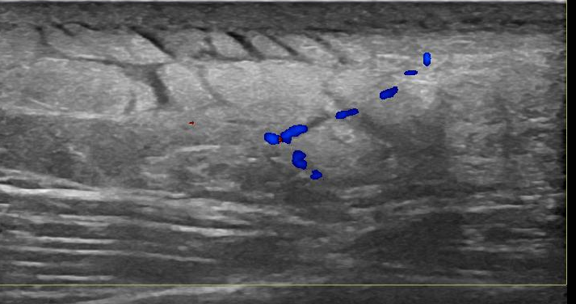
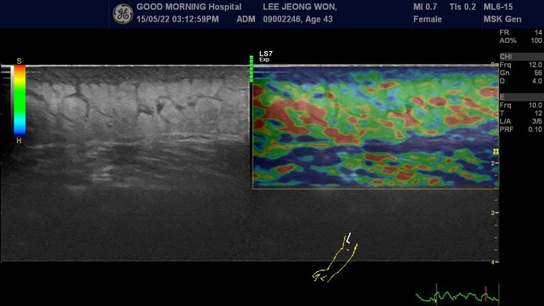

Slide 3
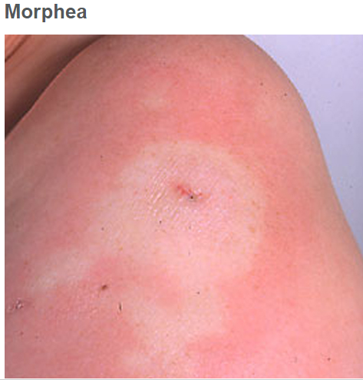
Morphea
Morphea (mor-FEE-uh) is a rare skin condition that causes
painless, discolored patches on your skin.
Typically, the skin changes appear on the abdomen, chest or back. But they might also appear on your face, arms or legs.
Morphea tends to affect only the outermost layers of your
skin. But some forms of the condition also restrict
movement in the joints.
Morphea usually subsides on its own over time,
though recurrences are common.
In the meantime, medications and therapies are available to help treat the skin discoloration and other effects.

Slide 4
