Slide 1
72yo,F, lower limb paresis

Slide 2
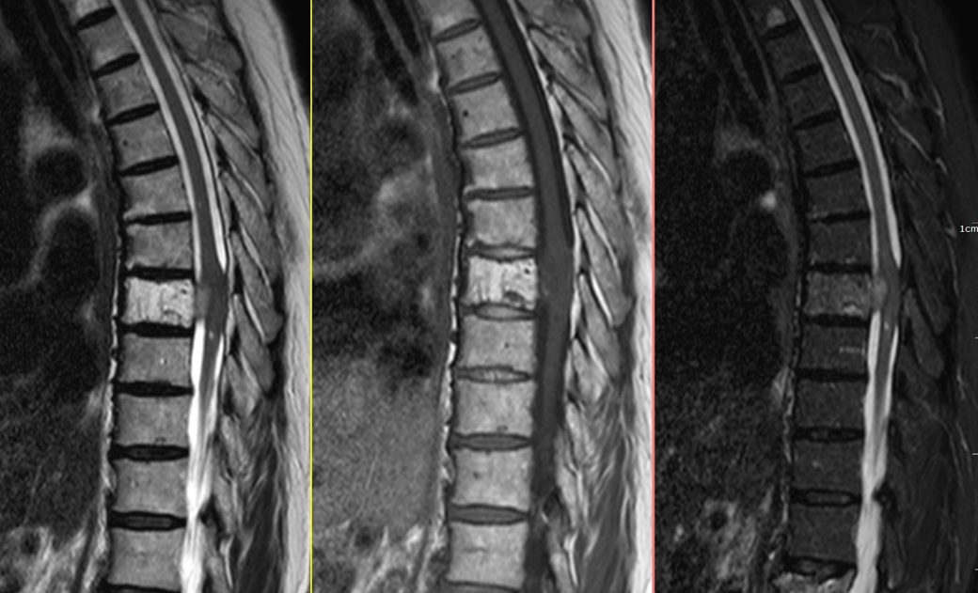

Slide 3
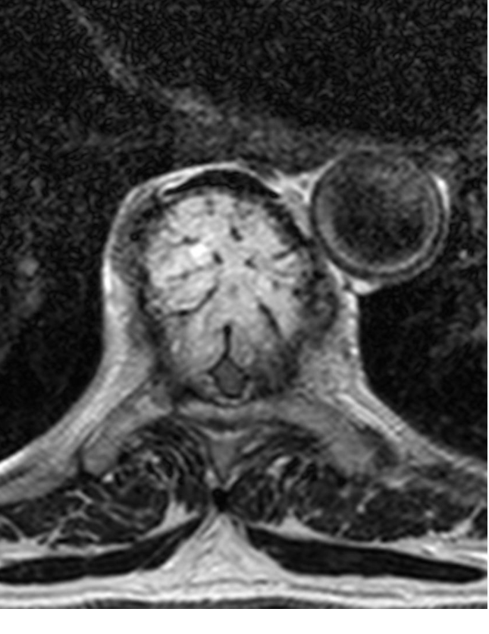

Slide 4
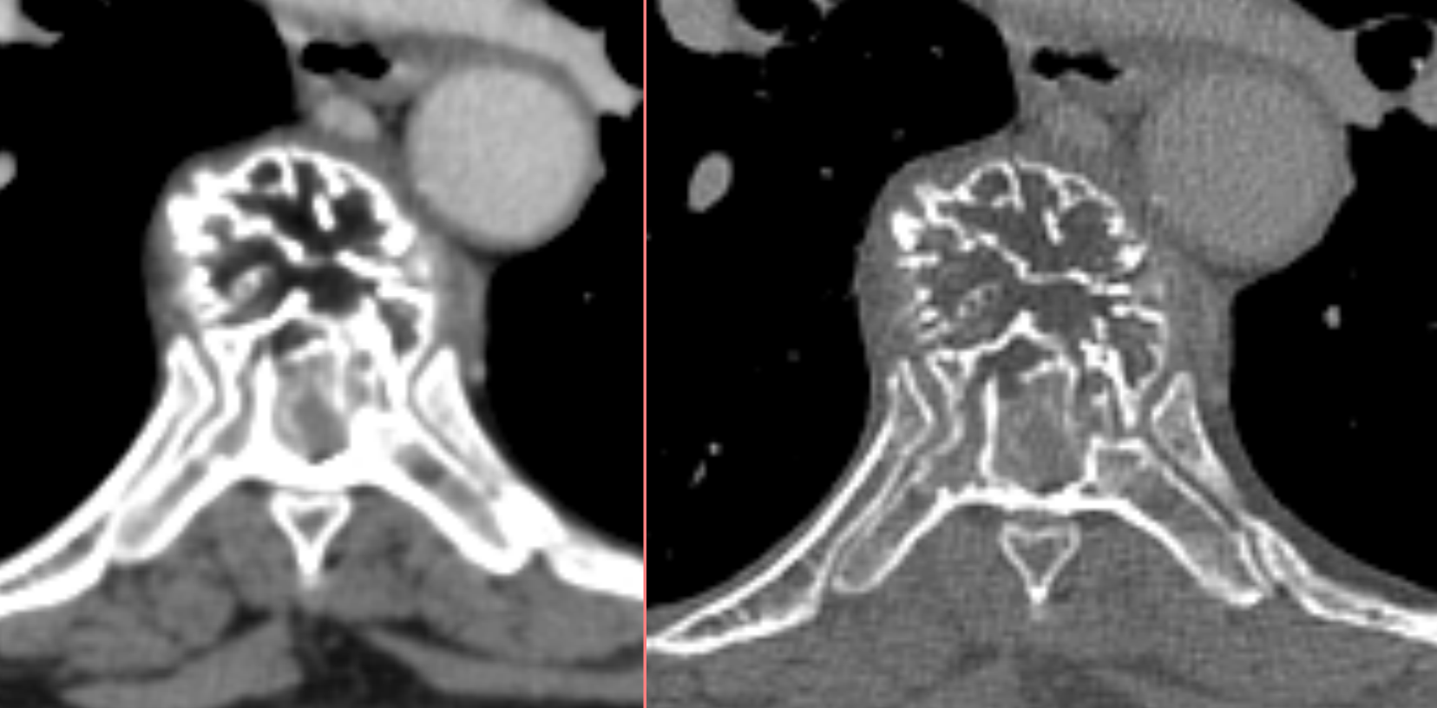

Slide 5
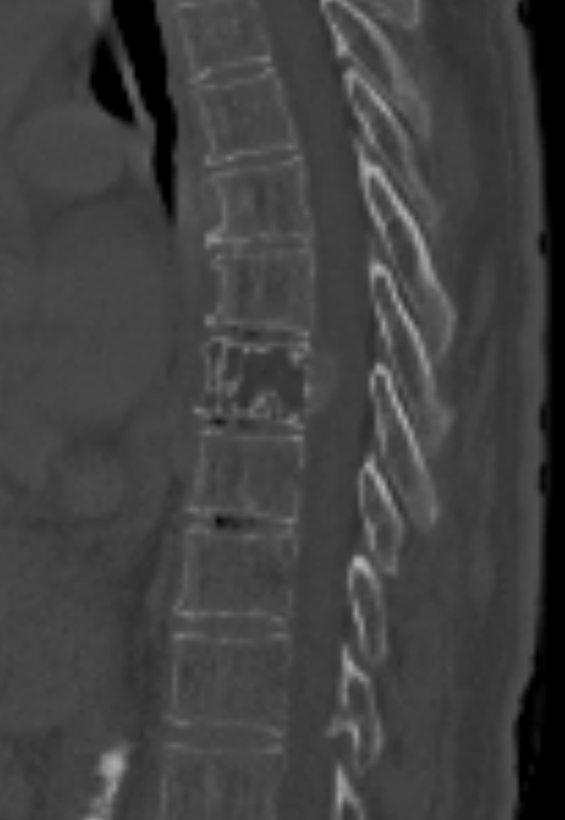

Slide 6
Aggressive vertebral hemangioma

