Slide 1
63 M with palpable mass at the dorsum of right foot with pain and swelling
Daniel Amirhamzeh, MD
Radnet/Envision
MSK Radiologist

Slide 2
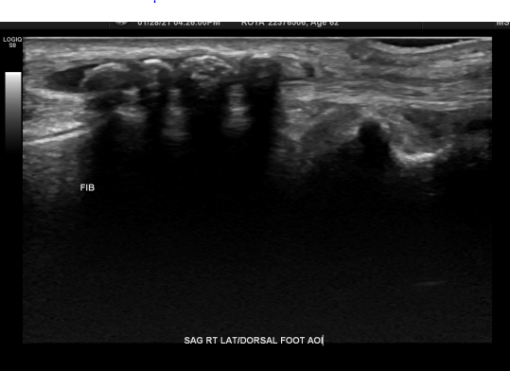
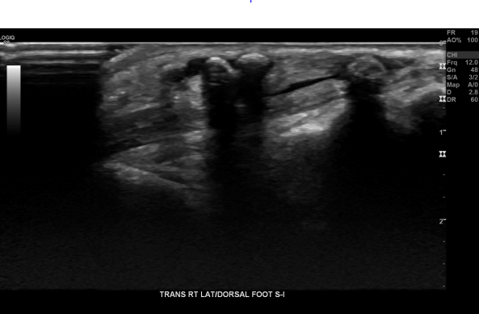
Several small subcutaneous calcifications with posterior acoustic attenuation/shadowing in the dorsum of the right foot

Slide 3
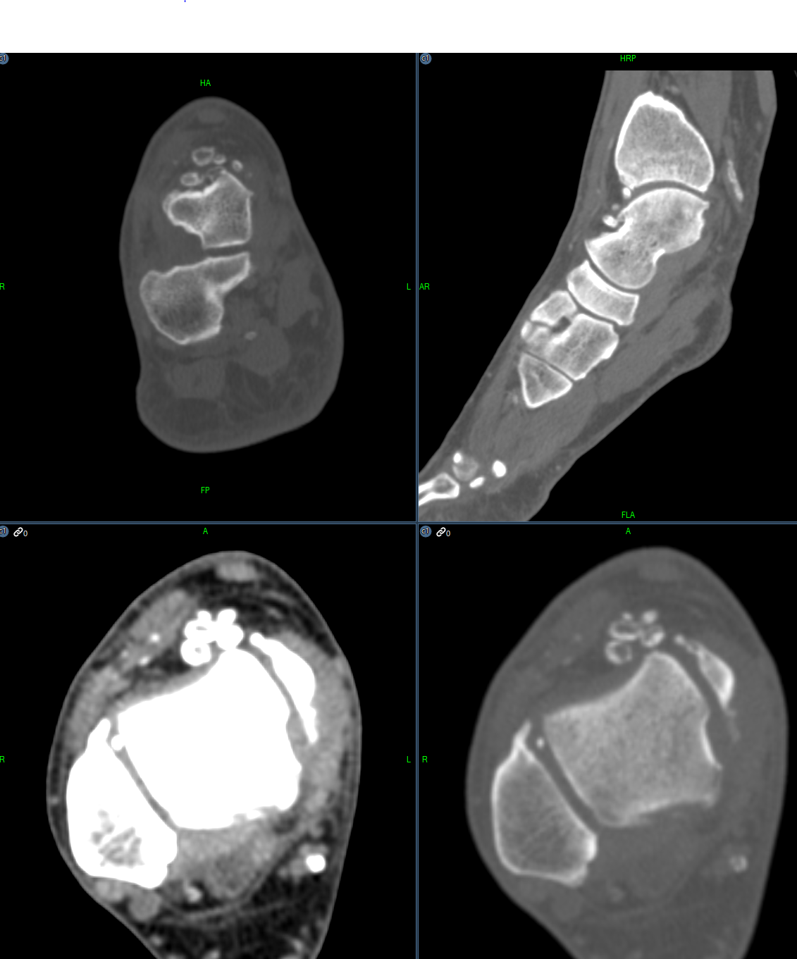

Slide 4
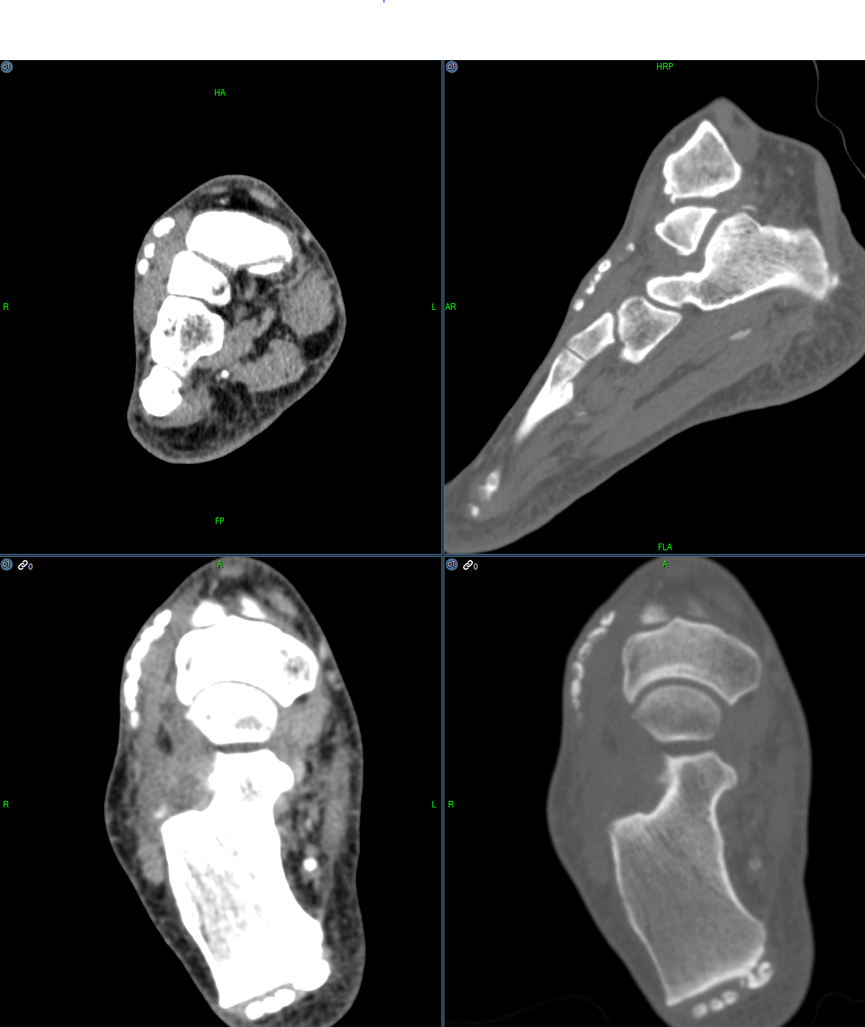

Slide 5
Diagnosis
Synovial chondromatosis of tibiotalar joint
Tenosynovial (extra-articular) chondromatosis of extensor digitorum brevis tendon sheath

