Slide 1
59 F with scapular pain
Daniel Amirhamzeh, MD
Radnet/Envision
MSK Radiologist

Slide 2
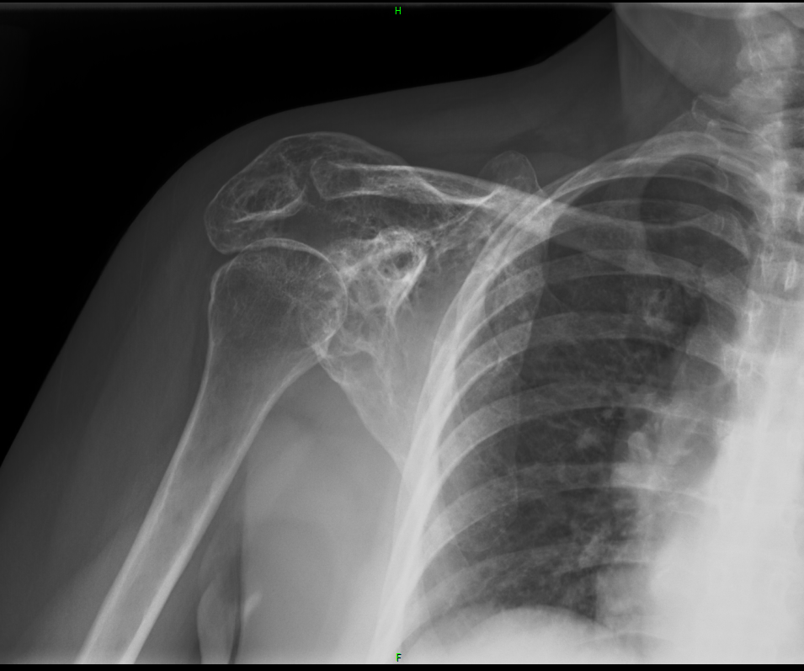
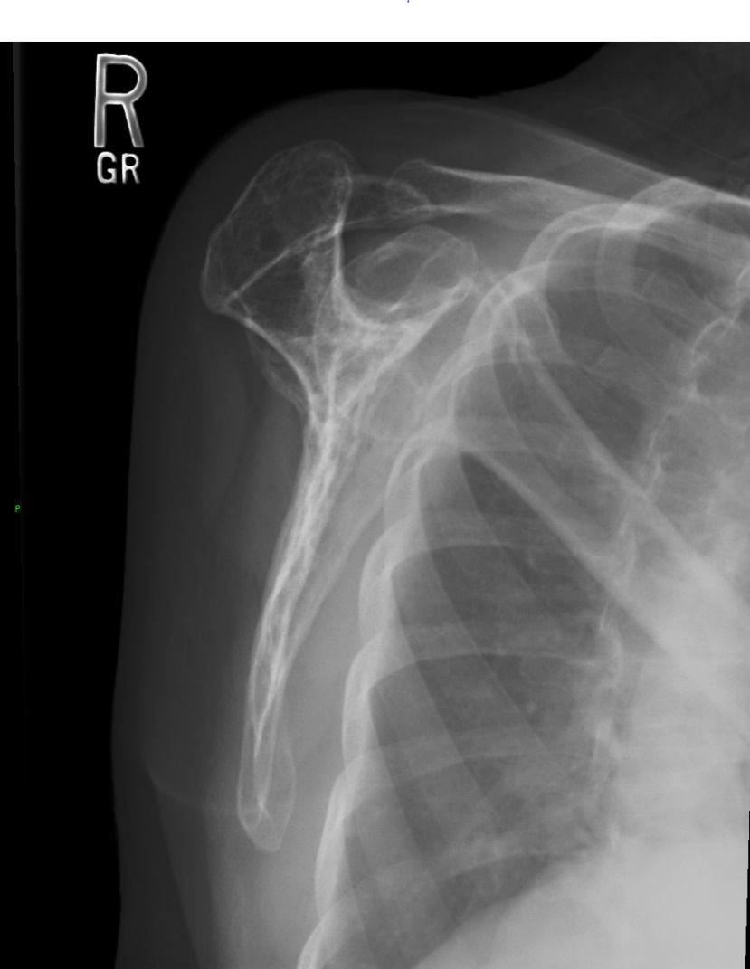

Slide 3
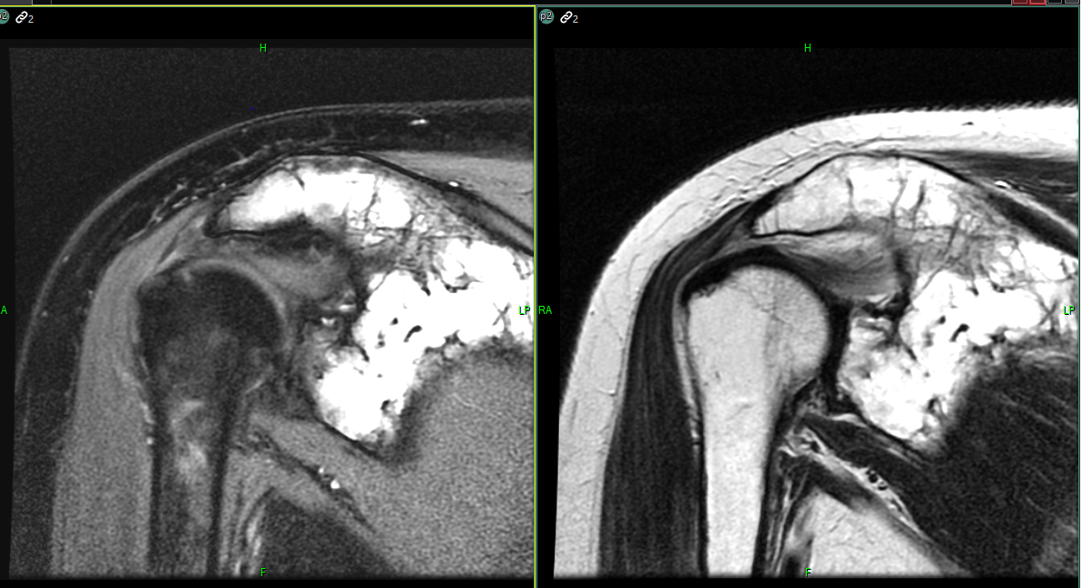

Slide 4
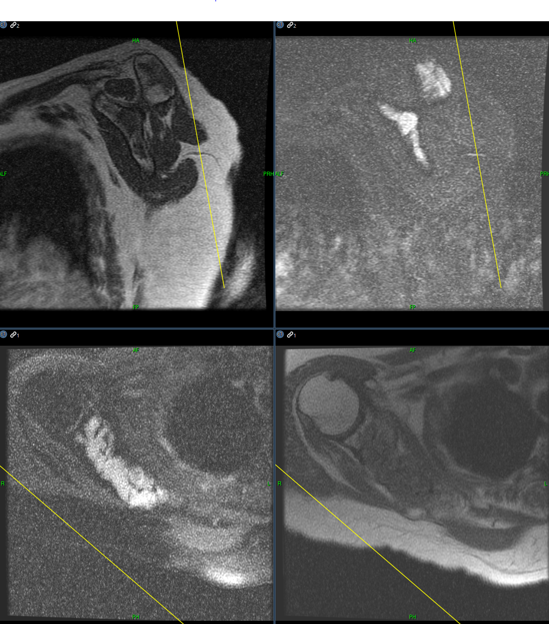

Slide 5
SCAPULAR PLASMACYTOMA

