Slide 1
36-year-old female with history of 1.5 years of lumbar back pain, progressed in the last 6 months, with a palpable mass in the right buttock, biopsy demonstrating bland fibrous tissue and glandular epithelial cells..1.5 years of lumbar back pain, progressed in the last 6 months, with a palpable mass in the right buttock, biopsy demonstrating bland fibrous tissue and glandular epithelial cells..

Slide 2
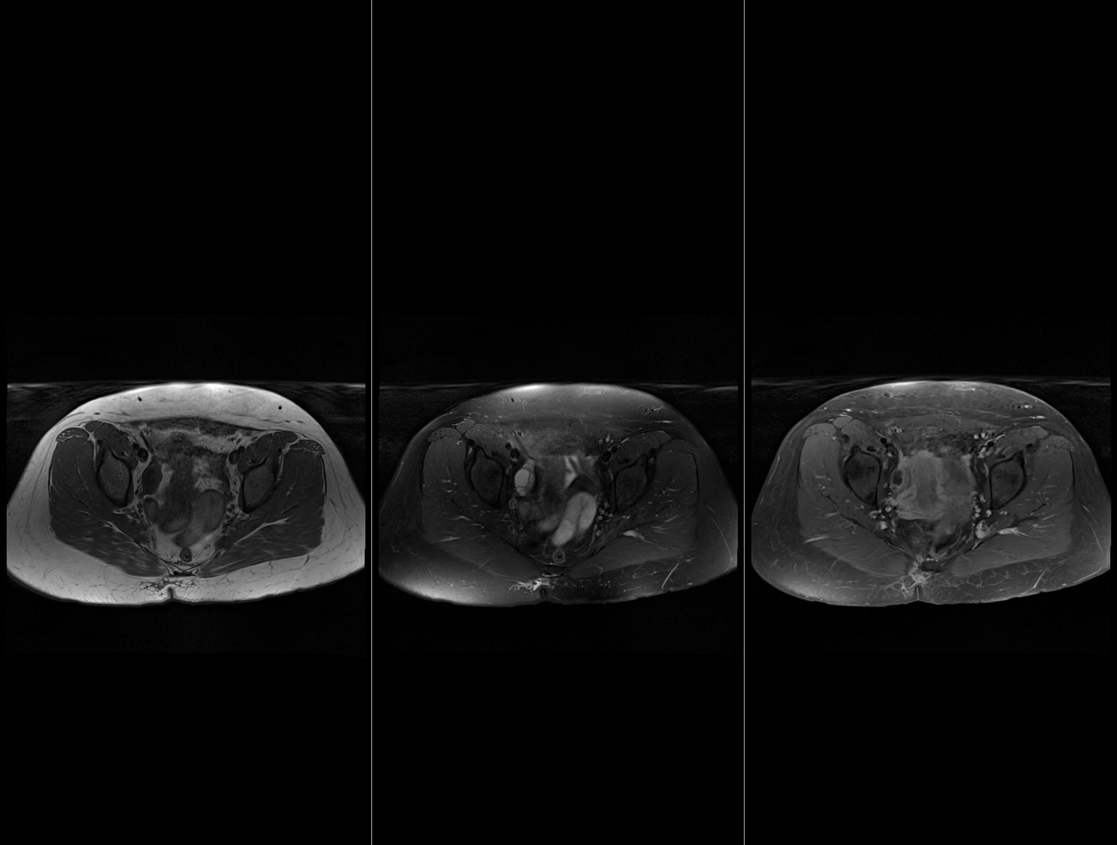
T1
T2
T1 postgd

Slide 3
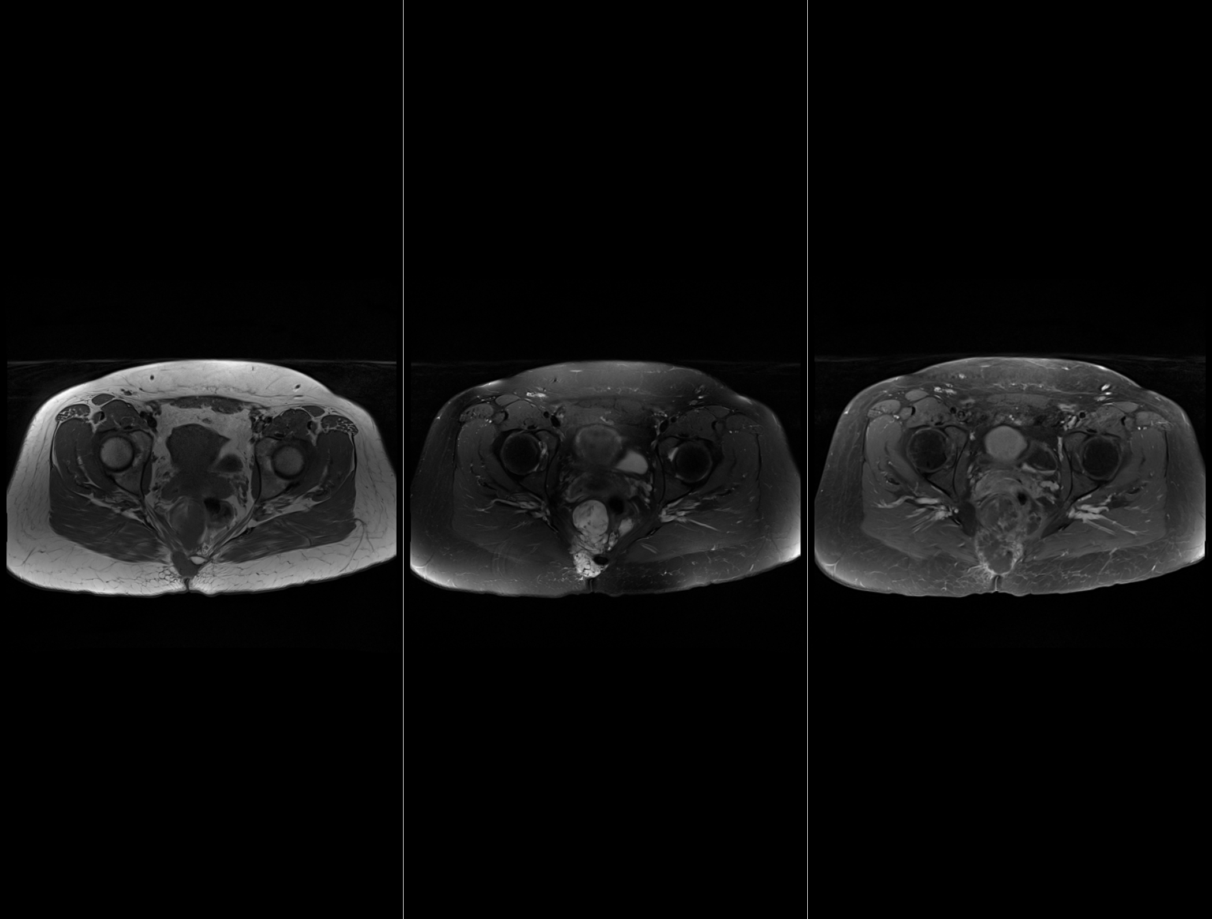
T1
T2
T1 postgd

Slide 4
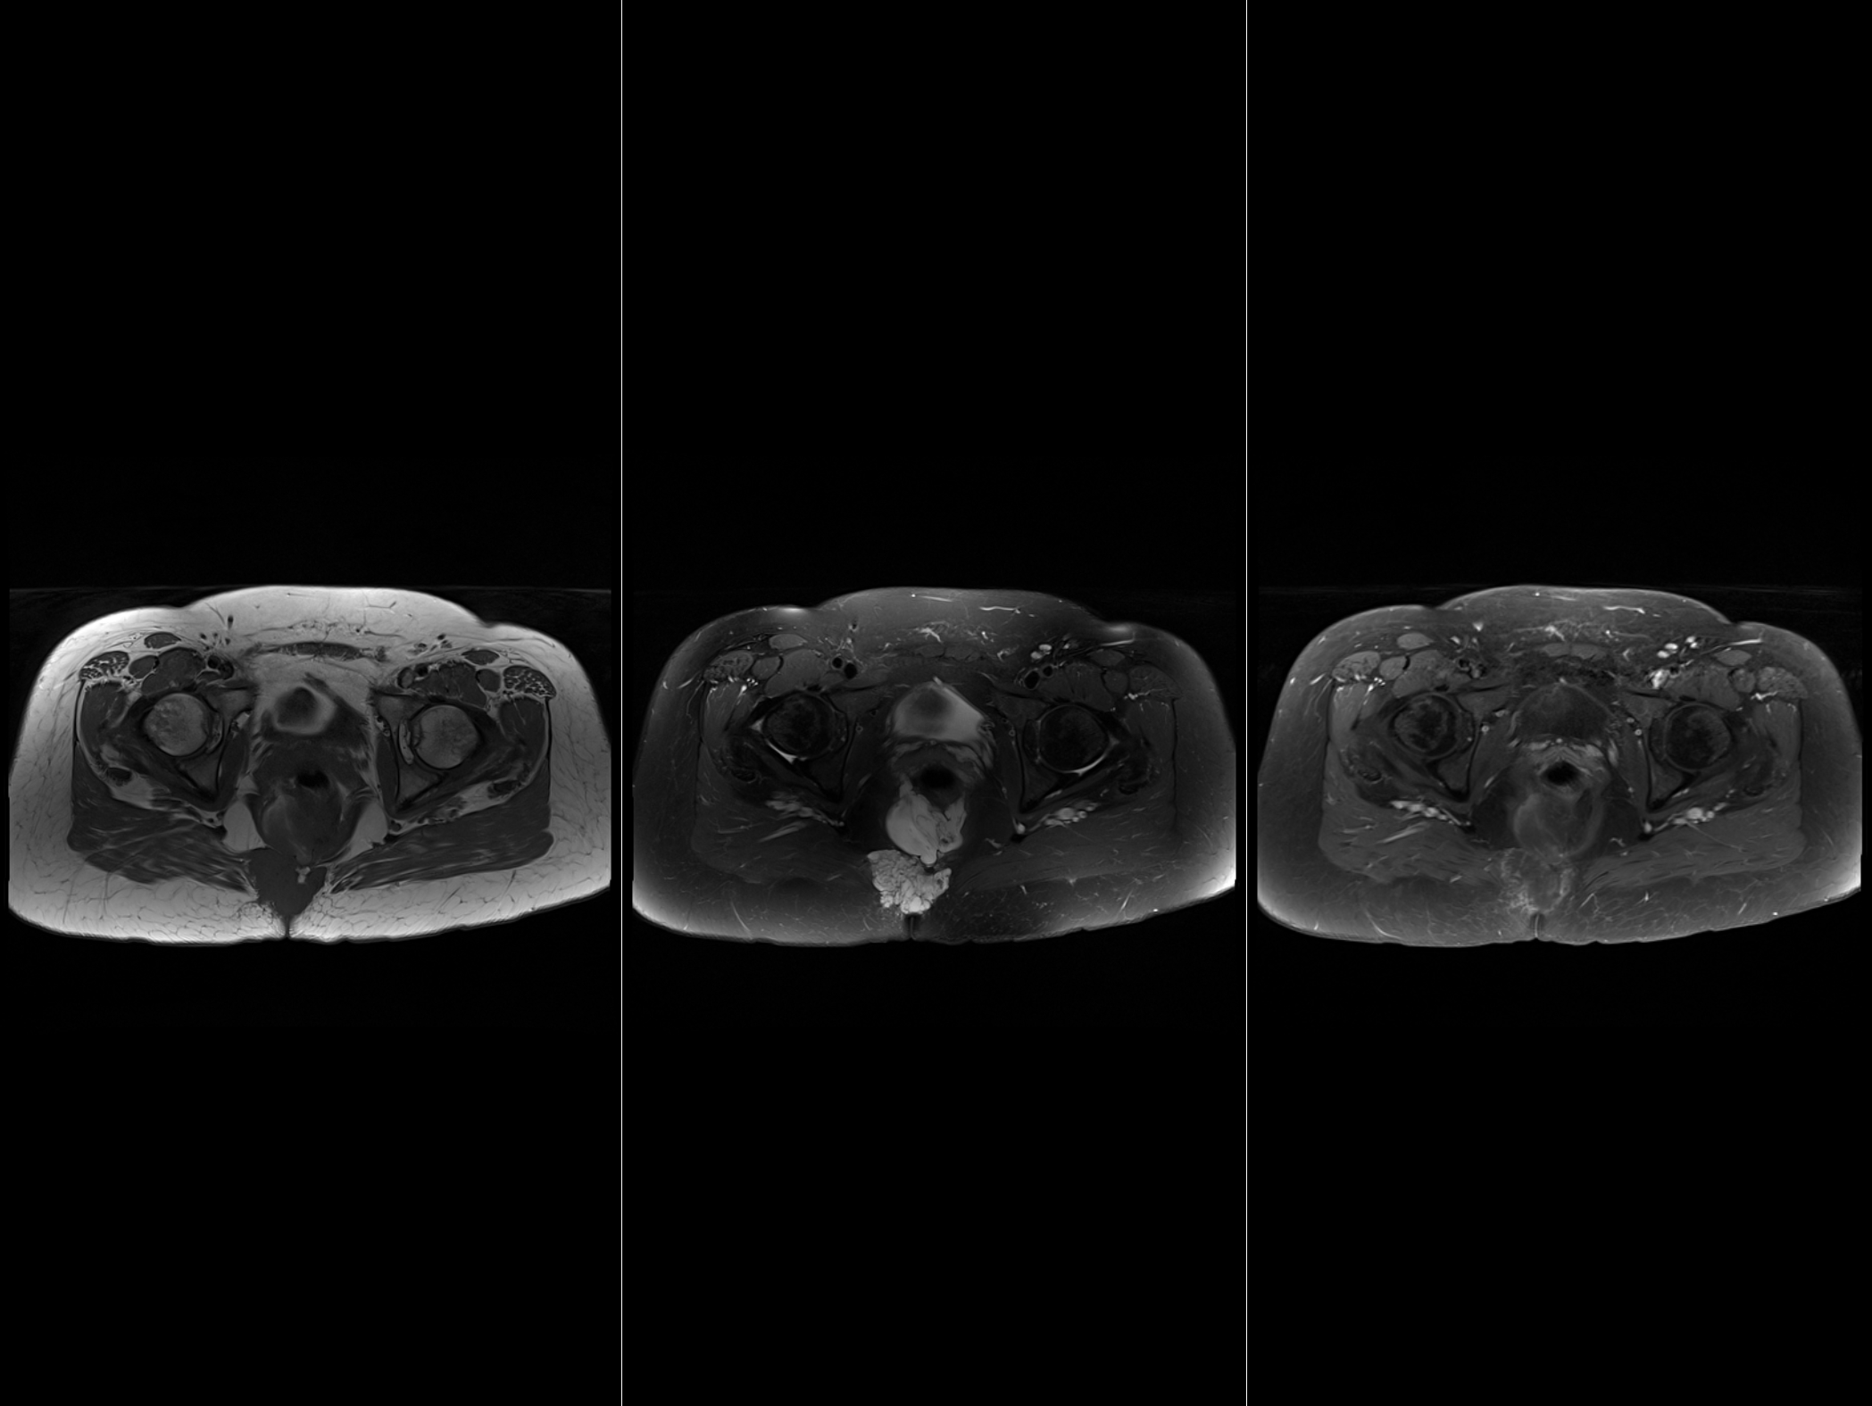
T1
T2
T1 postgd

Slide 5
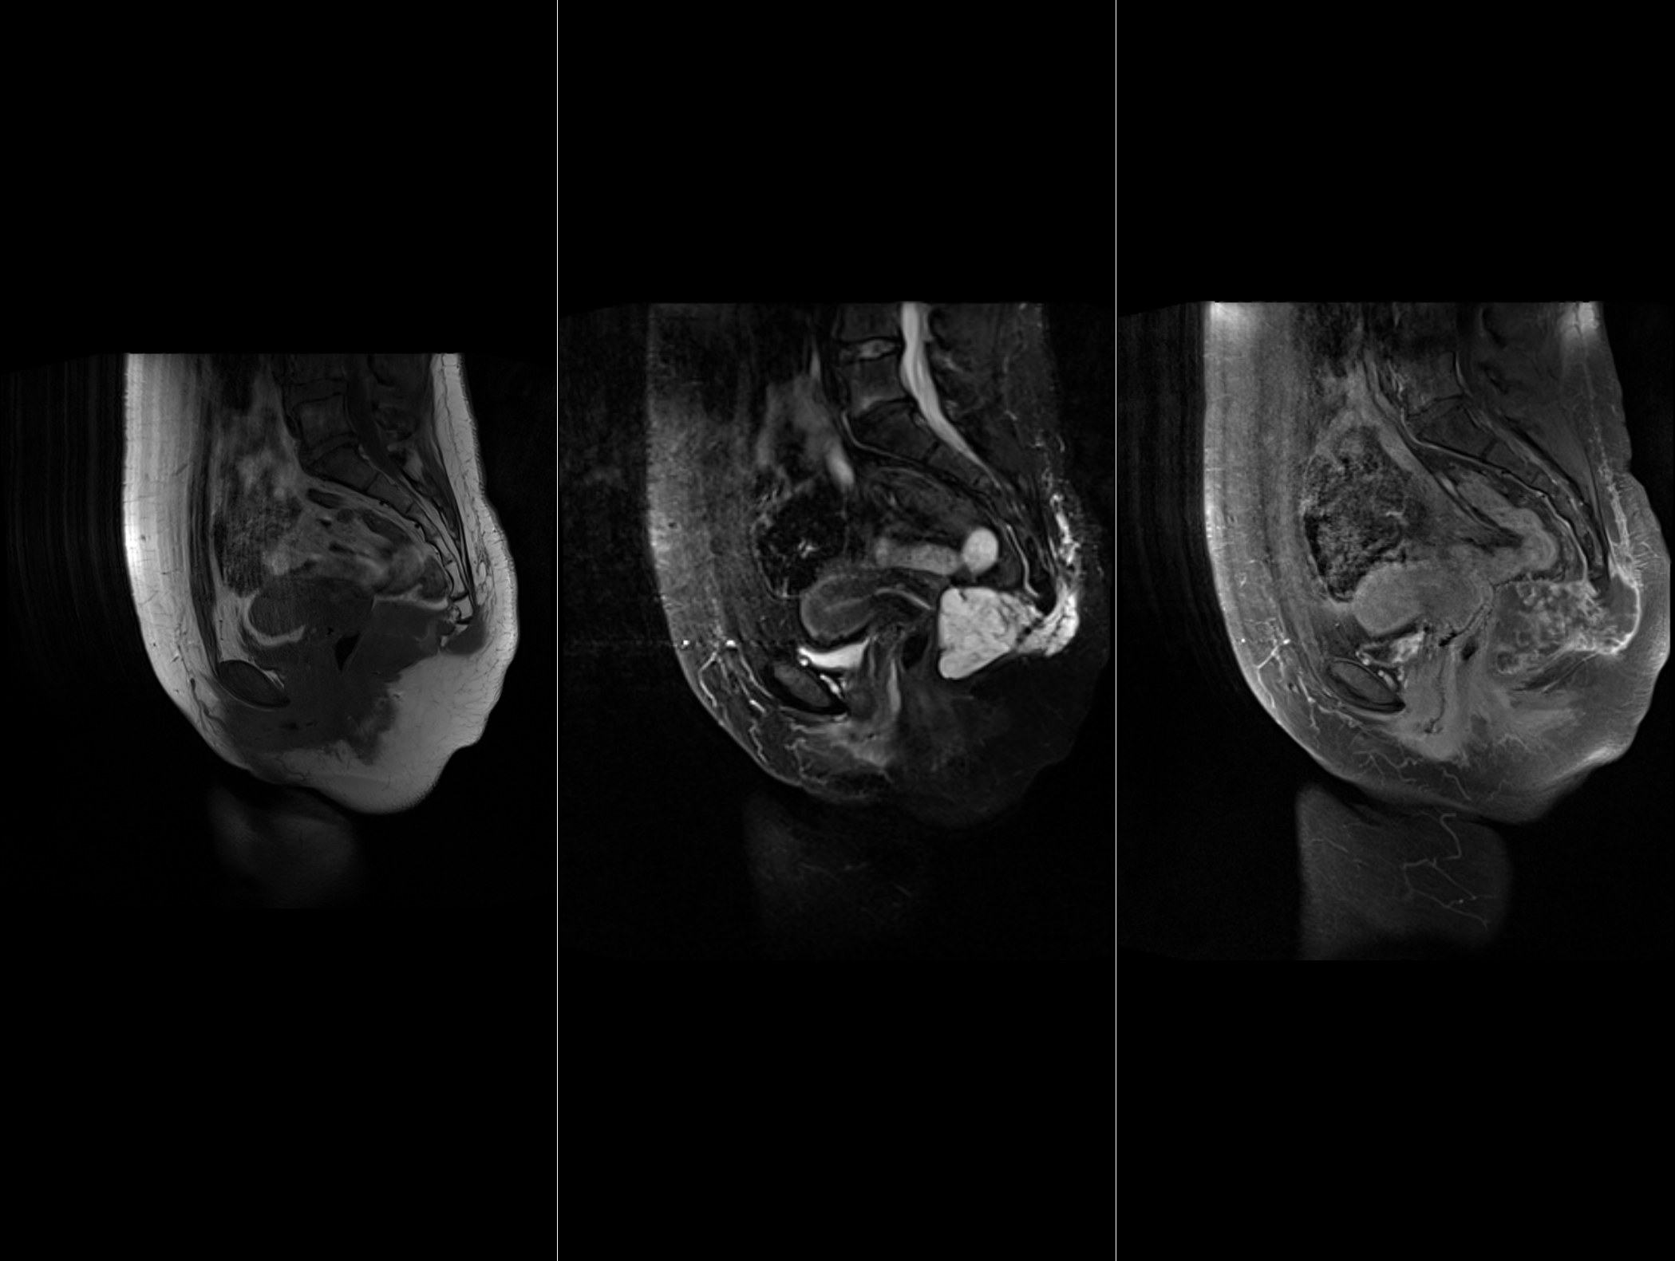
T1
T2
T1 postgd

Slide 6
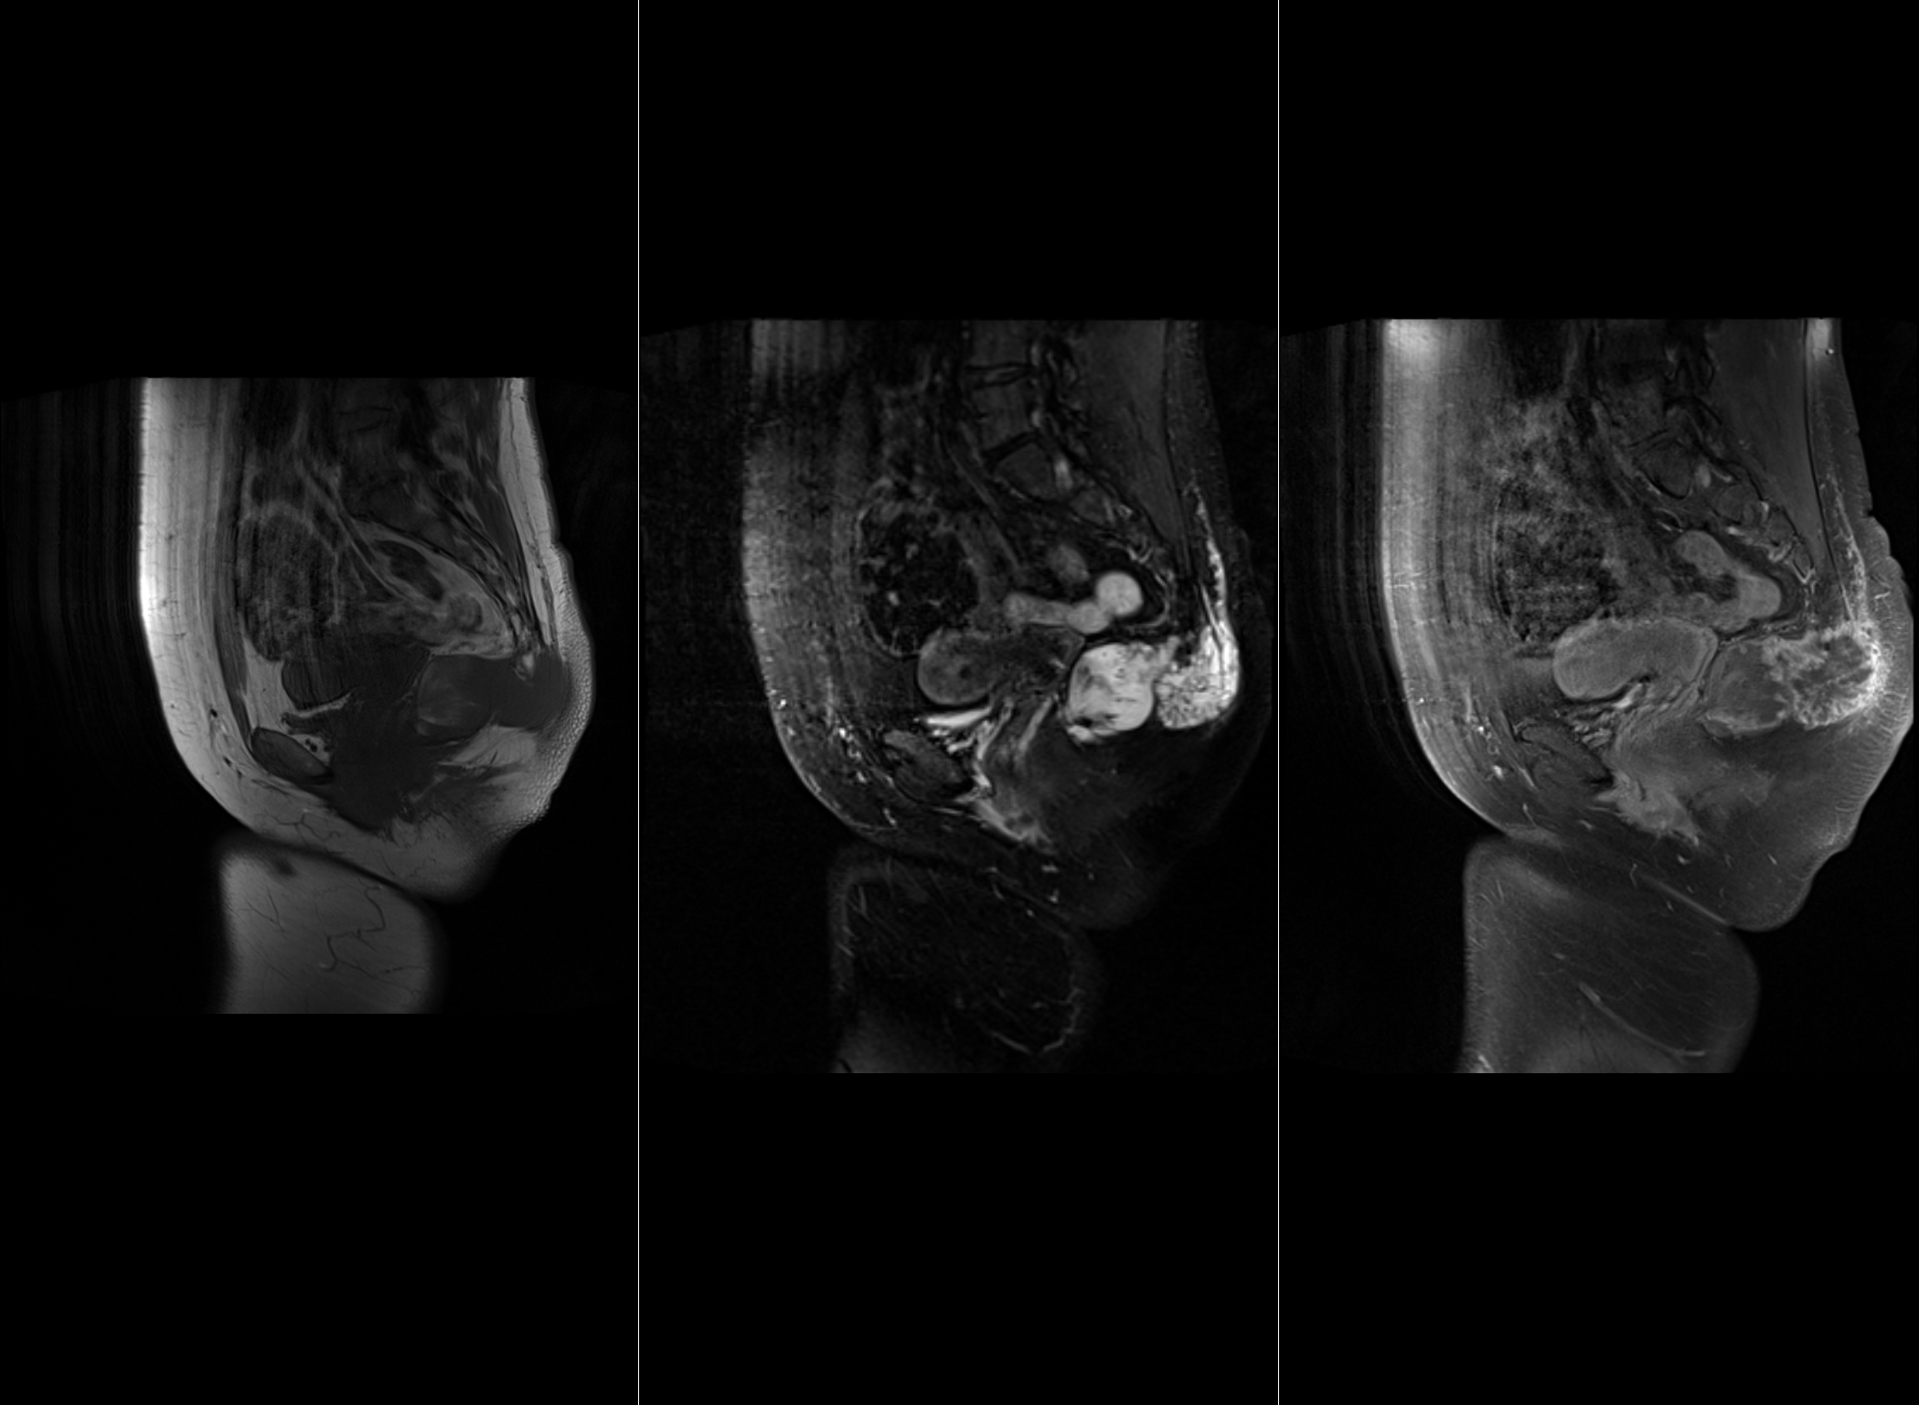
T1
T2
T1 postgd

Slide 7
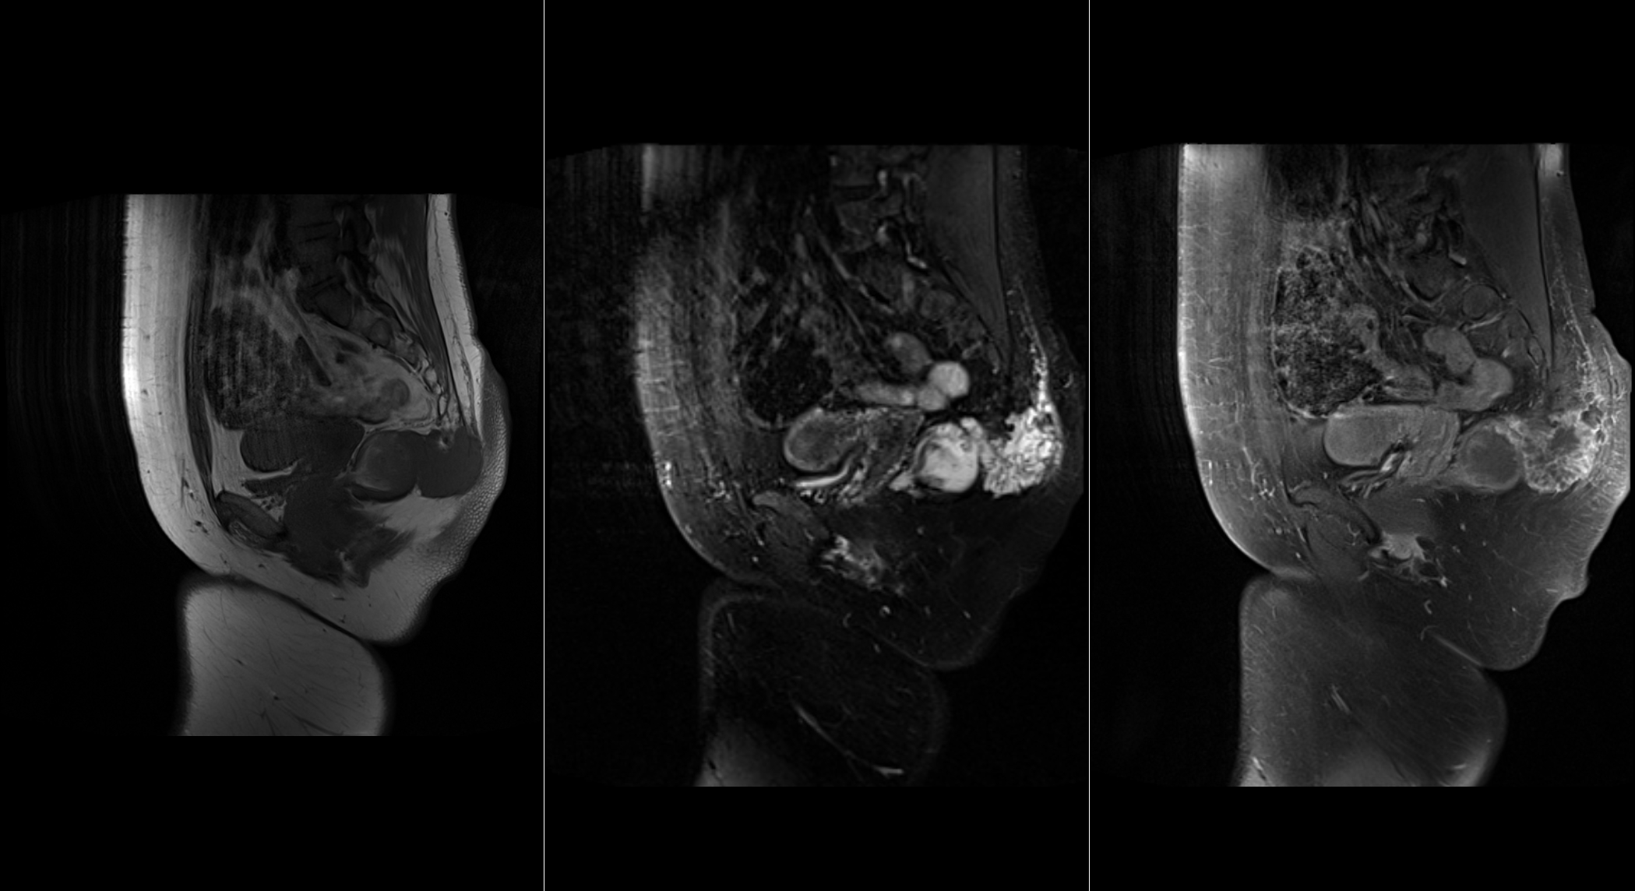
T1
T2
T1 postgd
T1
T2
T1 postgd

Slide 8
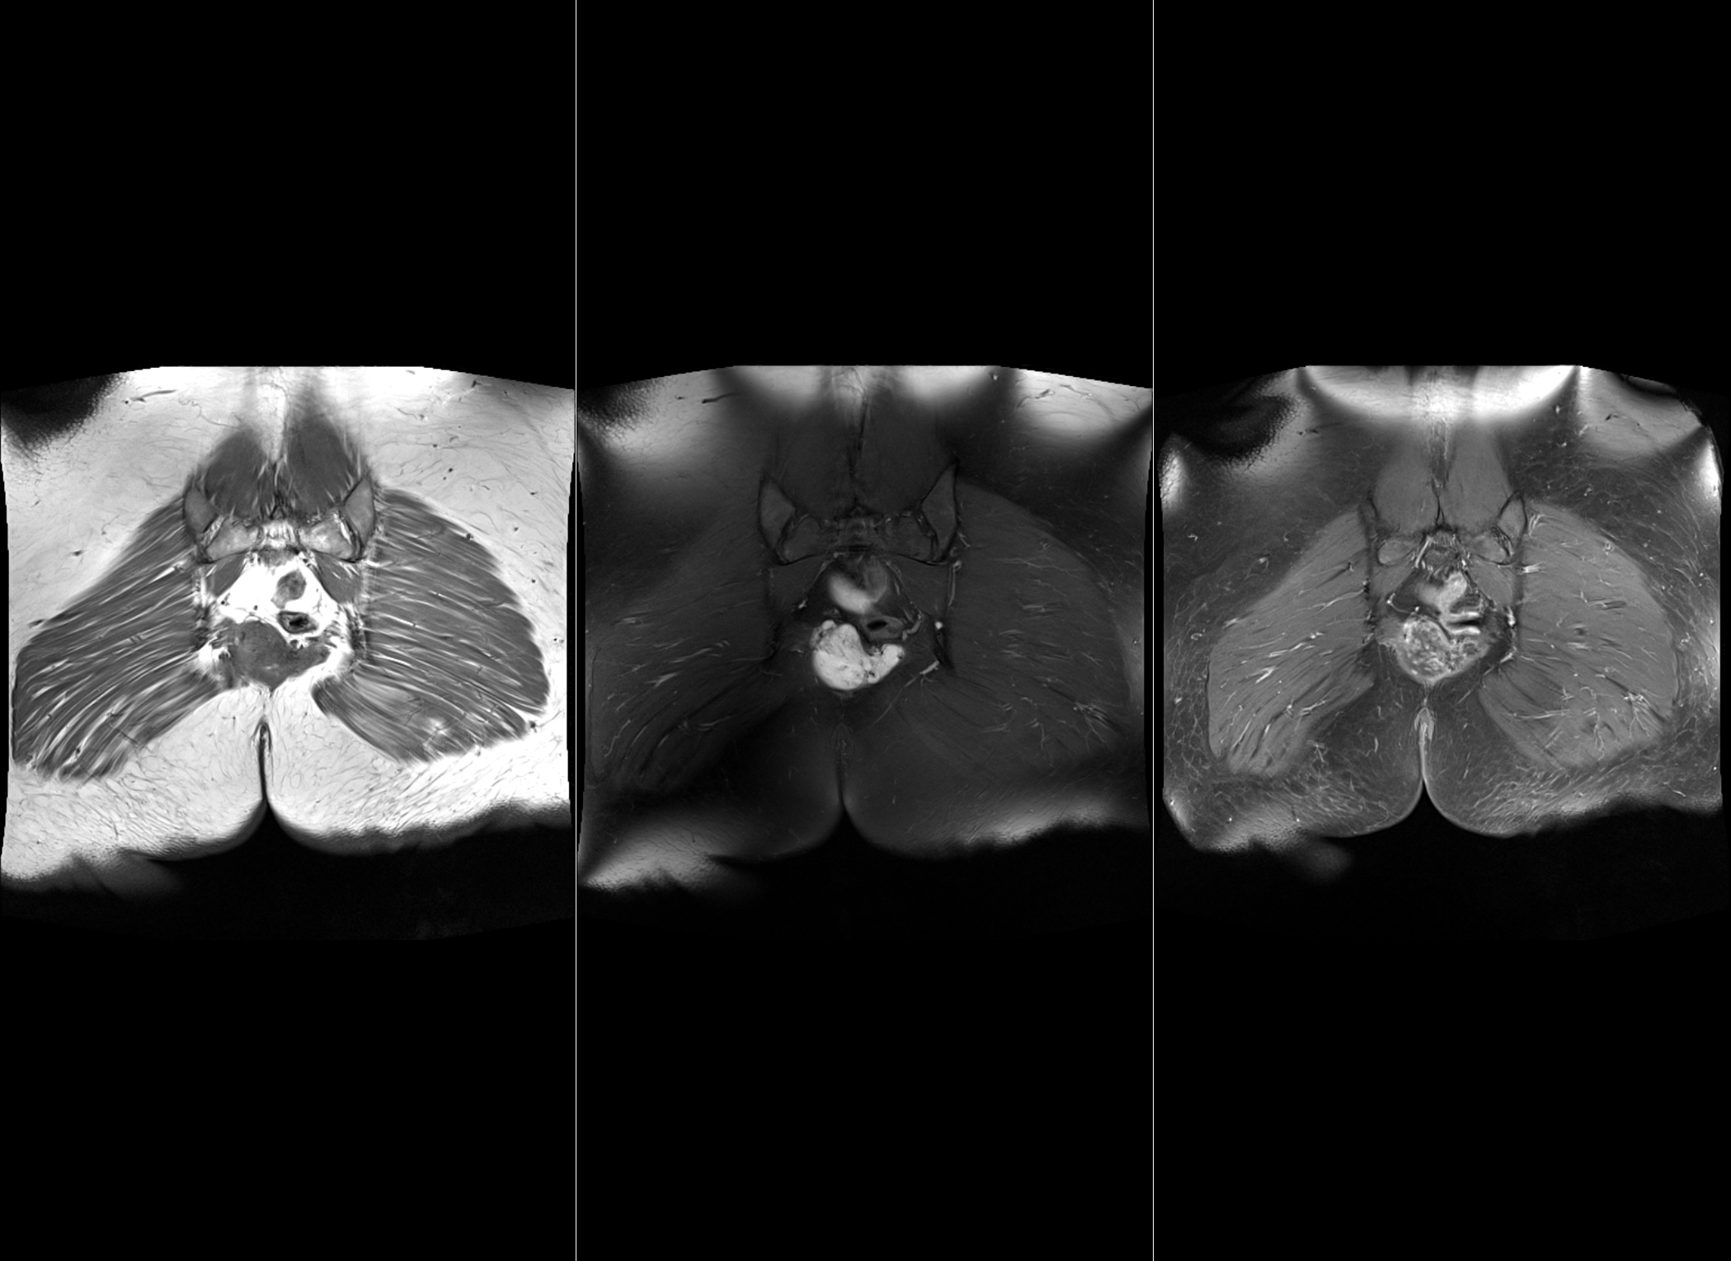
T1
T2
T1 postgd

Slide 9
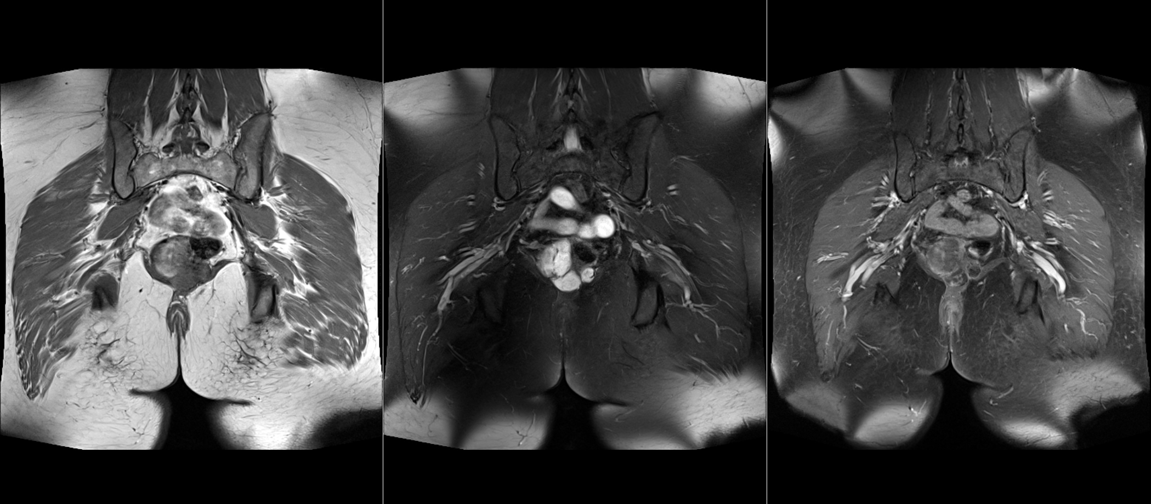
T1
T2
T1 postgd

Slide 10
