Slide 1
69M retired radiologist
Anterior shin mass 3.5 months after “bumping leg on snowblower”. Skin never broken, no discharge, swears there wasn’t a mass there before.

Slide 2
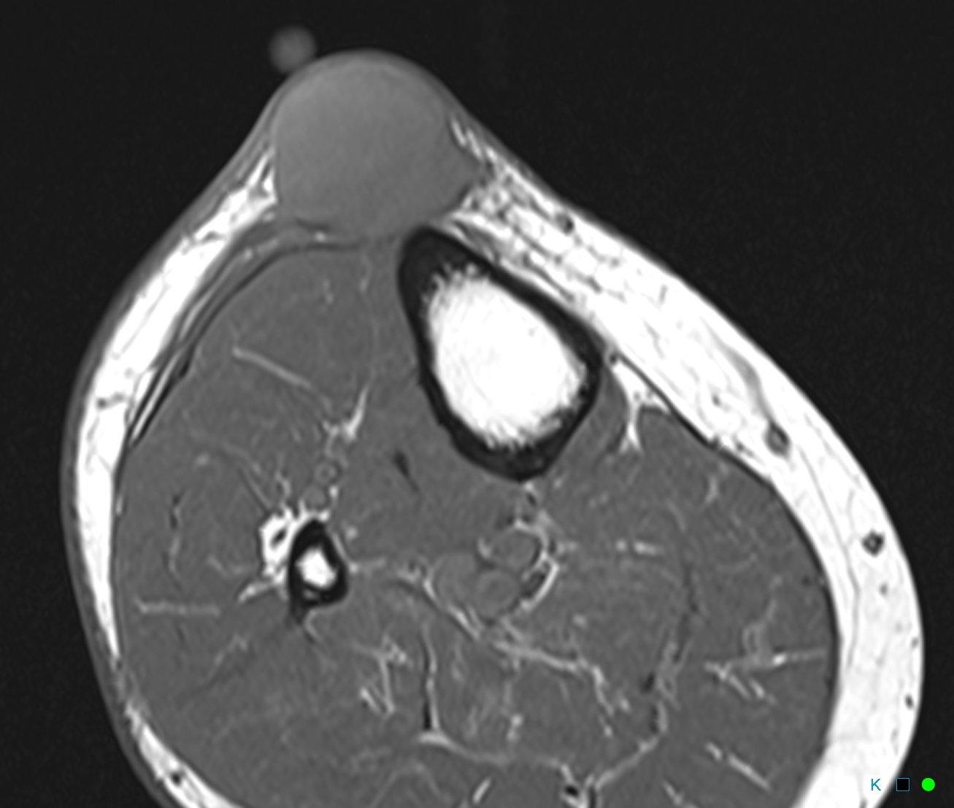
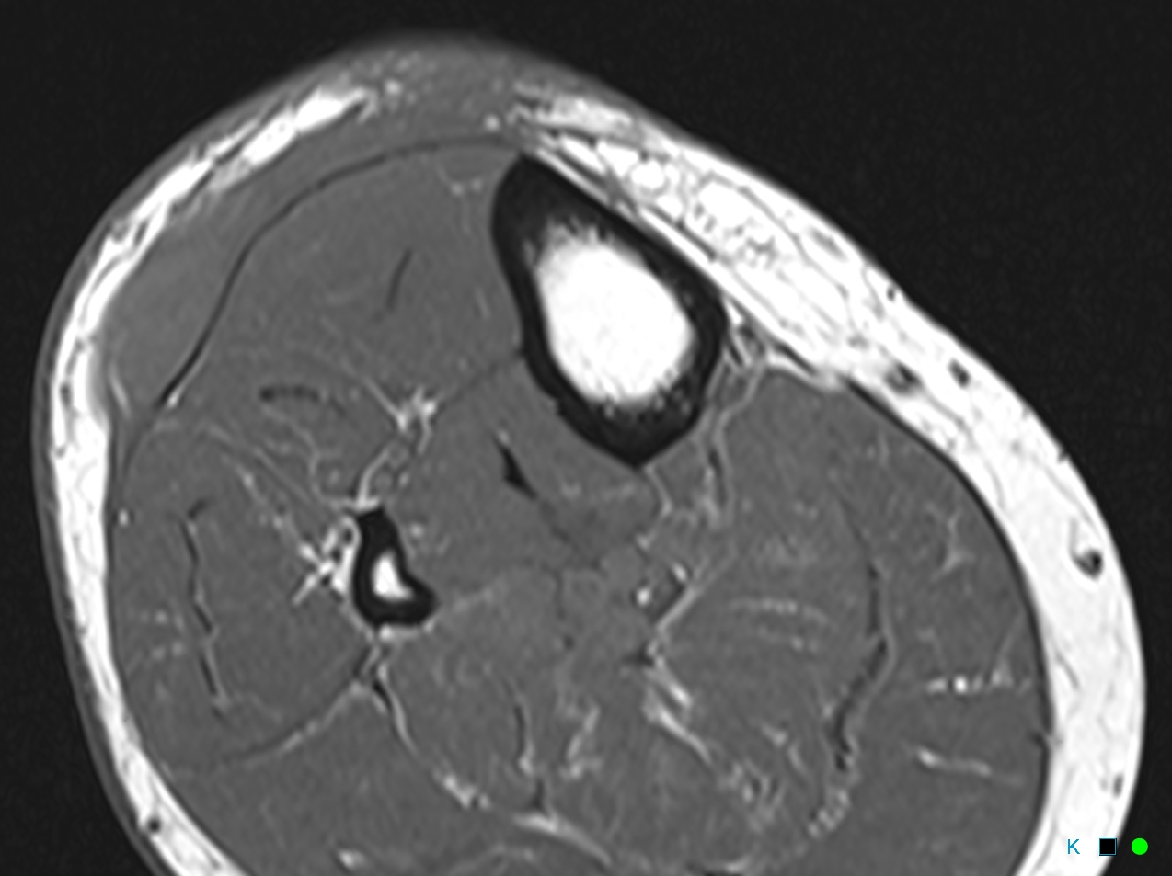
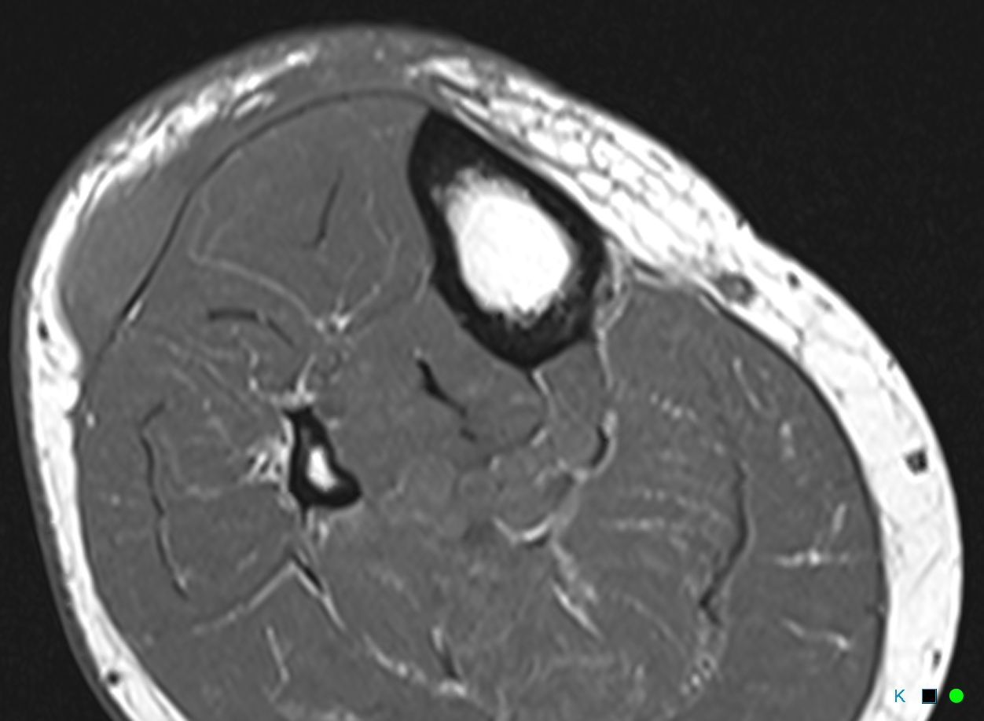
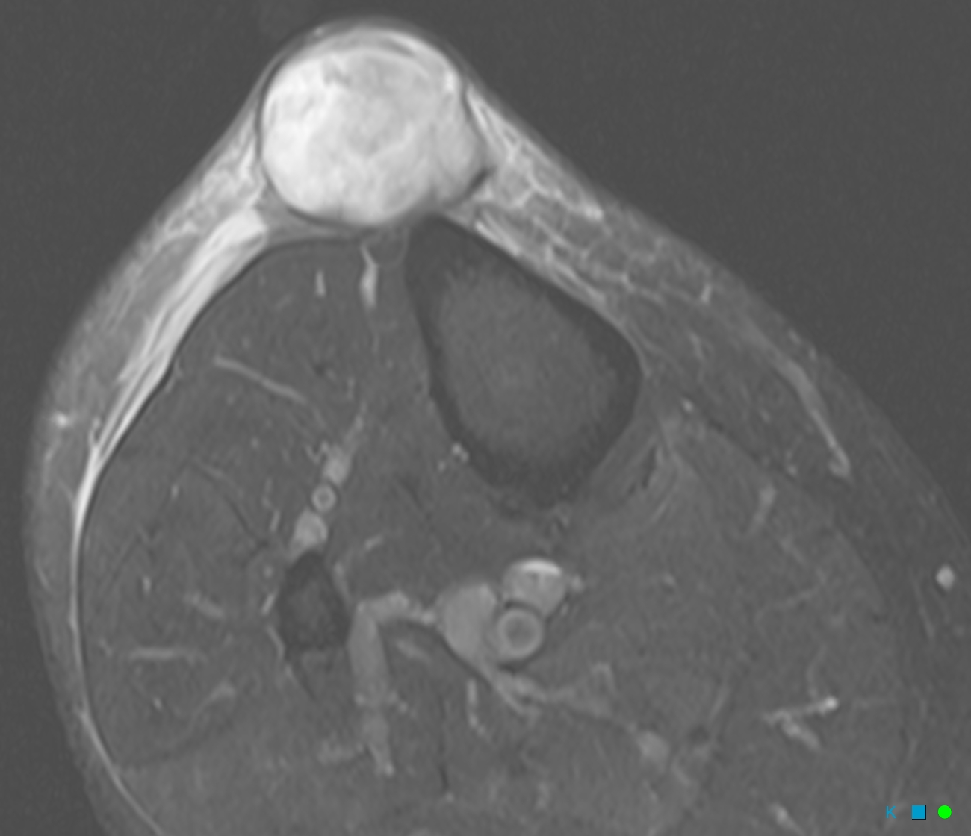
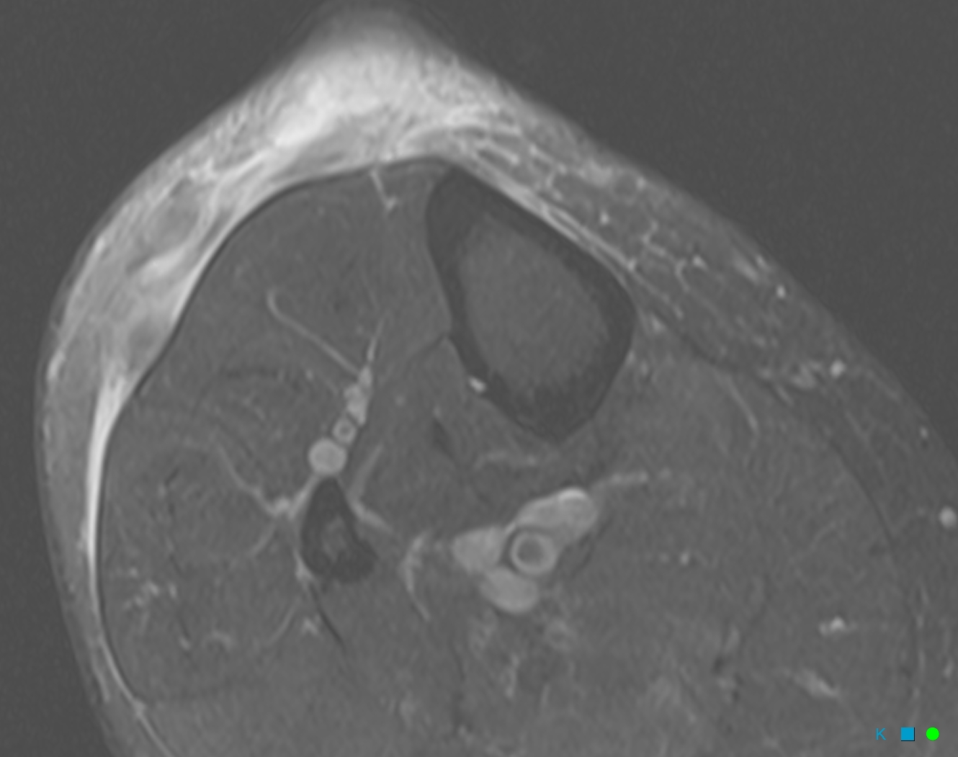
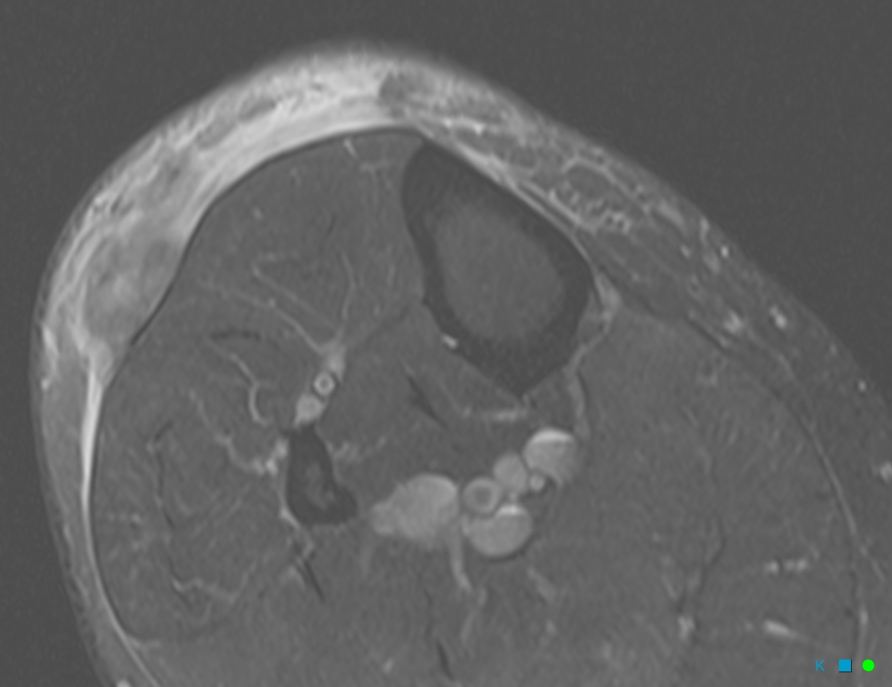
T1
T2 FS

Slide 3
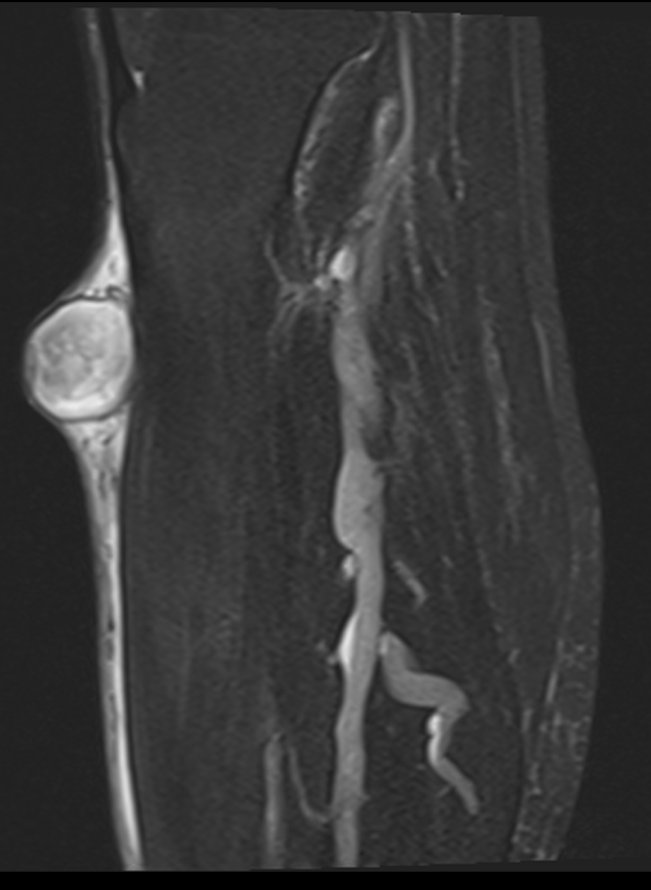
T2 FS

Slide 4
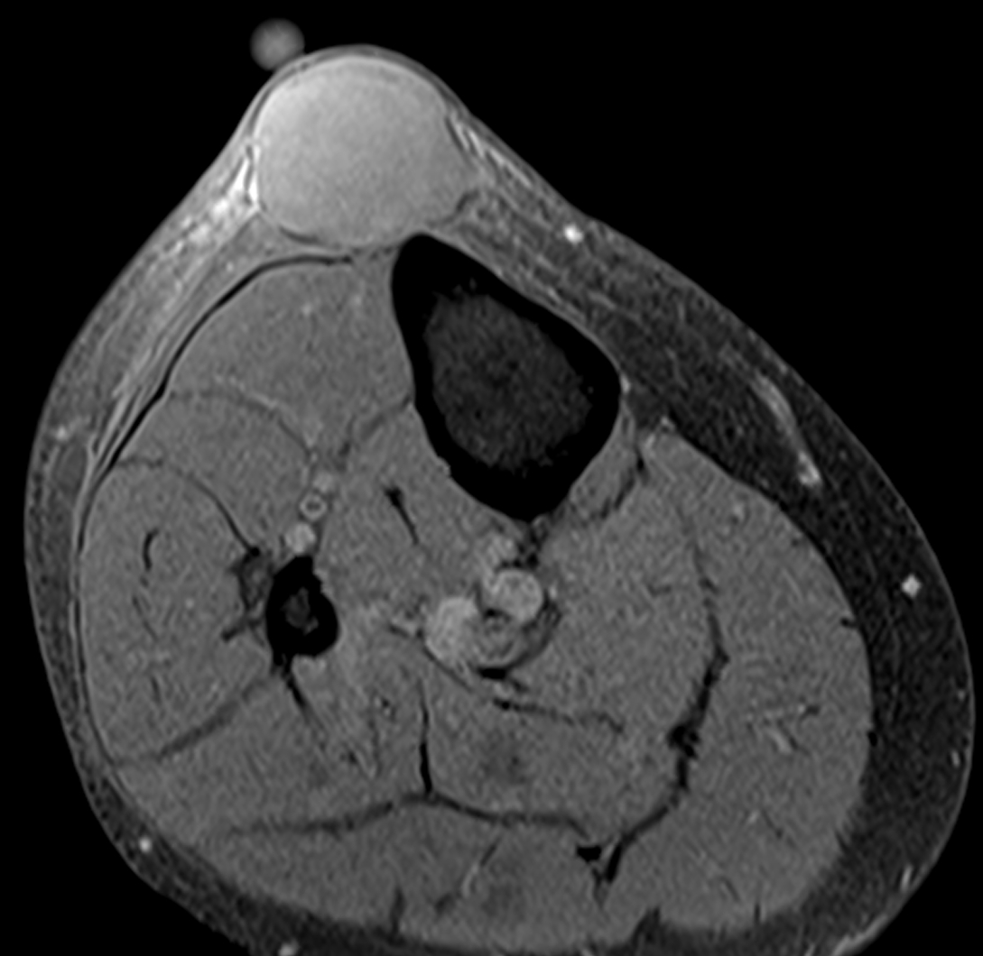
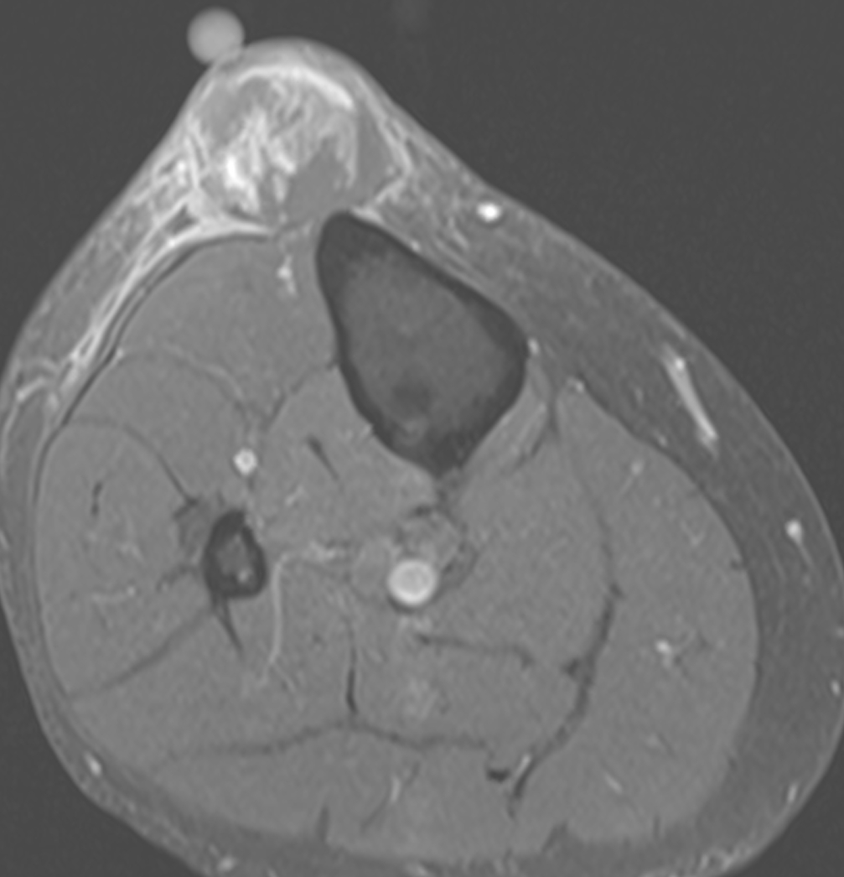
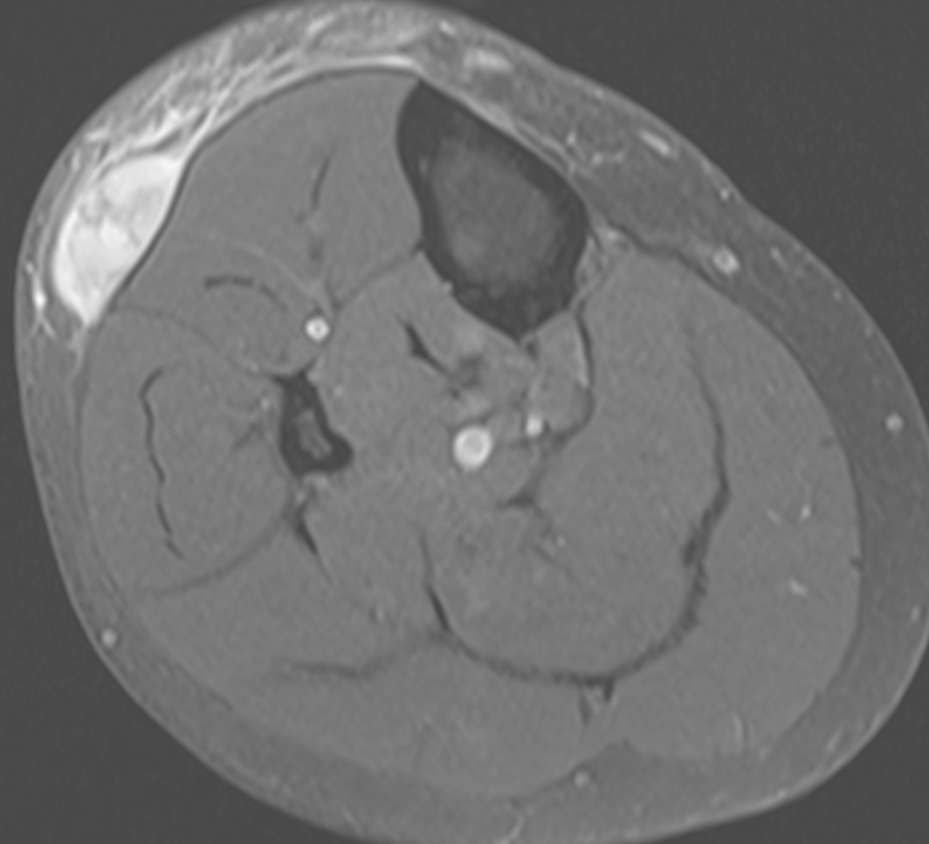
T1 FS pre- and post-Gd

Slide 5
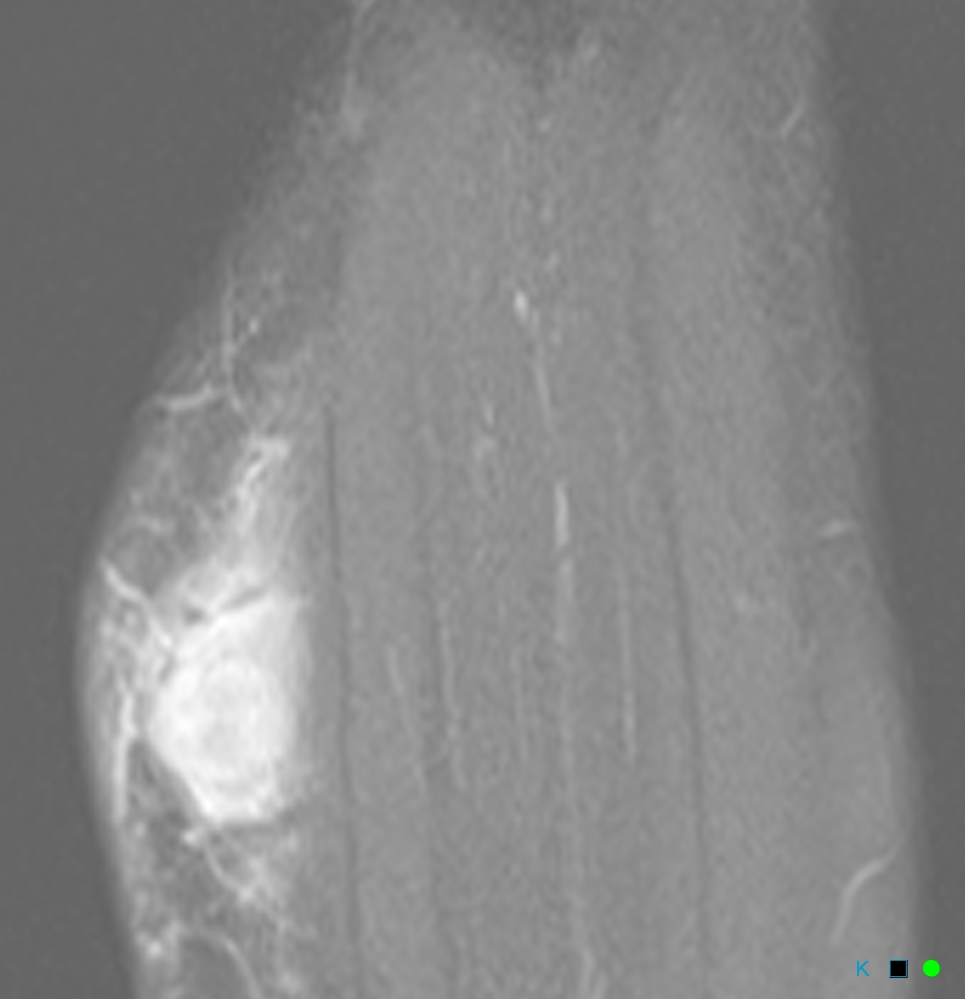
Sag T1 FS post-Gd

Slide 6
Questions that plague me:
1. If this is just hematoma
Why is there no methemoglobin signal almost 4 months after injury?
Why is there so much enhancement (particularly in the lateral mass)?
Why is it getting bigger (per patient)? Could this be due to ongoing bleeding in hematoma?
2. If this is neoplasm
What the hell is it? Doesn’t look like it arises from fascia, and the two masses look dissimilar on pre- and post-Gad images
Why so much edema, and looks like fluid track between them (with peripheral enhancement)?
Could this be infection? Clinically it isn’t……….

