Slide 1
85 yr old with suspicious lung lesion on CTPA
Sent for MRI T-spine

Slide 2
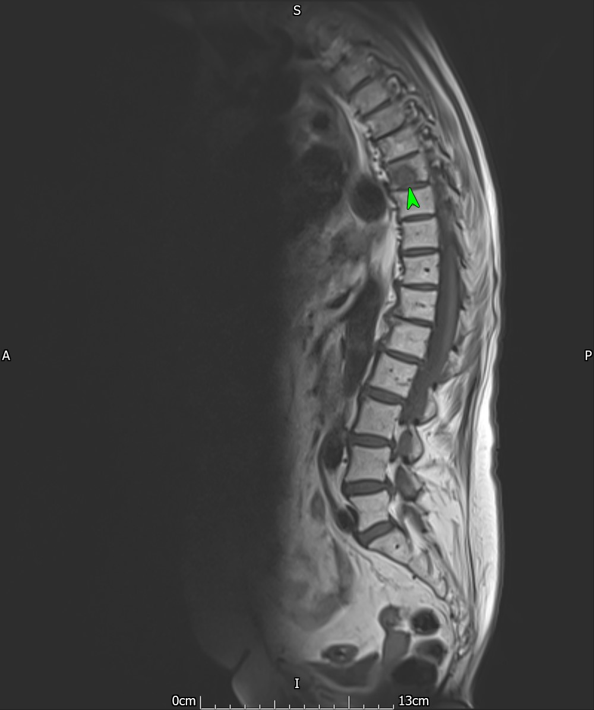
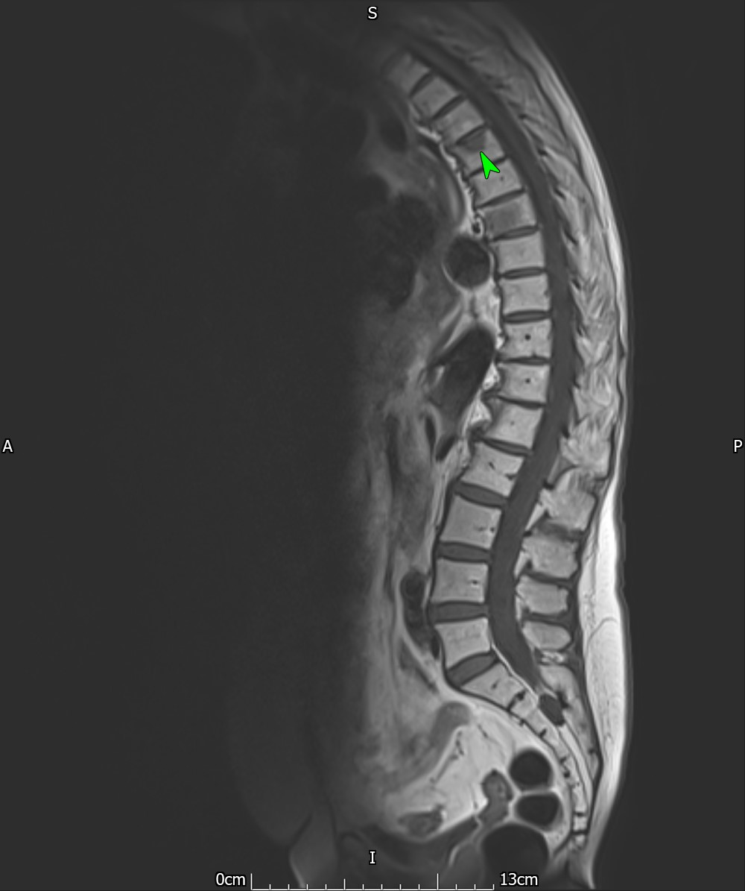
T1

Slide 3
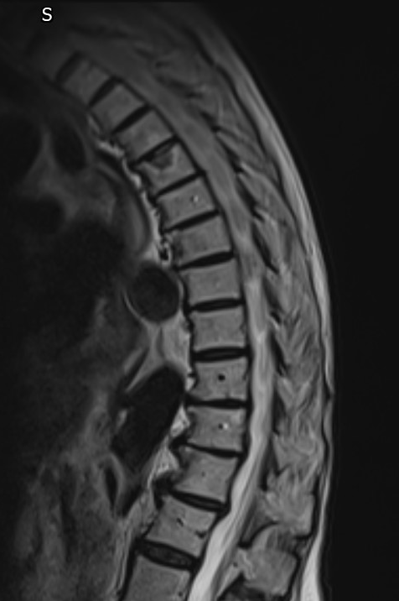
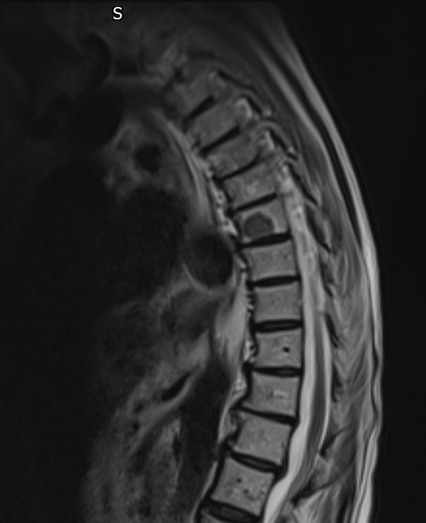
T2

Slide 4
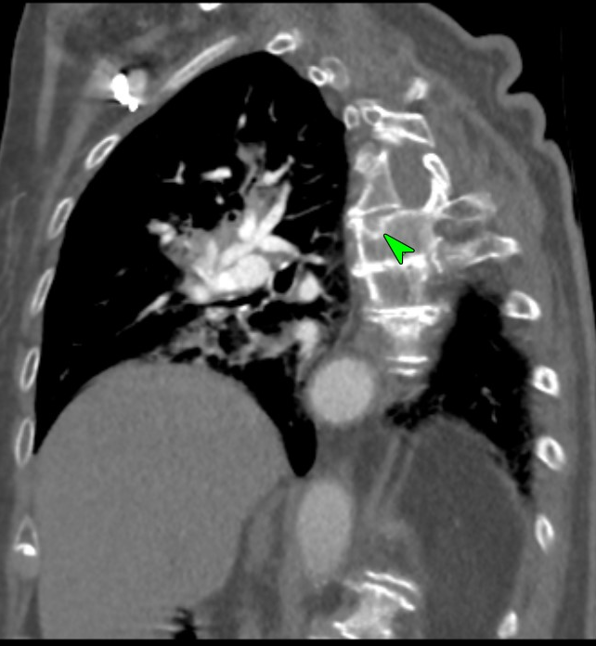
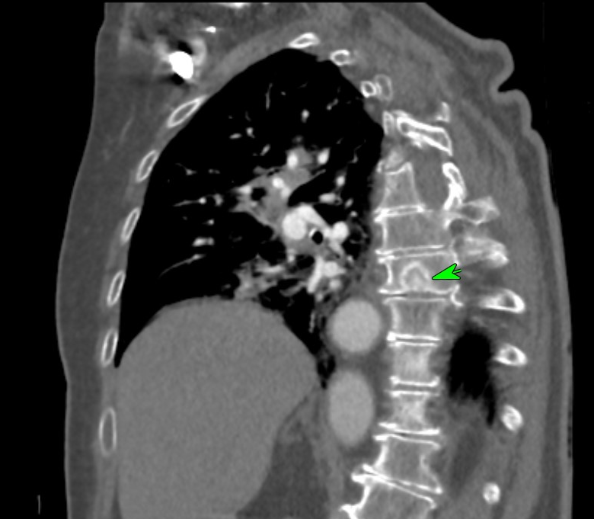
Recent CT
Confidently called Schmorl’s nodes

Slide 5
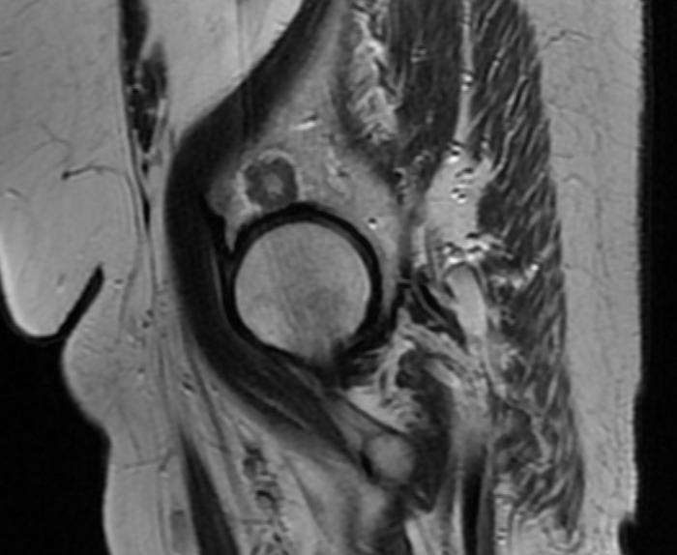
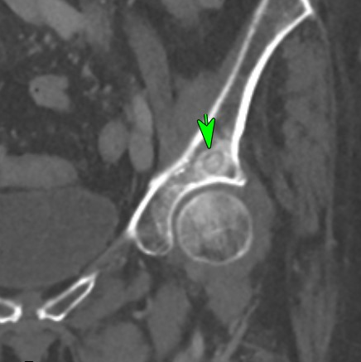
Gynae pelvis and Abdo pelvis CT (provided later for my review ?geode or met)
Gynae MRI not reviewed initially because it’s a gynae MR.

Slide 6
No results in yet but I didn’t let that stop me falling on my sword.
Mixed lytic/sclerotic metastasis
Recommended biopsy of acetabular lesion.

