Slide 1
40 yrs M, History of fall from bike 2 years back. Swelling in the knee since then

Slide 2
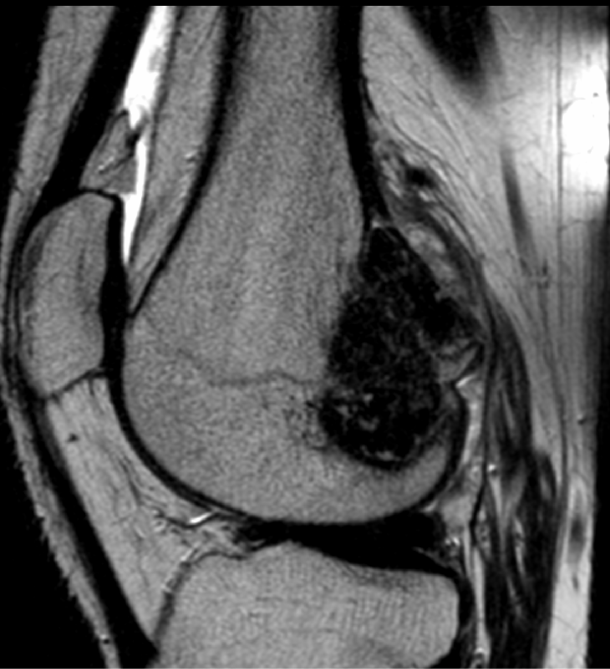
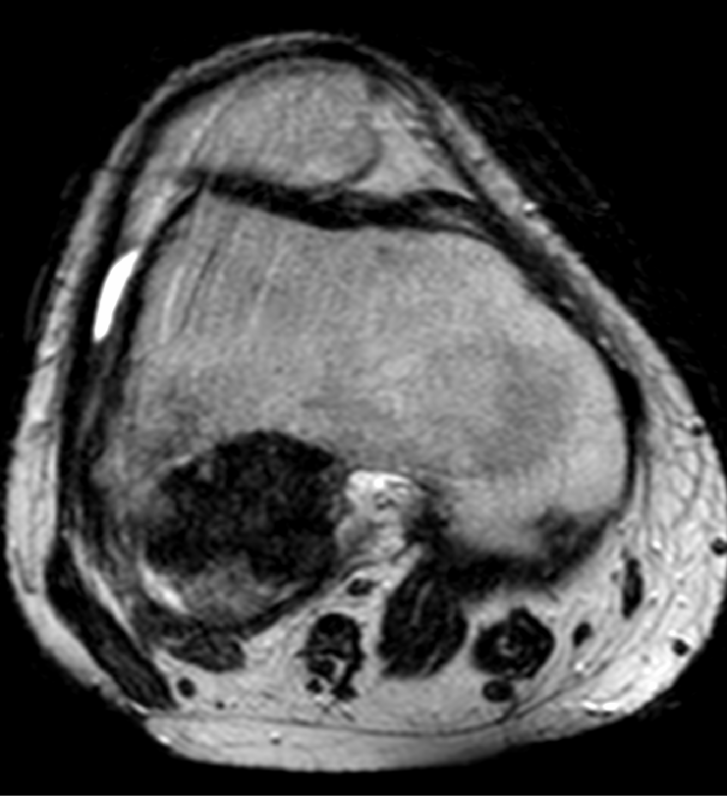
T2

Slide 3
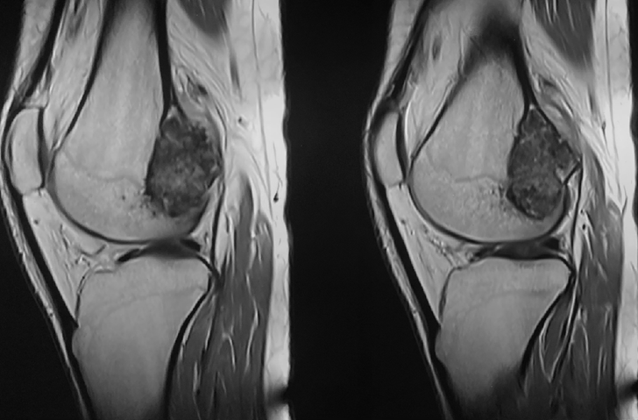
T1

Slide 4
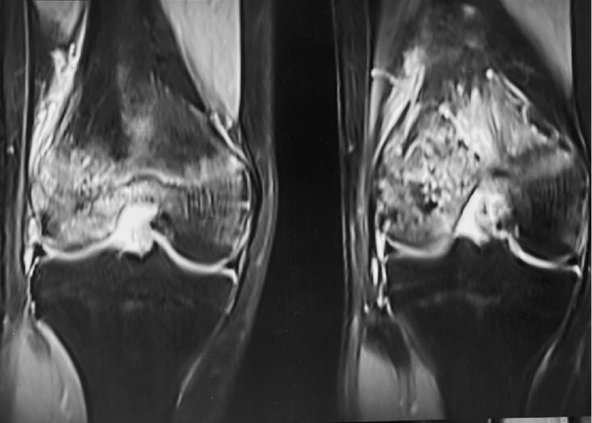
STIR

Slide 5
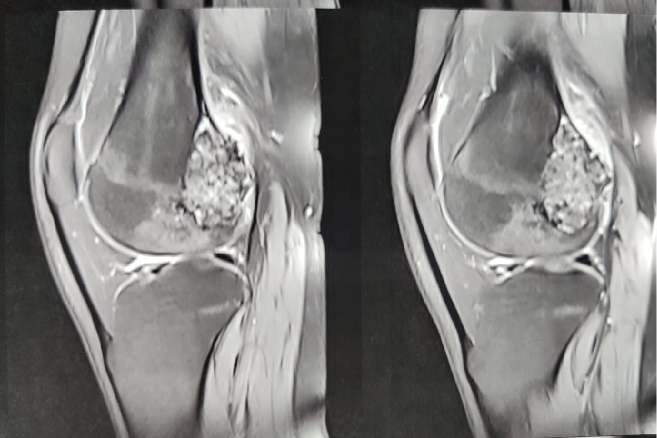
PDFS

Slide 6
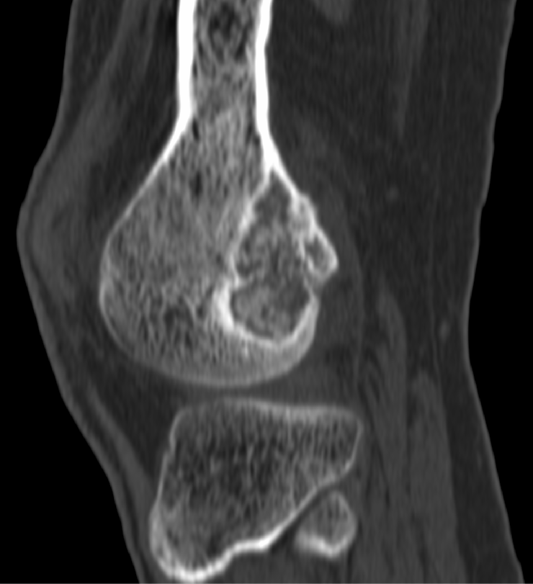
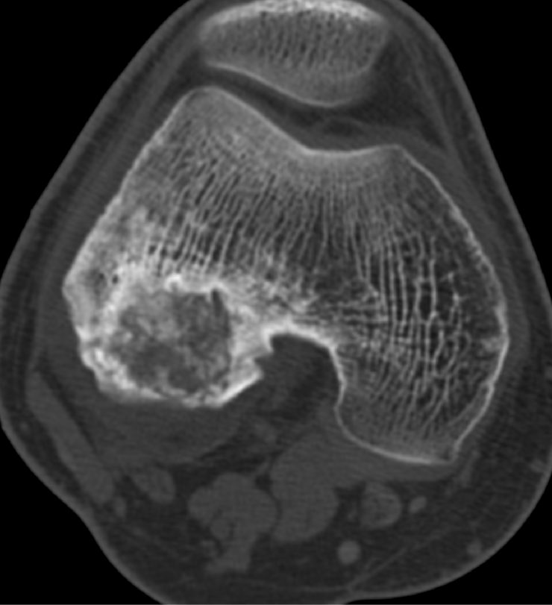
CT

Slide 7
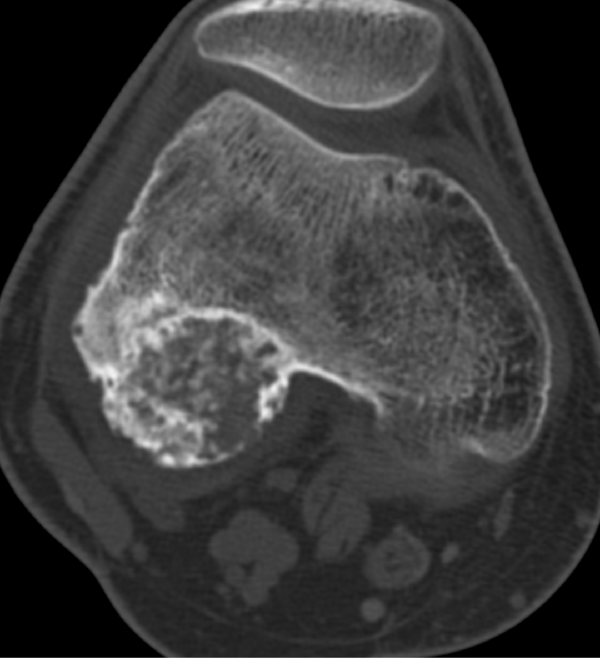
CT

Slide 8
BIOPSY:AGGRESSIVE CHONDROBLASTOMA
Looks like a lesion with chondroid matrix, bright on STIR
Cortical
Black on T2 so lot of fibrous tissue
What are your thoughts? Chondromyxoid fibroma?

