Slide 1
7 year old with ankle pain

Slide 2
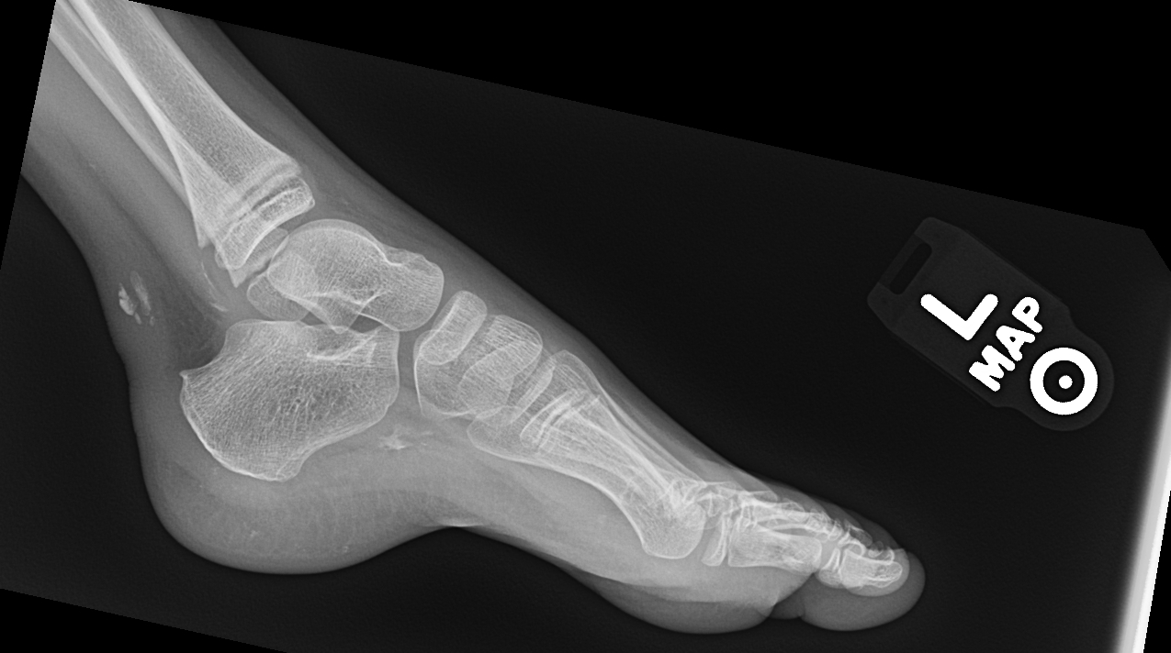
Calcifications in Achilles, deep to plantar fascia, also some in great toe

Slide 3
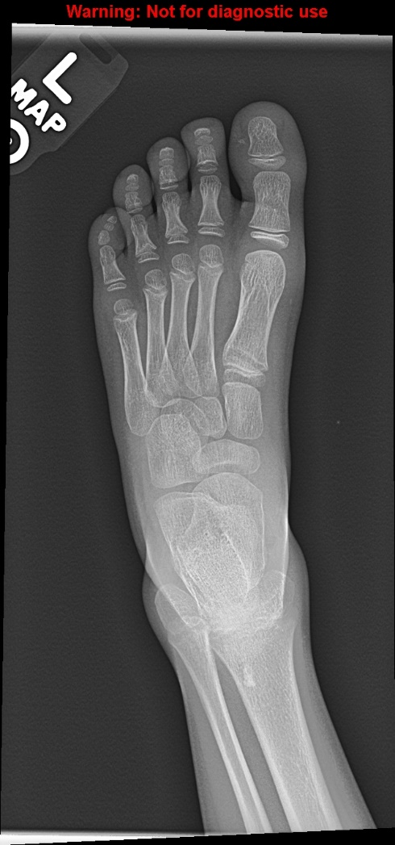
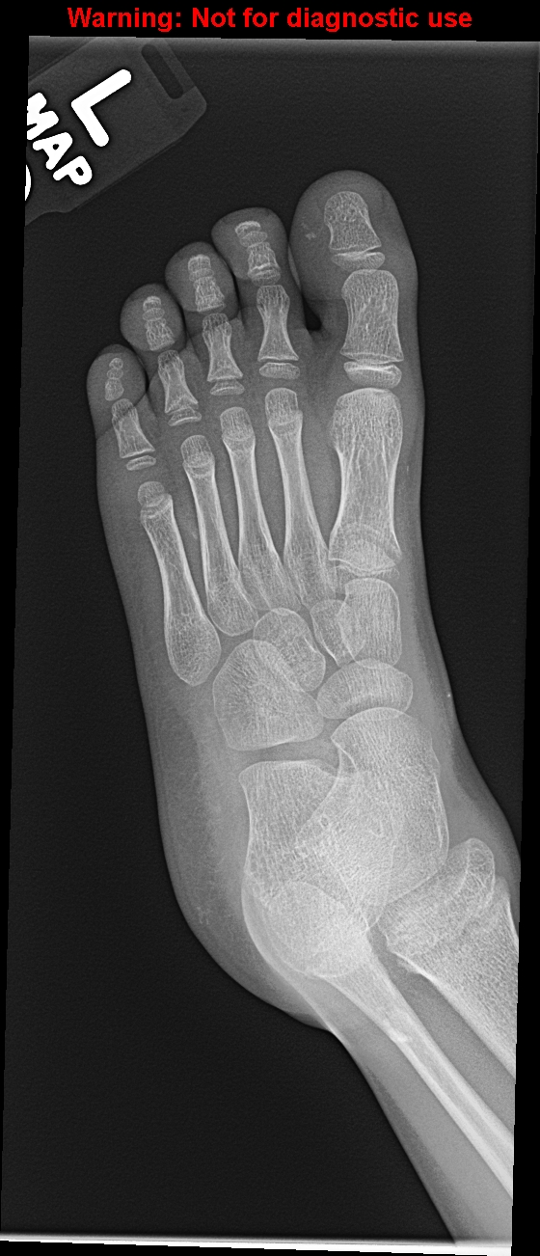

Slide 4
??

Slide 5
Case 2
16 year old girl knee pain
Is this cortical abnormality in distal femur concerning?

Slide 6
