Slide 1
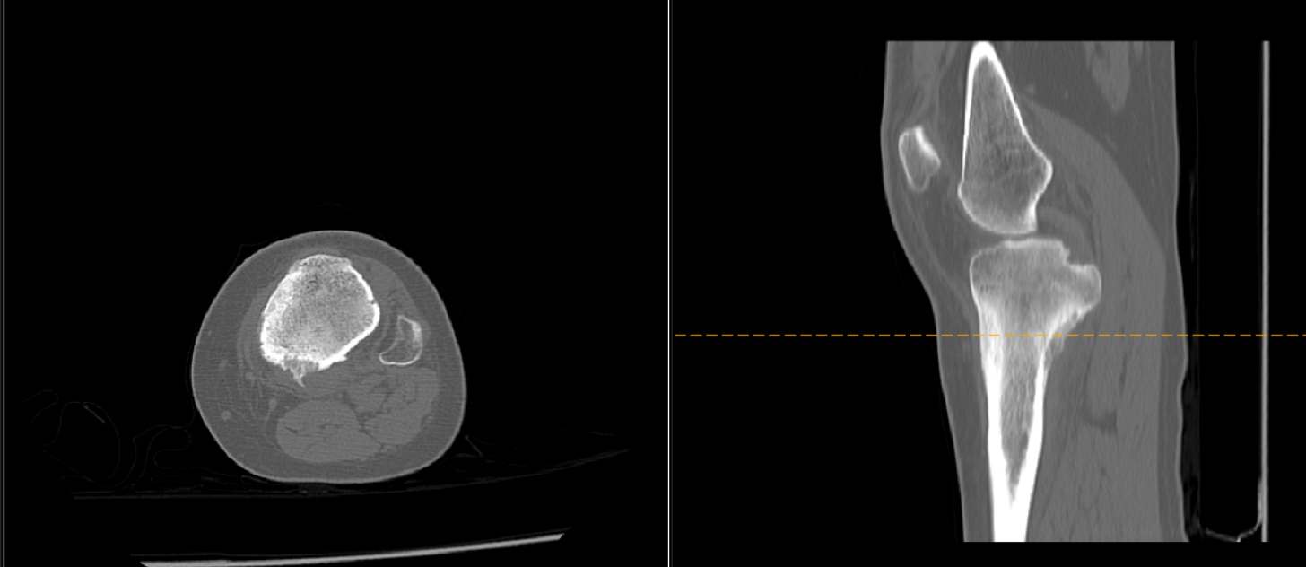

Slide 2
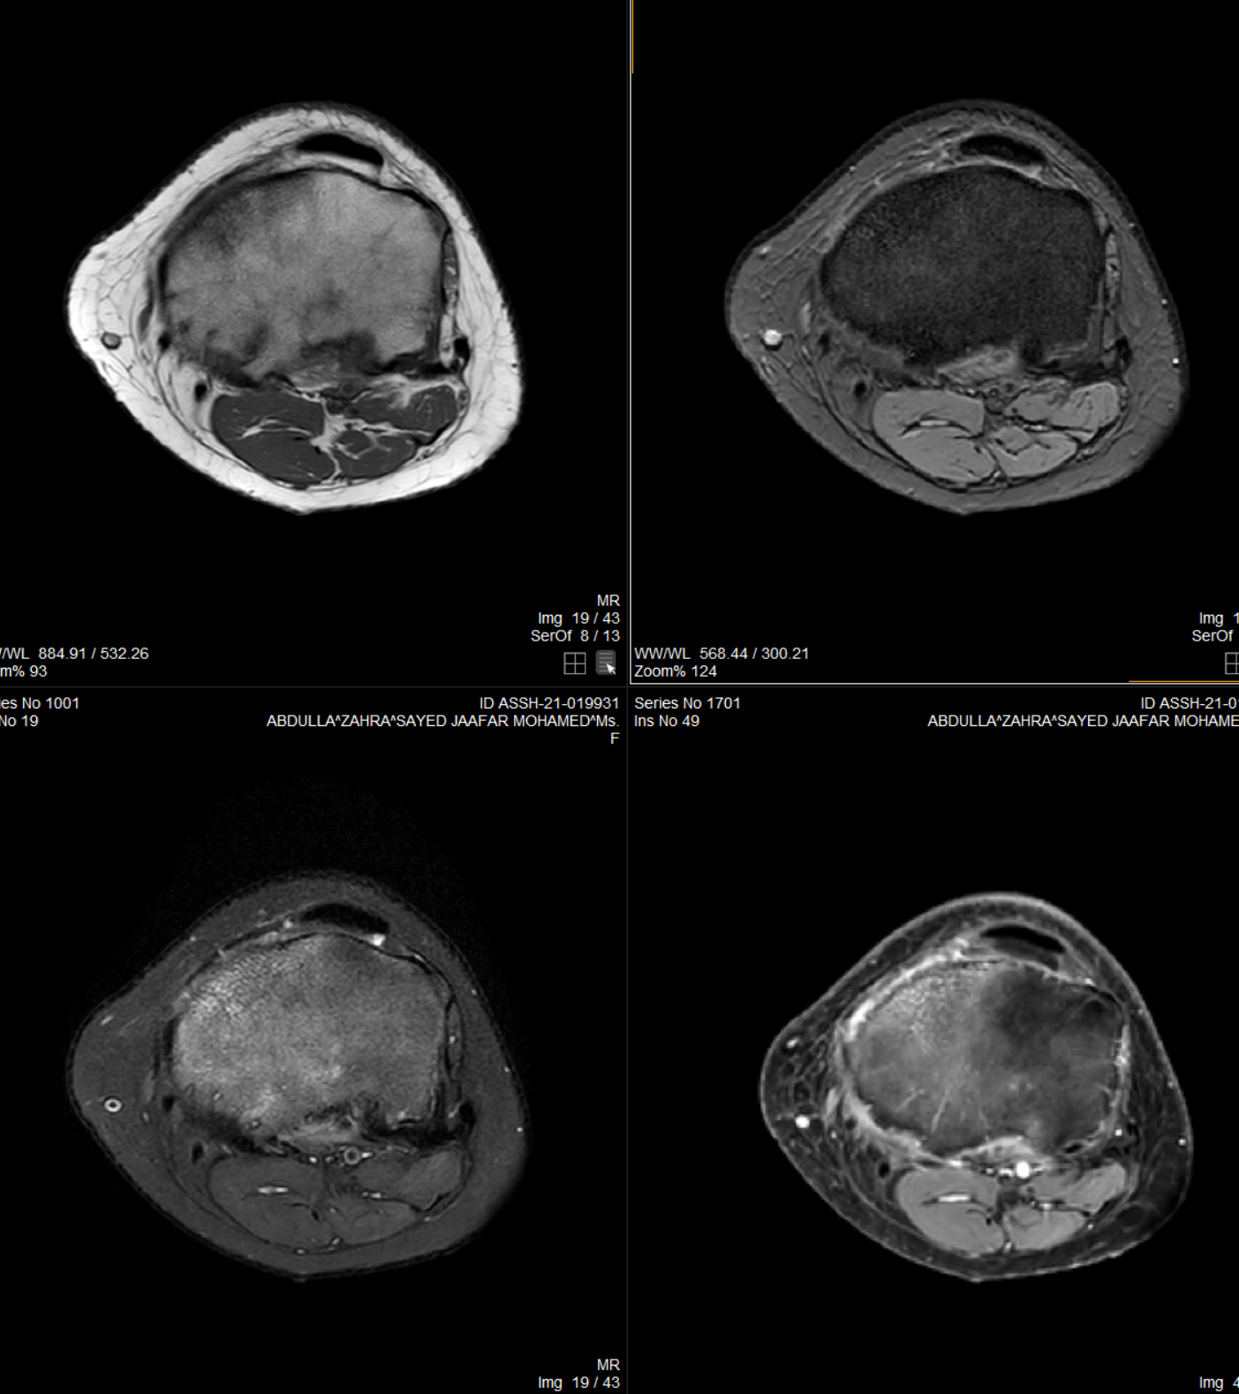
T1, GRE
T2FS, PC

Slide 3
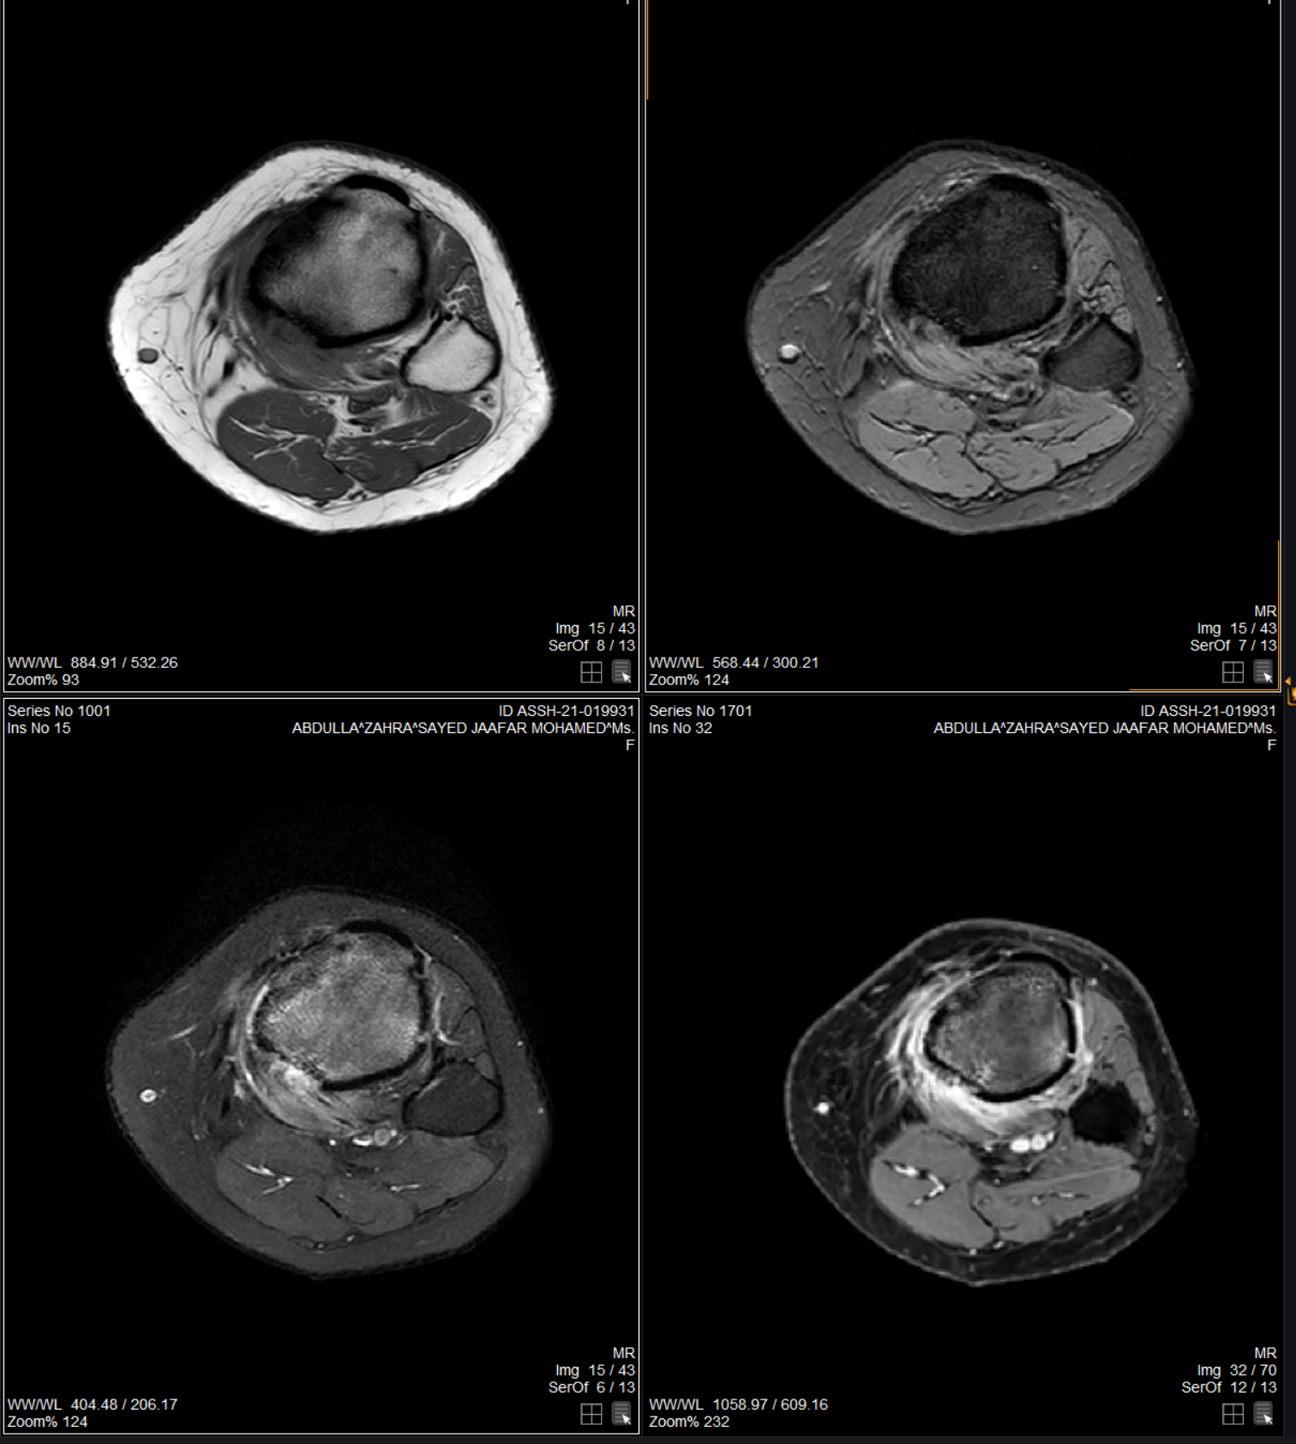
T1, GRE
T2FS, PC

Slide 4
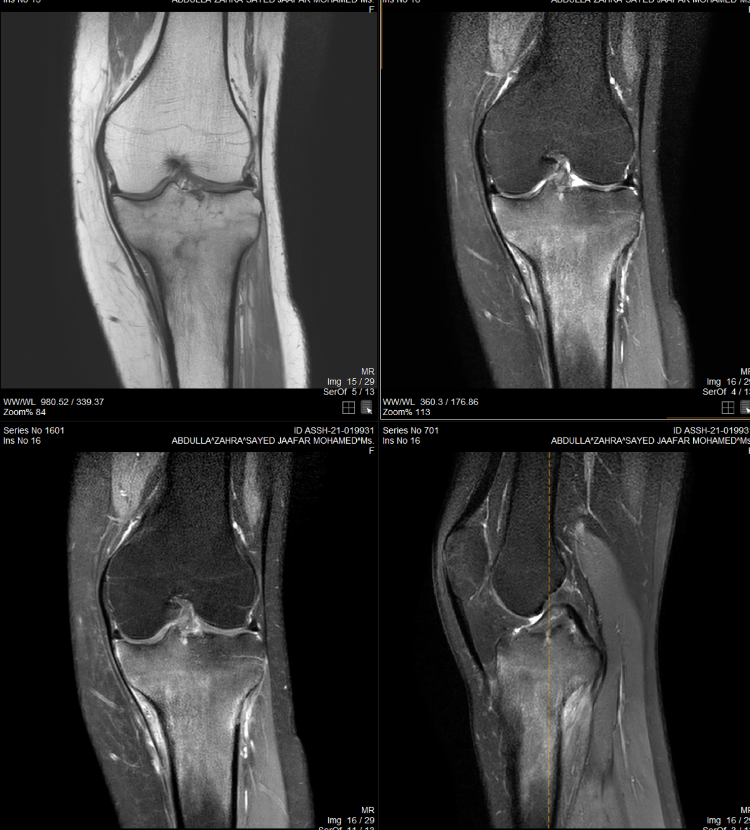
T1, T2FS
Cor and Sag PC

