Slide 1
12 year old male. Sternal pain for about 8 months
No pain in other joints
Pain iniciated after a fall 10 months ago

Slide 2
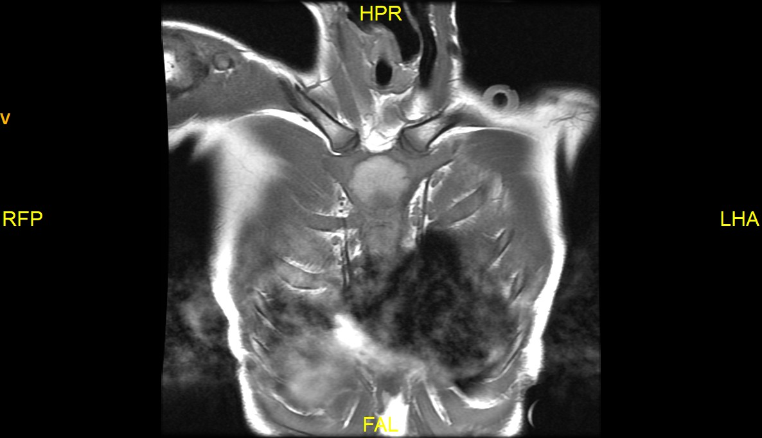
07/06/2021

Slide 3
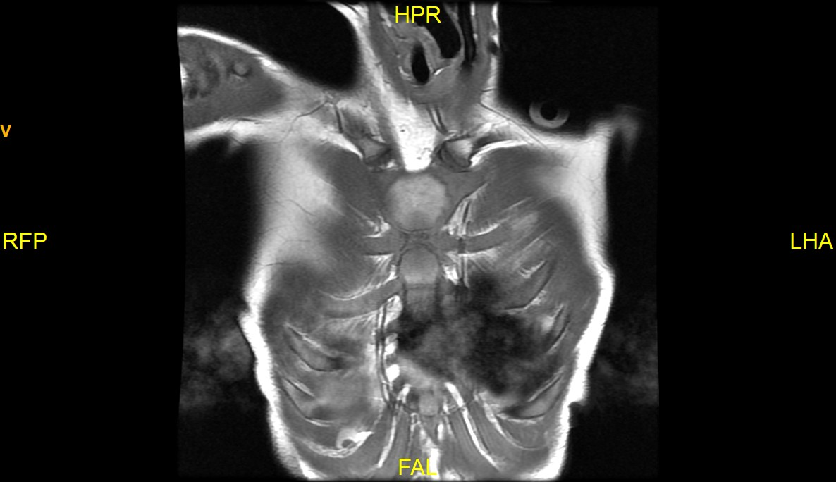

Slide 4
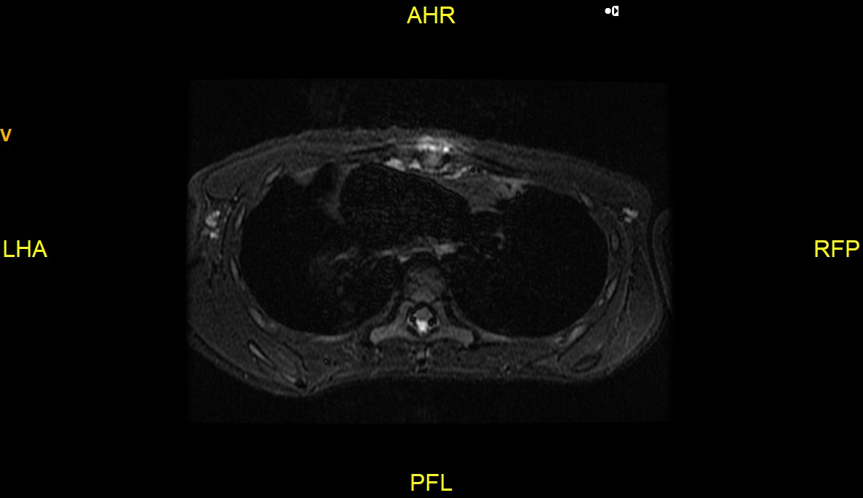

Slide 5
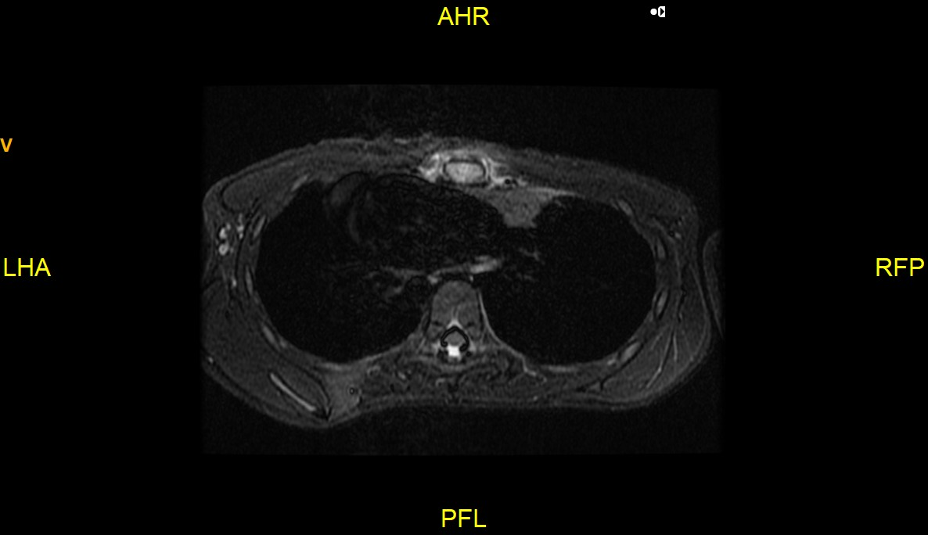

Slide 6
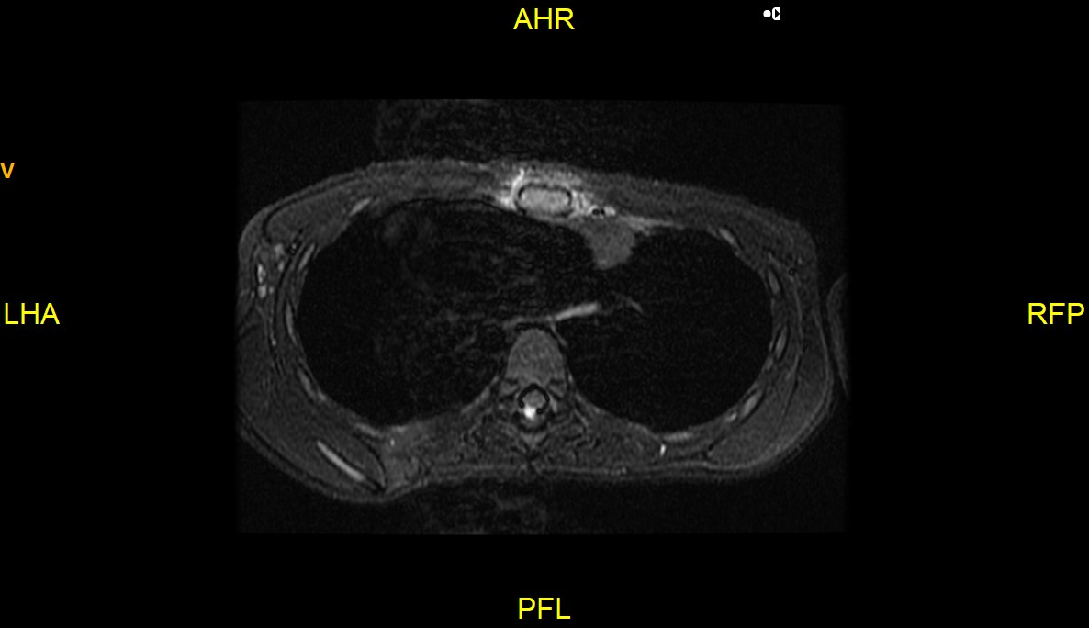

Slide 7
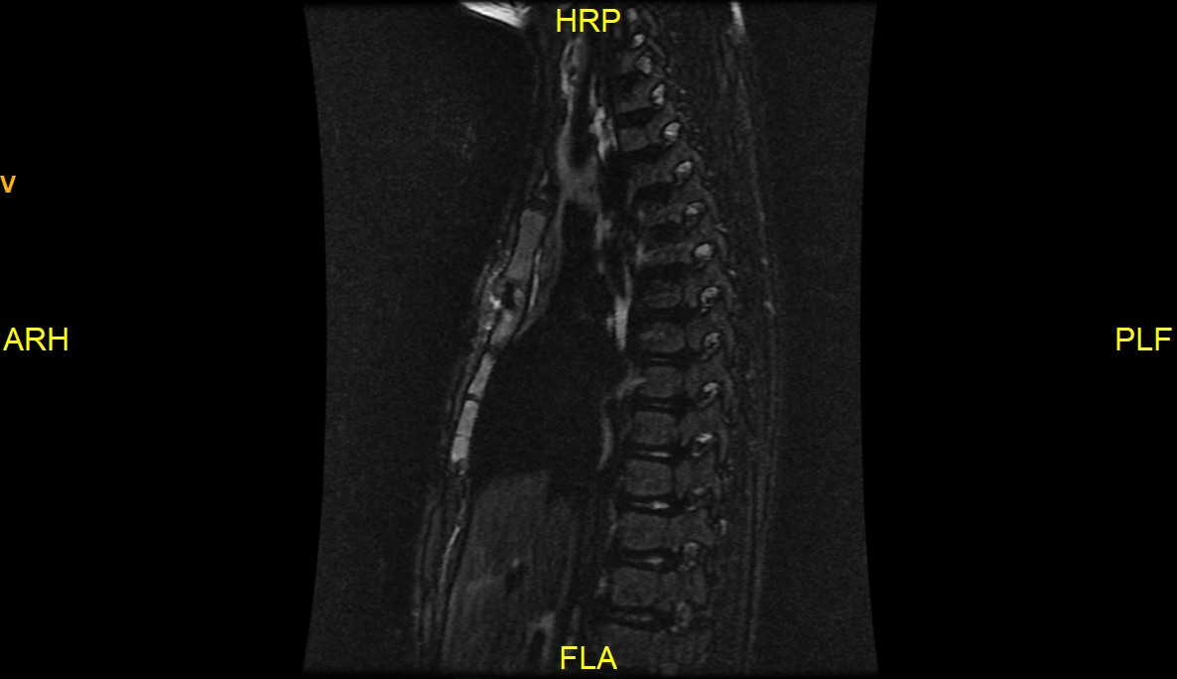

Slide 8
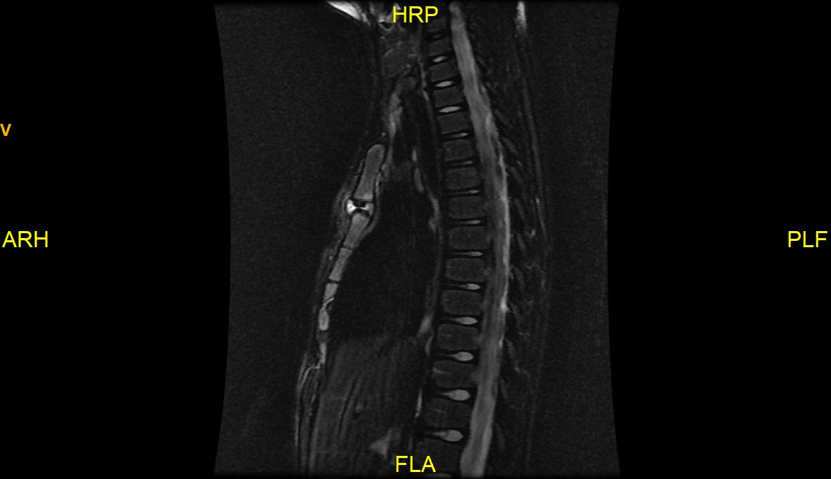

Slide 9
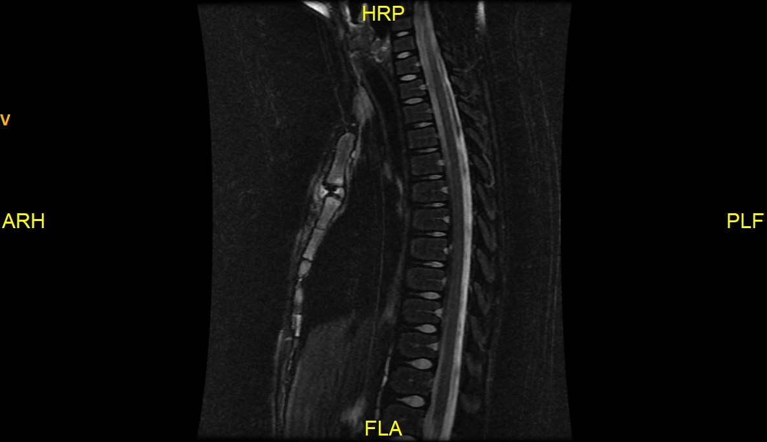

Slide 10
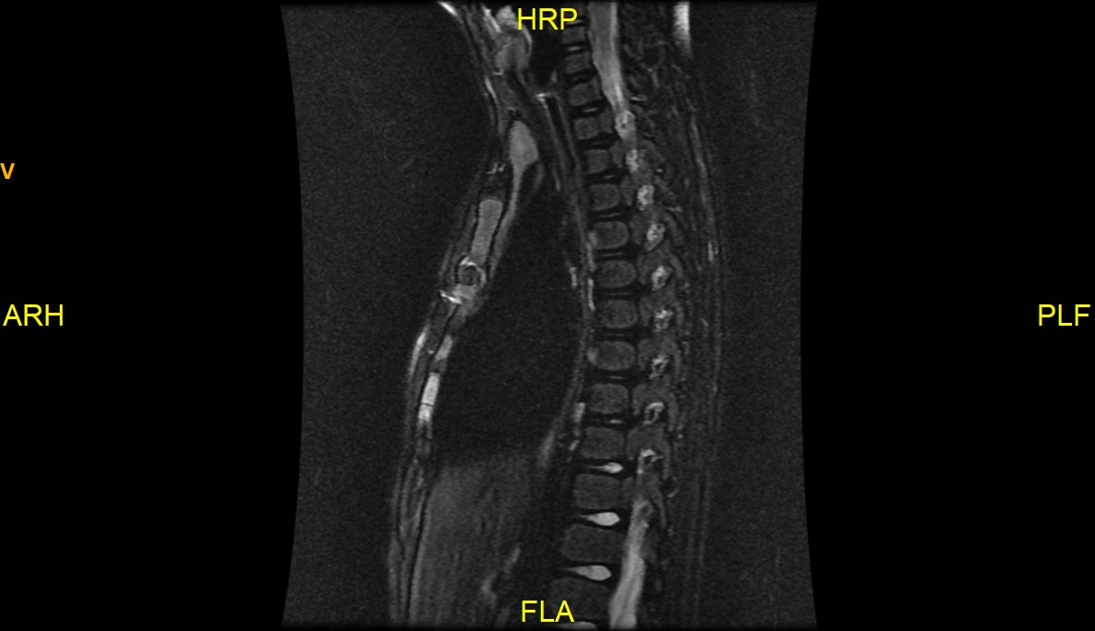

Slide 11
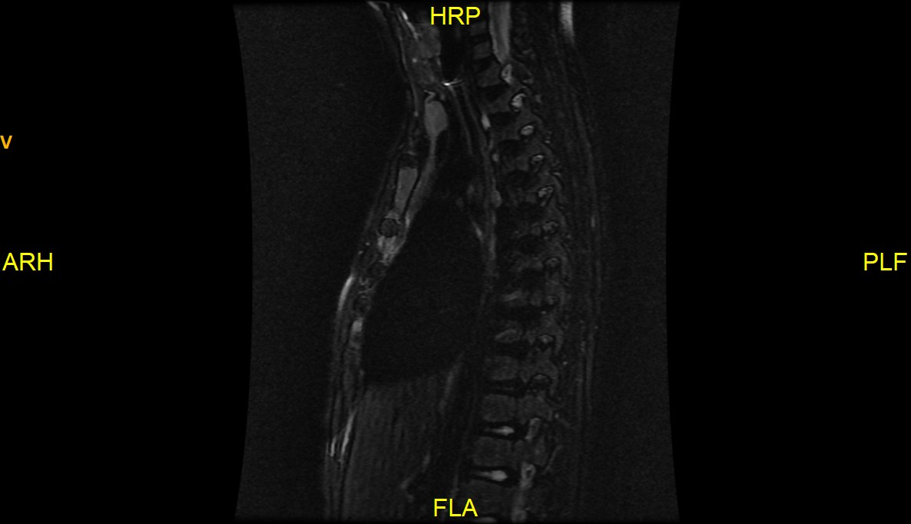

Slide 12
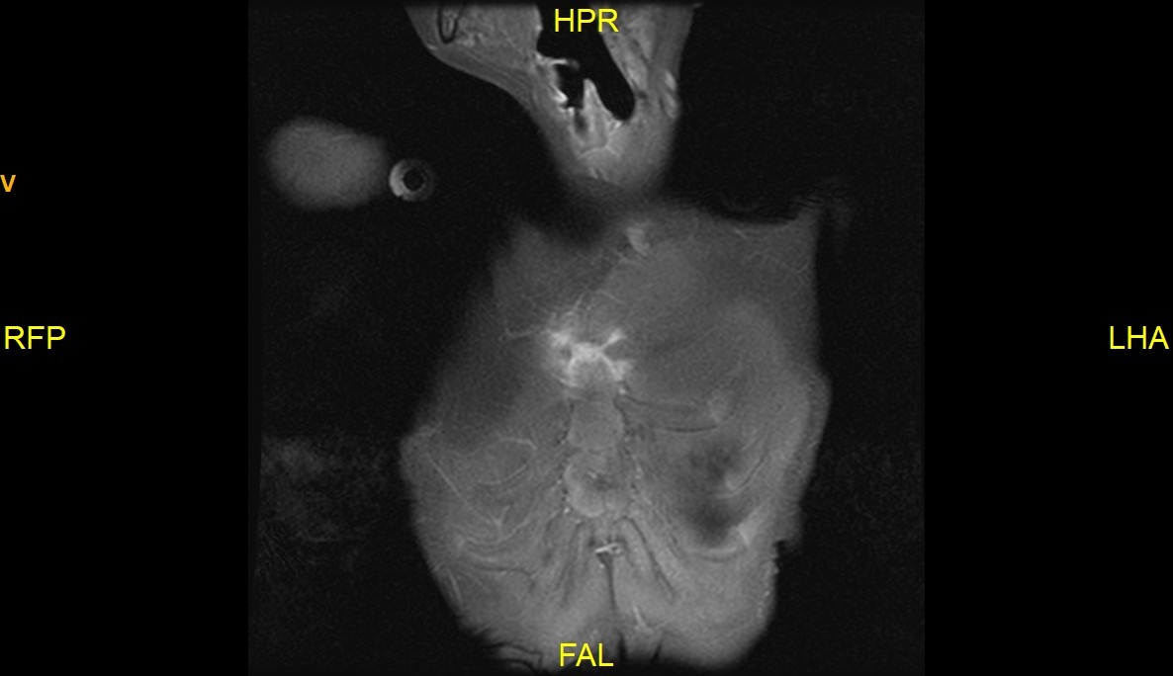
GAD

Slide 13
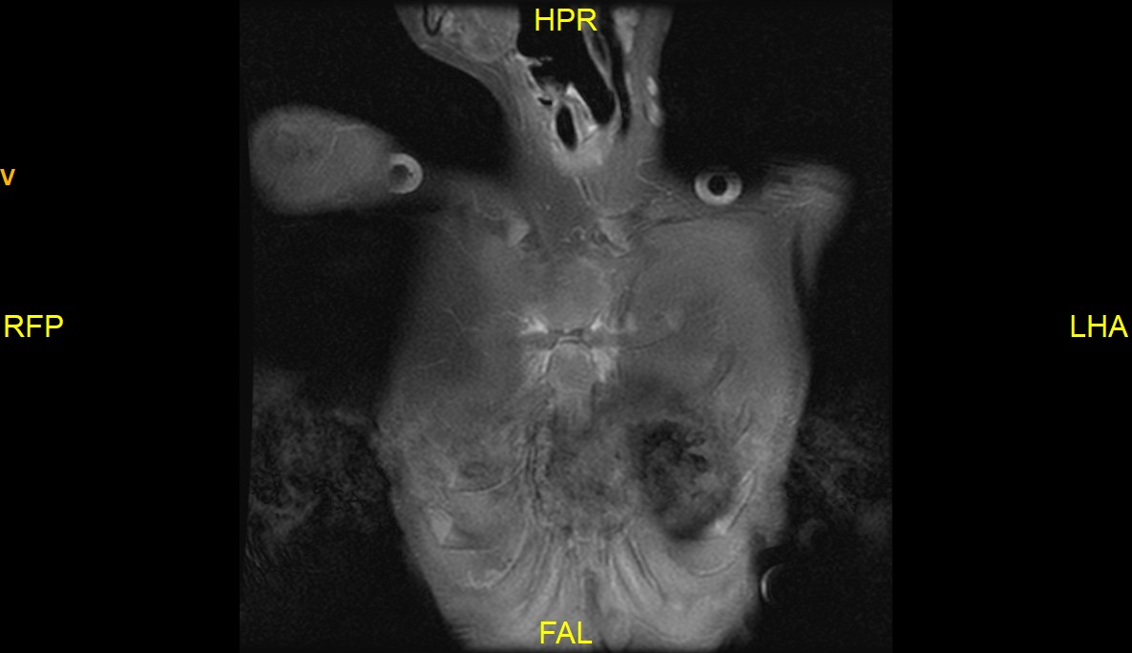

Slide 14
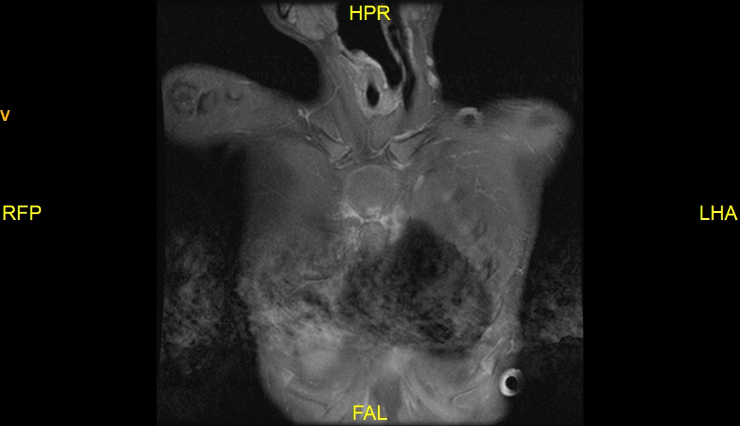

Slide 15
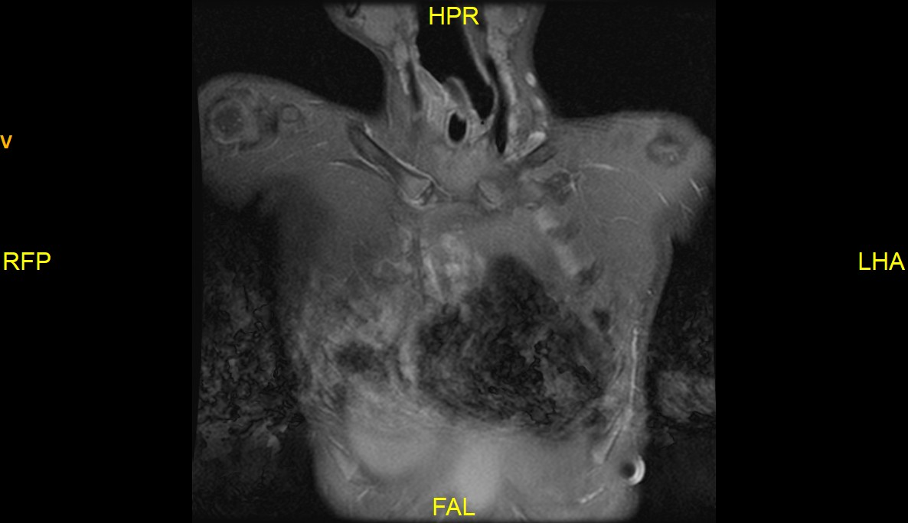

Slide 16
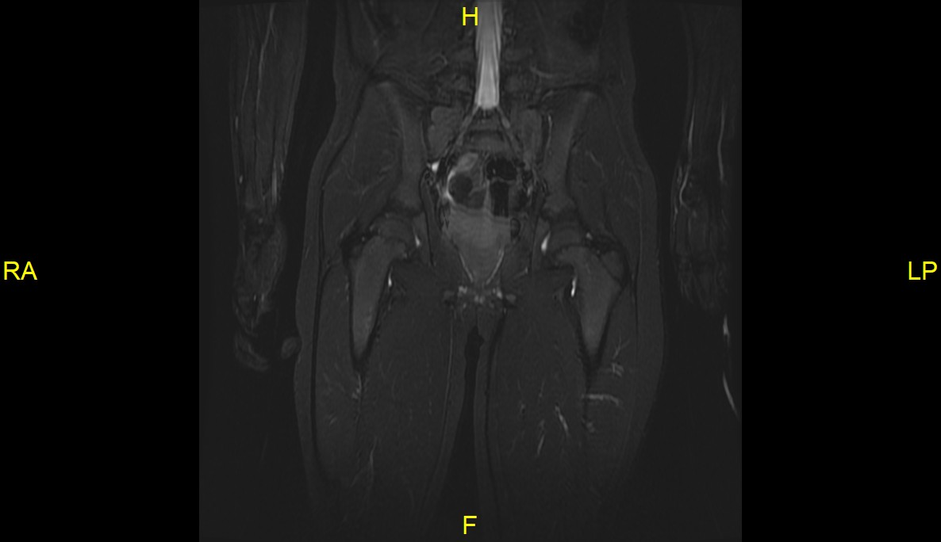

Slide 17
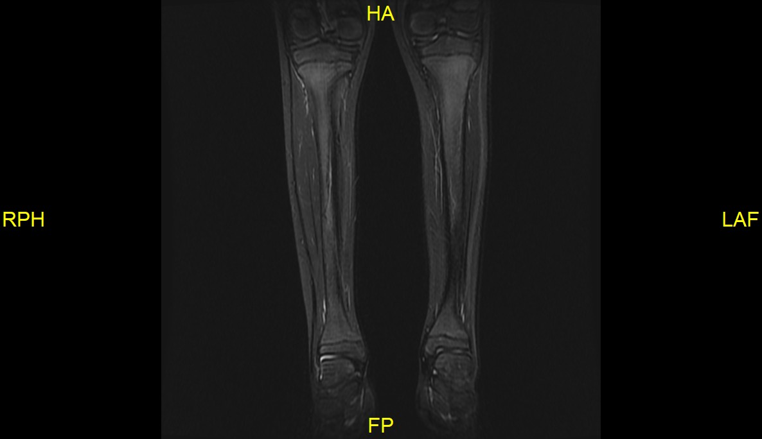

Slide 18
CRMO VS JIA
ANY OTHER THOUGHTS?

Slide 19
kID STILL COMPLAINS OF MANUBRIOSTERNAL DISCONFORT WITH NEW ONSET PAIN AT THE CALCANEUS INSERTION
LAB RESULTS POSITIVE FOR HLA B27 and ASO.
ALL OTHER BIOMARKKER ARE WITHIN NORMAL LIMITS
PATIENT IS SCHEDULLED FOR A STRNAL BIOPSY AS PER ORTH REQUEST.

Slide 20
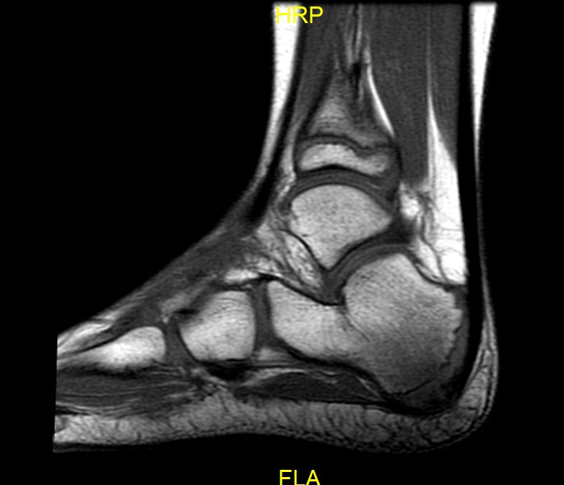
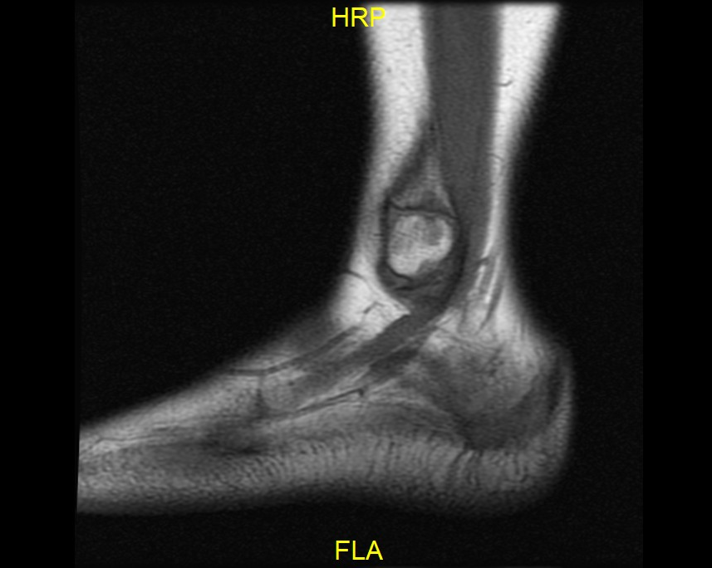
09/01/2021

Slide 21
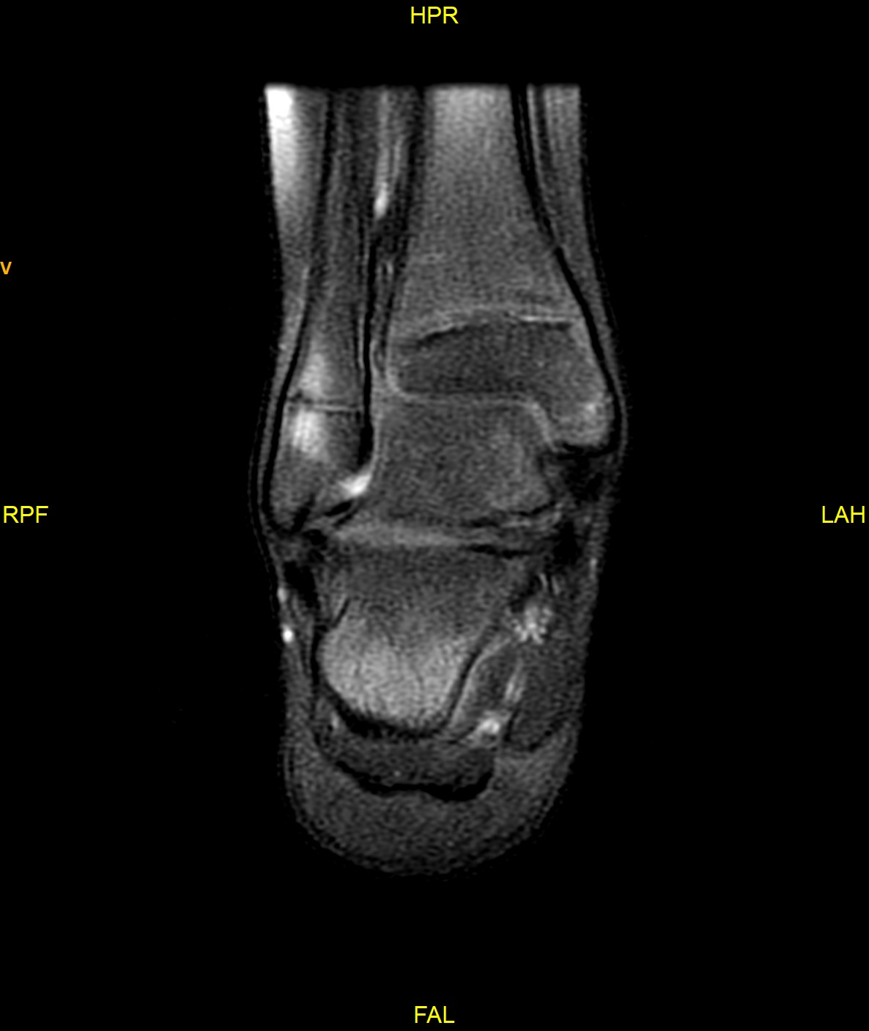
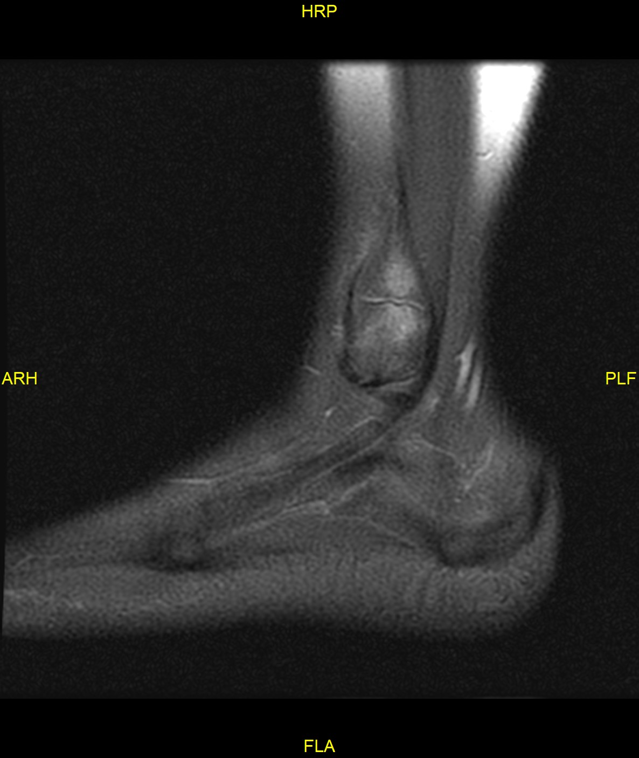
T2

Slide 22
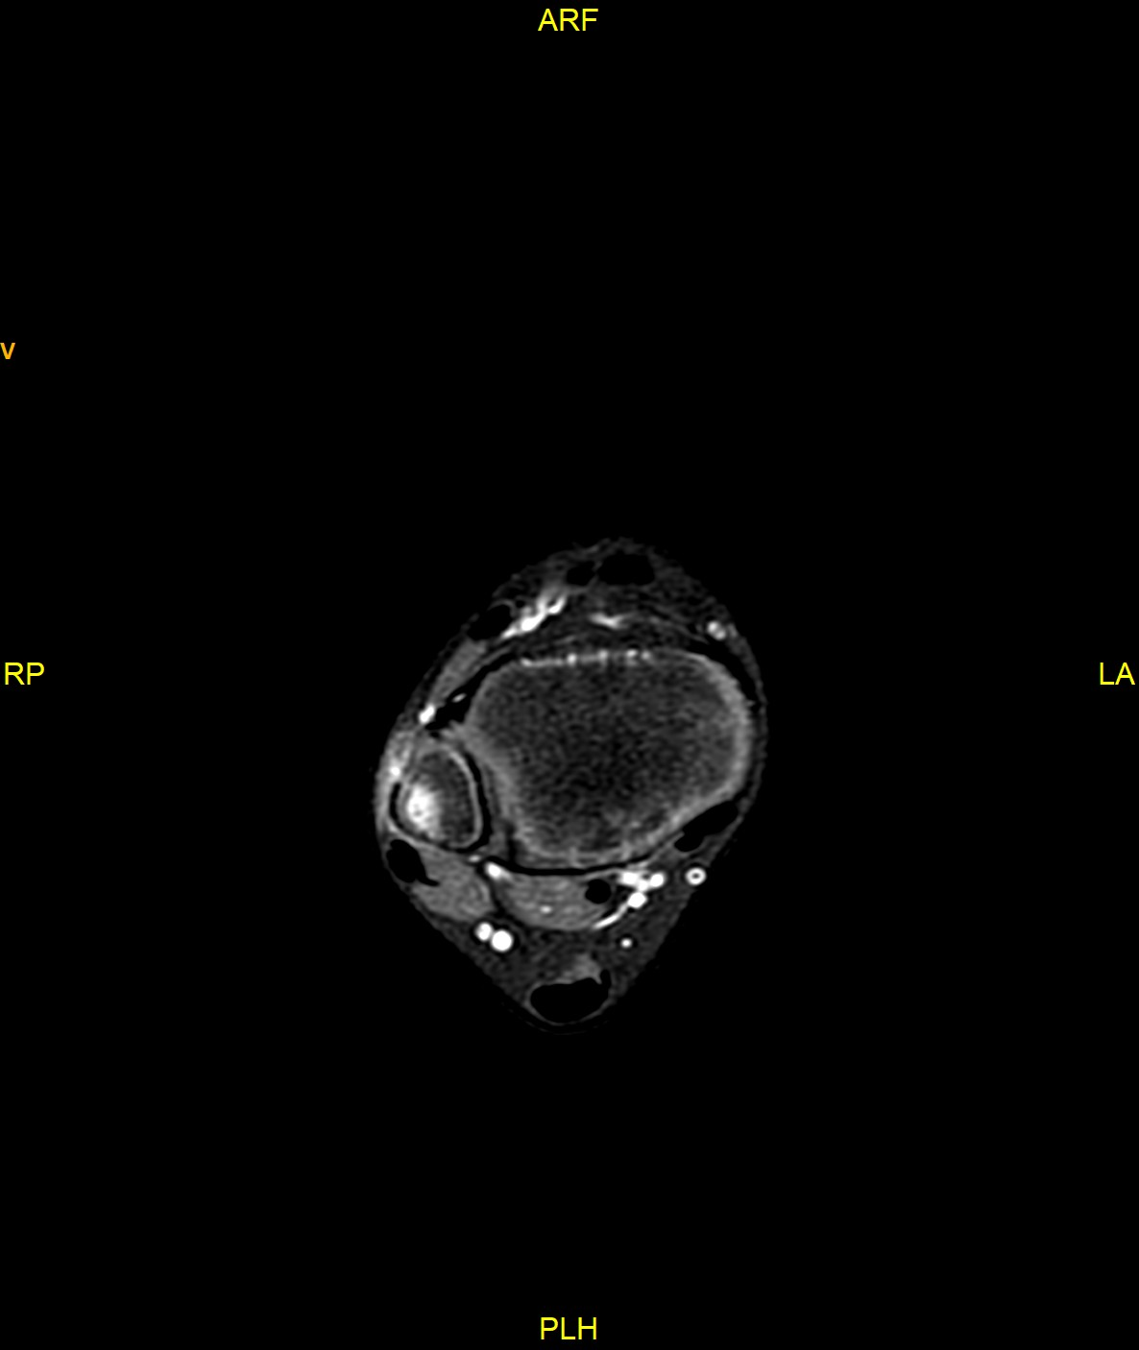
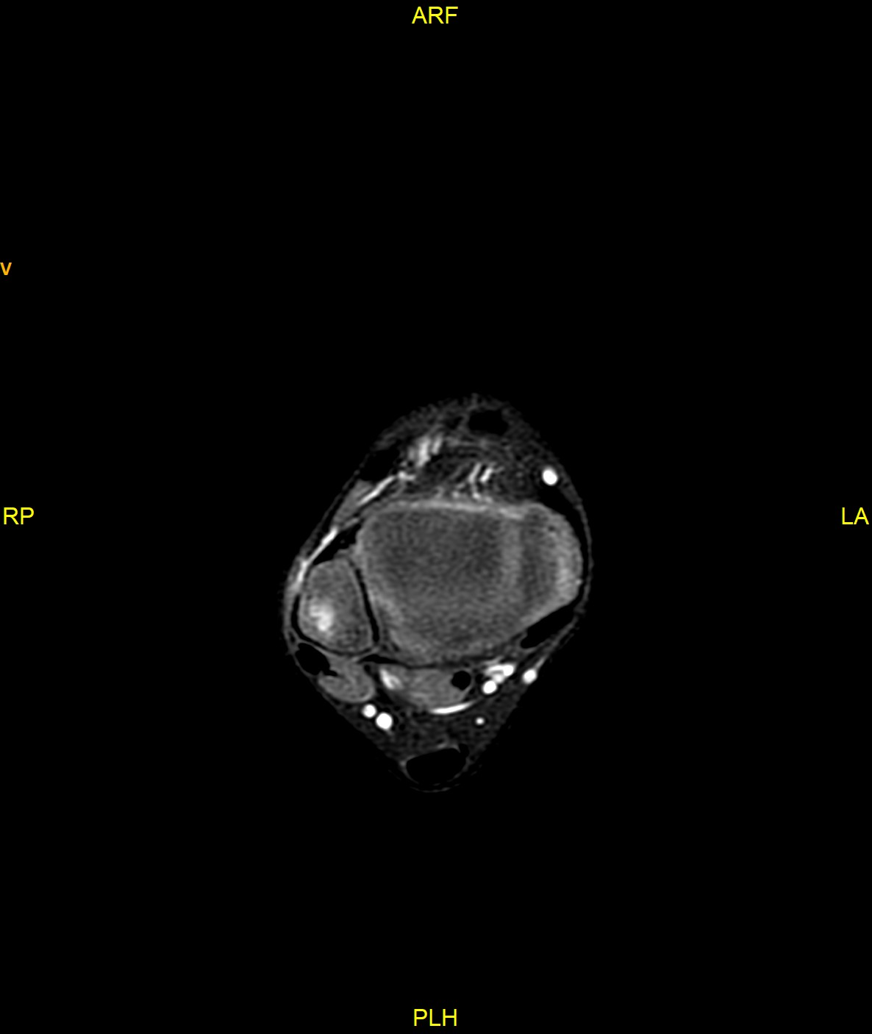
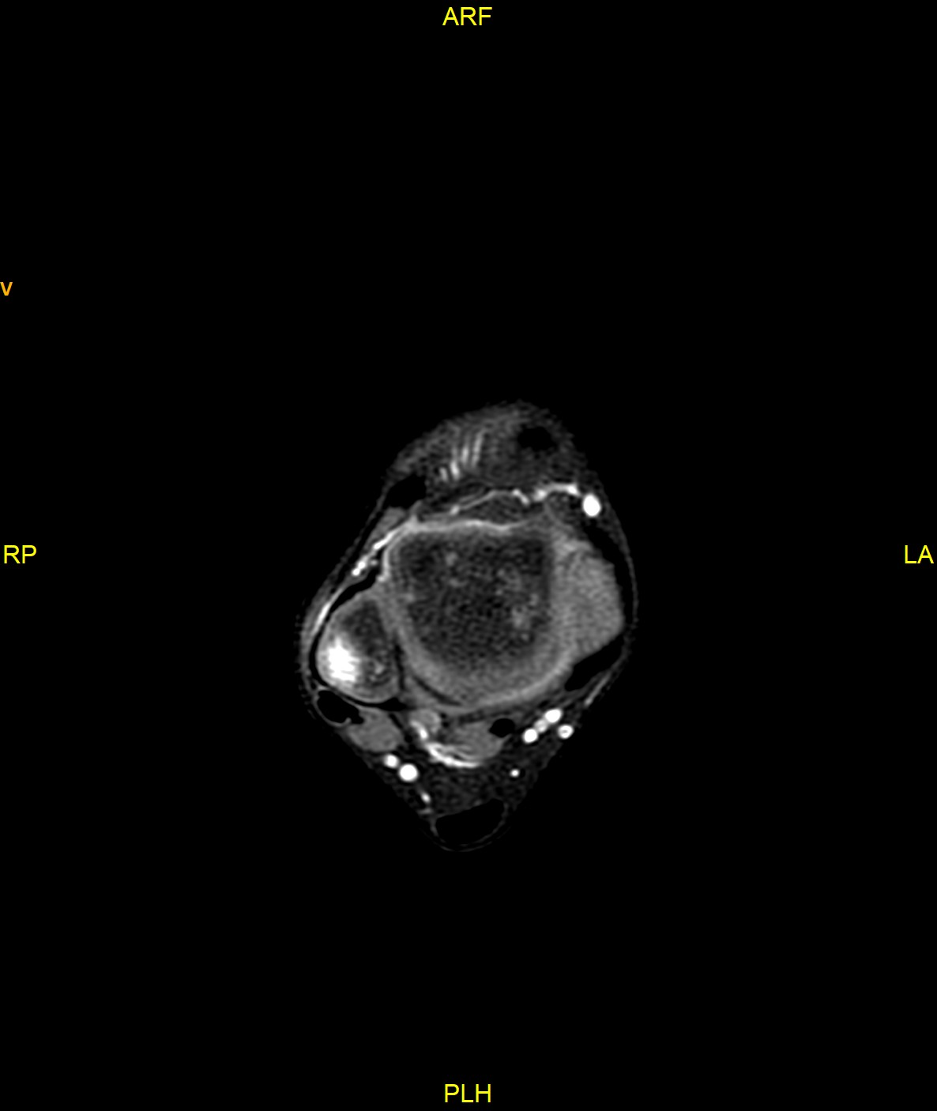
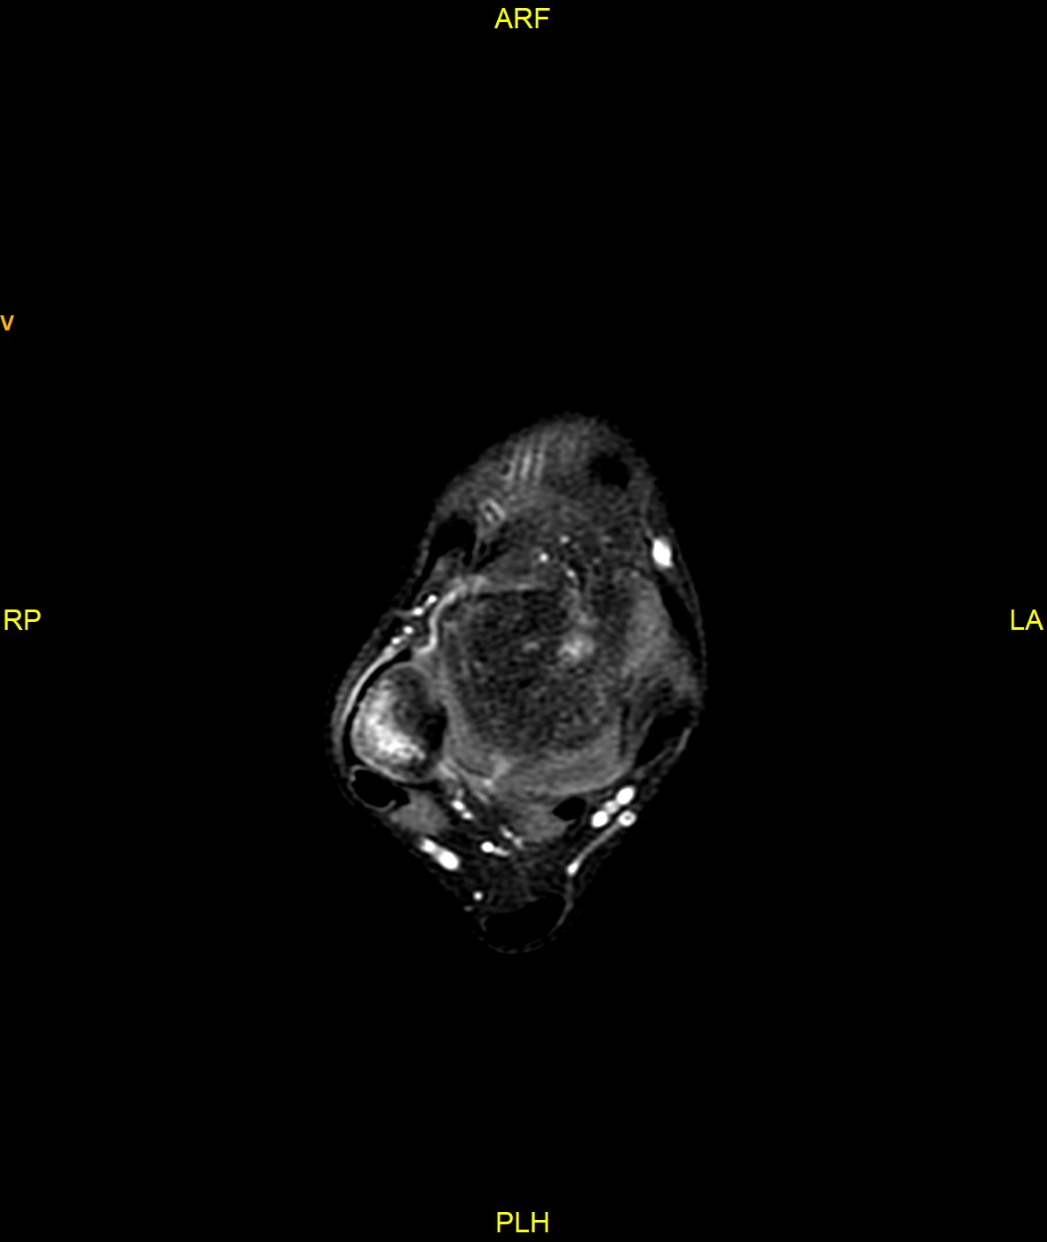
GAD

Slide 23
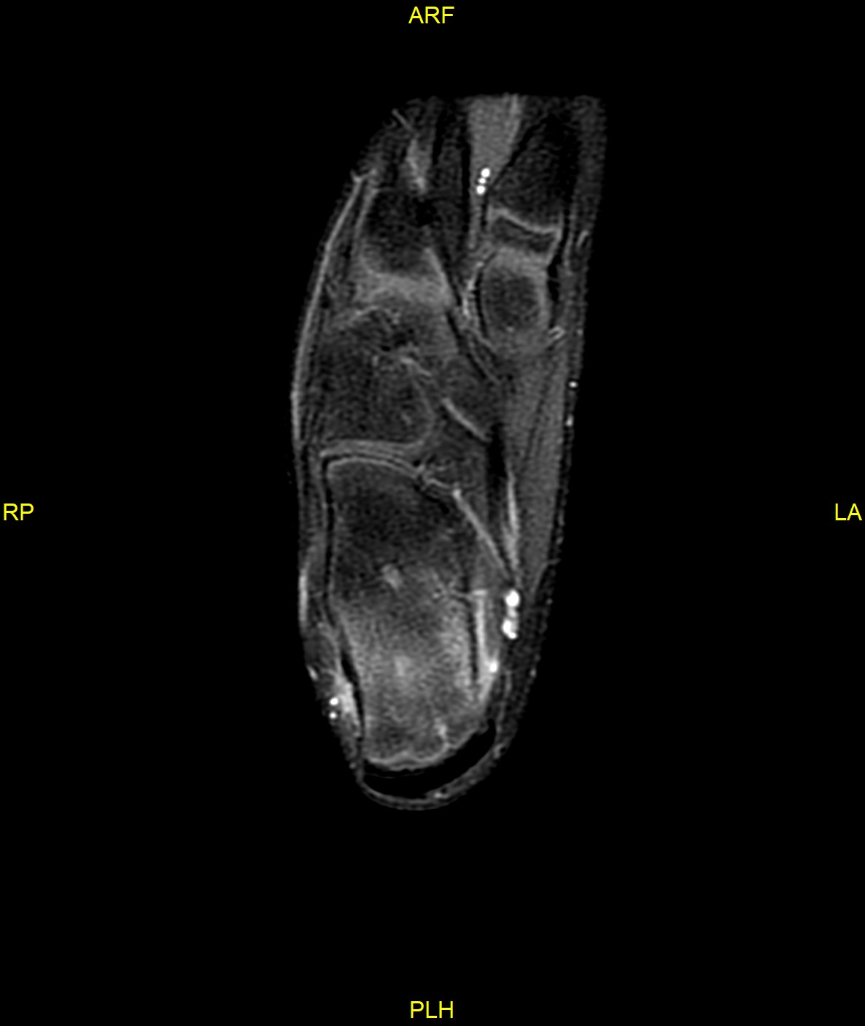
GAD

Slide 24
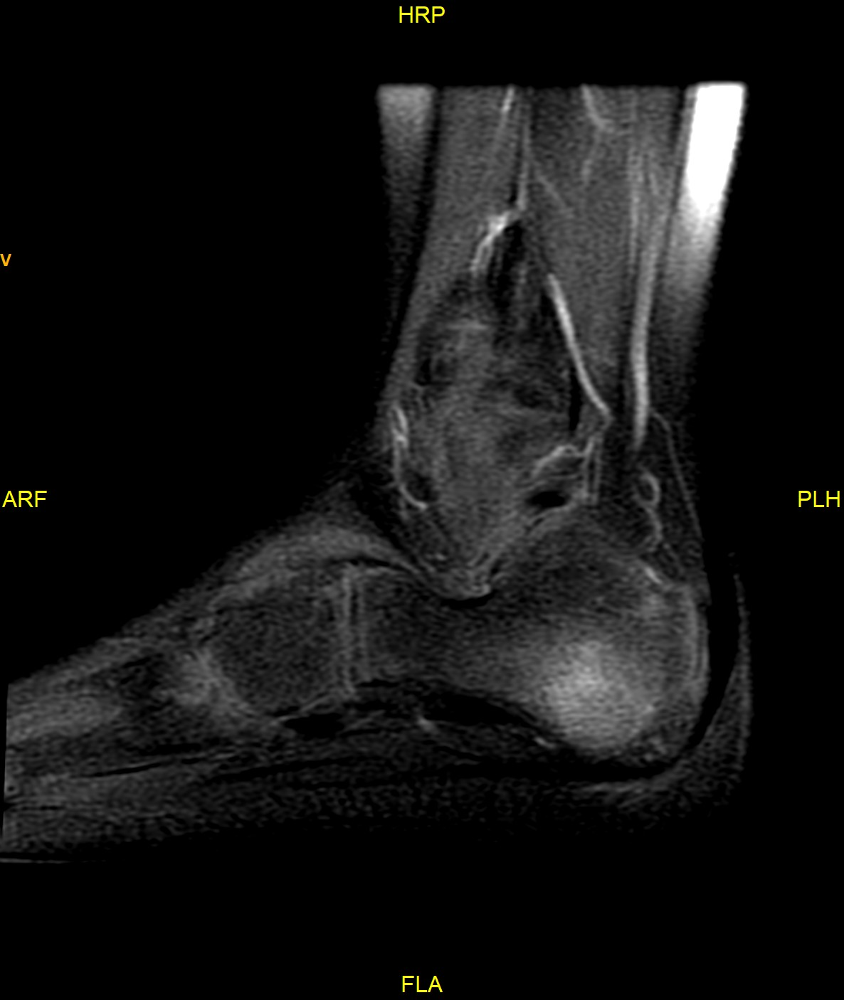
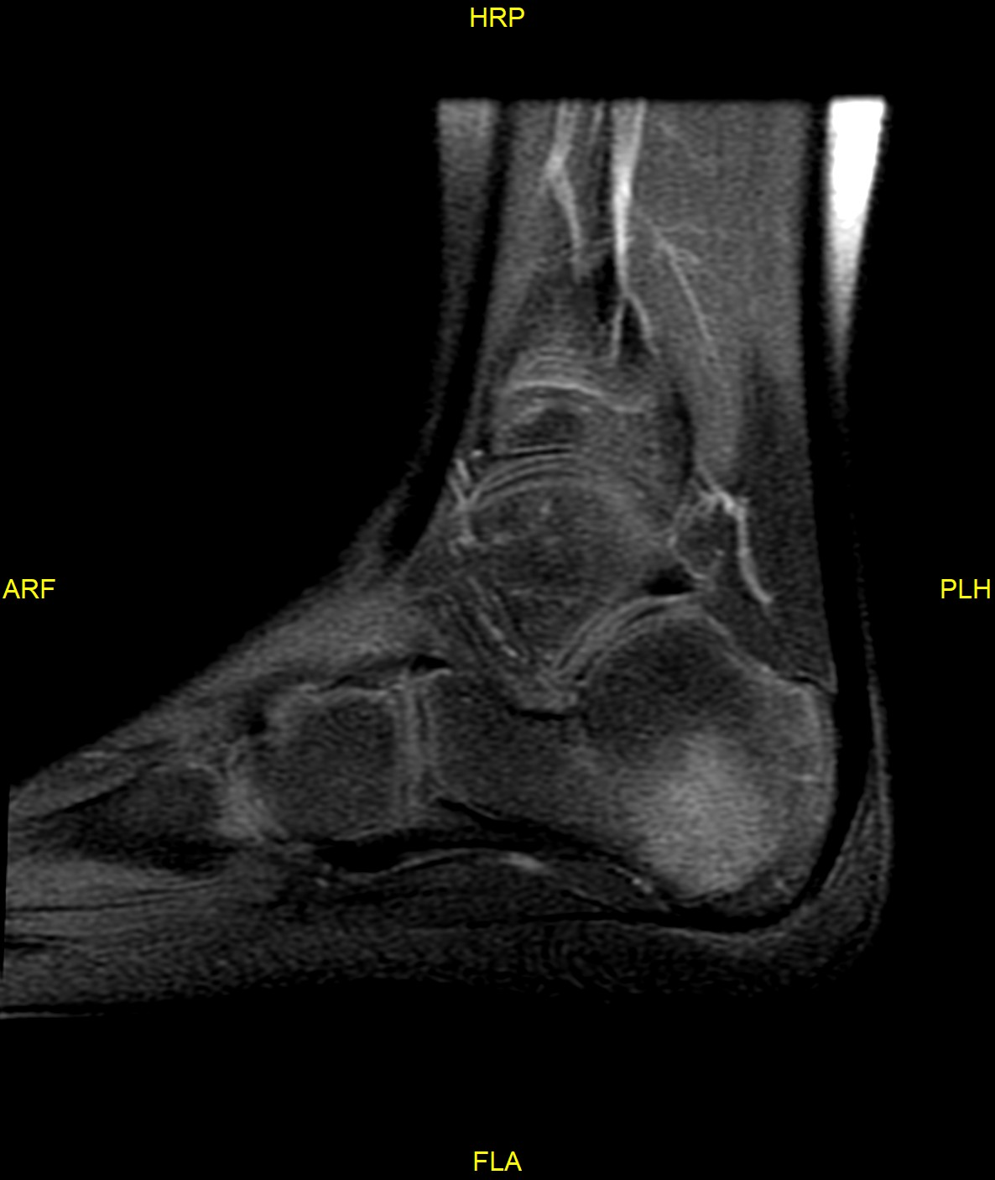
GAD

