Slide 1
63 male, fall

Slide 2
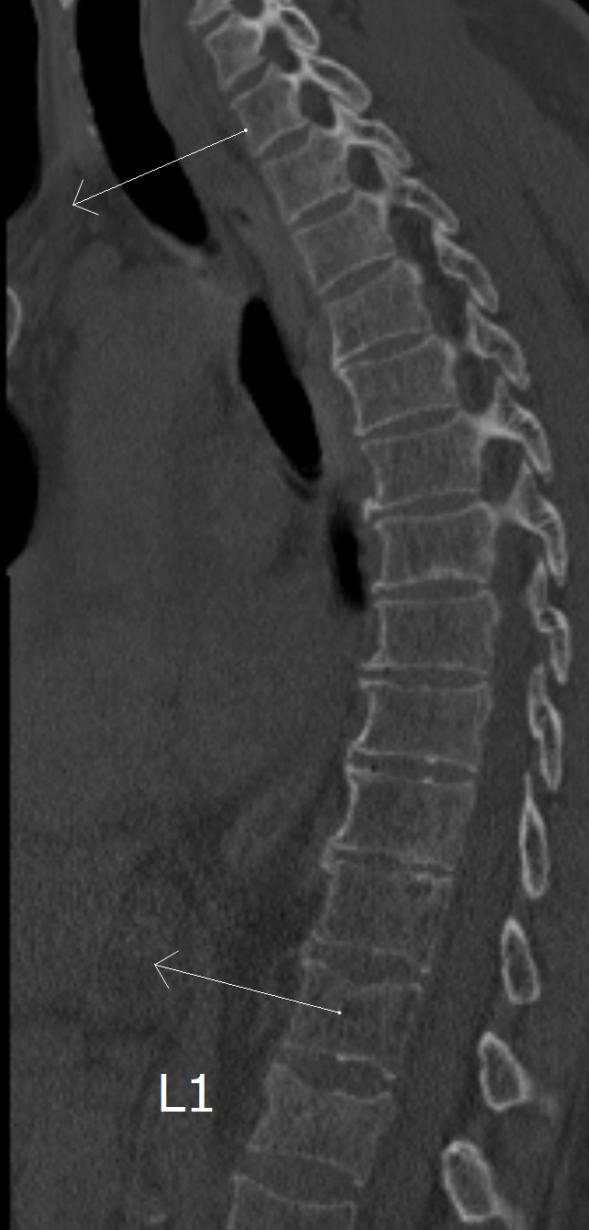
Fall
July 06

Slide 3
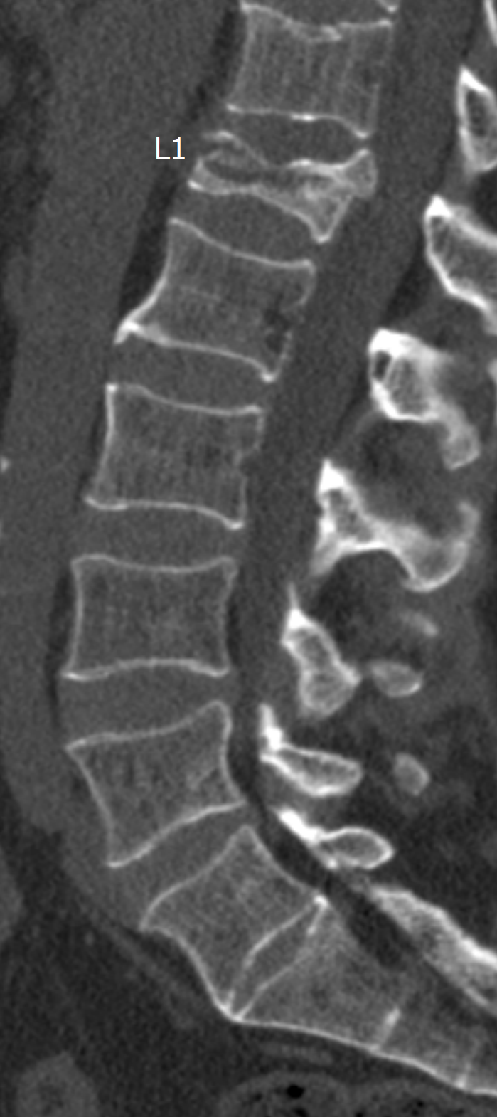
Control
August 26

Slide 4
Vertebral osteonecrosis and collapse (Kümmell's disease)

