Slide 1
History
2 yrs boy with 10-15 days pain and tenderness in midleg. (fibula)
No trauma or excessive sports activity.
There is local tenderness and pain on compression.
No specific pain at night. No fever in last 6 months.
Xray is normal (image not available but the report is from very reliable source).

Slide 2
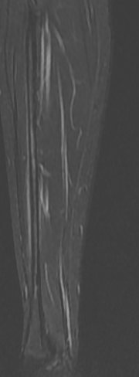
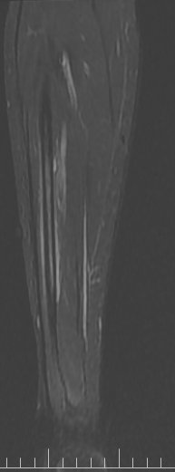
STIR

Slide 3
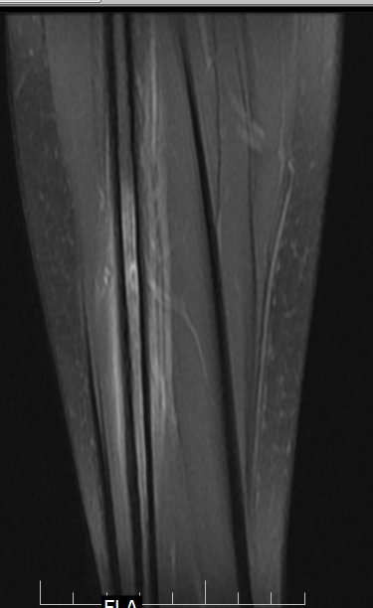
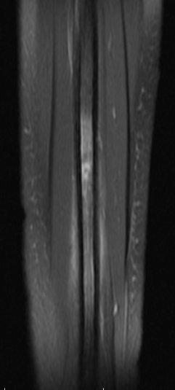
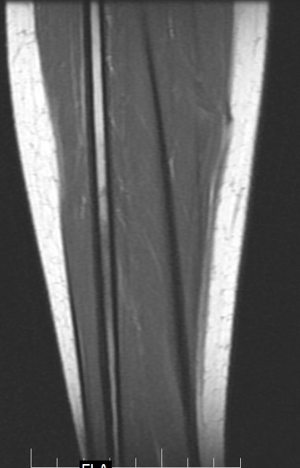
PDFS
PDFS
T1

Slide 4
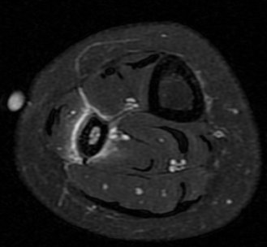
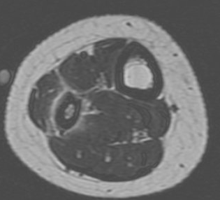
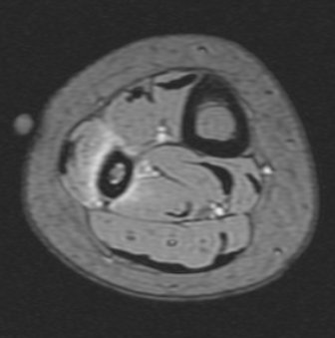
PDFS
T1
MERGE

Slide 5
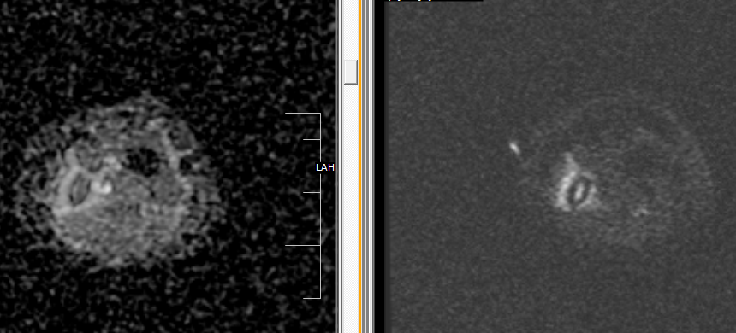
ADC
DWI

Slide 6
Differentials?
What next?

