Slide 1
26 y . woman , with a tortion in her ankle .
XR with an increased density area in distal tibia; no pain or masses .
What do you think?

Slide 2
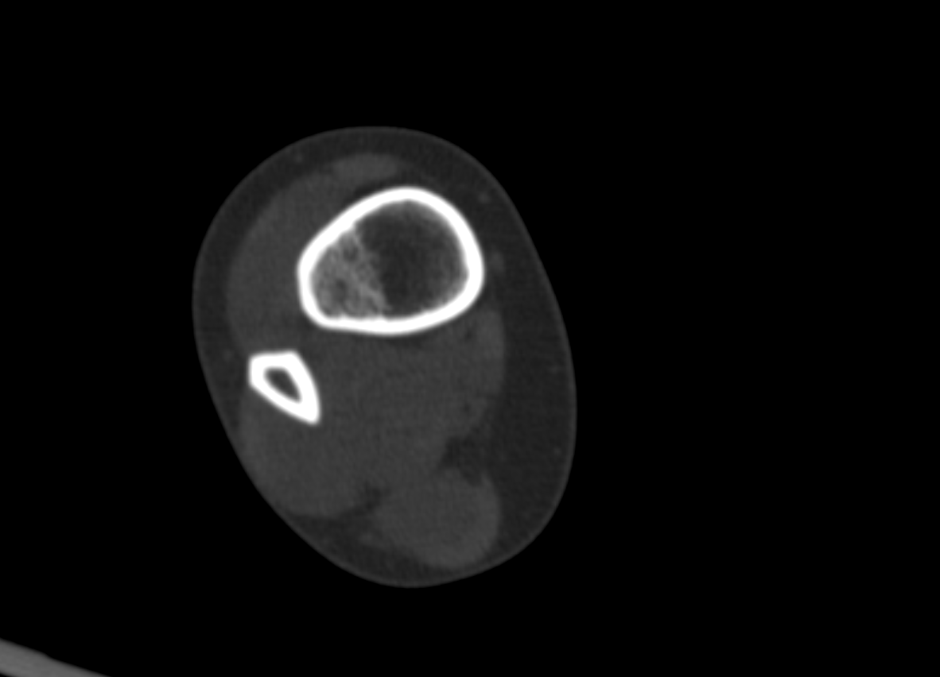

Slide 3
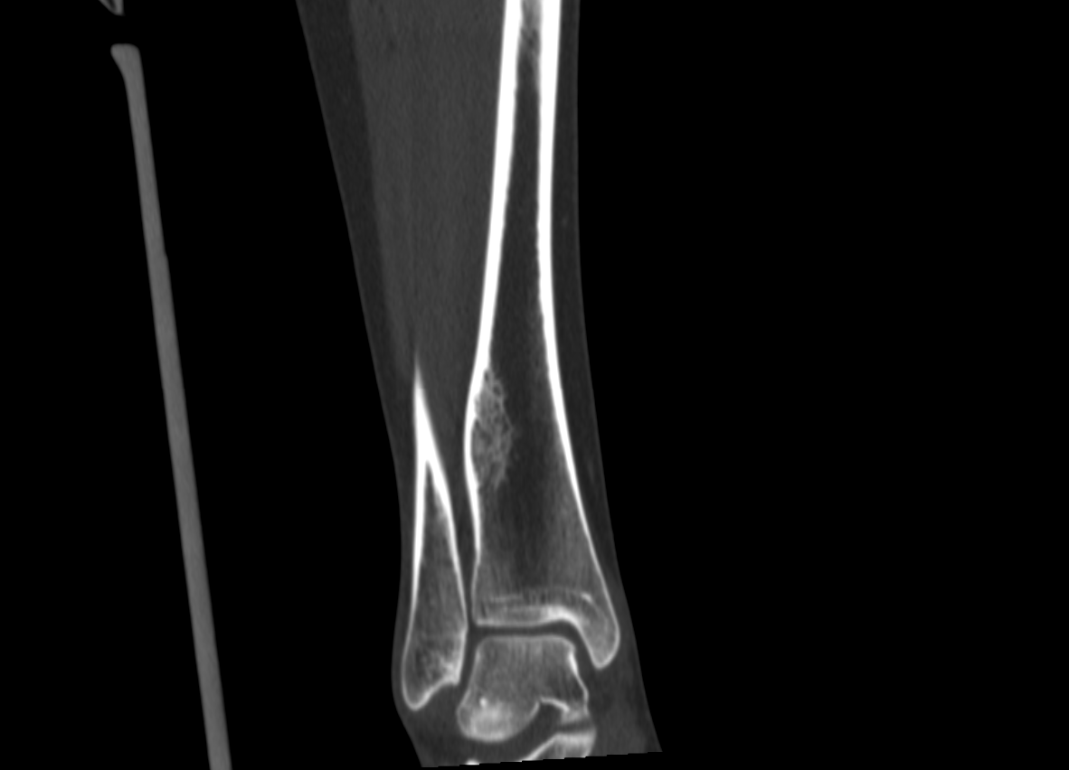
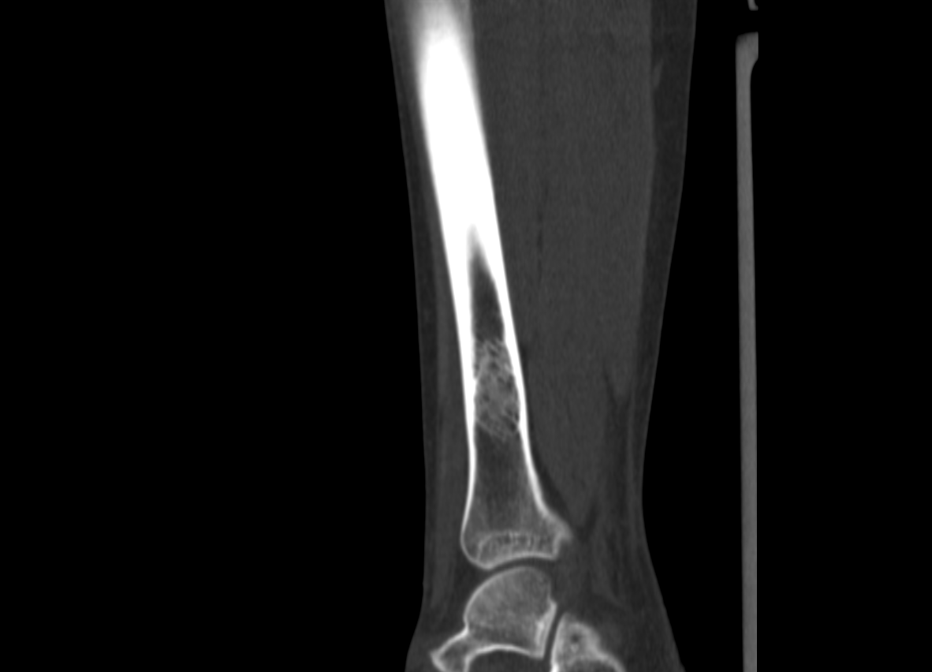

Slide 4
