Slide 1
57 year old female work colleague spontaneous pain lat left knee on long uphill walk
I called this likely osteochondral insufficiency fracture

Slide 2
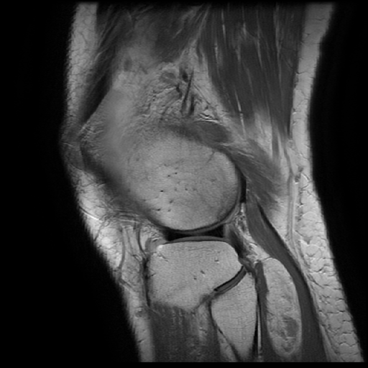
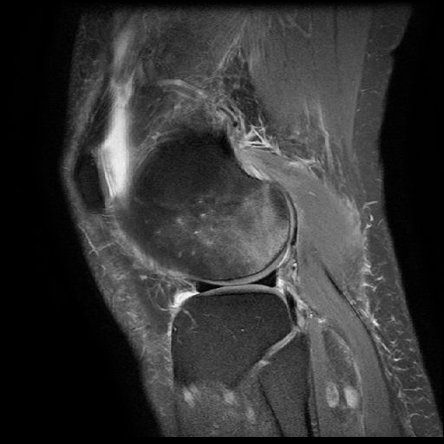

Slide 3
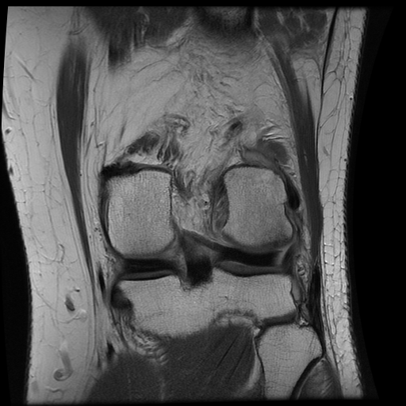
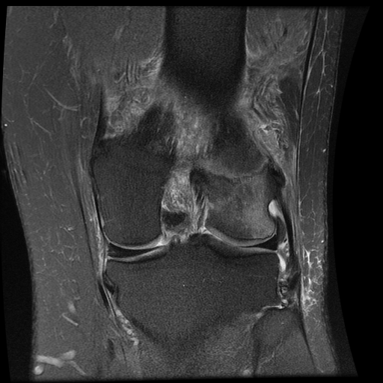

Slide 4
6 weeks later
Non weight bearing
Asymptomatic unless puts wt through it.
Is this natural history or should I be worried?

Slide 5
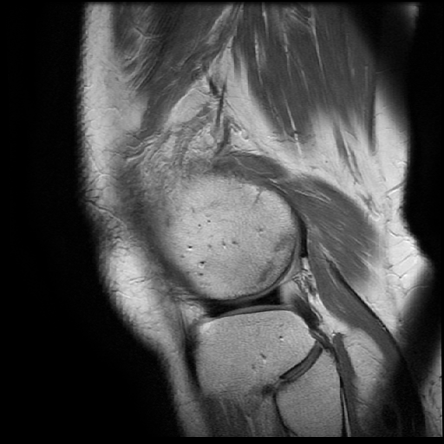
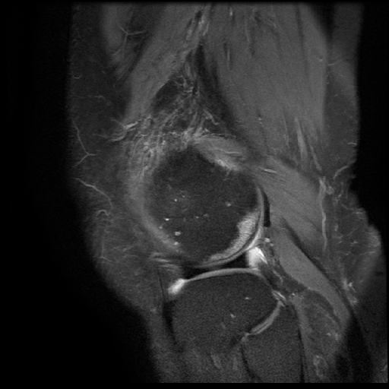

Slide 6
