Slide 1
19 Years old, Female
Investigating sacroiliitis
Sacral pain for the last two months
Looks like a mechanical edema.
Could it be an enthesitis?
What do you think
Thank you

Slide 2
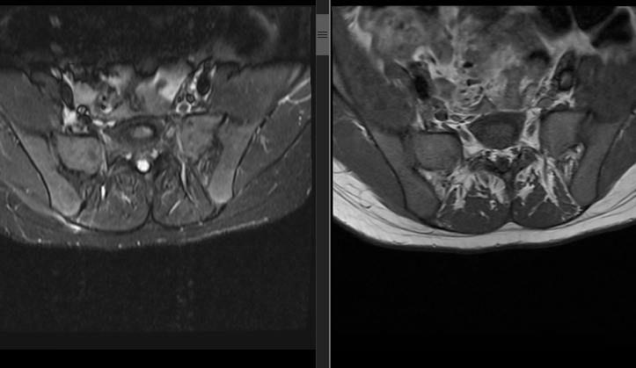
T2FS
T1

Slide 3
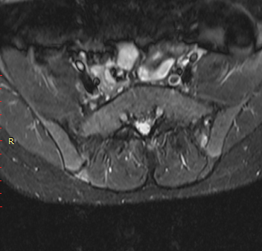
T2FS

Slide 4
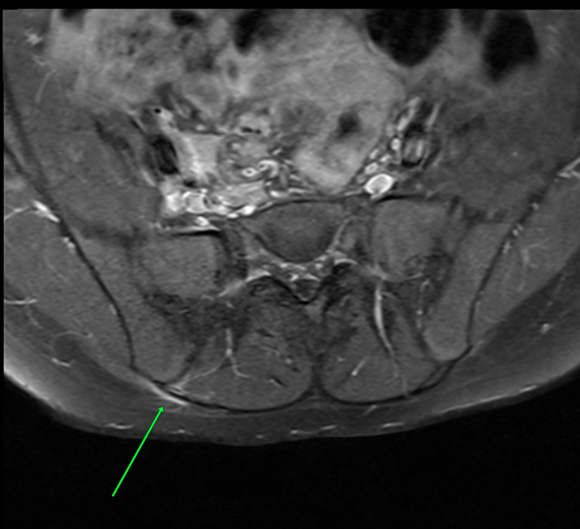
T1FS
POST CONTRAST

Slide 5
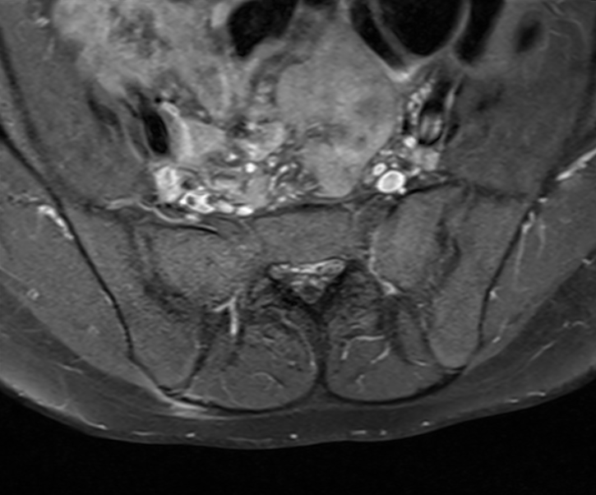
T1FS
POST CONTRAST

