Slide 1
16 Yrs/ Male
Clinical Profile: Painful swelling of right foot since 10 years. Operated twice in the past in 2015 and 2017.

Slide 2
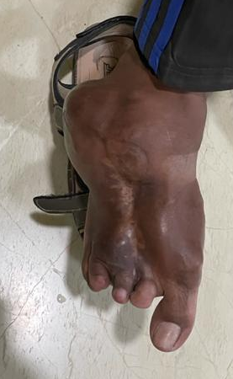

Slide 3
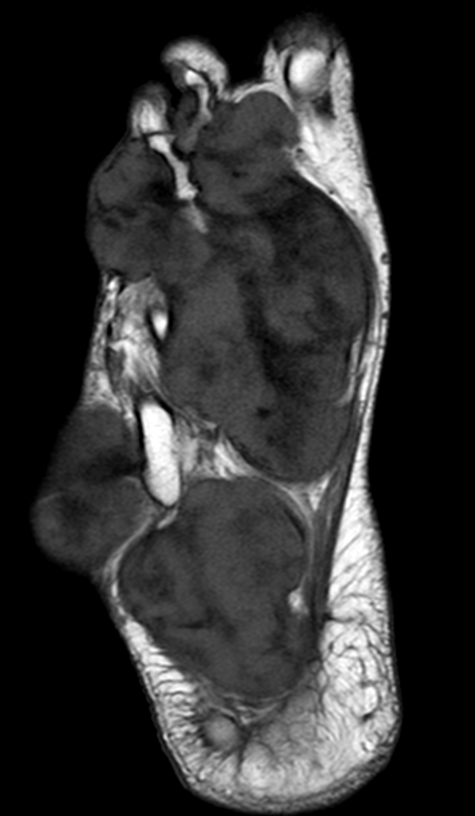
T1

Slide 4
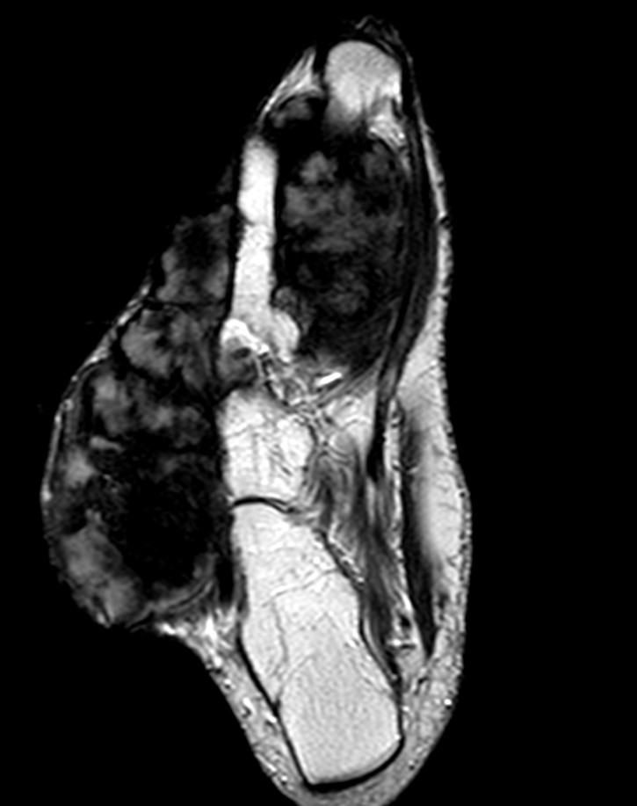
T2

Slide 5
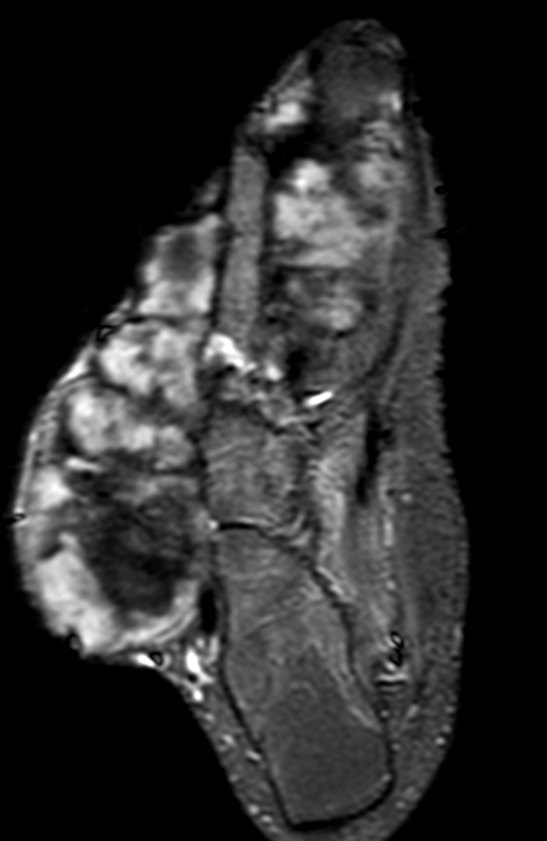
STIR

Slide 6
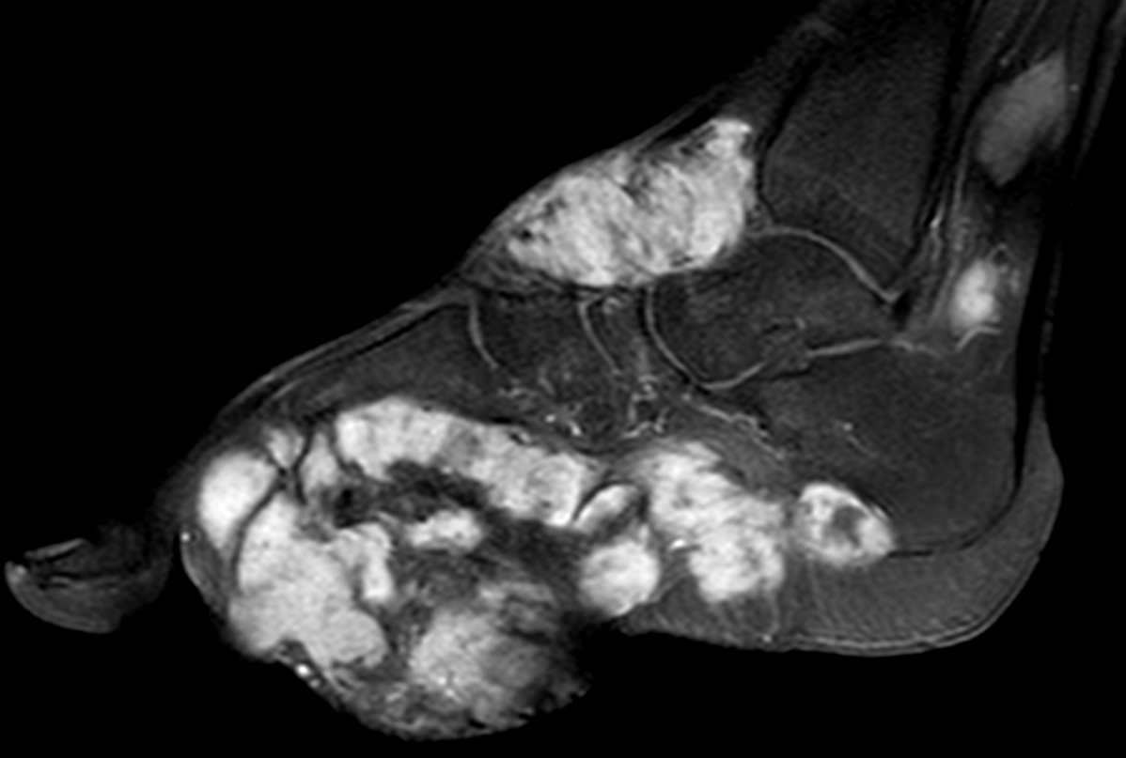
Post contrast T1

Slide 7
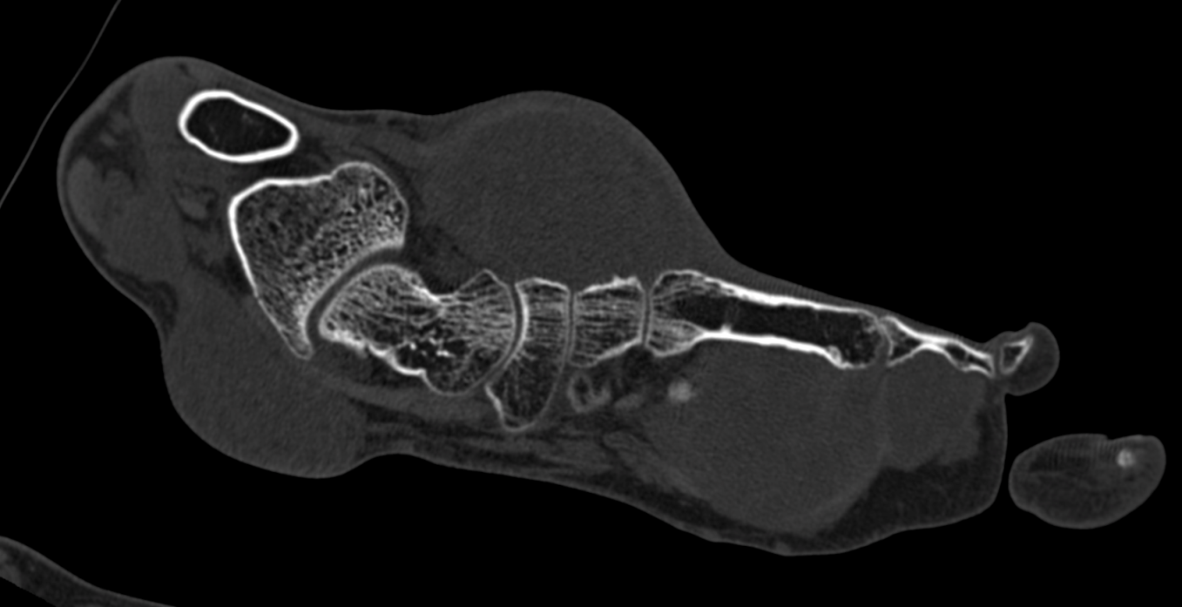
Second toe
Post contrast T1
Fourth toe

Slide 8
Patient, in addition also has a similar, synchronous mass in posteromedial upper same leg.

Slide 9
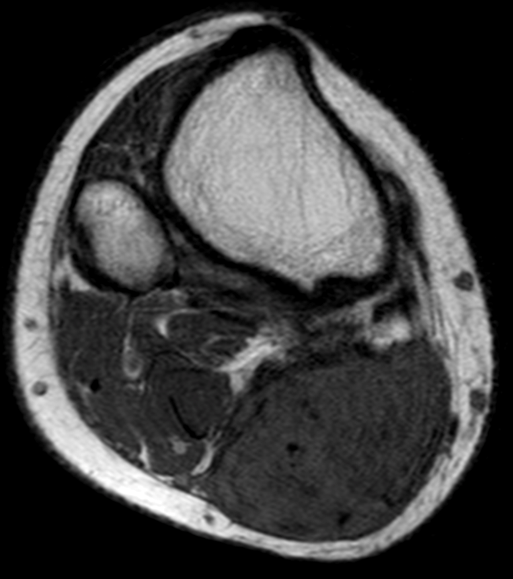
T1
STIR

Slide 10
T2 GRE

Slide 11
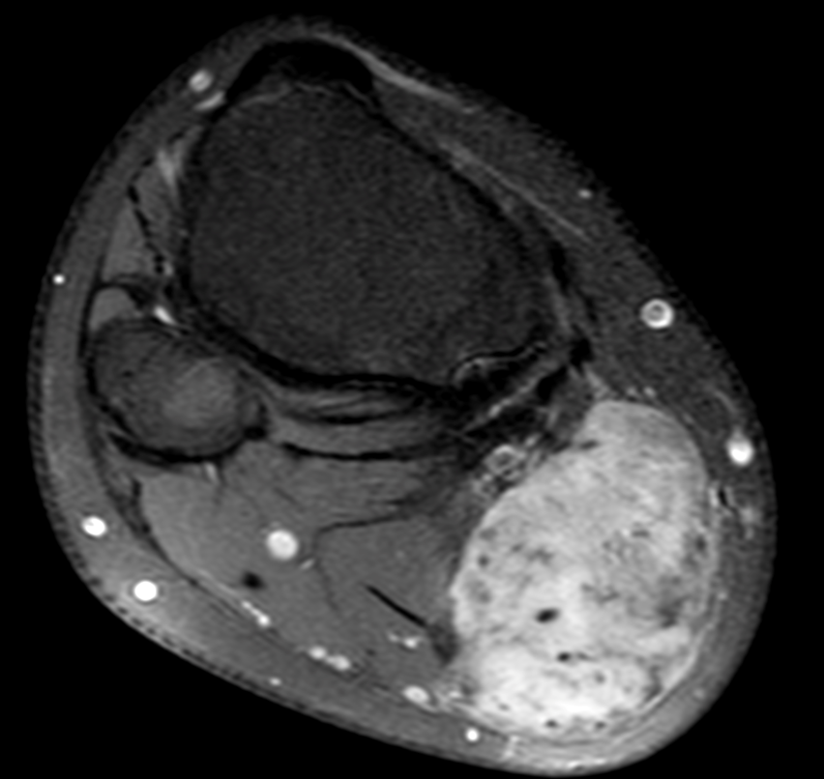
Post contrast T1

Slide 12
HPE has shown elastofibroma. Second opinion on HPE revealed fibromatosis.
Your suggestions, views and comments please

