Slide 1

Middle aged person with shoulder and arm pain

Slide 2
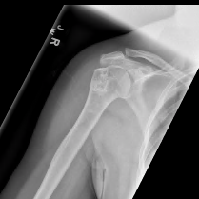
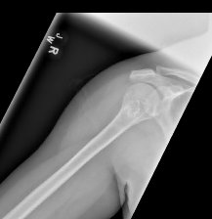
Radiographs- what do you think?

Slide 3
Indeterminate cartilage lesion- MRI was suggested

Slide 4
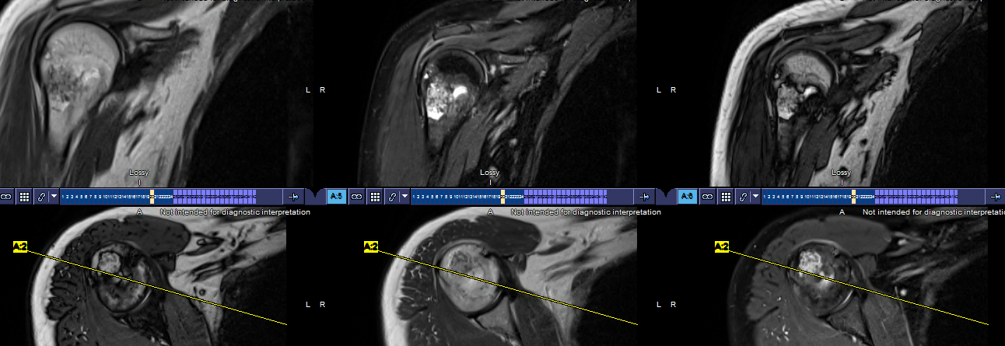
MRI- T2 Dixons- in-, water, opp- imaging

Slide 5
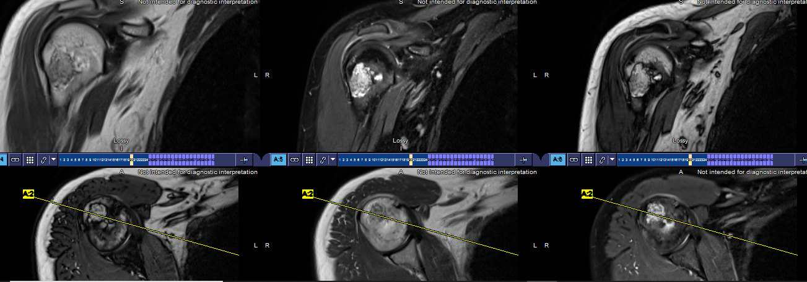
MRI- T2 Dixons- in-, water, opp- imaging

Slide 6
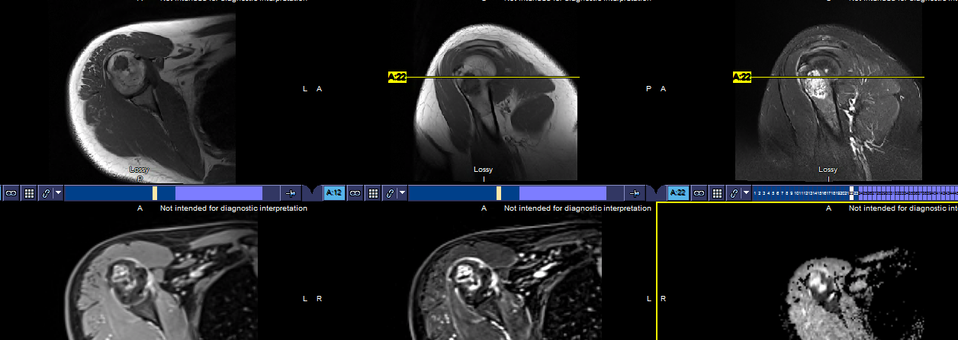
MRI- T1, STIR, post, ADC

Slide 7
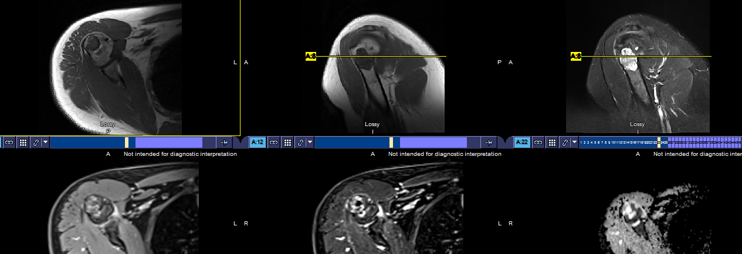
MRI- T1, STIR, post, ADC

Slide 8
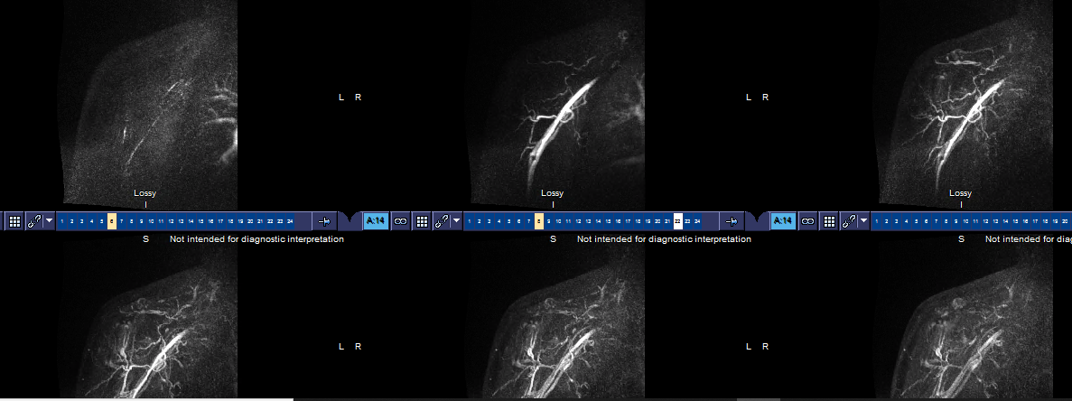
MRI - perfusion

Slide 9

What do you think?

Slide 10
Which OT-RADS category would you put it in?
How would do you intervene or follow it?

Slide 11

Attend this one for more guidance

