Slide 1
67/F
CC: left knee discomfort and swelling since 2021/02/01
Trauma (-)

Slide 2
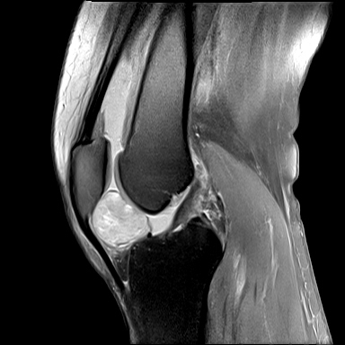
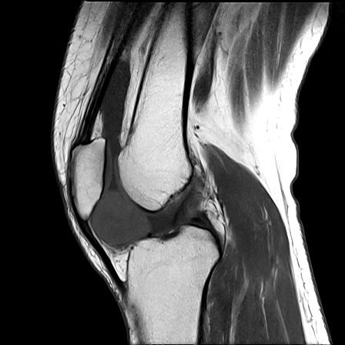
2021/02/01

Slide 3
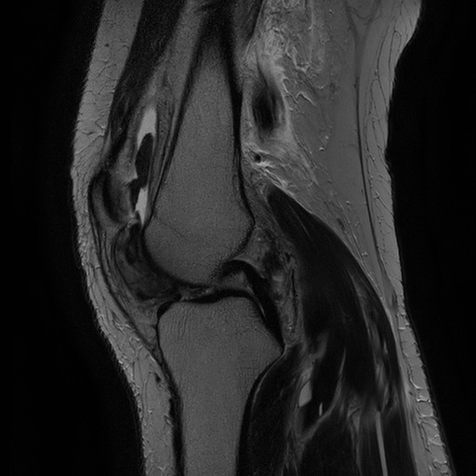
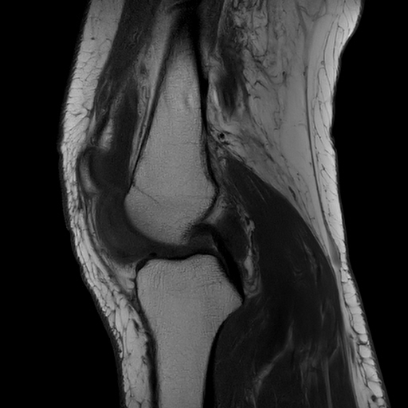
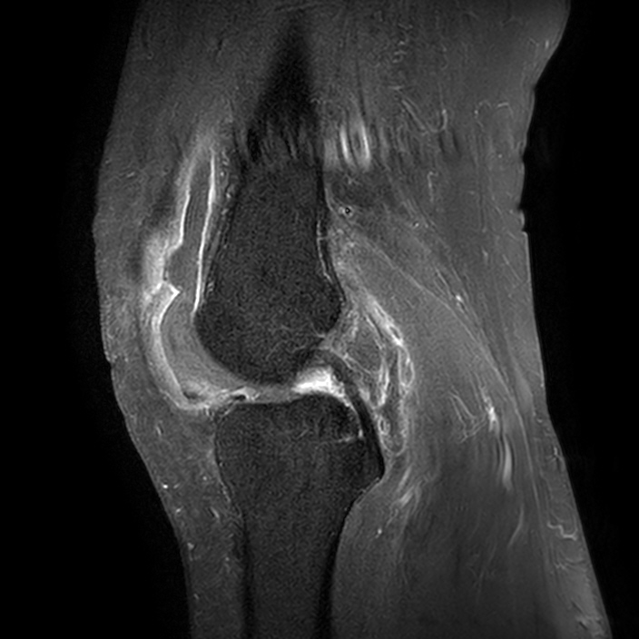
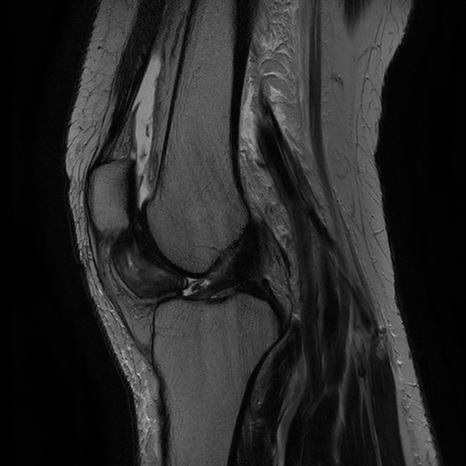
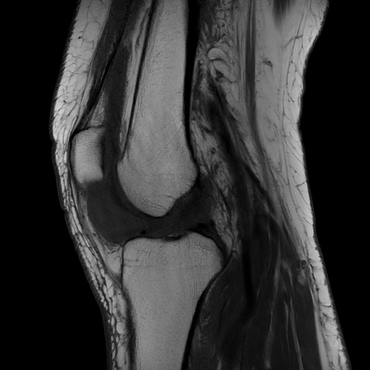
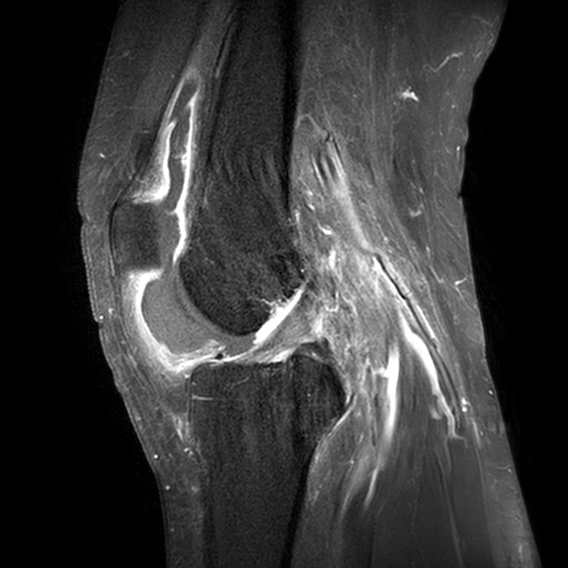
2021/02/28

Slide 4
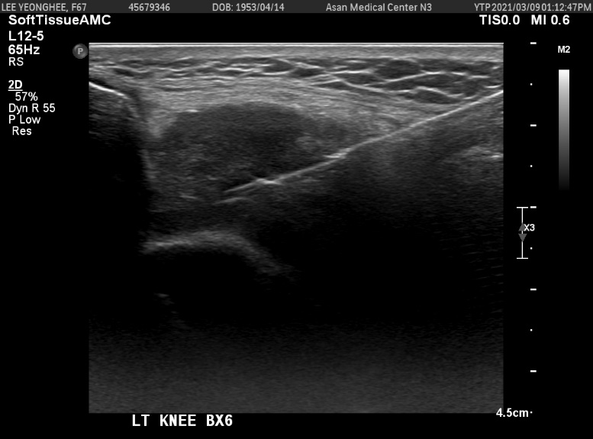
[ 2021.03.11 - US guided core needle biopsy]
Soft tissue, ( left knee, labeled "intraarticular mass" ), US guided core needle biopsy:
- Histiocytic aggregation,
favor tenosynovial giant cell tumor, suspicious localized type

