Slide 1
62 year old man
Medial compartment hemi 6 years ago
Presents with left knee pain
Imaging of right knee normal
Xrays of both knees 5 years ago (apart from hemi) normal.

Slide 2
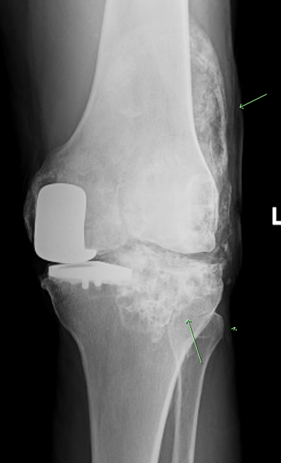
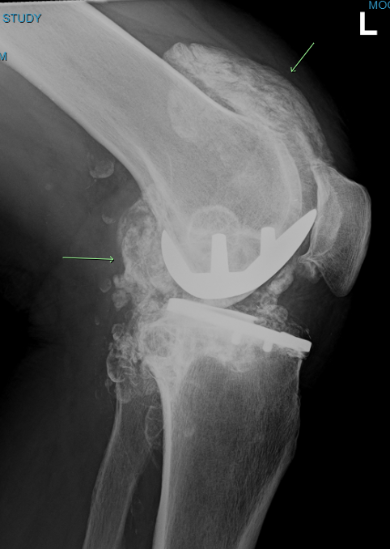

Slide 3
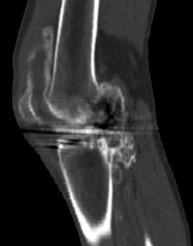
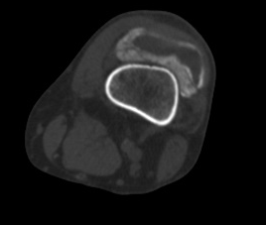
CT

Slide 4
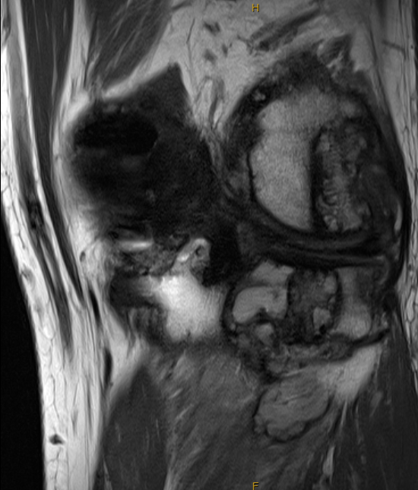
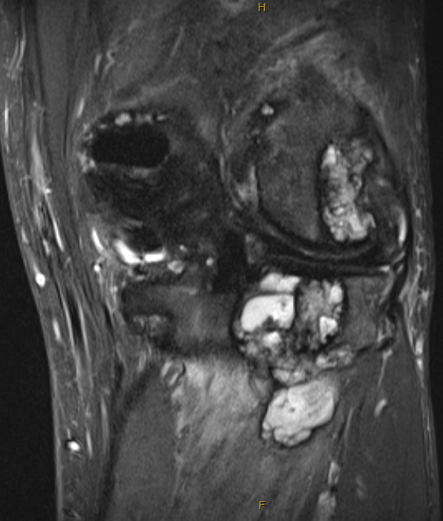

Slide 5
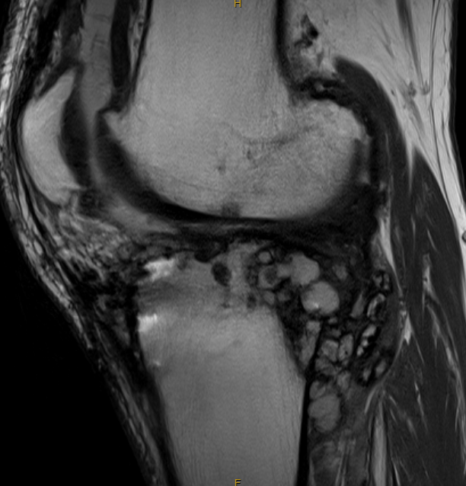
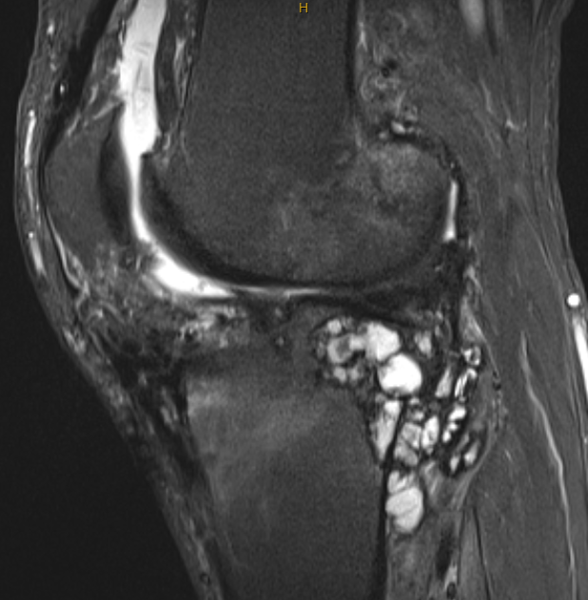

Slide 6
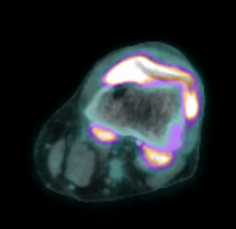
PET

Slide 7
Imaging findings
Xray: Extensive calcification of the synovium
MRI: soft tissue masses (with calcification) demonstrating intraosseous and extra osseous extension.
PET:The extensive region of synovial thickening/calcification within the left knee joint space shows intense increased metabolic activity. The metabolic changes are significantly more extensive than the osteoblastic activity on bone scan 6 weeks ago. Infection/inflammation may give this appearance but malignancy is not excluded.

Slide 8
Thoughts?
?Metallosis. But the lateral compartment(untouched) is grossly involved but the medial compartment (with the hemi) is much less involved.
? Synovial osteochondromatosis. This looks pretty rampant for that condition.
Help please!

