Slide 1
54M with multiple soft tissue masses affecting the face, both axillae, the neck, and the back of the left periscapular region. He had several biopsies done showing fibroadipose tissue with no diagnosis of malignancy or any other definitive diagnosis being made.

Slide 3
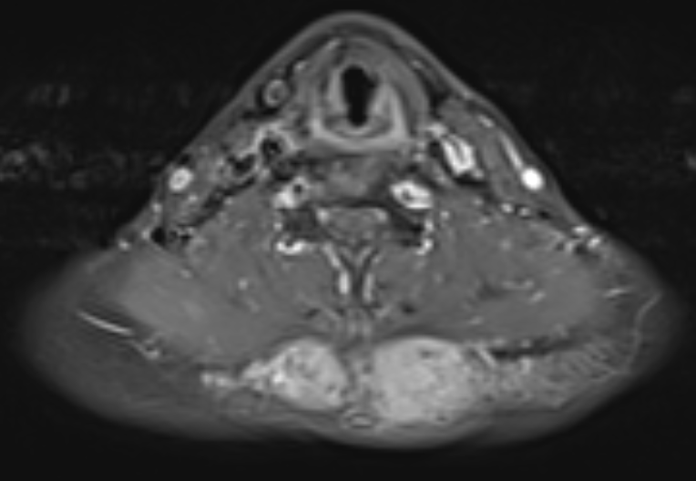

Slide 4
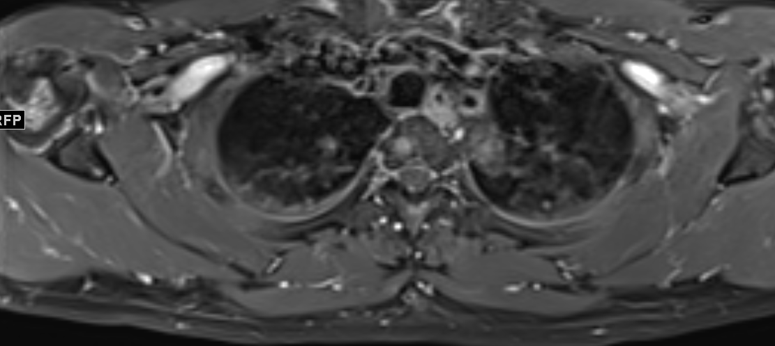

Slide 5
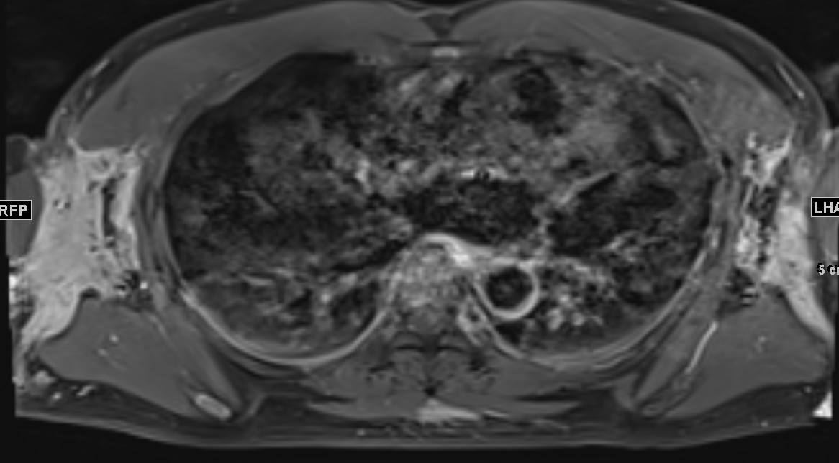

Slide 6
