Slide 1
34M ER patient, right hip pain
No known underlying conditions

Slide 2
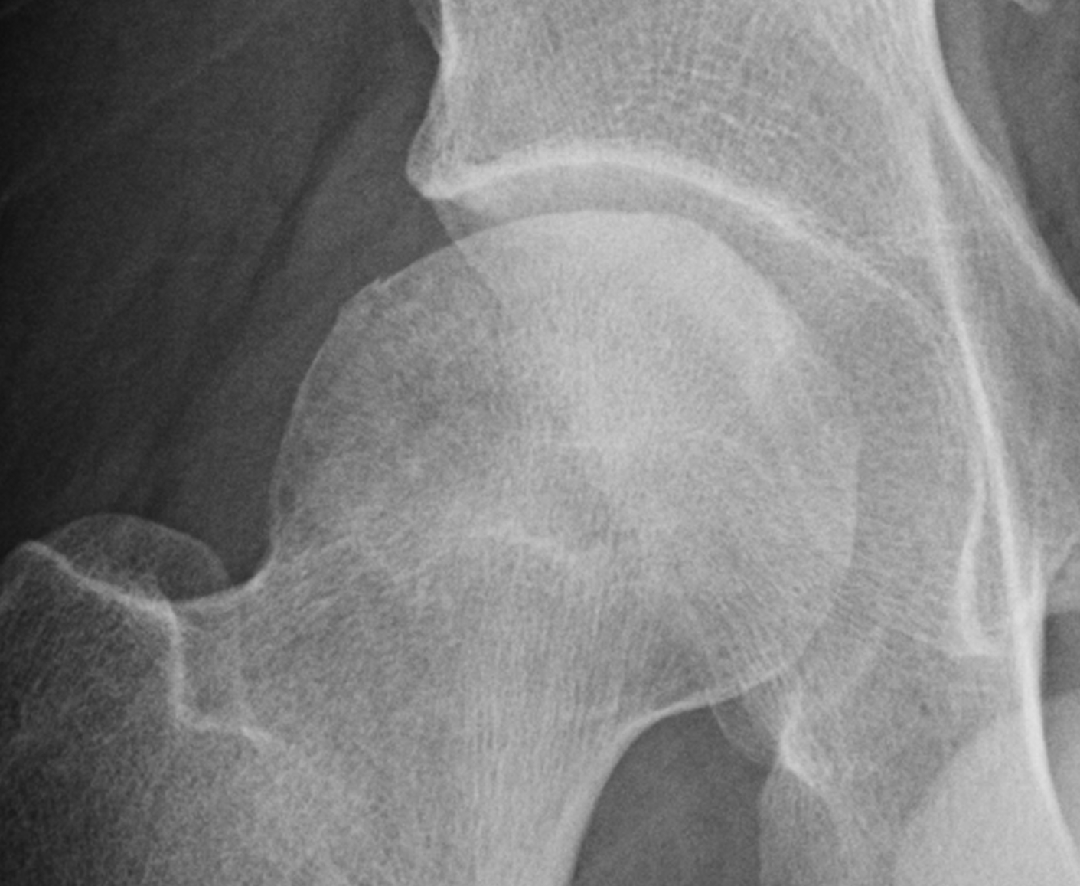
Based on this XR, I suspected subchondral collapse of lateral fem head due to AVN and suggested CT (much faster to get in ER)

Slide 3
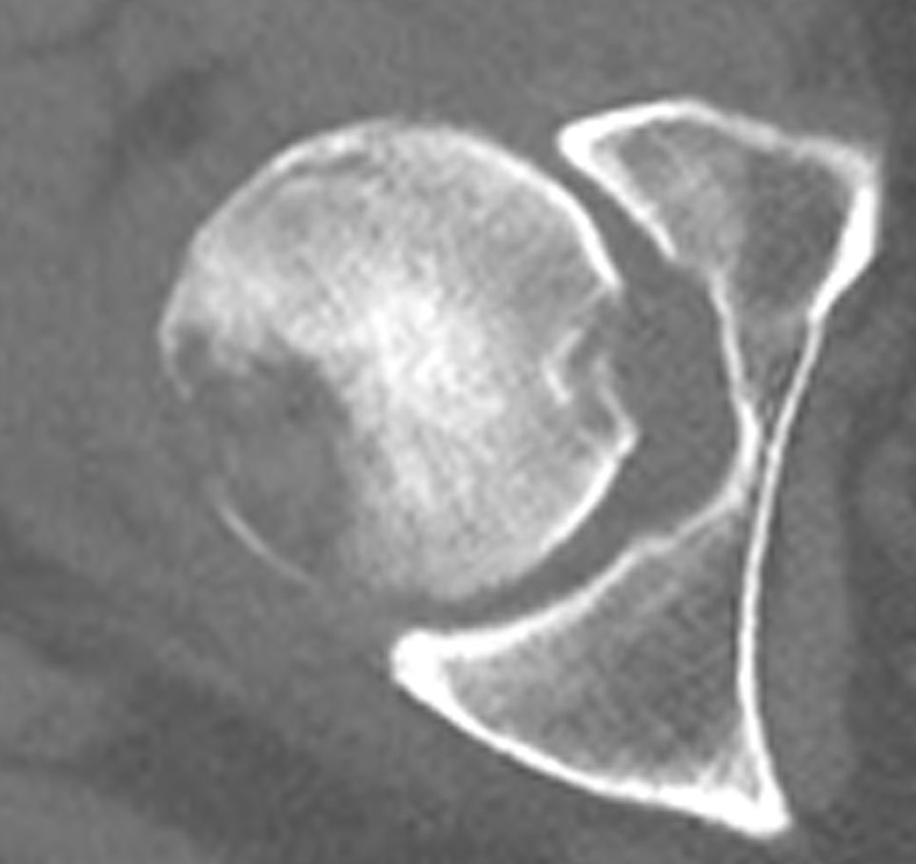
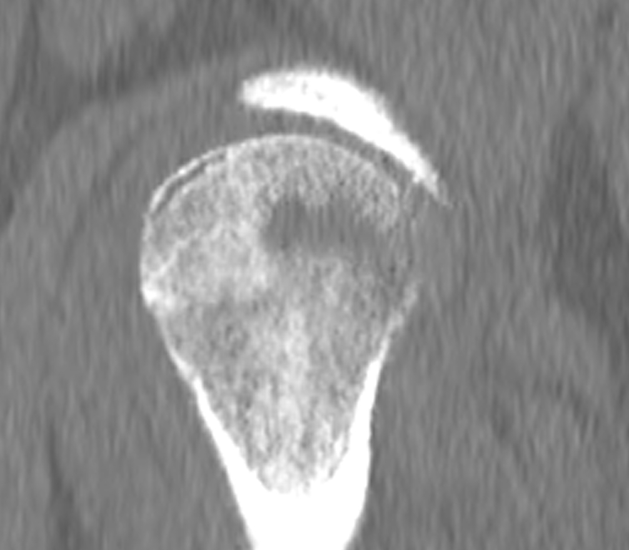
OK, so that’s about as pretty a crescent sign from subchondral collapse from osteonecrosis as you’re likely to see. But what’s that very lucent (destructive?) area in the posterior femoral head?

Slide 4
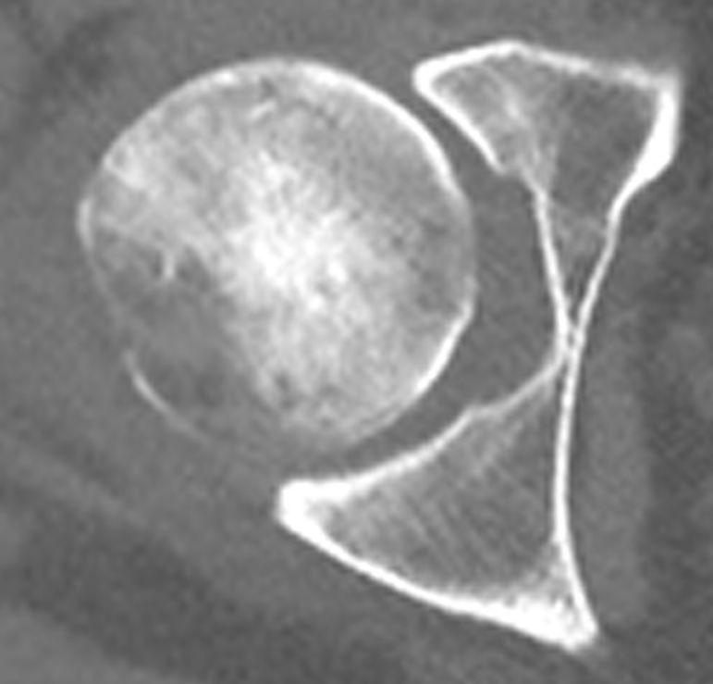
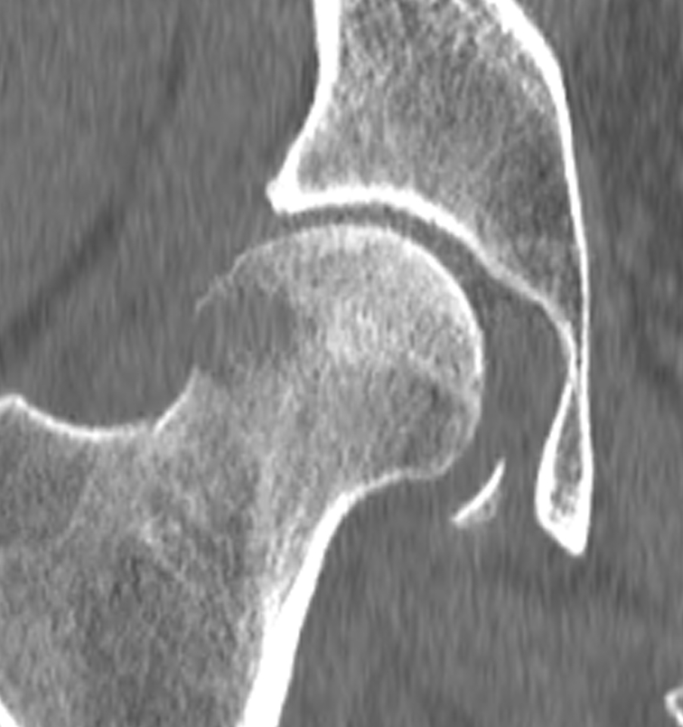
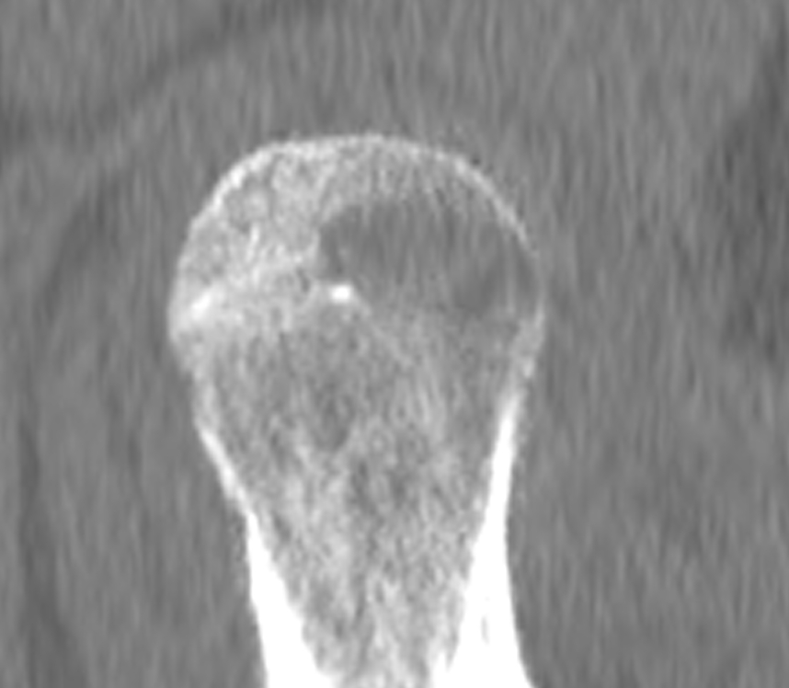
It looks like cortex is partially destroyed, no trabeculation…. I asked them to get an MR with Gad, as I was worried about infection or tumor

Slide 5
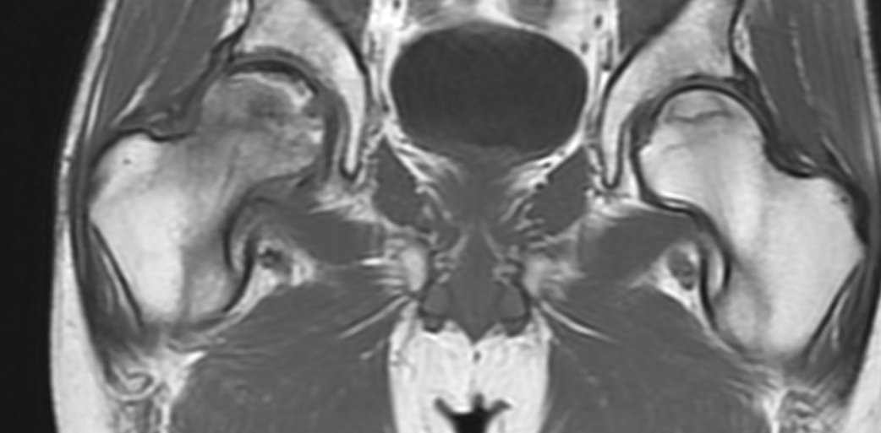
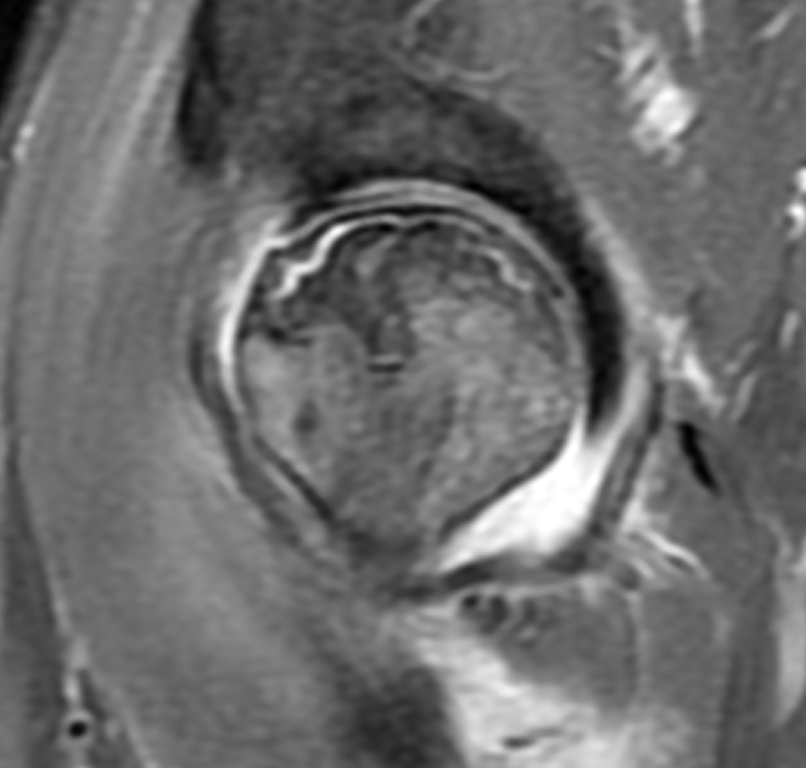
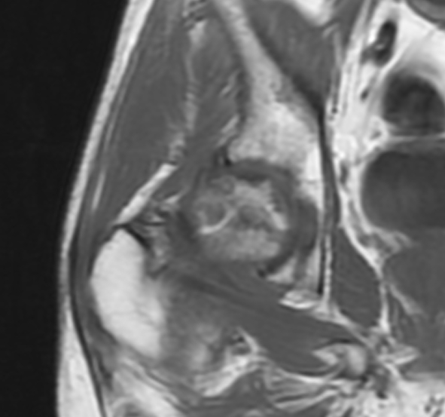
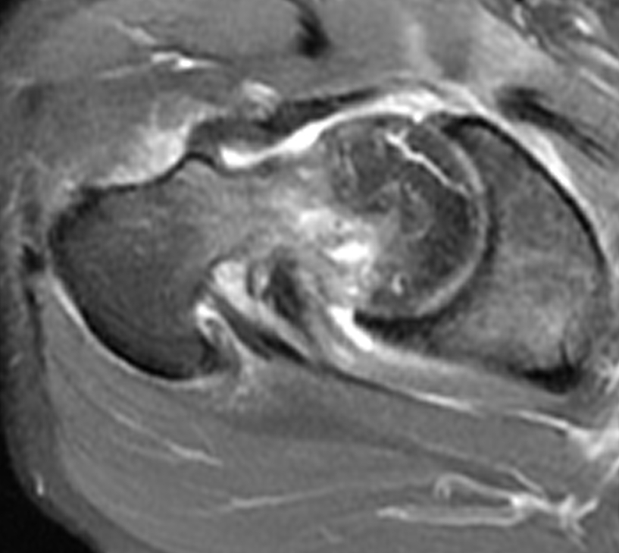

Slide 6
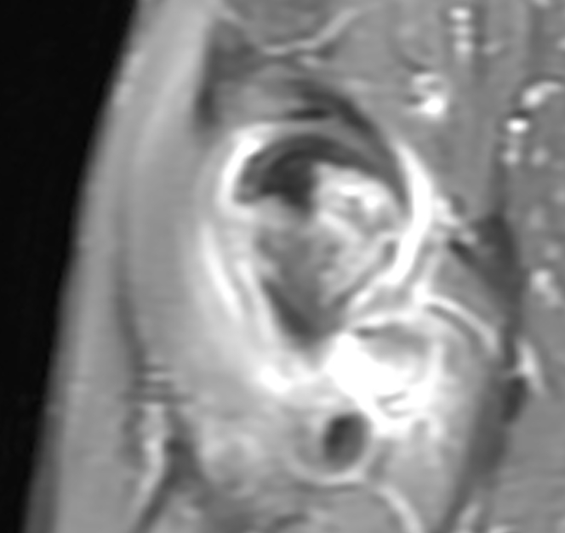
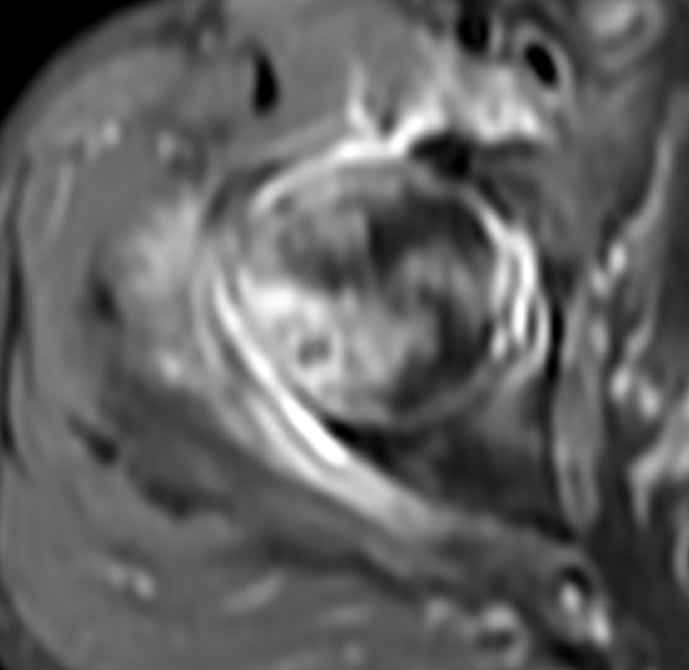
Fat-Sat T1 post Gad

Slide 7
Summary
….so given these findings I’m still worried that something else is going on in the posterior femoral head, particularly infection.
Does anyone else have any great ideas? I think some tissue is in order here…..

