Slide 1
Male, 33. Asymptomatic.

Slide 2
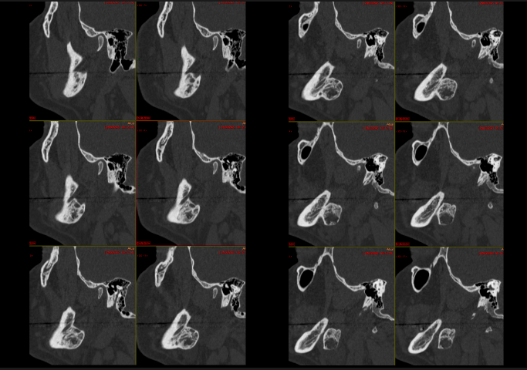

Slide 3
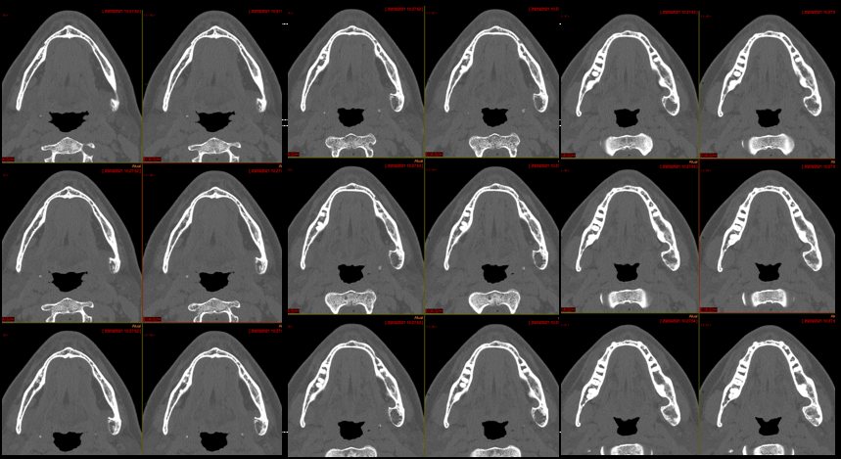

Slide 4
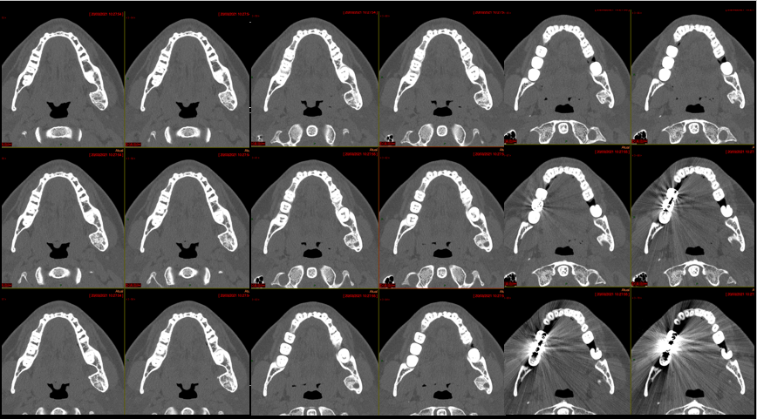

Slide 5
